Slide 1

Liraz Fridman,
PhD Candidate,
School of Kinesiology and Health Science, York University
CARSP
Monday June 6th, 2016
Canadian Child Road Safety Report Card: A Comparison of Injury Prevention Practices Across Provinces

Slide 2


Previous Work
Are we doing enough? – CPS Report
Compares each province
on injury prevention policies
in 2009 and 2011
Make recommendations for best practice

Slide 3
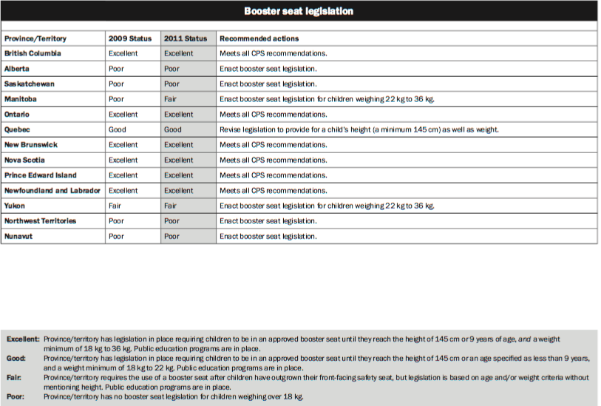

Slide 4
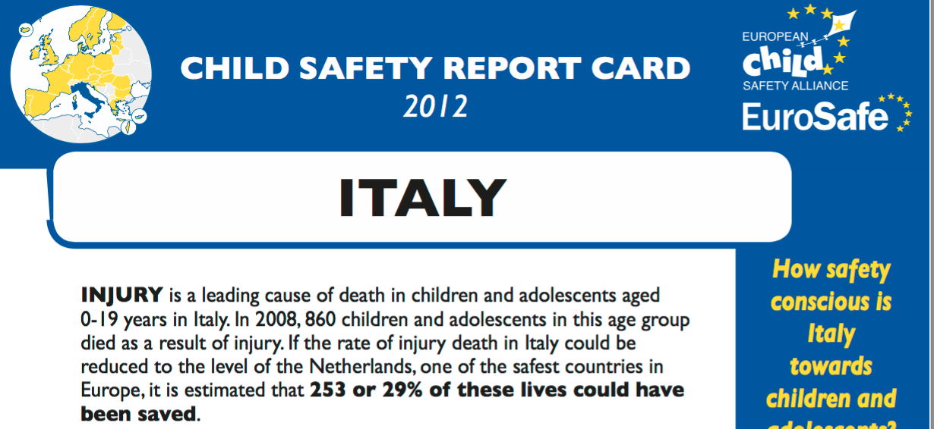
Previous Work

Slide 5
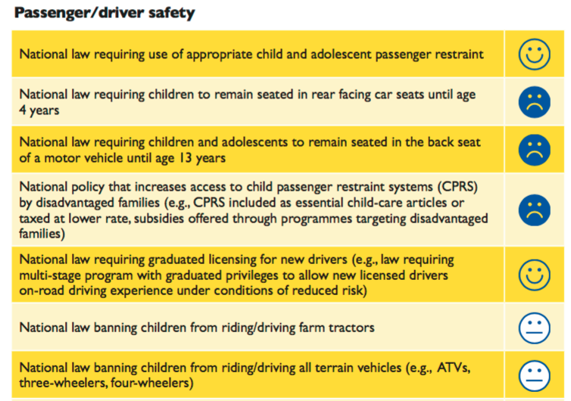
European Child Safety Report Card

Slide 6
Purpose
The aim of this project is to create evidence-based child road safety report cards that can be used to evaluate and influence policies and practices related to the prevention of childhood transport injuries

Slide 7
Methods – Phase I
Data Sources
  Hospitalizations:
    Canadian Institute for Health Information (CIHI) - Discharge Abstract Database (DAD)
  Deaths (??)
Analyses
  By broad cause (i.e. transport incidents)
  Population-based rate of hospitalizations due to specific transport injury (i.e., occupant, cyclist, pedestrian)

Slide 8

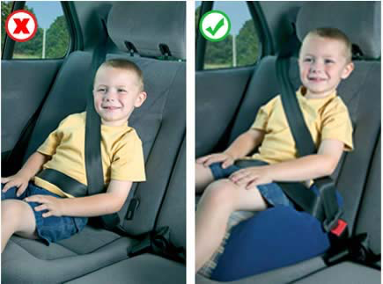


Methods – Phase II

Slide 9
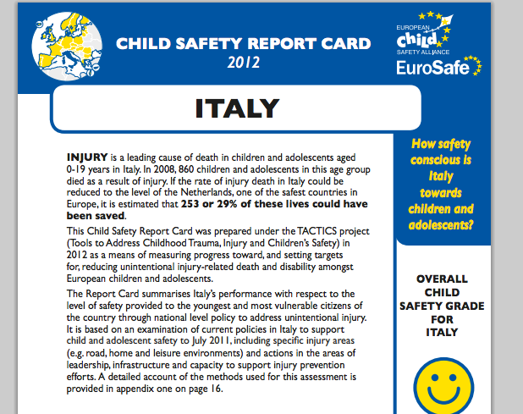
Methods – Phase III
Report Cards Include:
  Rates of injuries
  Specific causes
  Evaluation of policies
  Potential Years of Lives Saved

Slide 10
Preliminary Results – Overall (Transport Related Hospitalizations)
Canadian average excludes QC

Slide 11
Preliminary Results – Saskatchewan (Transport-Related Hospitalizations)
Canadian average excludes QC

Slide 12
Preliminary Results – Ontario (Transport-Related Hospitalizations)
Canadian average excludes QC

Slide 13
Preliminary Results – Overall (Motor Vehicle Occupant Related Hospitalizations)
Canadian average excludes QC

Slide 14
Preliminary Results – Saskatchewan (Motor Vehicle Occupant Related Hospitalizations)
Canadian average excludes QC

Slide 15
Preliminary Results – Ontario (Motor Vehicle Occupant Related Hospitalizations)
Canadian average excludes QC

Slide 16
Preliminary Results – Overall (Motorcyclist Related Hospitalizations)
Canadian average excludes QC

Slide 17
Preliminary Results – New Brunswick (Motorcyclist Related Hospitalizations)
Canadian average excludes QC

Slide 18
Preliminary Results – Ontario (Motorcyclist Related Hospitalizations)
Canadian average excludes QC

Slide 19
Preliminary Results – Overall (Pedal Cyclist Related Hospitalizations)
Canadian average excludes QC

Slide 20
Preliminary Results – New Brunswick (Pedal Cyclist Related Hospitalizations)
Canadian average excludes QC

Slide 21
Preliminary Results – Ontario (Pedal Cyclist Related Hospitalizations)
Canadian average excludes QC

Slide 22
Preliminary Results – Overall (Pedestrian Related Hospitalizations)
Canadian average excludes QC

Slide 23
Preliminary Results – Saskatchewan (Pedestrian Related Hospitalizations)
Canadian average excludes QC

Slide 24
Preliminary Results – Prince Edward Island (Pedestrian Related Hospitalizations)
Canadian average excludes QC

Slide 25
Conclusions
Transport-related injury rates vary by subcause and province
Motor vehicle occupants had the highest rate of injury per 100,000 population of any specific subcause
Ontario was the only province with an incidence rate consistently below the Canadian average, and with many evidence-based policies in place.

Slide 26
Conclusions
This is the first study to compare transport-related injuries among children and youth across Canadian provinces in terms of hospitalization, and the enactment of evidence-based policies.
This data may influence prevention through harmonization of best-practice policy and legislation in Canada.

Slide 27


Acknowledgements
Dr. Alison Macpherson
Dr. Ian Pike

Slide 28


