Slide 1
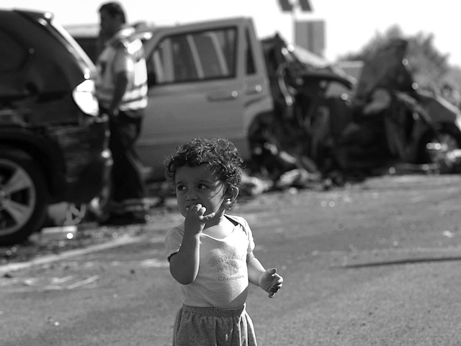
Preventing Motor Vehicle-Related Fatalities: A Collaborative Project to Enhance Data Capture and Use
Devon Williams, The Hospital for Sick Children
Co-authors: Sarah A. Richmond, Ian Pike, Dirk Huyer, Lisa Lapointe, Colin Macarthur, Andrew Howard

Slide 2

In 2013, motor vehicle collisions (MVC) caused 1,923 collisions nationwide
1,923

Slide 3

240
240 of those deaths were among children under 19 years of age

Slide 4
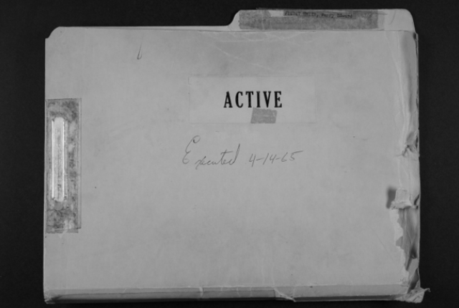
Data specific to these deaths are often referenced, yet few Canadian jurisdictions systematically collect comprehensive details of child occupant and pedestrian MVC fatalities…

Slide 5




The Child Fatality Research Team

Slide 6
Phase 1

Slide 7
Methods
PHASE 1 Retrospective Data Collection
Office of the Chief Coroner of Ontario
Children 0 – 17
2004 - 2008
British Columbia Coroners Service
Children 0 – 17
2007 - 2012

Slide 8
Results
Ontario
British Columbia
Notes:
Children ages 0-12 years, Ontario
106 child fatalities from 2004-2009
21 cases pedestrians
68 cases occupants
Children ages 13-17, Ontario
164 child fatalities from 2004-2009
31 cases pedestrians
112 cases occupants
Children ages 0-12, British Columbia
39 child fatalities from 2007-2012
17 cases pedestrians
22 cases occupants
Children ages 13-17, British Columbia
46 child fatalities from 2007-2012
12 cases pedestrians
34 cases occupants

Slide 9
The Challenge
Review of death investigation files (n=317) did not allow ascertainment of the following:
Data Element | Level of Completeness
Medical Cause of Death | 56.5%, n=160
Restraint Status | 38.1%, n=121
Crash Type | 7.3%, n=23

Slide 10
Phase 2

Slide 11
A standardized form was developed and provided to each provincial coroner service to facilitate consistent and detailed data collection…

Slide 13
Methods
PHASE 2 Prospective Data Collection
Office of the Chief Coroner of Ontario
Children 0 - 18
Motor vehicle collision
November 2013 - 2014

Slide 14
Phase 2
Data Element | Level of Completeness
Medical Cause of Death | 100%, n=37
Restraint Status | 100%, n=37
Crash Type | 100%, n=37
Prospective data collection reduced missing data to 0%.

Slide 15
Next Steps
The Office of the Chief Coroner to adopt and adapt the Unintentional Victim Information System – UVIS) for data collection and management
Pilot of the electronic system within Ontario
Scalability plan

Slide 16
Implications
Children have a significant physical vulnerability to injury in a MVC
Highlights the importance of gathering key information to identify prevention strategies and interventions
Need for process change

Slide 17
Questions? Devon.williams@sickkids.ca

Slide 18
Thank You!
Dirk Huyer, Office of the Chief Coroner for Ontario
Lisa LaPointe, British Columbia Coroners Service
Ian Pike, British Columbia Injury Research and Prevention Unit

