Slide 1
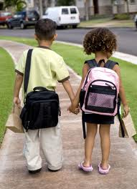
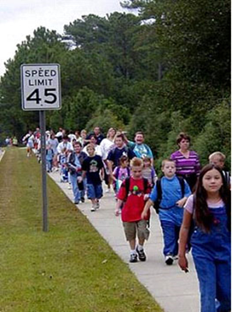



Child Pedestrian Collisions, Walking to School and the Built Environment: A Case Control Study
CARSP Conference 2016, Halifax NS
Linda Rothman, York University, Hospital for Sick Children
Alison Macpherson, York University
Ron Buliung, University of Toronto Mississauga
Sarah A. Richmond, York University, Hospital for Sick Children
Colin Macarthur, Hospital for Sick Children
Andrew Howard, Hospital for Sick Children

Slide 2
INTRODUCTION
Road traffic injuries
  70 deaths, 9,000 reported injuries, ages 0-14 (2013)
  Leading cause of injury-related death, 2nd after falls for all injury admissions (ages 0-24)
  60 million dollars annual cost
Notes:
-4-12 year olds, in Toronto

Slide 3
INTRODUCTION
Child pedestrians are overrepresented in road user fatalities
  33% of all child road user fatalities vs 13% in adults (2013)
Many child pedestrian motor vehicles collisions (PMVCs) occur near schools
  ~40% occur during school travel times and months
  > 1/3 of collisions within 300 m of a school, highest density within 150 m
Notes:
-4-12 year olds, in Toronto

Slide 4
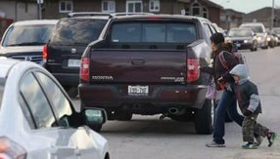
INTRODUCTION
Decline in child PMVCs due to children walking less?
Walking to school decreased from 59% to 45% (1986-2011, ages 11-13, TTS Survey)
24% use only active school transportation (AST,) 14% used combination (ages 5-17, Active Healthy Kids Canada, 2013)
There are many initiatives to increase AST in children
Notes:
Decline over 20 years
Reducing exposure to vehicles
AST = walking, cycling, scooters etc.)

Slide 5
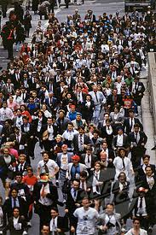
BACKGROUND
  Safety in numbers?
  OR
Increased walking exposure = increased risk?
Notes:
Jacobson – safety in numbers effect –
3 large population datasets in europe and u.s. Pedestrian vomlume – measured by journey to work share or distance or trip day per capita. Individual pedestrian’s collision risk decreased by 66% in communities where there is twice as much walking.
Child pedestrian collisions positively correlated with: # school day road crossings, proportion using AST en route home^{4,5}
1.5 times increased odds of collisions with AST over longer distances⁶
Different ages, mix of traffic, environmental conditions?

Slide 6



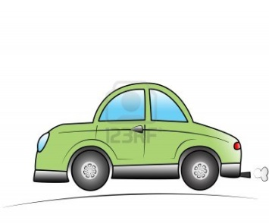
Walking to School
Built Environment Design
Potential Health Benefits
Potential Pedestrian- Motor Vehicle Collision Risks
BALANCE
Notes:
There has been a decrease in child PMVC of more than 50% in Canada over the last 20 years. It has been suggested this trend has been due to fewer children walking to school
The are many potential health benefits of walking to school include prevention of chronic conditions related to obesity, also health issues related to air quality
There are many initiatives to increase walking to school in Europe and North America
-however, also potential for increased PMVCs with more walking and there has been little research regarding the impact of more walking on PMVC.
**need to find the balance between the benefits and risks of walking to school
**The built environment- has been found to influence both walking to school and collision risks and can be potentially be modified to achieve this balance.
Ultimate goal – to promote walking in the safest environment possible.

Slide 7
AIMS
To determine if the proportion of children observed walking to school is a potential PMVC risk factor
To identify modifiable built environment risk factors associated with historically higher child PMVC rates within school attendance boundaries

Slide 8
METHODS
Case-control study, Spring 2015, Toronto
Regular, kindergarten-grade 6 (n = 198)
Exclusions: French immersion, >grade 7, other active transportation programs
Police-reported PMVCs, ages 4-12, 2000-2013
  Mapped within school attendance boundaries
Cases- highest quartile (n = 50)
Controls- lowest quartile (n = 50)
Notes:
-exclusions:grade combinations that included grades > 7; 2) special programs that accept children from outside the school’s attendance boundaries (e.g., French immersion) and; 3) involvement in other walking studies.
Toronto’s urban areas consist of older, pre-World War 2 straight grid street patterns, and inner suburban neighborhoods with newer, car-oriented post-World War II, long winding streets and cul-de-sacs.²⁷ These areas were politically amalgamated into the City of Toronto in 1998. A school with over 50% of its attendance boundary within the urban core of Toronto was designated an urban school.
LOI - describe

Slide 9
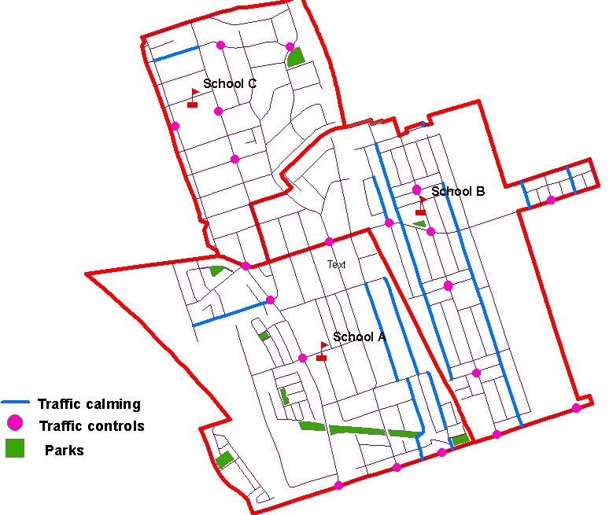
METHODS
Risk Factors
Proportion walking to school
    Transportation mode during morning drop off
  Built environment
    Density, Diversity, Design (municipal data sources, 2006 Census)
    Downtown versus inner suburbs.
  School Social environment
    Learning Opportunities Index (LOI), neighbourhood SES, etc
Notes:
How you mapped it, 50 cases, 50 controls, 19 non-overlapping stroller schools = 119 total!
Collision rates: The City of Toronto police-reported pedestrian collision data from 2000-2013 (ages 4-12 years) will be used to identify child-pedestrian collision locations. Rates will be calculated using 2011 Canadian census population, ages 4-12 years, within the school attendance boundaries.
Observational counts of transportation mode to school will be conducted at all schools. : Mode of school transportation, including walking, cycling, other active transportation (i.e. scooters, rollerblades, skate-long boards), stroller, wagon and car will be counted by teams of trained observers outside the selected case and control JK-6 Toronto schools for 20 minutes before and 5 minutes after the morning arrival bell. One observer will stand where the primary car drop off location is and a second observer will stand at the next busiest school arrival zones (in consultation with the school principal).
Stroller counts aka Cross-sectional study: 50 schools were chosen at random to conduct cross-sectional observational counts. Only schools with separate JK-SK entrances will be included. Mode of school transportation, including walking, cycling, other active transportation, strollers, wagon and car will be counted outside of separate JK-SK arrival entrances.
Exclusion criteria includes schools with 1) grade combinations that include grade > 7) 2) special programs that accept children from outside the school’s attendance boundaries (e.g. French immersion); and 3) involvement in other walking studies. Children arriving by school bus will be excluded as it is assumed that these children either do not live within walking distance to the school according to the TDSB transportation policy or they have special needs that preclude them from walking to school.

Slide 10
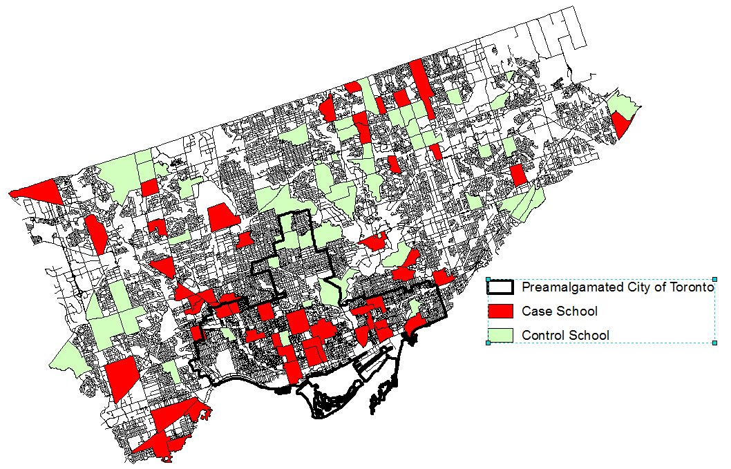
513 collisions (cases) vs 88 (controls)
25 downtown : 17/25 = 68% cases
75 inner suburb: 33/75 =44% cases
Mean walking : 70% cases, 61% controls
Notes:
Walking proportions not significantly different

Slide 11
Odds of higher child pedestrian motor vehicle collisions: Multivariate models
 | Variable | Adjusted OR (95% CI) All schools | Adjusted OR (95% CI) Inner Suburbs | Adjusted OR (95% CI) Downtown Urban Core
EXPOSURE | Walking to School | 0.49 (0.02, 13.72) | 0.34 (0.008, 14.56) | 0.52 (0.16, 1.71)
Built Environment
Design | One way streets km/ 10 km roads | 4.00 (1.76, 9.08) | 1.47 (1.13,1.90) | -
 | School crossing guard | 3.65 (1.10, 12.20) | - | -
 | Traffic lights #/km roads | - | 1.59 (1.17, 2.15) | -
 | Traffic calming km/10km roads | - | 3.56 (1.03, 12.26) | -
Land Use Diversity Social Environment | Residential land use km/10 km² Higher school disadvantage (*10) | 0.56 (0.37, 0.86) 1.37 (1.11, 1.70) | - - | - 2.55 (1.28, 5.09)
Notes:
higher one way street density, the presence of a school crossing guard and higher school disadvantage were risk factors for higher collision rates
higher residential densities were protective for collisions Walking to school was not a risk factor.
In the inner suburbs, one way street, traffic light and traffic calming densities were risk factors for higher collision rates.
The only significant risk factor for higher collision rates in the urban downtown schools was higher school disadvantage

Slide 12
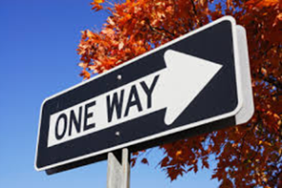
DISCUSSION
Protective Features
  Higher density residential land use
Walking to school unrelated to collisions
Risk Factors
One way streets
  Higher traffic speeds, drivers paying less attention, difficulty crossing the street
School crossing guards
  Indicator of higher historical collision rates?
  More walking at these locations?
Notes:
Risk Factors confirm 2011 study
Residential areas: Slower speed limits, less traffic volume

Slide 13
DISCUSSION
Traffic lights (inner suburbs)
Traffic calming (inner suburbs)
  Higher collision roadways, protective effect
School social disadvantage
  Social gradient even after controlling for BE
  Only risk factor downtown
    BE in suburbs may play a greater role
    Greater social gradient, walking to school downtown
    Differences re: schools’ LOI correspond with the BE surrounding the school
Notes:
Traffic lights represent crossing locations
Traffic calming- Previous pre-post intervention study found null effect
Higher social disadvantage consistently associated with PMVCs

Slide 14
STRENGTHS AND LIMITATIONS
  Strengths
    Large, population-based
    Case control study
    Objective observational counts and BE
    Multivariate analysis
  Limitations
    Ecological data
    Walking to school used as an estimate for total walking
    Historical collision data
    Small numbers of downtown schools
Notes:
-traffic lights and traffic calming also found in cross-sectional study

Slide 15
CONCLUSIONS
Modifiable risk factors identified for child PMVCs
Walking to school is not associated with child PMVCs as long as the built environment is safe
School locations:
  Central
  residential neighbourhoods
  two-way local streets
  low posted speed limits
Notes:
consistent with previous studies.

Slide 16
CONCLUSIONS
Further work necessary
  Differences in influence of social disadvantage by location
  Pedestrian and vehicular volume data
Results have implications for the design of roadways around schools considering location and social disadvantage
Notes:
consistent with previous studies.

Slide 17


ACKNOWLEDGEMENTS
Toronto District School Board
Funding
    Strategic Teams in Applied Injury Research (STAIR)
      CIHR Chair in Child and Youth Health Services and Policy Research
      (Dr. Alison Macpherson)

