Slide 1
The Cost of Transport Injuries in Canada
The Clock is Ticking
Jennifer Russell
Atlantic Collaborative for Injury Prevention (ACIP)
June 6, 2016

Slide 2
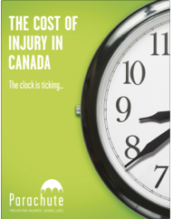
About the Report
The development of the Report was completed by Parachute in collaboration with the Conference Board of Canada, with funding support from the Public Health Agency of Canada.
Notes:
PHAC provided funding
Conf Board did data and forecasting

Slide 3
About the Report
The report draws on 2010 injury data on deaths, hospitalizations, non-hospitalized injuries to provide detailed information on the cost of leading types of injury in Canada by age and cause.
The analysis was conducted from a societal perspective, using an incidence costing, human capital approach.
The population of Canadian residents injured in 2010 was costed over the lifetime of the injured individuals.
Notes:
Human capital methodology the indirect costs are societal productivity losses, which accounted for the injured individual’s inability to perform his or her major activities.
Incidence costing – involves estimating the lifetime direct and indirect costs of the new cases of a condition or group of conditions which have their onset (incidence) in a given year. This approach emphasizes that it is necessary to estimate not only the direct costs of these new cases accruing in the first year but also the present value of direct costs which may accrue in the future until the person dies. In this approach prevention costs are actually investments and unmanaged injury risk are incremental costs.
PYLL info – used age 65 as upper limit as this is still the industry standard

Slide 4
About the Report
The report examines national and provincial data related to transportation, falls, self-harm/violence in particular.
The report uses the Electronic Resource Allocation Tool (ERAT) that combines existing data with variables from the literature in order to model full episodic costs of injuries.
Notes:
Due to the small cell sizes that affect the ability to report data and compromise privacy as well as the issue of non-comparable data, make it difficult to present information on the three territories.

Slide 5
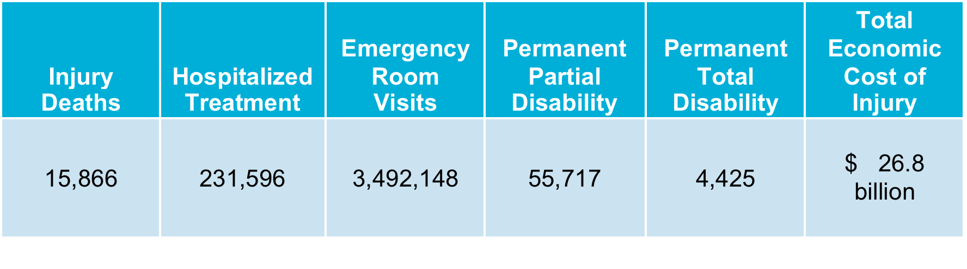
By the Numbers

Slide 6

By the Transport Numbers
Transport incidents are among the top three causes of death and the second leading cause of overall injury costs in Canada.

Slide 7
By the Transport Numbers
In 2010, transport incidents that include : motor vehicle, pedestrian, pedal cycle, ATV/snowmobile, railway, and streetcar incidents, resulted in
    2,620 deaths
    28,350 hospitalizations
    290,782 emergency room visits
    7,903 Canadians either partially or permanently disabled
    $4.29 billion in total economic costs

Slide 8
Forecasts
Forecast scenarios were developed using the ERAT model, augmented by the Conference Board of Canada to include an injury forecast from 2011 to 2035.
By including a full population forecast, a full wage and inflation forecast, as well as an incidence forecast (for each injury) based on actual historical data, the EBIC forecast is extremely robust.
Notes:
Forecast scenarios take into account changes in population over time, forecasts for wages and inflation were used and applied each year (e.g. not just in 2035).
For example they adjust for rate of inflation

Slide 9
Forecasts
The forecasts for all hospital, medical, and rehabilitation costs are calculated on a cost-per-case basis. As a result, a change in the incidence rate for a particular injury will lead to an identical change in the economic burden of that injury.
Scenarios link each area with specific intervention expectations.
Notes:
For example, a 10% reduction in motor vehicle incidents over the forecasted period will lead to a 10% decrease in the total cost of motor vehicle incidents.

Slide 10
Speed Calming
A speed calming intervention could result in 6,300 lives saved and a total of $35 billion transport costs avoided between 2010 and 2035.
Notes:
Speed control (calming), and speed-camera networks in particular are effective at reducing speed related injury and death, and should be central to road safety and injury prevention initiatives. Speed control is a central tenet in Canada’s road safety vision to have the “safest roads in the world”. This requires that sufficient resources can and will be provided to support enforcement of road safety laws to realize their full benefit; however, there is a strong cost effective case for this investment. Previous studies have demonstrated an average return of investment (ROI) of 5:1 after 1 year and 25:1 after 5 years. The benefit from avoided injuries was more than four times the cost of enforcement.
The following two scenarios outline two different interventions. The first is based on the intervention of speed cameras with a projected 15% decrease in death and injury (Figure 12) while the second scenario is based a speed calming intervention with a 30% decrease in deaths and a 50% reduction in injuries (Figure 13). Again, the approach used the most conservative expected proportionate reductions according to the recent research analyses.
Achieving a 15% reduction between 2010-2035 in injuries and deaths related to transport incidents will result in 3,200 lives saved and a total of $11.4 billion in costs avoided.
Research Used
Gavin, A., Walker, E., Murdoch, C., Graham, A., Fernandes, R., Job, R.F.S. (YEAR) Is a focus on low level speeding justified? Objective determination of the relative contributions of low and high level speeding to the road toll. Australasian Road Safety, Research, Policing and Education Conference, August – 3 September 2010, Canberra, Australian Capital Territory
Transport Canada. 2011. Road Safety in Canada: Making Canada’s Roads the Safest in the World. Government of Canada; Ottawa, Ontario.
Institute for Road Safety Research. (2009). SWOV Fact Sheet: The Relation Between Speed and Crashes.
Gains A, Heydecker B, Shrewbury J, Robertson S. 2004. The national safety camera programme: three-year evaluation report. http://www.dft.gov.uk/stellent/groups/dft_rdsafety/documents/page/dft_rdsafety_029193.hcsp

Slide 11
Speed Cameras
A targeted speed camera intervention could save 3,200 lives and a total of $11.4 billion between 2010 and 2035.
Notes:
Speed control (calming), and speed-camera networks in particular are effective at reducing speed related injury and death, and should be central to road safety and injury prevention initiatives. Speed control is a central tenet in Canada’s road safety vision to have the “safest roads in the world”. This requires that sufficient resources can and will be provided to support enforcement of road safety laws to realize their full benefit; however, there is a strong cost effective case for this investment. Previous studies have demonstrated an average return of investment (ROI) of 5:1 after 1 year and 25:1 after 5 years. The benefit from avoided injuries was more than four times the cost of enforcement.
The following two scenarios outline two different interventions. The first is based on the intervention of speed cameras with a projected 15% decrease in death and injury (Figure 12) while the second scenario is based a speed calming intervention with a 30% decrease in deaths and a 50% reduction in injuries (Figure 13). Again, the approach used the most conservative expected proportionate reductions according to the recent research analyses.
Achieving a 15% reduction between 2010-2035 in injuries and deaths related to transport incidents will result in 3,200 lives saved and a total of $11.4 billion in costs avoided.
Research Used
Gavin, A., Walker, E., Murdoch, C., Graham, A., Fernandes, R., Job, R.F.S. (YEAR) Is a focus on low level speeding justified? Objective determination of the relative contributions of low and high level speeding to the road toll. Australasian Road Safety, Research, Policing and Education Conference, August – 3 September 2010, Canberra, Australian Capital Territory
Transport Canada. 2011. Road Safety in Canada: Making Canada’s Roads the Safest in the World. Government of Canada; Ottawa, Ontario.
Institute for Road Safety Research. (2009). SWOV Fact Sheet: The Relation Between Speed and Crashes.
Gains A, Heydecker B, Shrewbury J, Robertson S. 2004. The national safety camera programme: three-year evaluation report. http://www.dft.gov.uk/stellent/groups/dft_rdsafety/documents/page/dft_rdsafety_029193.hcsp

Slide 12
Compendium

Slide 13
The human impact, on individuals, families and communities is immeasurable, and is exacted through diminished health, wellbeing, and potential to live long lives to the fullest.

Slide 14
The Clock is Ticking
The simple fact is, almost all of these injuries and deaths could have been prevented.
The vast majority of injuries in Canada are both predictable and preventable.
Investing wisely in programs for which there is already good evidence makes a difference.

Slide 15
The Clock is Ticking
If we continue on the same trajectory,
forecasts for all injuries show that by 2035
injuries will cost Canada $75 billion and 26,390 lives.
An increase of 180 per cent and over 10,000 more lives.

Slide 16
Pamela Fuselli
pfuselli@parachutecanada .org
647-776-5103
Notes:
Add contact info

