Slide 1

Slow Down, Move Over
Adding tow trucks to Ontario’s Highway Traffic Act

Slide 2

CAA’s Advocacy

Slide 3
Slow Down Move Over law
Ontario’s Highway Traffic Act requires motorists to slow down and move over for stopped emergency vehicles with their lights flashing
Similar slow down, move over laws applied to roadside assistance vehicles in most provinces and states
83 percent of Ontarians believed extending slow down, move over provision to roadside assistance vehicles was a good idea
Motorists and roadside assistance workers risk injury or death during service calls because passing vehicles were not required to slow down and move over on approach.

Slide 4
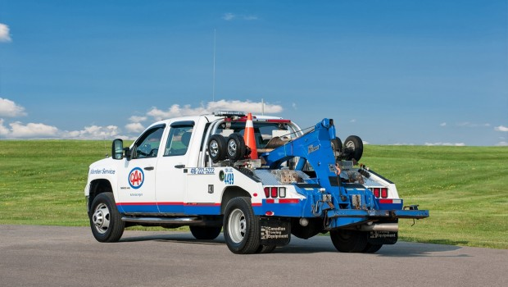
CAA advocates for Slow Down, Move Over
Since 2010, CAA SCO has advocated for the protection of motorists and roadside assistance workers through Slow Down, Move Over legislation.
With tow truck drivers at risk of being injured or killed by passing vehicles, CAA believes that these essential service workers have the right to a safe place to work.

Slide 5
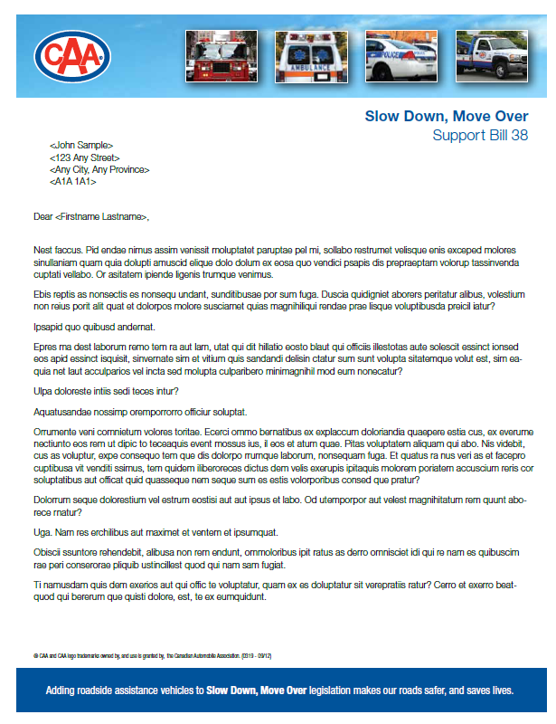
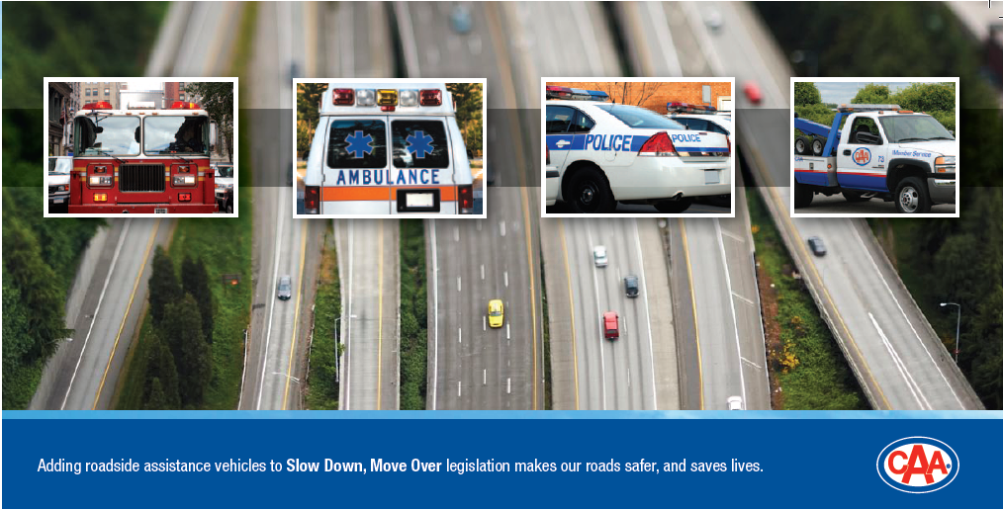
CAA’s efforts with government
Brochures and letters were sent to all 107 MPP’s in Ontario regarding Slow Down, Move Over legislation.

Slide 6

CAA’s Petition to the Legislature
What’s next?
Through our towing network, CAA circulated a petition that received about 7,500 signatures in 2012, and another 1,500 in 2014 to present to Members of Provincial Parliament at Queen’s Park.

Slide 7
The Making Ontario’s Roads Safer Act
The Ontario government passed the Making Ontario’s Roads Safer Act in June 2015 to help keep Ontario’s roads among the safest in North America.
After four legislative attempts, the Bill updates the Highway Traffic Act to extend Slow Down, Move Over provisions to tow truck drivers.

Slide 8
The Making Ontario’s Roads Safer Act
According to the Act, when motorists approach an emergency vehicle with its red lights or red and blue lights flashing, they are required to slow down and, if safe to do so, move over.
Motorists are also required to slow down and move over for tow trucks that are stopped at the side of the road with their amber lights flashing.

Slide 9

CAA’s Heads Up! Campaign
What’s next?
Launched in July 2015 following the passing of Bill 31
Designed to educate and inform the public prior to rule changes on September 1, 2015
Attended by Ontario Provincial Police, Toronto Police, York Regional Police, Ontario’s Minister of Transportation
Focused on three key changes to road rules in Ontario
  Distracted Driving
  Slow Down Move Over
  Cycling

Slide 10
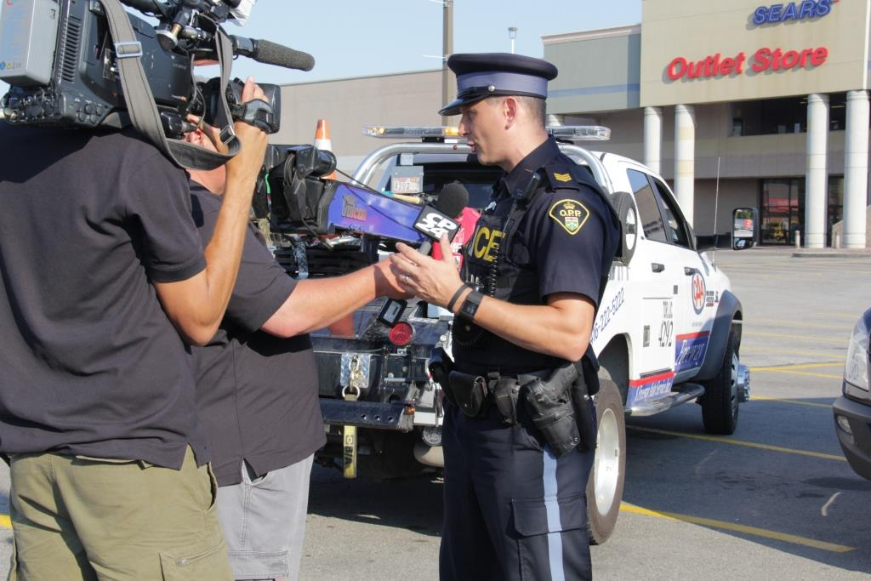




Slide 11
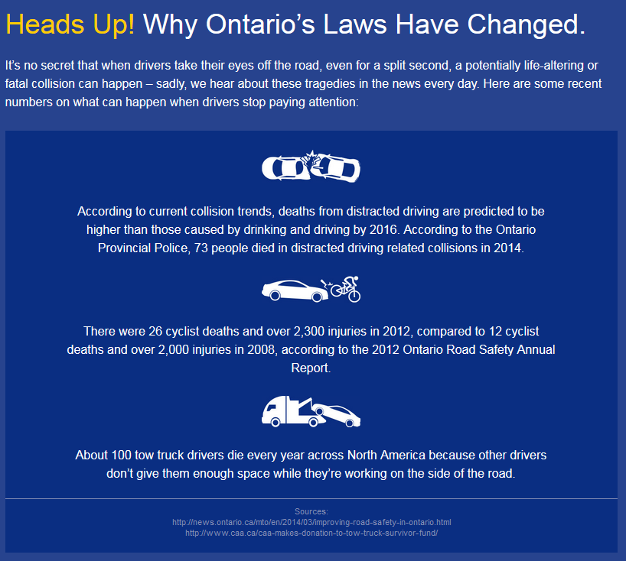
Heads Up! Website
Visit headsupontario.ca for more information

Slide 12
Penalties for Slow Down Move Over Infractions in Ontario
 | Fine | Demerit Points
First Offence | $490 | 3 points
Subsequent Offences | $1,000-$4,000 | 3 points

Slide 13

Slow Down Move Over
Radio PSA

Slide 14

Slow Down Move Over
Video PSA

Slide 15
Contact:
Elliott Silverstein
Manager, Government Relations
CAA South Central Ontario
Phone: (905) 771-3464
Email: esil@caasco.ca

