Slide 1
Driving and Aging in New-Brunswick: Comparison of driving exposure, perceptions and personal characteristics of rural and urban living older drivers
VALERIE MCLAUGHLIN,¹ PAUL-ÉMILE BOURQUE,¹ ANITA MYERS² and ALEXANDER CRIZZLE²
¹UNIVERSITÉ DE MONCTON
²UNIVERSITY OF WATERLOO
CARSP CONFERENCE, JUNE 2016

Slide 2
Background: driver perceptions and exposure
Driver perceptions
Assessment of one’s level of comfort and driving abilities
Rooted in Self-efficacy theory
Driving exposure: how much people drive
Driving patterns: where and when people drive and how much people drive

Slide 3
Perceptions and driving exposure of older drivers (cont.)
Driver perceptions (comfort and perceived driving abilities) are significantly related to driving exposure and patterns via self-report and objective measures
Influenced or moderated by
age
gender
health status

Slide 4
Study rationale: environment and driving exposure
Circumstances may influence driving exposure;
Limited research on the driving practices of older drivers living in rural and remote areas;
Most driving in day time and off major highways
Decrease in driving exposure with age
Perceptions of rural older drivers have not been assessed.

Slide 5
AIMS OF THE CURRENT STUDY
Translate and adapt the Driving Comfort Scales and the Perceived Driving Abilities Scale from English to French
Explore differences in driving exposure, perceptions and self-reported restrictions of drivers 65 years and older amongst rural and urban communities in New-Brunswick.

Slide 6
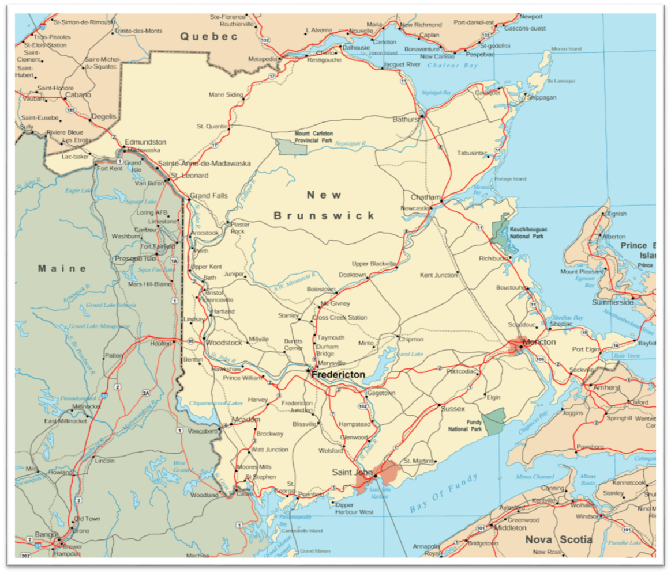




Methods
Participant criteria:
Aged 65 years and older
Drive once a week (min.)
Main driver of a vehicle
Live in private dwelling
Live in New-Brunswick

Slide 7
Tools
Driving indicators (2 week period):
Trip logs
Driving History and Habits questionnaire
Socio-demographic questionnaire
Clock-draw test

Slide 8
Tools (cont.)
Driver perceptions*
Driving Comfort Scale – Day (DCS-D; 13 items)
Driving Comfort Scale – Night (DCS-N; 16 items)
Perceived Driving Abilities (PDA; 15 items)
Self-reported driving behaviours*
Situational Driving Frequency (14 items)
Situational Driving Avoidance (21 items)
*The above noted scales have sound psychometric properties and were translated and adapted to French in the Summer of 2015

Slide 9
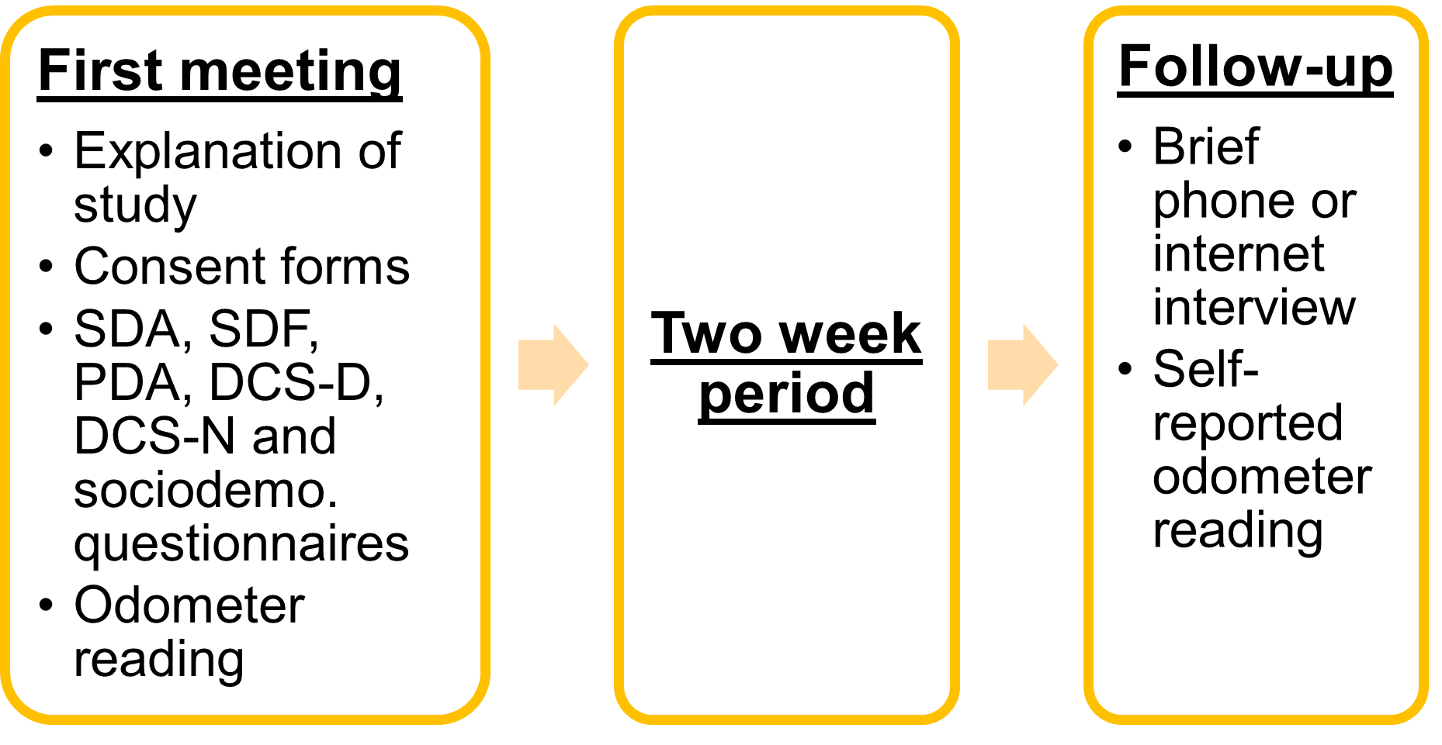
Protocol (Main phase)

Slide 10
Findings: Objective I
Samples
Focus group (n = 7)
Test-retest group (n = 23)
Tool translation and adaptation
Item added to the Situational Driving Avoidance Scale (concerns re: wooded areas at night because of wild animals)
English term (median) was added in parenthesis on an item of the Perceived Driving Abilities Scale

Slide 11
Tool translation and adaptation (cont.)
Internal consistency was excellent (α >.89) for all the scales except the Situational Driving Frequency Scale;
Test–retest reliability
Excellent (ICC = .91-.92): Driving Comfort Scale-Night and Perceived Driving Abilities Scale
Good (ICC = .81): Situational Driving Frequency
Adequate (ICC = .78): Driving Comfort Scale – Day
Poor (ICC = .58): Situational Avoidance Scale.

Slide 12
Objective II
Sample Size; N =50
Mean age: 72 (Min. = 65; Max. = 84)
Area of residence
26 urban
24 rural
Gender
25 ♂
25 ♀

Slide 13
Demographics Cont….
Education: 47% have a university degree
Work: 83% are retired
Volunteer work: 68% take part in volunteer activities
Marital Status: 74% are married/living with CLS
Language at home: 81% speak mostly French
Living with other driver: 58%

Slide 14
Driving exposure (km)
No significant differences in kilometers driven in the two-week study period for:
gender: ♂(M = 618; S.D. = 358), ♀ (M = 492; S.D.= 332), p = .118
area of residence: Urban (M= 600; S.D. = 418); Rural (M= 504; S.D.= 259), p =.801.

Slide 15
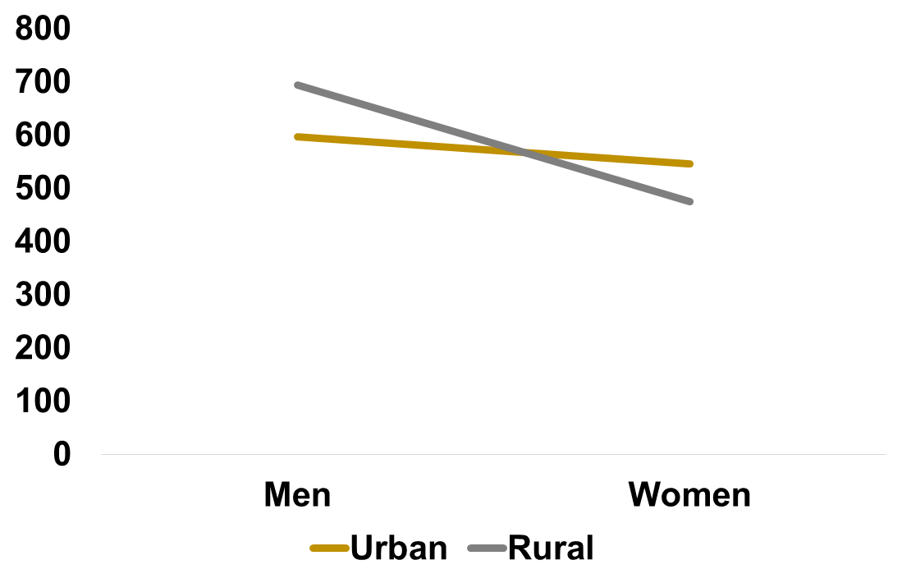
Figure 1. Gender and area of residence differences in km driven
Kilometers driven

Slide 16
Driving exposure (cont.)
 | Day trips | Night trips | Total trips
Men (n=24) | 14.9 | 5.7 | 20.6
Women (n=26) | 9.7 | 4.0 | 13.7
Urban (n=25) | 14.0 | 5.9 | 19.6
Rural (n=25) | 11.0 | 3.7 | 14.3
Table 3. Average number of day, night and total trips
Total trips: Men > Women, U = 147, p = .001; Urban > Rural, U =174, p =.007
Night time trips: Urban > Rural, U =198, p =.025.

Slide 17
Self-reported driving avoidance
Most avoided situations (0-20 pt scale):
Night time with bad weather (88%)
Bad weather (88%)
Fog (62%)
Women (M= 10, S.D.= 5) reported avoiding significantly more situations than men (M= 6, S.D.= 3), U =, 148, p = .001
Two participants cancelled volunteer outing because of storm

Slide 18
Driver Comfort Scales
Figure 2. Driving comfort (mean %) and gender (n=50)
Driving comfort
Day: U =151, p = .002
Night: U = 137, p = .001

Slide 19
Driver Comfort Scales (cont.)
Figure 2. Driving comfort (mean %) Urban vs Rural (n=50)
Driving comfort
Day: U =176, p = .008
Night: U = 230.5, p = .111

Slide 20
Driver Perceptions (perceived driving abilities scale)
Men (M= 37.1, S.D. =4.6) report significantly higher levels of perceived driving abilities (0-45 pt scale) than women (M = 32.6, S.D. = 4.6) U = 208, p = .044.
Positively and significantly correlated with driving comfort (both day and night; p < .01) and self-reported driving frequency (0-56 pt scale) (p < .05)
Negatively and significantly correlated with self-reported driving avoidance ( p< .01) and age (p< .05).

Slide 21
Main conclusions
Most translated tools have sound psychometric properties
Men and urban living older drivers make significantly more trips on average than women and rural drivers
Men report higher levels of driving comfort (day and night) and better perceived driving abilities
Women report avoiding more situations

Slide 22
Future implications
Non-significant, but noteworthy tendencies
Interaction pattern gender X area of residence
Larger samples & moving away from inferential stats
Statistical control of other variables (e.g.: age and health)
Longitudinal studies
Need for more representative samples with regards to gender and area of residence
Better understanding of the needs of older drivers in less populated areas

Slide 23
Thank you kindly for your attention!
Questions? Comments? Feedback?
E-mail: evm4867@umoncton.ca

