Slide 1
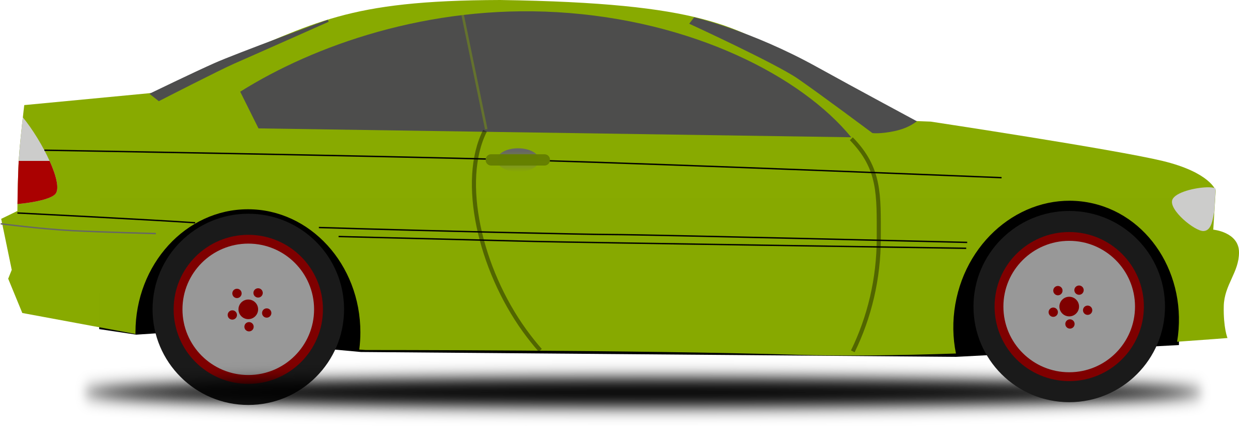

The Effects of Valence on Driving
MSc. Candidate: Caroll Lau
Supervised by: Dr. Lana Trick
Drive lab

Slide 2
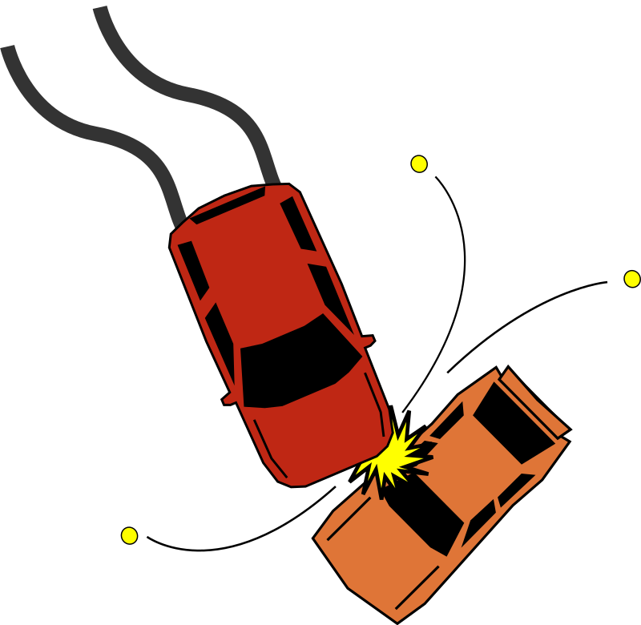
Emotions & Driving

Slide 3



What is Emotion?
Arousal
Valence
Intensity of the Stimulus
Polarity of the Stimulus

Slide 4
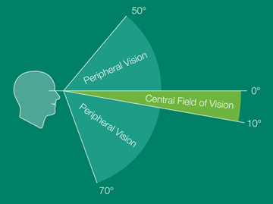
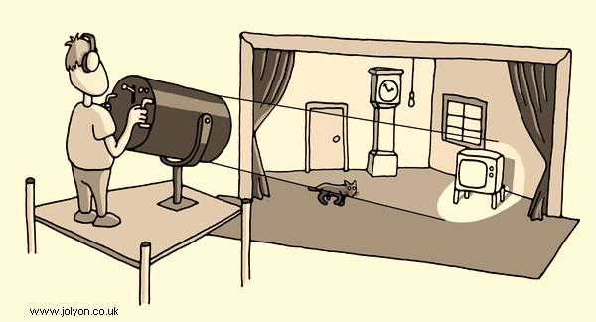
Valence and Attention
Positive Valence
Negative Valence
Broaden & Build Model
Narrow Attentional Focus

Slide 5
Research Question
How does Positive and Negative Valence affect Driving Performance?

Slide 6

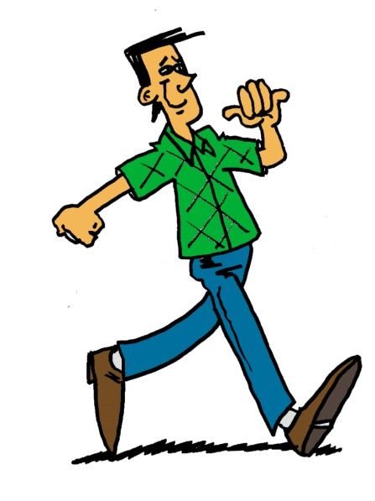

Attention & Driving

Slide 7
Hypothesis I
Hazard Response Times
Positive-Valence will provide faster responses for Peripheral Hazards

Slide 8
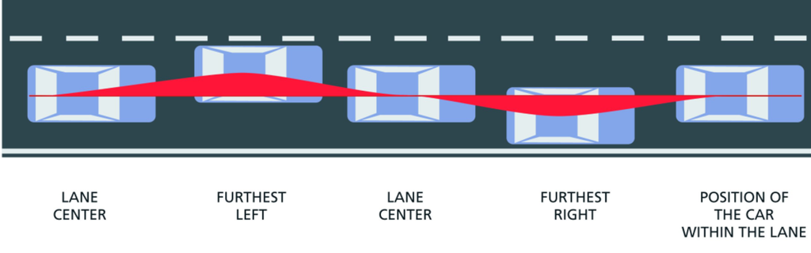
Wicken’s Theory of Attention:
Hazard Detection and Steering
Focal Attention: Hazard Detection
Ambient Attention: Steering
Notes:
Focal Attention: Hazard Detection
Object recognition and visual search
Ambient Attention: Steering
Controlling position in space

Slide 9
Hypothesis II
Steering Performance
Positive-Valence will improve Steering Performance

Slide 10
Current Driving Research:
Confounding Valence & Arousal
Positive Music Arousal (tempo)
Negative Music Arousal (tempo)

Slide 11
Emotion Objective
Valence
Arousal
Polarity of Stimulus
Intensity of Stimulus

Slide 12

Music Stimuli
Long term
Non-distraction
Major & Minor Keys
Music Tempo
Notes:
Major & Minor Keys
Create Positive and Negative Mood
Music tempo influences arousal level (higher arousal with faster tempo)
Music stimuli (instrumental classical)

Slide 13


Strengthening Valence Manipulation
Major & Happy Events
Minor & Sad Events

Slide 14
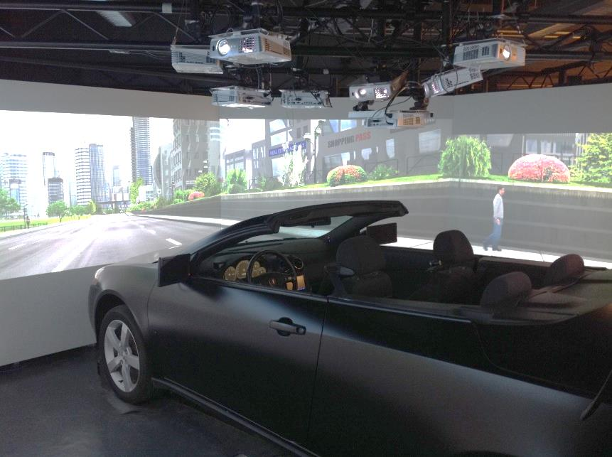
Driving Experiment:
“The Effects of Valence on Driving”

Slide 15
Research Question
How does Positive and Negative Valence affect Driving Performance while controlling arousal?

Slide 16
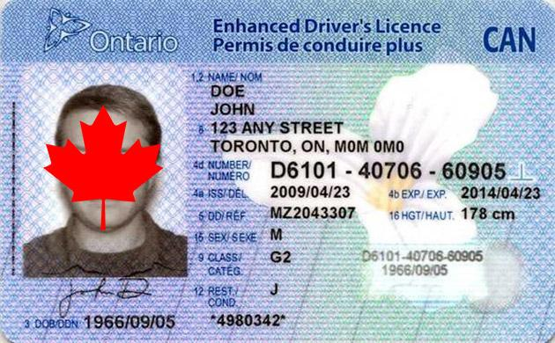
Method
N = 60
Eligibility:
  Pass Pre-screening
  G2 or better license
Notes:
N = 60, students from University of Guelph
Eligibility:
Must pass Simulator Adaptation Pre-screening
Possess G2 or better / equivalent license

Slide 17

Powerful Manipulation of Valence
Music & Mood Induction Condition (Between Group)
Positive
Negative
Neutral
Notes:
Major Music & Happy Event
Minor Music & Sad Event
No Music Control Group

Slide 18
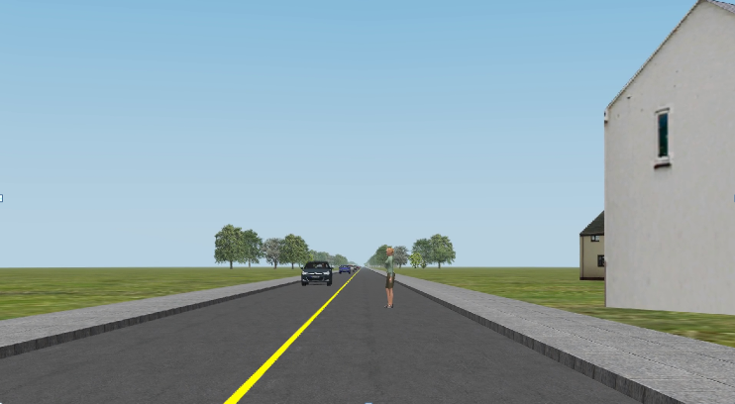
Road Simulations:
Peripheral Hazards

Slide 19
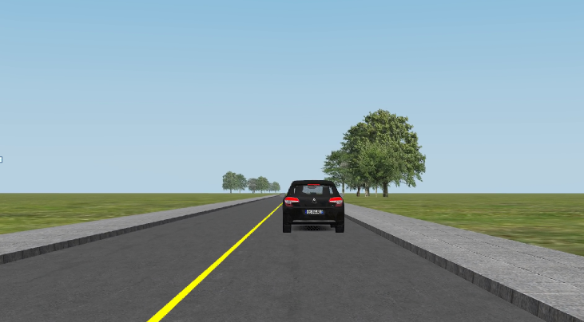
Road Simulations:
Central Hazards

Slide 20
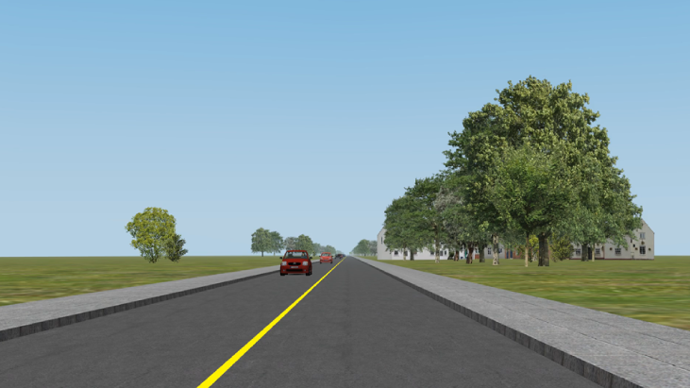
Road Simulations
1 hour long drive
Straight drive
Hazards at random intervals
Notes:
1 hour long drive
4 roads of ~15 minutes long
Straight drive with no turns / swerves
Hazards occur at random intervals

Slide 21
Variables
Independent Variables
  Music
  Hazard Type
Dependent Variables
  Response Time
  Steering Variability
Notes:
Independent Variables
Music - Valence
Hazard Type
Dependent Variables
Hazard Response Time
SDLP (Steering Variability)

Slide 22

Pre – Post Self-Report Questionnaires
Valence & Arousal
Music Elements
Driving History / Experience
Notes:
Valence & Arousal
Slide Bar from a scale of 1 – 100
Music Elements
Familiarity
Enjoyment
Distraction
Driving History / Experience

Slide 23
Results:
Manipulation Check

Slide 24
Post Valence
Expected Results
Actual Results
**
** p < 0.01

Slide 25
Post Arousal
Expected Results
Actual Results

Slide 26
Results:
Driving Data

Slide 27
Hypothesis I
Hazard Response Times
Expected Results
Actual Results
*
* p < 0.05
Notes:
Significant interaction with Hazard Type & Music such that Individuals in the Positive Valence group responded faster to central hazards but not peripheral
While individuals in the negative valence group responded to both central and peripheral hazards equally
This is quite odd given that the observations here are actually the opposite of what I was expecting
Also as it appears, despite the possibility the negative affect produced by the minor music group, individuals in this group responded to both peripheral and central hazards similarly.

Slide 28
Hypothesis II
Steering performance
Expected Results
Actual Results

Slide 29
Summary of Results
Manipulations Worked
Controlling arousal:
  Hazard Response Time – NOT EXPECTED
  Steering Performance – NOT MET
Notes:
Results show that although there was a significant interaction between valence condition and hazard type, it was unexpected. The positive valence showed significantly faster response times for CENTRAL hazards as opposed to the peripheral hazard as hypothesized. This may be due to the fact that arousal was controlled for and therefore eliminated that broadening of attention behaviour. IN ADDITION, it may also mean that valence and arousal affect different aspects of attention differently as previously mentioned there are different types of attention while driving.
** BECAUSE arousal is eliminated from the equation, we don’t see the effect of broadening attention that other studies have seen such as the Broaden and Build Model due to confounding valence with arousal

Slide 30


Limitations
Road Simulations are straight
Self-Report Questionnaires
Notes:
Road Simulations are completely straight
Less opportunity for participants to actually steer (not much steering going on) and this may have contributed to the lack of significant differences between groups for steering variability
Self-Report Questionnaires
Reports of Valence and Arousal is very subjective.
Perhaps in the future we can use more objective measures in obtaining valence & arousal data (e.g., EEG, Heart Rate etc.)

Slide 31

Discussion
Confounding Valence & Arousal = complicating effects
Broaden & Build Model underestimates Arousal
Road Safety & Research
Notes:
Confounding Valence with Arousal can create complicating effects
Ability to detect hazards is dependent on both Valence and Arousal
Broaden & Build Model underestimates effect of Arousal on expansion of Peripheral Field of Vision
Currently, the focus is on positive valence alone when it’s possible that it’s both positive valence + arousal OR perhaps it’s just an effect of arousal?
Upon looking at actual arousal reportings and then grouping participants up based on their arousal scores, the expected results were found
Important for Road Safety & Research
Determines how effectively and how quickly a driver can respond to hazards on the road
A lot of research has worked on Arousal + Driving with little focus on Valence
Both Arousal and Valence has influences Hazard Detection
Better understanding on how emotions influence driving performance
Take this information to create the most ideal driver behaviour emotional state to maximize performance and reduce # of collisions related to inattention

Slide 32



Acknowledgements
Tricksters
Dr. Lana Trick
Ryan Toxopeus
Lyon Smith
Research Interns
  Lindsay Haas, Breanne Larson, Brittany Cohen,
  Adrienne Van Aaken, Olivia Maan,
  Megan Kelly, & Aleece Katan

Slide 33

Questions?
MSc. Candidate: Caroll Lau
Supervised by: Dr. Lana Trick
DRiVE Lab

