Slide 1


Psychological Factors in Motorcycle Conspicuity
The Role of Context and Prevalence
Bertrand Sager
Elisabeth Kreykenbohm
Thomas M. Spalek
Simon Fraser University
(2016)
Notes:
Image Copyright 2015 BMW Motorcycle Magazine

Slide 2


Introduction
Motorcycle collisions typically attributed to
poor conspicuity
Improvements in motorcycle conspicuity not reflected in collision statistics
Previous research: Motorcycles are conspicuous

Slide 3
Change Blindness Demo
An image will flicker, alternating between two versions
One version has an object added/removed
Find that object

Slide 4
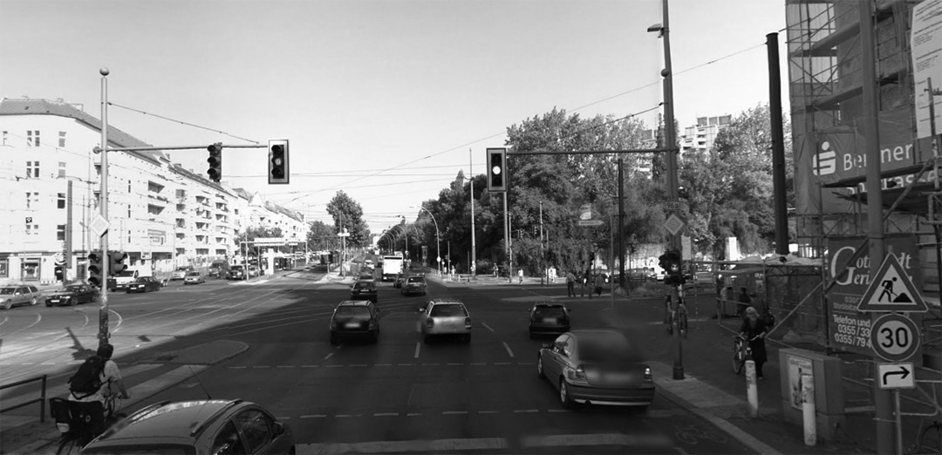


Change Blindness Demo

Slide 5
Change Blindness Demo

Slide 6
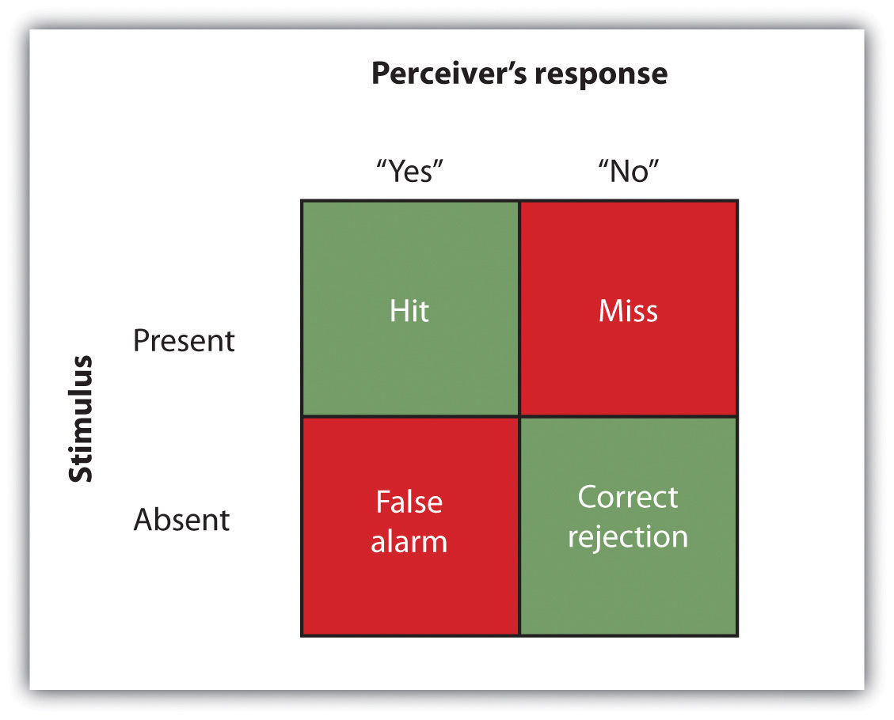
Signal Detection Theory
Notes:
Image from http://gru.stanford.edu/doku.php/tutorials/sdt

Slide 7
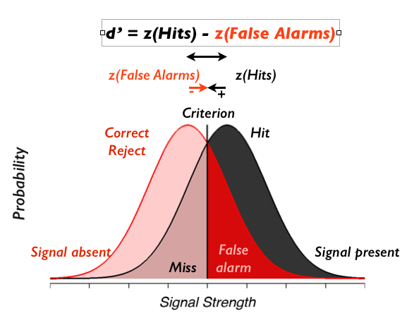
Signal Detection Theory
Say “No”
Say “Yes”
(β)
Notes:
Image from http://gru.stanford.edu/doku.php/tutorials/sdt

Slide 8
Experiment 1 (Traffic Context)
Do motorcycles stand out?

Slide 9
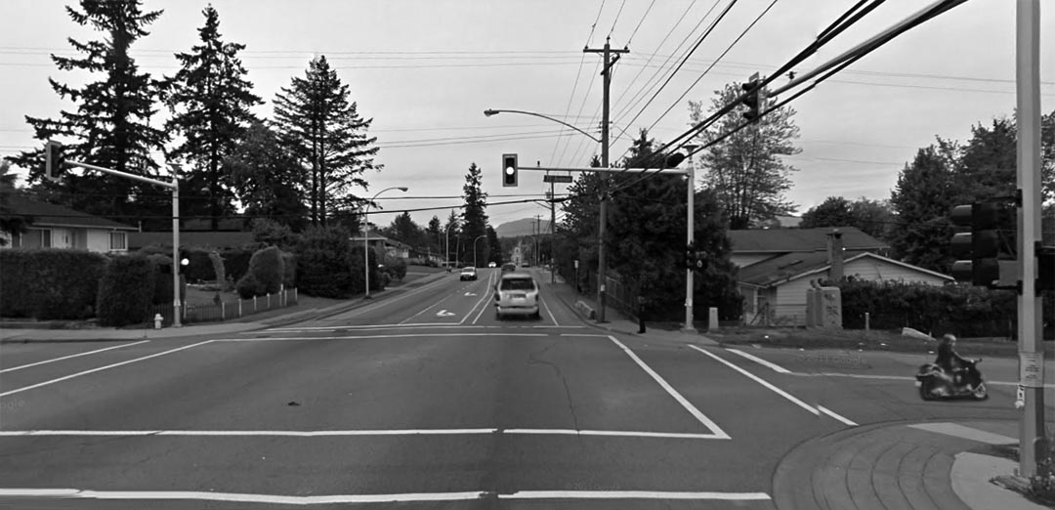
Experiment 1: Target Detection in a Traffic Context

Slide 10
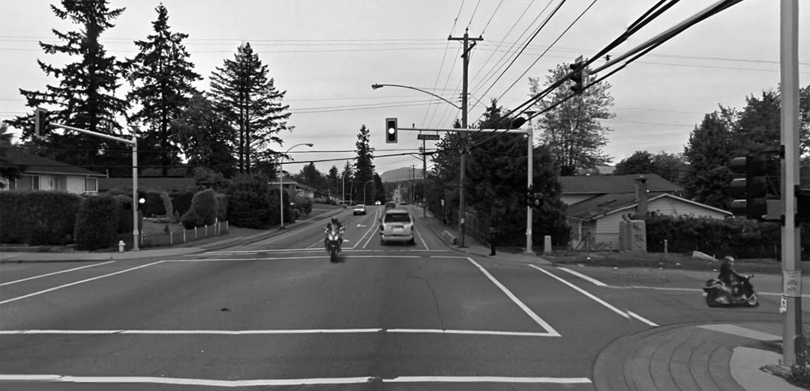
Motorcycles
Experiment 1: Target Detection in a Traffic Context

Slide 11

Cars
Experiment 1: Target Detection in a Traffic Context

Slide 12
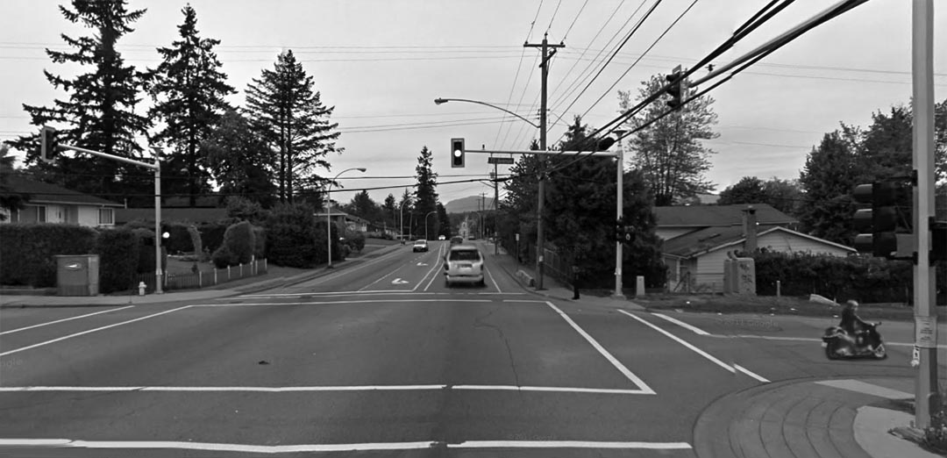
Traffic-Irrelevant
Experiment 1: Target Detection in a Traffic Context

Slide 13
Experiment 1 (Traffic Context) Results: Criterion

Slide 14
Experiment 1 (Traffic Context) Results: Sensitivity
p = .030
p < .001
Notes:
With N=97, p=.030

Slide 15
Experiment 1 (Traffic Context): Discussion
Higher sensitivity to motorcycles
Not due to bias (if anything, more conservative for motorcycles)
Low sensitivity to traffic-irrelevant objects
(Search guided by traffic-schema?)

Slide 16
Experiment 2: No Traffic Context
Do motorcycles stand out
Because of the context?

Slide 17
Experiment 2: No Traffic Context
Display always contains
10 Motorcycles
10 Cars
Target changes on 50% of the trials
Proportion of Changes:
50% Motorcycles
50% Cars

Slide 18
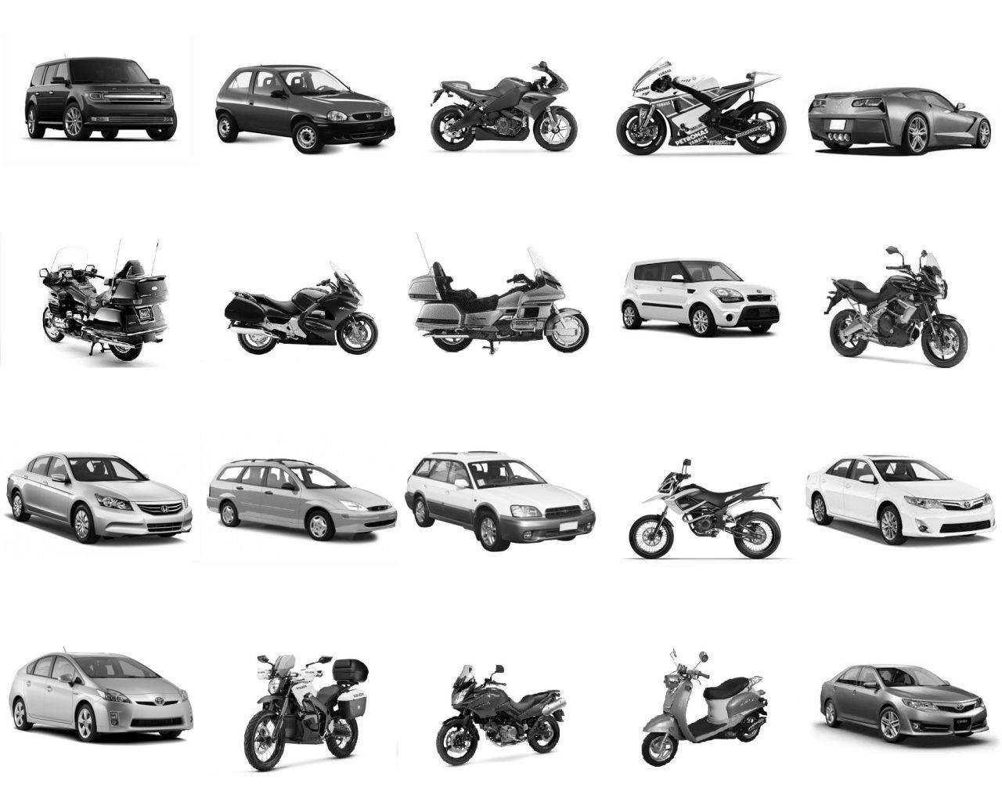
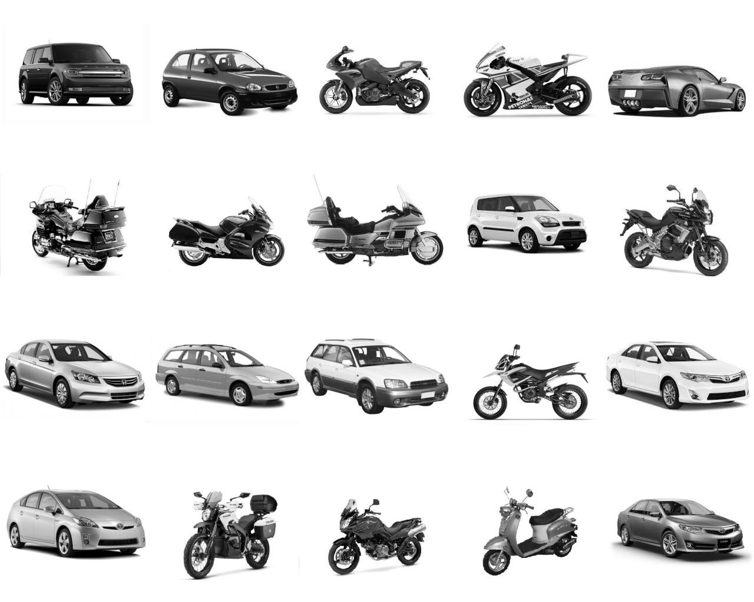
Experiment 2: Equal In-Display and Across-Trials Prevalence

Slide 19
Experiment 2: Equal In-Display and Across-Trials Prevalence

Slide 20
Experiment 2: Equal In-Display and Across-Trials Prevalence

Slide 21
Experiment 2: Equal In-Display and Across-Trials Prevalence
p = .045
Notes:
N Trimmed from 39

Slide 22
Experiment 2: Discussion
Higher sensitivity to cars than to motorcycles
Outside of a traffic context
For all the reasons we expect:
Cars are bigger
Cars are more familiar

Slide 23
Experiment 3: In-Display Prevalence Manipulation
What is it about the context that makes
motorcycles stand out?
Is it because they are scarce in the visual field?

Slide 24
Experiment 3: In-Display Prevalence Manipulation
Displays:
15 Motorcycles, 5 Cars
or 5 Motorcycles, 15 Cars
Target changes on 50% of the trials
Proportion of Changes:
50% Motorcycles
50% Cars

Slide 25
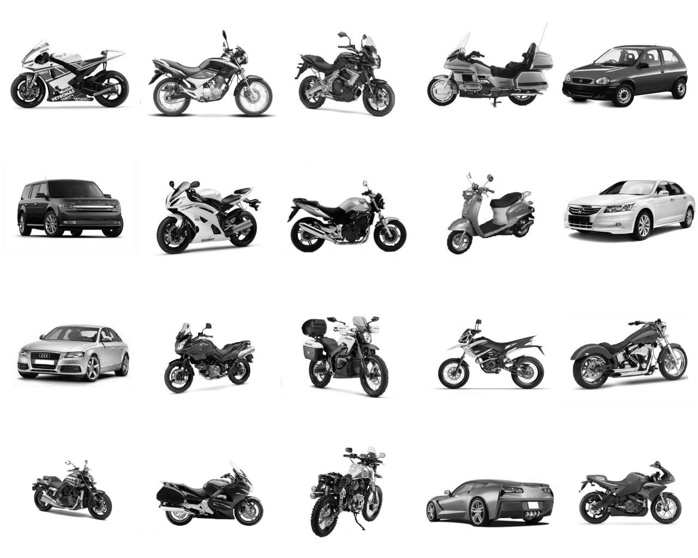
Experiment 3: In-Display Prevalence Manipulation

Slide 26
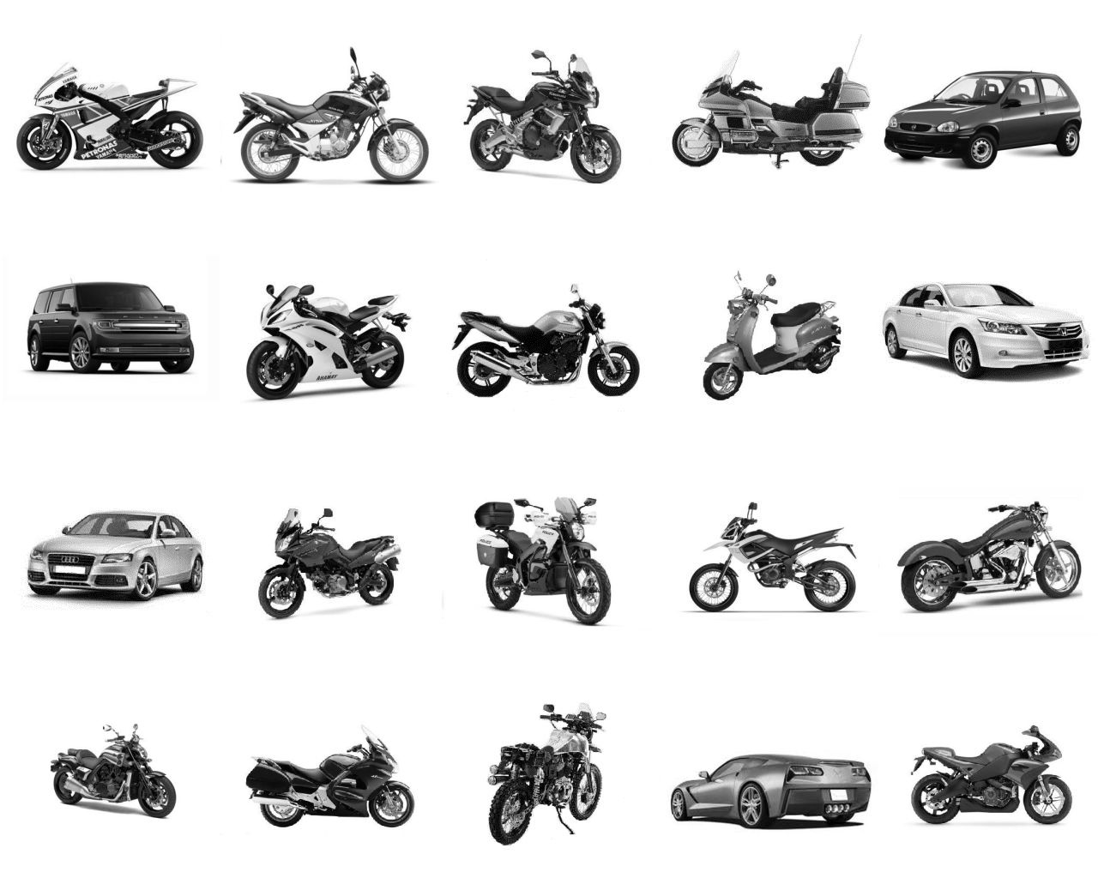
Experiment 3: In-Display Prevalence Manipulation

Slide 27
Experiment 3: In-Display Prevalence Manipulation

Slide 28
Experiment 3: In-Display Prevalence Manipulation
Notes:
N trimmed from 52, main effect p was .055 then too.

Slide 29
Experiment 3: Discussion
No effect of in-display prevalence manipulation

Slide 30
Experiment 4: Across-Trials Prevalence Manipulation
What is it about the context that makes
motorcycles stand out?
Is it because we rarely interact with them?

Slide 31
Experiment 4: Across-Trials Prevalence Manipulation
Display always contains
10 Motorcycles
10 Cars
Target changes on 50% of the trials
Between-Subject Manipulation:
Targets: 75% Motorcycles, 25% Cars
Targets: 25% Motorcycles, 75% Cars

Slide 32
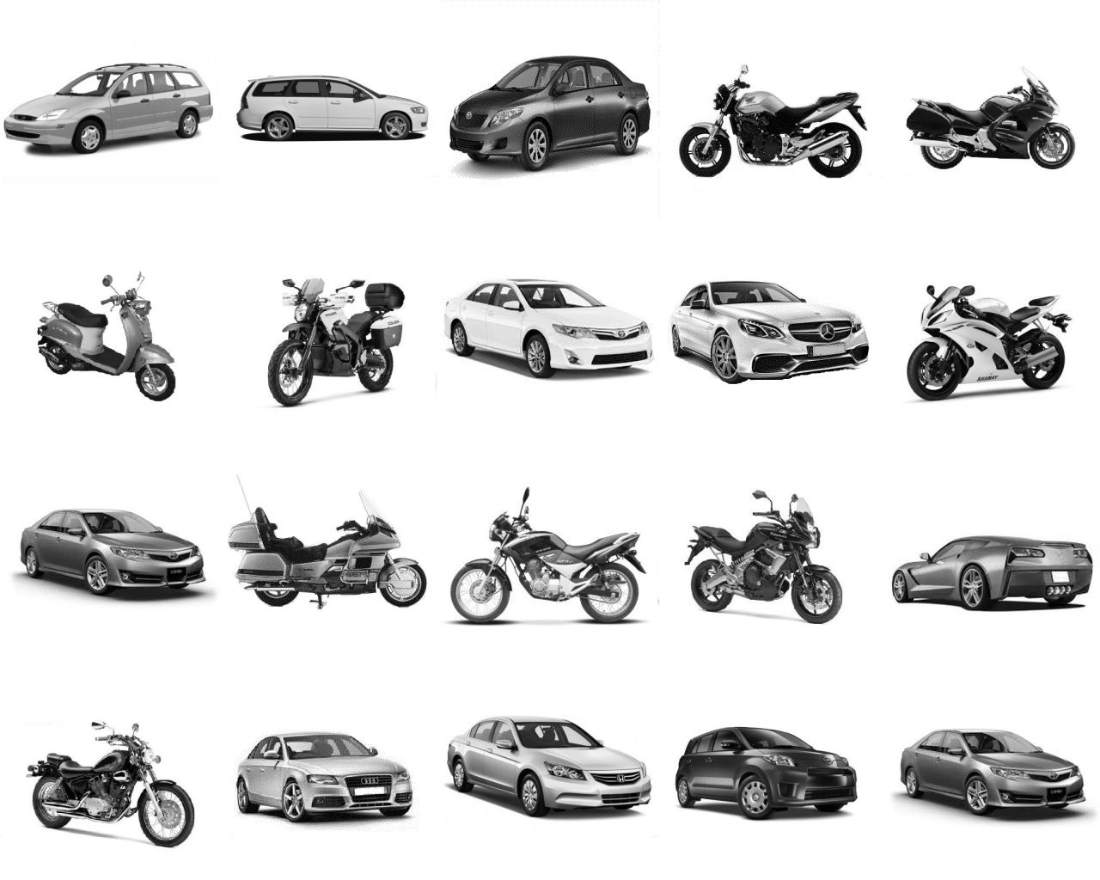
Experiment 4: Across-Trials Prevalence Manipulation

Slide 33
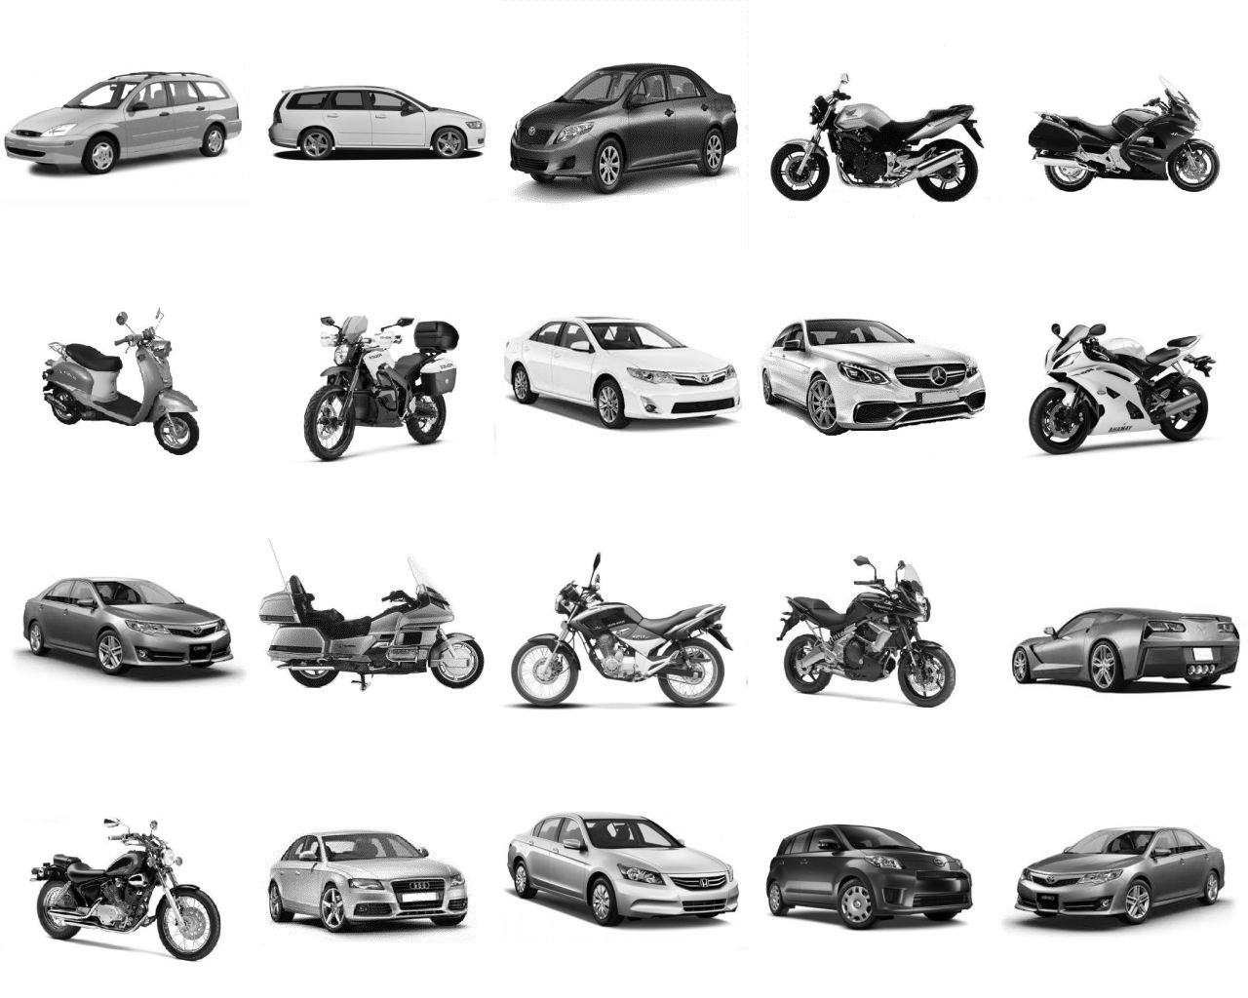
Experiment 4: Across-Trials Prevalence Manipulation

Slide 34
Experiment 4: Across-Trials Prevalence Manipulation
p = .006
p = .017
p = .014

Slide 35
Experiment 4: Across-Trials Prevalence Manipulation
p = .031
p = .046
Notes:
N trimmed from 56

Slide 36
Experiment 4: Discussion
Manipulating how often a vehicle is the target only had an effect on cars
When cars are frequent targets, observers become desensitized to them
This causes motorcycles to stand out
Not because of their relative rarity
But because of how rarely we interact with them

Slide 37
General Discussion
In a traffic context, motorcycles are more conspicuous than cars; this seems to be due to the rarity with which drivers interact with them
Outside of a traffic context, with target likelihood and in-display prevalence held constant, detection is driven by sensory conspicuity
Motorcycle collisions are likely not due to low conspicuity

Slide 38


The End
Notes:
Extra slides to show the data again without animations during question period (if needed)

