Slide 1
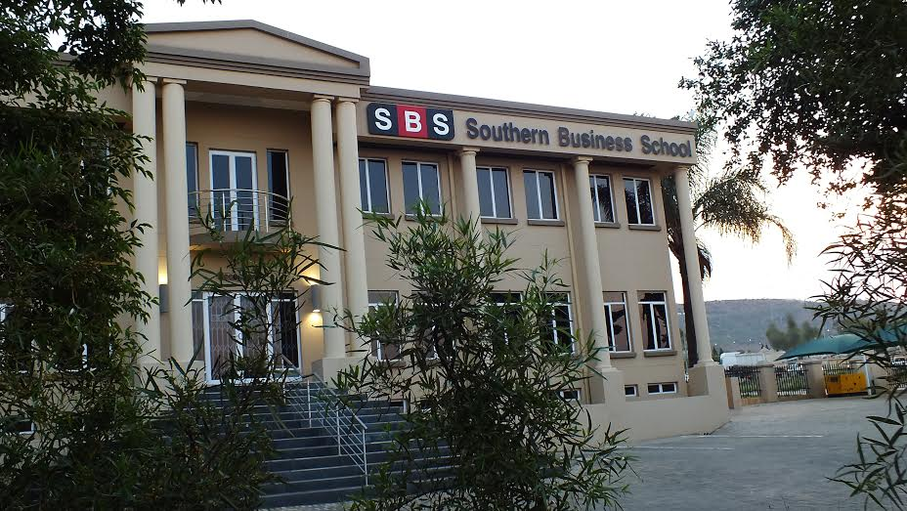
AN ASSESSMENT OF THE CRIMINOLOGICAL SIGNIFICANCE OF MOTOR VEHICLE CRASH DATA WITHIN THE CRIMINAL JUSTICE CONTEXT
Presenter: Andre Roets
Tel: +27 (0) 83 785 2238
E-mail: aroets@sbs.ac.za
Notes:
1
1

Slide 2
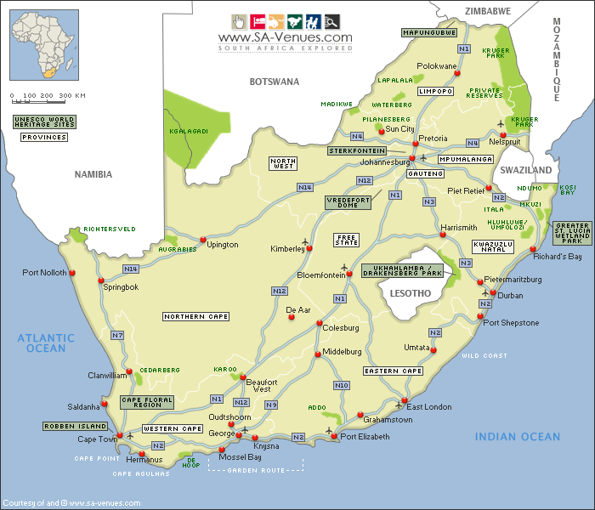
SOUTH AFRICA

Slide 3
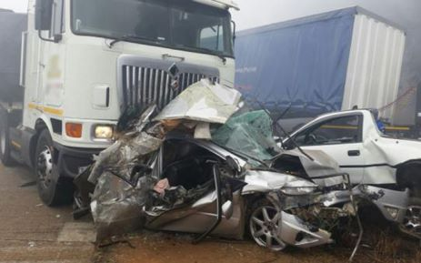
SOUTH AFRICA IS ONE OF THE WORLD’S MOST DANGEROUS COUNTRIES IN WHICH TO DRIVE!
Notes:
Sien Nicky Smith

Slide 4
FATALITIES: DECEMBER 2007 – DECEMBER 2013
Notes:
Gradual increase of approx. 20%

Slide 5
INTRODUCTORY REMARKS
Traffic offenders are turning our roads into killing fields
“We do not compare favourably with even other developing nations in the world, so we’ve got a serious problem on our hands and money can’t buy change”
“The problem with road deaths in South Africa is that no one knows how many people are actually killed in car accidents”
Notes:
P6 - dissertation

Slide 6
TRAFFIC LAW ENFORCEMENT: SOUTH AFRICA

Slide 7
IMPACT OF TRAFFIC CRASHES
Each and every person is a road user, irrespective whether in a car or by foot
Road crashes are unnecessary and cause despair and poverty
Notes:
P80

Slide 8
IMPACT OF TRAFFIC CRASHES (CONT.)
Road crashes are considered modern problems resulting in huge human and material losses
People often develop Post-Traumatic Stress Disorder (PTSD) following exposure to a traumatic traffic crash

Slide 9
ROAD TRAFFIC CRASHES
Developing countries are severely affected by road crashes, because young people are the leading cause of death
South Africa is not only paying an expensive price concerning the skills of economically active citizens, but the growth of the country is also negatively affected
There is no quick and simple solution to the problem

Slide 10
ECONOMICAL IMPACT OF CRASHES
In 2013 the average cost of crashes –
Fatal: R1.23 mil p/crash
Damage only: R74,000 p/crash
811% increase from 1998 to 2013
Notes:
In 1998 average cost per crash = R24,817*511 (R13.7 billion p/year)

Slide 11
LEGAL RESPONSIBILITY OF CRASH RECORDING
Great uncertainty amongst Law Enforcement Practitioners (LEPs) as to when and who attend to and record crashes
Serious and fatal crashes MUST be attended to by South African Police Service (SAPS)
Argument founded in sect 205(3) of the Constitution of the RSA, 1996 – “the objects of the police service are to prevent, combat and investigate crime…”

Slide 12
LEGAL RESPONSIBILITY (CONT.)
Traffic officers become the 1ST RESPONDER i.e. to safeguard the scene, which result in crashes classified as ‘serious’ and referred to SAPS for action
Contradicts Sect 61(1)(f) of National Road Traffic Act (93 of 1996)

Slide 13
LEGAL RESPONSIBILITY (CONT.)
“61(1) The driver of a vehicle at the time when such vehicle is involved in or contributes to any accident in which any person is killed or injured or suffers damage in respect of any property, including a vehicle, or animal shall-
(f) if he or she has not already reported the accident to a police or traffic officer at the scene of the accident, … report the accident to any police officer at a police station or at any office set aside by a competent authority for use by a traffic officer, …..”

Slide 14
LEGAL RESPONSIBILITY (CONT.)
Problematic due to the lack of training of South African Police Service (SAPS) members
All forms of training concerning crash attendance and recording are removed from the basic training curriculum of the SAPS

Slide 15
RESPONSIBILITY (CONT.)
This unfeasible practice resulted in the vast majority of Traffic Officers bearing no knowledge about crash scene attendance and recording of road crashes

Slide 16
REPORTING AND RECORDING PROCESS: ROAD TRAFFIC CRASHES
Collection of data is a challenging process
Registration of crashes only materialises if recorded / reported
Reduction of traffic injuries in developing countries is ineffective because of the underestimation of traffic injuries due to underreporting
Approx. 75% vehicles uninsured, problematic
Notes:
Legal procedure somewhere hidden in a policy

Slide 17
REPORTING AND RECORDING (CONT.)
Recording of crashes are challenging with removal of vehicles and/or drivers prior to arrival of Law Enforcement Practitioners
Official radios are rented to breakdown companies to respond to crash scenes
Registration of recorded crashes on average 2 years behind

Slide 18
INTEGRITY OF DATA
Although statistics are recorded in South Africa, it is not without controversy
The national picture in relation to traffic crashes does not depict the total picture of road traffic crashes in South Africa

Slide 19
INTEGRITY (CONT.)
Crashes involving road traffic injuries are neglected, especially the categorisation of injuries
Around 78% of all information recorded provides inaccurate and unreliable statistics

Slide 20
INTEGRITY (CONT.)
Participants acknowledged that “…. the information that is recorded on the forms are of a bad quality not portraying the correct picture as to what the true state of affairs concerning traffic crashes are.”
Statistics from 2009 onwards are seasonal and indicate fatalities only

Slide 21
INTEGRITY (CONT.)
The European Commission (EC) warned against strategies with too much focus on the reduction of fatalities
Problem is that the real picture about road traffic crashes is suppressed

Slide 22
EXTRACT – COMPLETION RATE: ACCIDENT REPORT FORMS
N=503
DESCRIPTION | COMPLETION RATE
Location of crashes | 73%
Speed limit indicated | 27%
Junction type | 33%
Gender of driver | 70%
Alcohol suspected | 1%
Vehicles indicated | 84%
Traffic control type | 62%
Road type | 50%

Slide 23
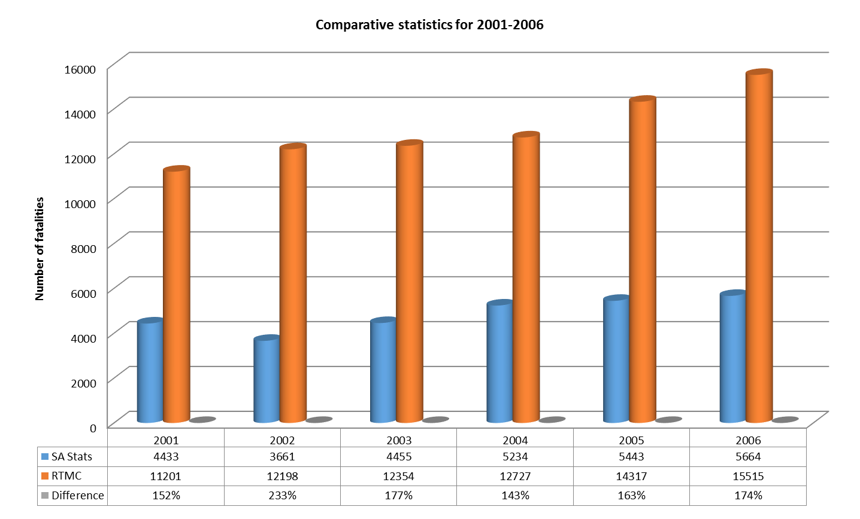
RELIABILITY OF STATISTICS

Slide 24
RESEARCH STATISTICAL ANOMOLIES
67% of information recorded reflect no connection between driver action, crash type and crash description
62% of all Accident Report (AR) Forms were not verified for completeness
Results indicate that management statistics available to develop interventions are inaccurate and worthless

Slide 25
REALITY OF PROSECUTION
Well known fact that at least 20 people sustain non-fatal injuries for every 1 fatality

Slide 26
TYPES OF PROSECUTION
Active Prosecution
Active (At-the-scene) Prosecution
Passive (Administrative) Prosecution
Passive
Prosecution
Identify offenses overlooked at the scene
Crashes reported by the driver
Most effective, officer on-scene, in best position to observe scenario

Slide 29
RECOMMENDATIONS
Traffic officers need to change from trained incompetence that result in operational ineffectiveness to professional service oriented officers
Crash statistics must be submitted on the requested monthly basis to the national data base
Traffic law enforcement agencies should implement effective databases that are in line with national standards

Slide 30
RECOMMENDATIONS (CONT.)
Legislation should be amended to allow Traffic Law Practitioners to investigate crash scenes, including serious and fatal injuries
Supervisors to be compelled to verify Accident Report Forms on daily basis
Aspect surrounding prosecutors should be investigated to improve the effectivity of the Criminal Justice System

Slide 31
Thank you!

Slide 32

