Slide 1
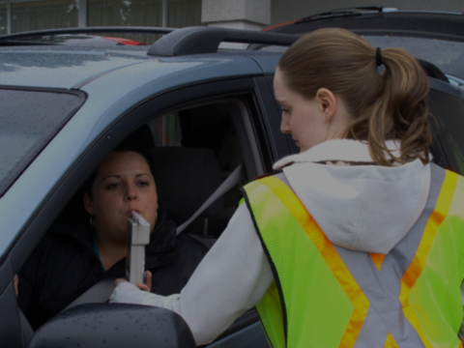
2014 Ontario Roadside Alcohol and Drug Survey
Doug Beirness
Erin Beasley
Paul Boase
Lloyd Robertson
Kevin McClafferty

Slide 2
2014 Ontario Roadside Survey
Need for current, reliable and valid estimate of prevalence of alcohol and drug use by drivers
Provide information on temporal, geographic and demographic characteristics of those involved
Last Ontario survey was conducted in 1986

Slide 3
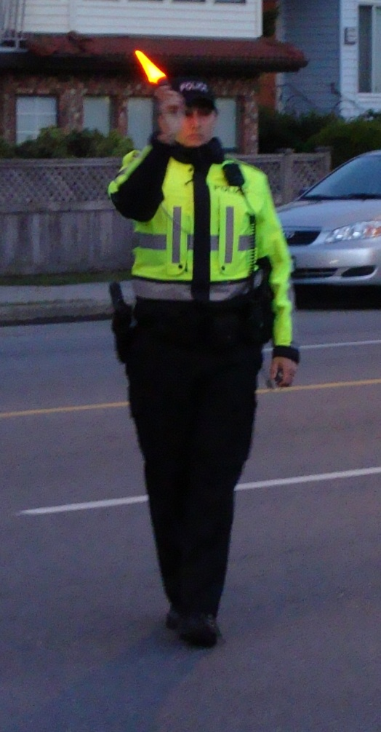
Method
Transport Canada protocol
Wed through Sat nights
9:00 PM to 3:00 AM
4 sites per night – 90 min each
Set up survey site in parking lot
2 survey crews of 4-5 interviewers
Police officer to direct traffic
VOLUNTARY!

Slide 4
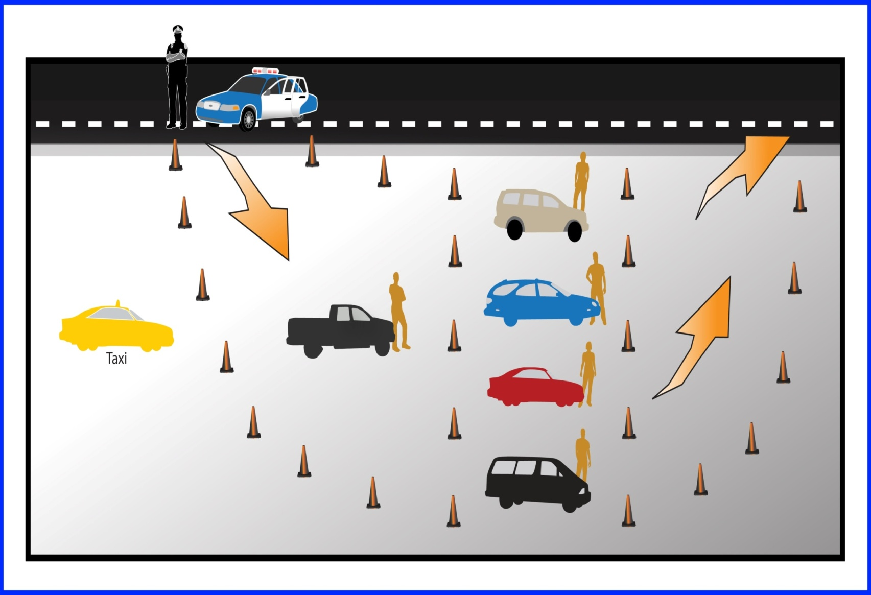
Roadside Survey Site Layout

Slide 5
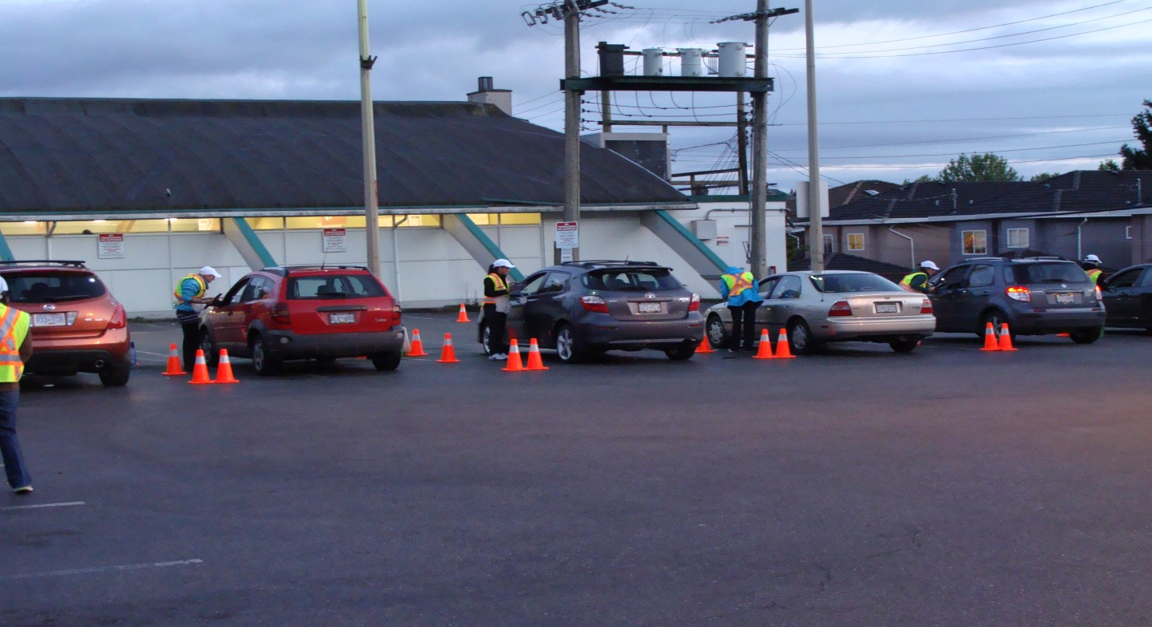
Survey Site

Slide 6
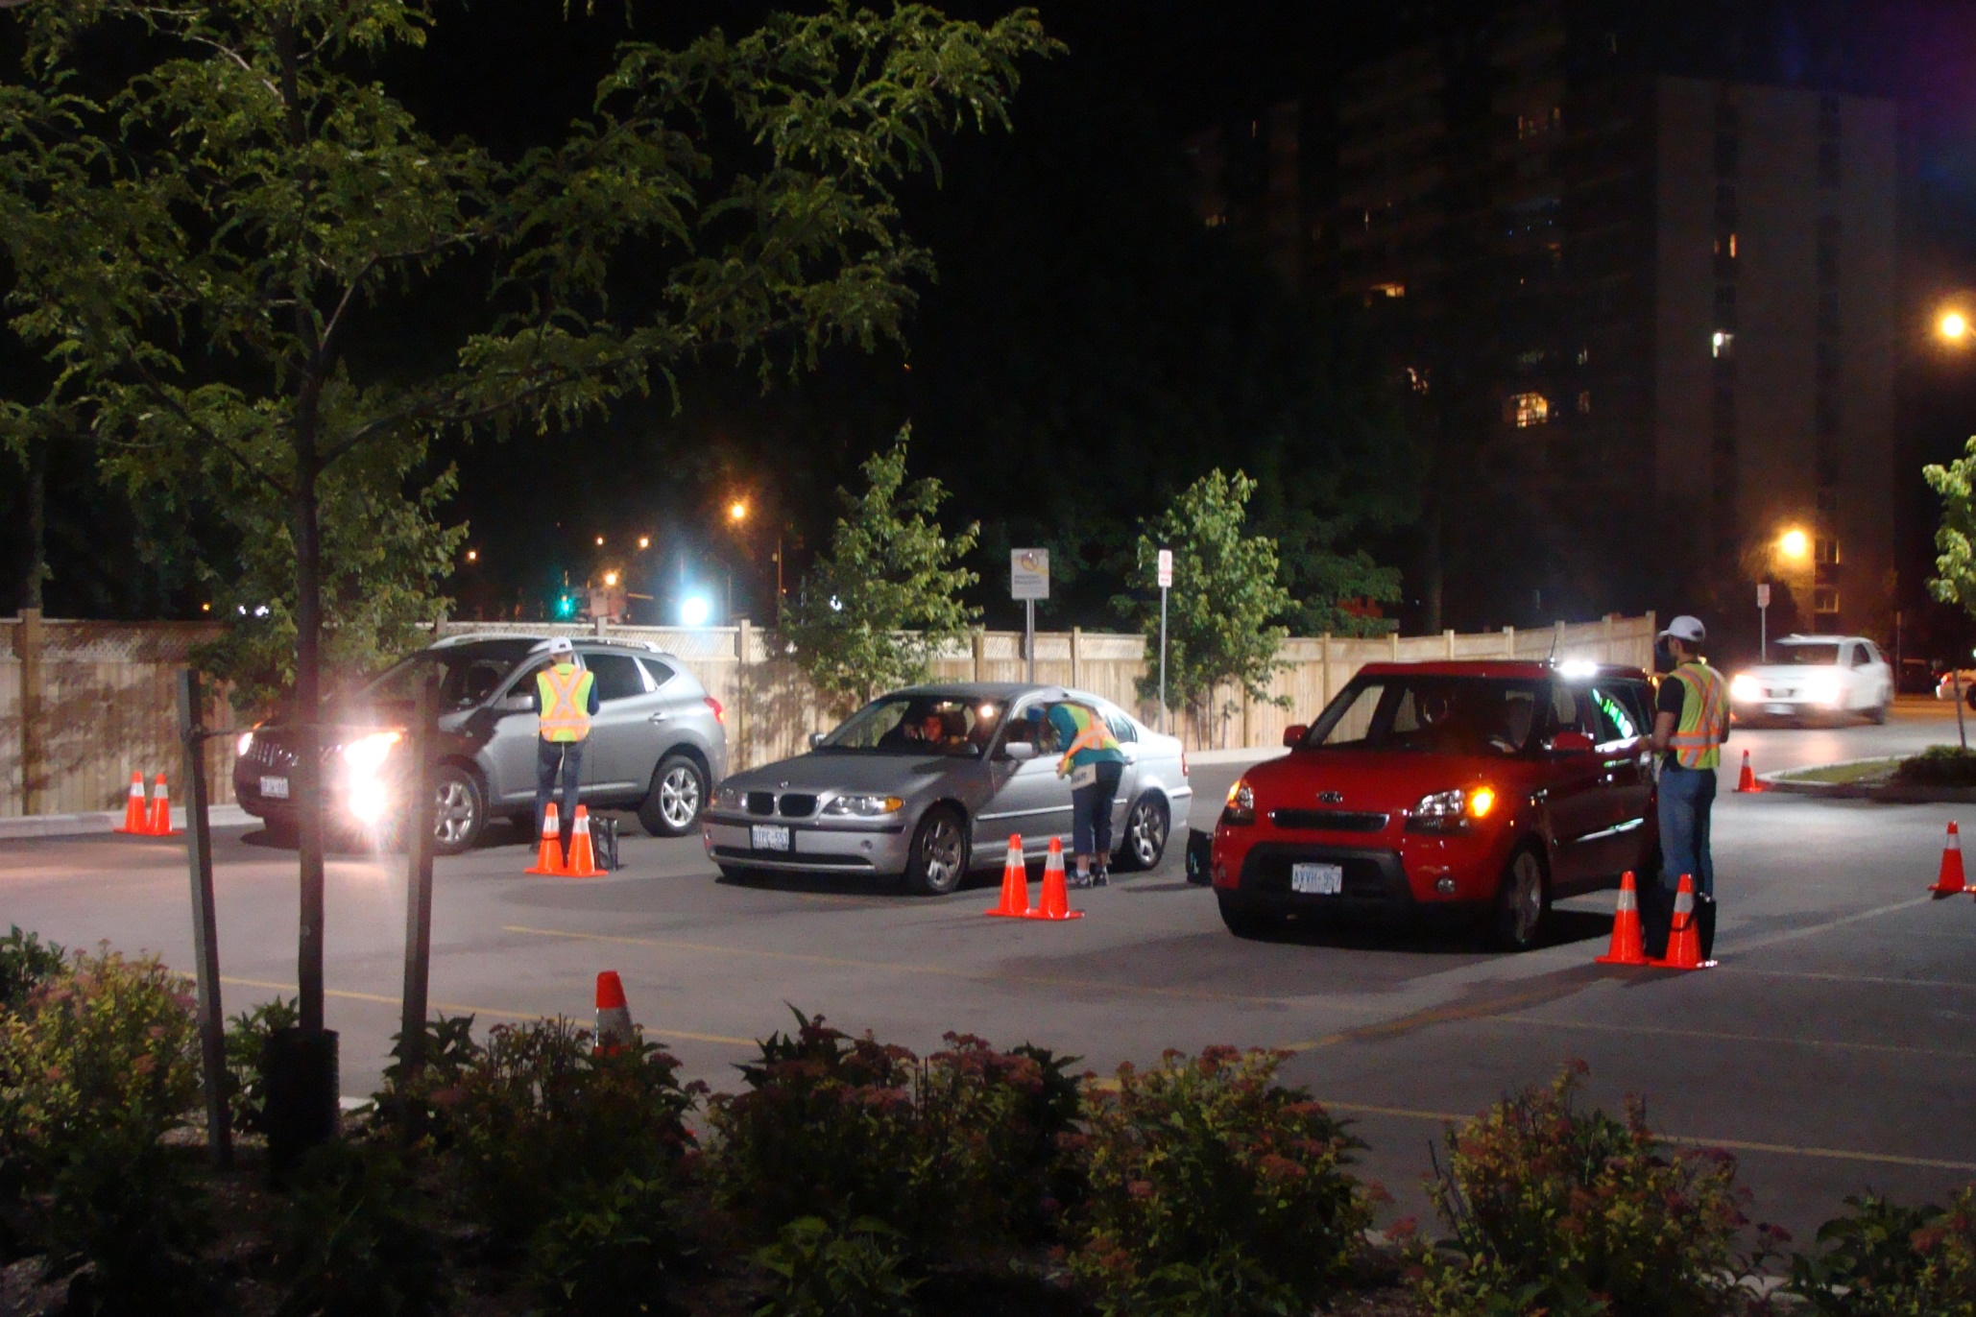

Slide 7
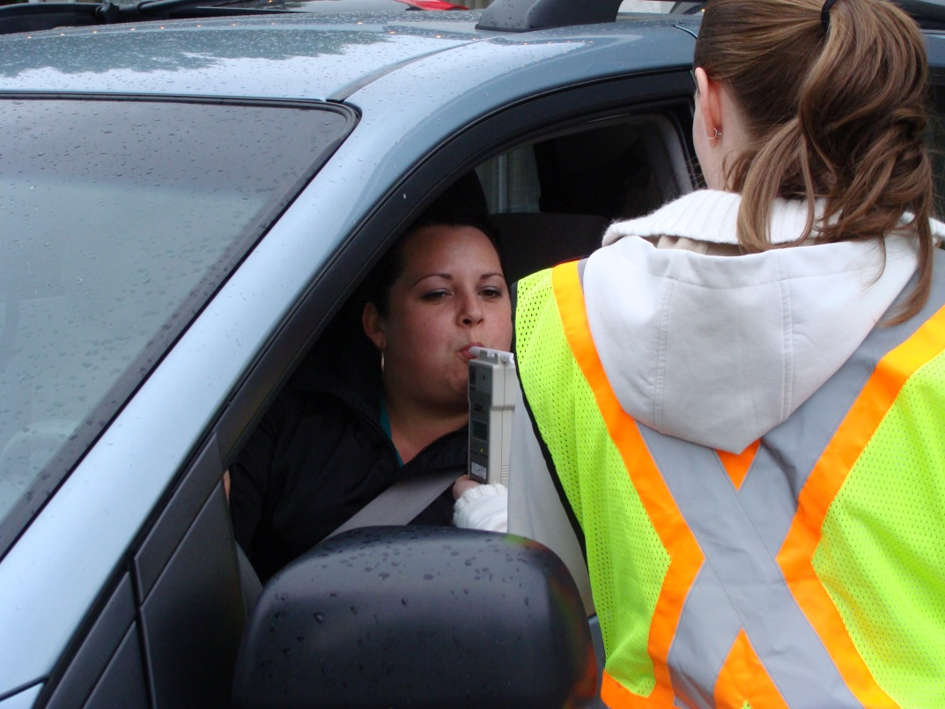
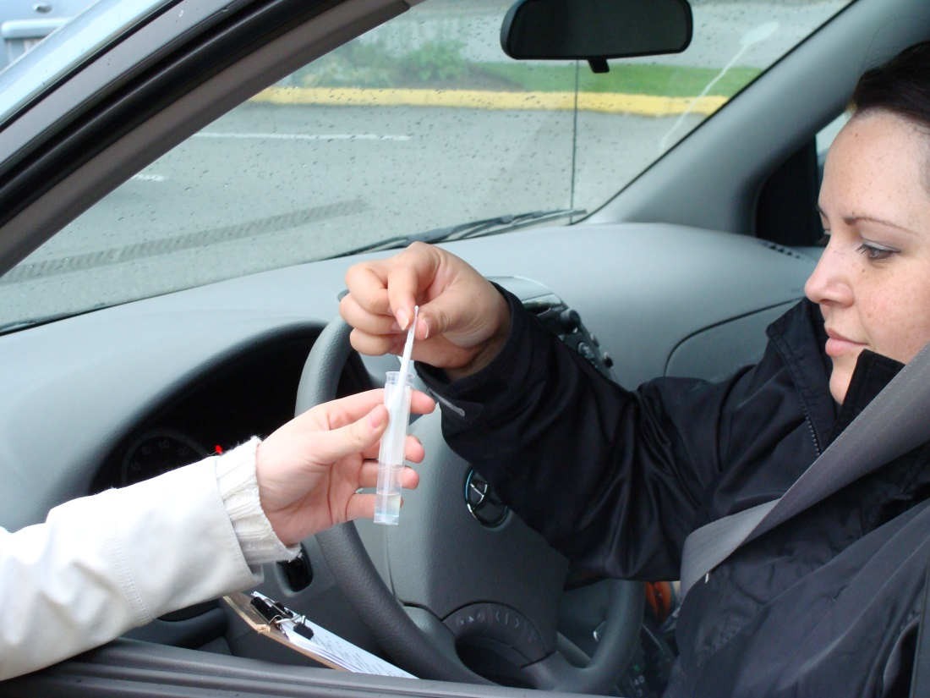
Breath and Oral Fluid Samples

Slide 8
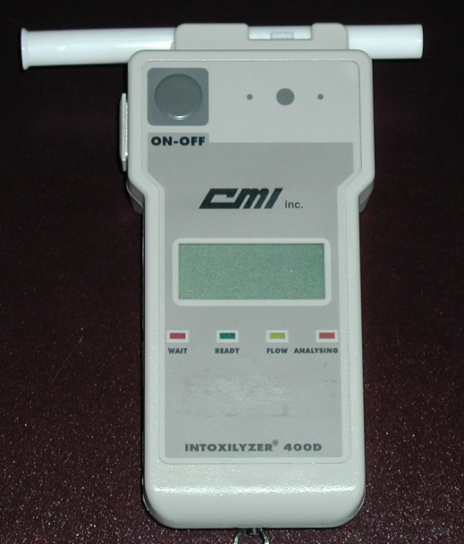
Intoxilyzer 400D
Automated breath alcohol screening device
Approved for police use
Provides digital BAC accurate to ± 5 mg/dL

Slide 9
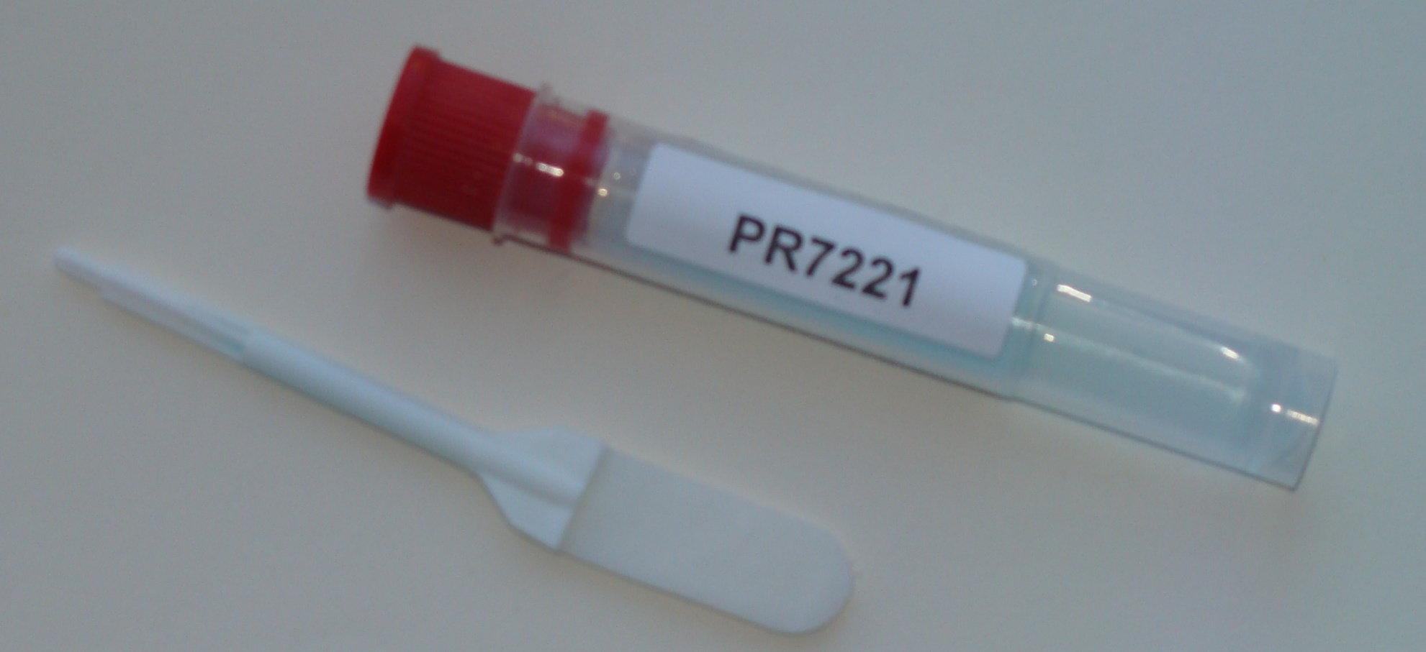
Quantisal Oral Fluid Collection Kit

Slide 10
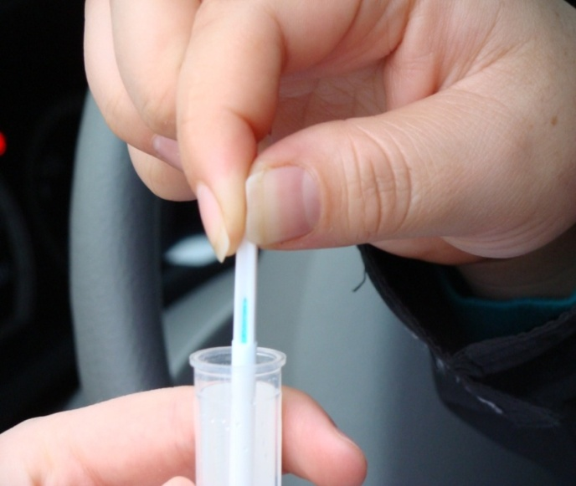

Slide 11
Participation Rates
N=2648 Vehicles
206 (7.8%) Refused
Breath
n=2344 (95.9%)
Oral Fluid n=2135 (87.4%)

Slide 12
BAC Distribution of Drivers
Positive <50 50-80 >80

Slide 13
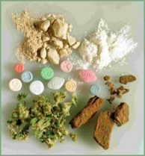
Drugs
10.2% tested positive for drugs
Cannabis - 69%
Stimulants – 21%
Opioids - 20%
Benzodiazepines – 3%

Slide 14
Drug-Positive Drivers According to Age

Slide 15
Drug-Positive Drivers According to Survey Night

Slide 16
Drug-Positive Drivers According to Survey Time

Slide 17
Key Findings: Alcohol
Alcohol use lowest ever!
Few had BAC > 80 mg/dL
No drivers under 19 had been drinking
Older G1/G2 drivers and those under 22 had been drinking
Females as likely has males to have BAC >50 mg/dL

Slide 18
Key Findings: Alcohol
Late nights – i.e., after midnight
Weekends – particularly Friday night
Vehicles with driver only, one passenger most likely BAC >50
Groups have designed driver

Slide 19
Key Findings: Drugs
Drugs more common than alcohol
Drivers aged 19 to 24
Cannabis most common drug
Younger drivers most likely to use cannabis
Opioids and stimulants among older drivers

Slide 20
Key Findings: Drugs
Thursday nights
Late nights
Coming from work, bar/pub/nightclub -- using on these premises?
Belief that driving using drugs are less likely than drinking drivers to be stopped by the police

Slide 21
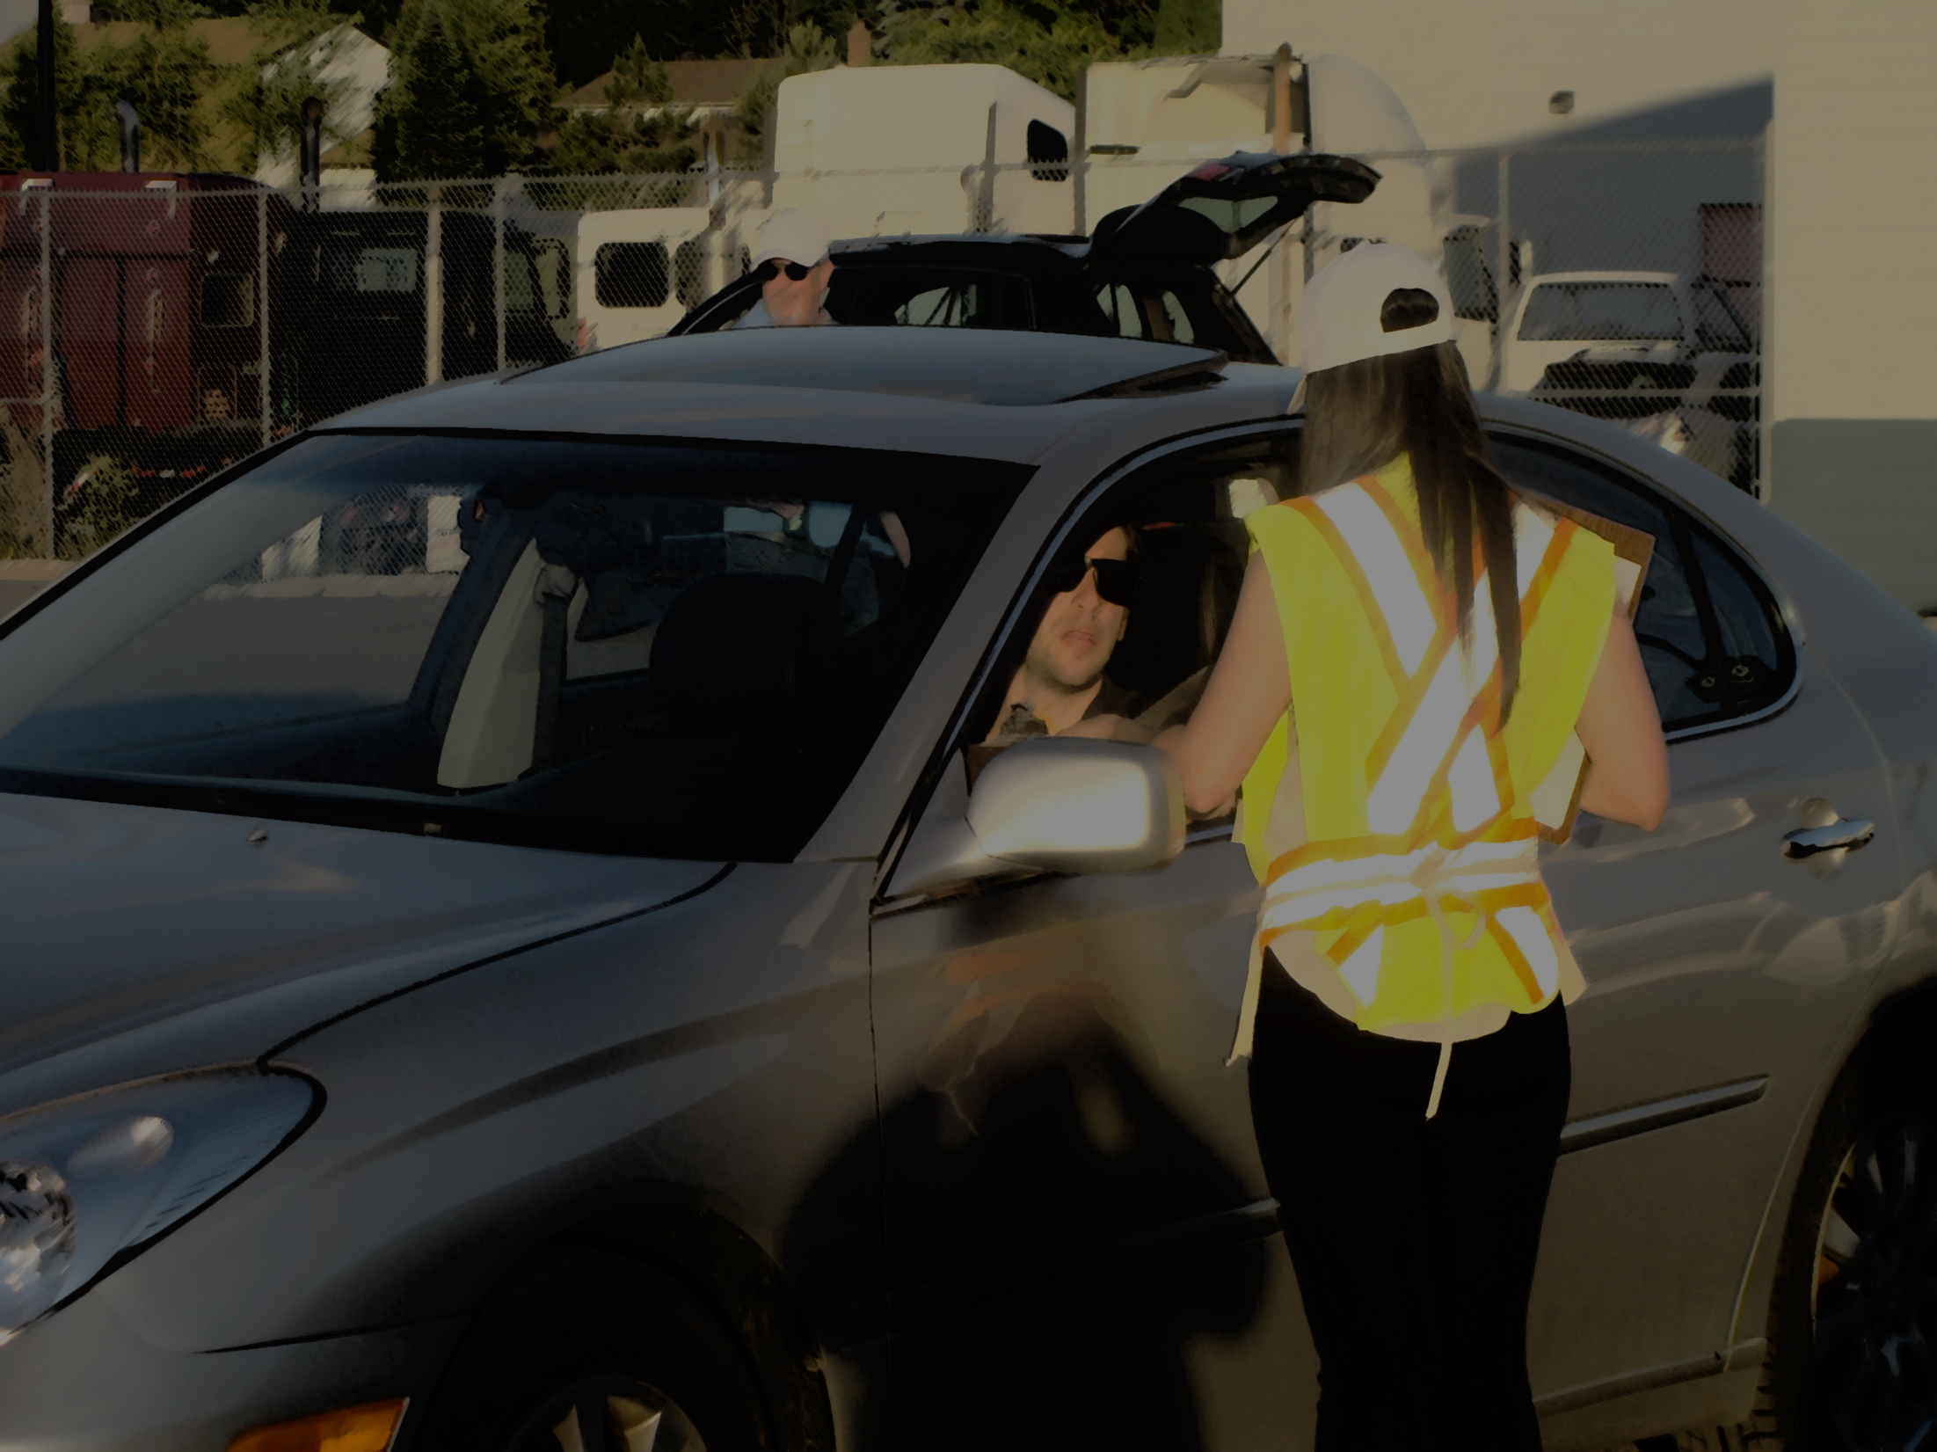
Doug Beirness
DBeirness@magma.ca
Acknowledgements
Ontario Ministry of Transportation
Transport Canada
MADD Canada
Southwestern Collision Analysis
2014 Ontario Roadside Survey

Slide 23
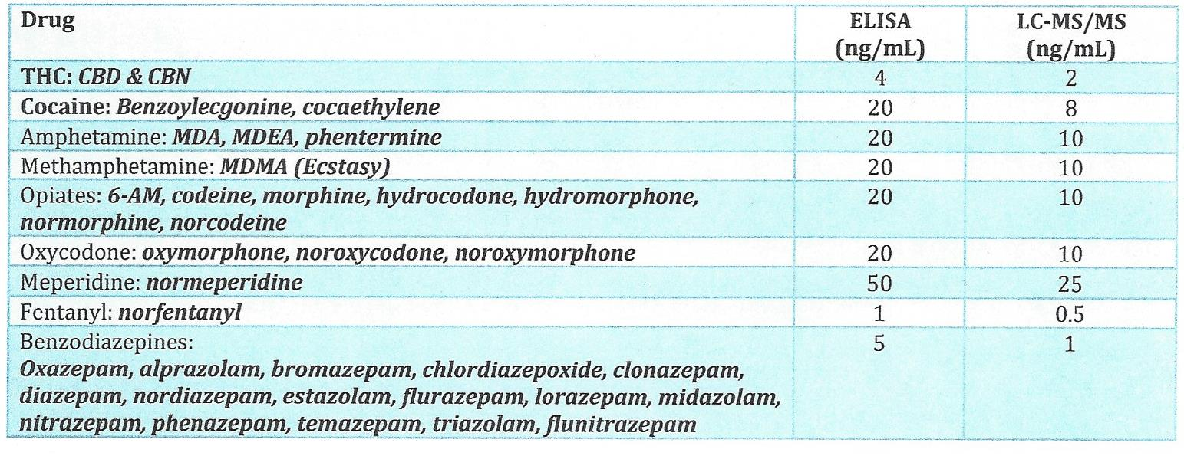

Slide 24
Drug Type According to Age
Age Group | Cannabis (%) | Stimulants (%) | Sedatives (%) | Opioids (%) | Poly Drug (%)
16 to 18 | 100 | 0 | 0 | 0 | 0
19 to 24 | 93.4 | 18.4 | 0 | 2.6 | 13.2
25 to 34 | 78.1 | 23.8 | 0 | 12.7 | 15.6
35 to 44 | 55.6 | 27.8 | 2.9 | 19.4 | 8.6
45 to 54 | 60.0 | 20.0 | 0 | 37.9 | 10.3
55+ | 30.0 | 33.3 | 11.1 | 33.3 | 10.4

