Slide 1
Nova Scotia
AIIP Outcome Evaluation
Marisela Mainegra Hing, Ph.D.
Research Scientist
26th CARSP Conference
Halifax, June 5-8, 2016

Slide 2
Overview
Objectives
Data Collection
Data Analysis Methods
Results
Conclusions
Recommendations

Slide 3
Objectives of the evaluation
Effectiveness of Nova Scotia's Alcohol Ignition Interlock Program (AIIP) in reducing drinking driving.
Potential improvements to the program.

Slide 4
Data collection: individual drivers
Experimental Group 1: Voluntary Interlock
Interlock device from March 2010 to December 2012.
Control Group 1: Voluntary no-Interlock
Declined to participate in AIIP. Registration from March 2010 to December 2012.
Vs.
Experimental Group 2: Mandatory Interlock
Interlock device from March 2010 to December 2012.
Control Group 2: Retrospective Control Group
Offense from March 2003 to December 2005.
Vs.

Slide 5
Data collection: monthly counts
Alcohol - charges: 1998-2013;
Alcohol - convictions: 1998-2013;
Alcohol - fatal and serious injury crashes: 1998-2011.

Slide 6
Data analysis methods
  Descriptive and survival analyses
  Individual data on convictions and crashes;
Interrupted time series analysis: S-ARIMAX
  Monthly counts of charges, convictions and crashes;
Descriptive and logistic regression analyses
  Individual data from interlock.

Slide 7
Descriptive analysis results: %
 | Tracking period: After | Interlock Mandatary | Interlock Voluntary | Control Voluntary | Significant (p-value)
alcohol-convictions | install/ inclusion | 3.02 | 0.94 | 8.93 | yes (<0.001)
 | removal | 3.73 | 1.89 |  | yes (<0.001)
alcohol-crashes | install/ inclusion | 0.83 | 0.62 | 1.57 | no (0.16)
 | removal | 1.86 | 0.63 |  | no (0.26)

Slide 8
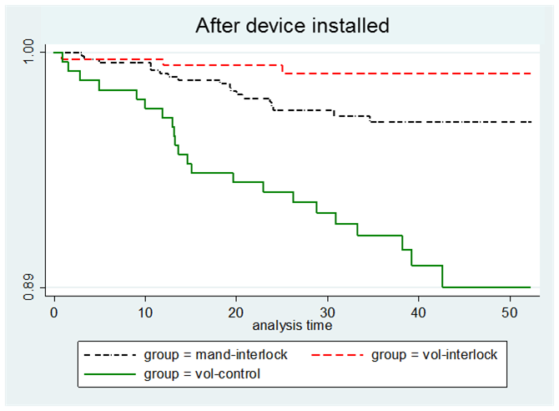

Slide 9
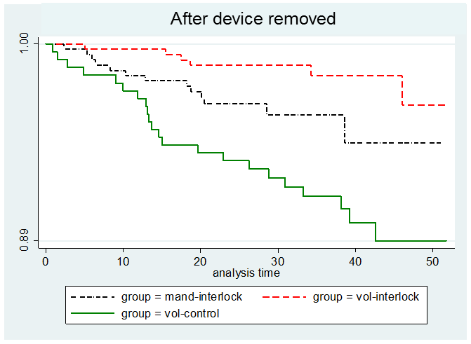

Slide 10
Cox regression
No significant differences: crashes;
No significant differences: voluntary /vs. mandatory interlock participants;
Interlock-voluntary /vs. control-voluntary
  control group: 10.5 times hazard rate for convictions after device installed;
  control group: 5.4 times hazard rate for convictions after device removed.

Slide 11
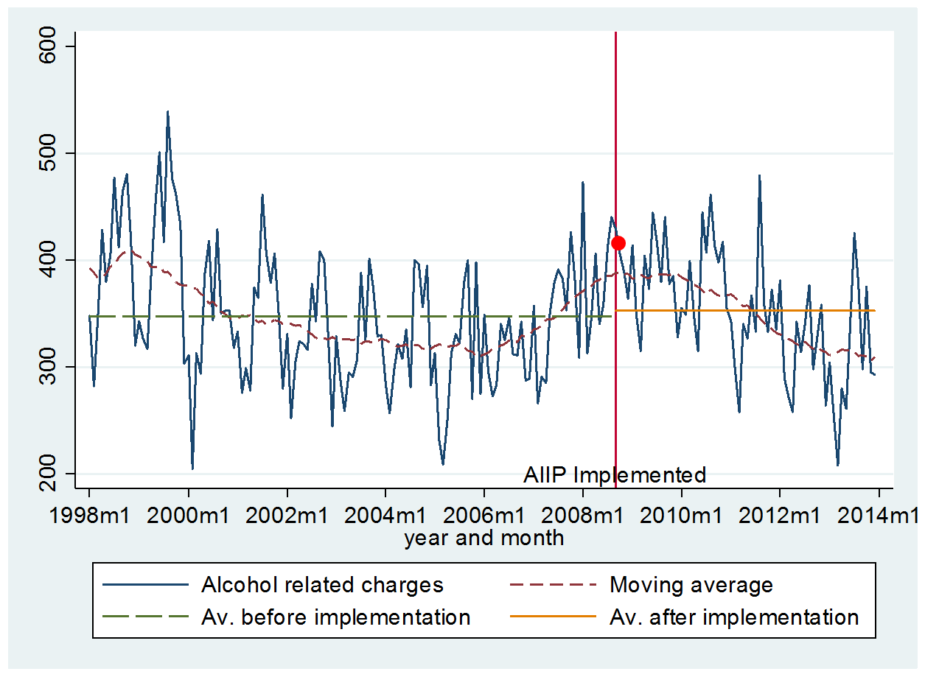
Charges: 13.32% significant temporary decrease

Slide 12
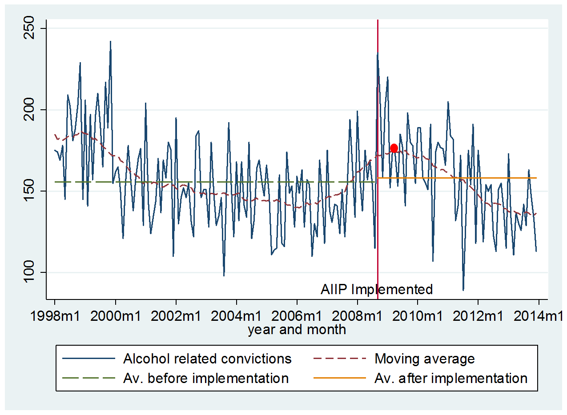
Convictions: 9.93% significant temporary decrease

Slide 13
Crashes: significant gradual permanent decrease

Slide 14
Interlock data analysis
Learning effect

Slide 15
Interlock data analysis

Slide 16
Interlock data analysis
odds of failing over the 0.02 limit:
  decreased 6% per month;
  larger (OR=1.3) for a mandatory /vs. voluntary participant;
  larger (OR=1.5) for participant with condition 37 /vs. participant without it;
  larger (OR=3.4) at start-up /vs. at running retests;
  decreased 3% per 1000 kilometers driven.

Slide 17
Conclusions
Specific deterrence: strong evidence of a reduction in recidivism rates due to interlock program (90% after device is installed and 79% after device is removed).
General deterrence: strong evidence of a permanent decrease in the number of alcohol-related crashes with fatal and serious injuries.
Learning curves: more violations at the beginning of program participation but over time these violations decreased;

Slide 18
Main recommendations
Continue the use of the interlock program.
  Reduction in recidivism rates (79%-90%) at the high end of the spectrum (35%-90%).
  Gradual permanent reduction in crashes.
  Use of performance-based exit in the interlock program.
  offender’s time extended until compliance with rules.
  Further strengthening of monitoring in the interlock program.
  mileage levels, face-to-face meetings at servicing, sufficiently high levels of traffic enforcement

Slide 19
Acknowledgements
Co-authors:
Ward Vanlaar
Robyn Robertson

Slide 20



Stay informed!
Connect with us!
http://www.tirf.ca
tirf@tirf.ca
https://www.facebook.com/tirfcanada
@tirfcanada
http://www.linkedin.com/company/
traffic-injury-research-foundation-tirf

