Slide 1

Lessons learned:
Results from a large-scale evaluation of drinking and driving countermeasures
Road Safety Research Office
Ministry of Transportation of Ontario
CARSP Conference 2016

Slide 2

Drinking and driving in Ontario
~1 in every 5 road users killed died from a drinking & driving collision.

Slide 3
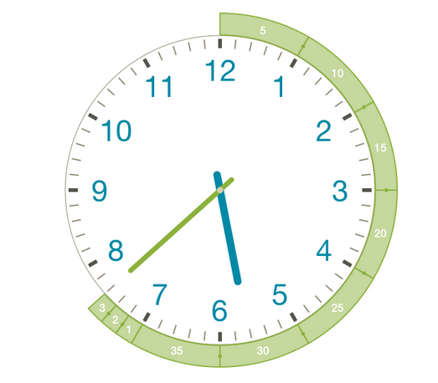
Drinking and driving in Ontario
Every 38 minutes, 1 person is detected at roadside for driving with an alcohol level above the legal limit*.

Slide 4
Drinking and driving in ontario
#1 risk factor for traffic fatalities
thankfully, D&D injuries and fatalities are declining

Slide 5
Ontario’s D&D Countermeasures: what are they?
Zero BAC (novice drivers)*
Zero BAC (novice drivers)*
90-Day License Suspension
Remedial Measures*
Long Term Vehicle Impoundment
Long Term Vehicle Impoundment
Ignition Interlock
Warn Range Sanctions
Zero BAC (young drivers)
Reduced Suspension Ignition Interlock Conduct Review
7-day Vehicle Impoundment
1995
2000
2005
2010

Slide 6
Ontario’s D&D Countermeasures: how ARE they intendED to work?
general population and special groups
sanctioning at multiple BAC levels
sanctions at roadside and post-conviction
both general and specific deterrence

Slide 7
Ontario’s D&D Countermeasures:
Do they work?
What is the effect on the # of drinking drivers ?
What is the effect on the # of D&D injuries and fatalities?

Slide 8
Overview of Methodology
Time Series Design
countermeasure

Slide 9


Overview of Methodology
Cohort Design
X
X
X
Time
X
X
X
X
Time
X = outcome

Slide 10
Lessons learned
one. Immediate and certain sanctions that target novel subgroups and/or circumstances are very effective.
Ex: Warn Range
Licence suspension
Monetary Penalty
Remedial
1st
3-day
$180 Administrative Monetary Penalty
BAC
0.05 - 0.08
2nd
7-day
alcohol education
alcohol treatment medical evaluation
3rd
30-day
6-month ignition interlock condition

Slide 11
Lessons learned
two. Increasing the severity of a sanction is effective at reducing recidivism through enhanced compliance.
Ex: 7-day Impoundment, on top of the 90-day ADLS
BAC > 0.08%
Seven-day roadside
vehicle impoundment
Refusal of screening
Payment of towing and storage by driver
Violation of ignition
interlock condition
Driving under HTA suspension
Notes:
.

Slide 12
Lessons learned
three. Program design features, such as incentivization, are effective tools for influencing behaviour.
Ex: Reduced Suspension Ignition Interlock Conduct Review
Stream A
3-month suspension
9-month interlock condition
Automatic removal of interlock condition unless performance failures within last 3 months
1st alcohol impaired driving conviction
6-month suspension
12-month interlock condition
Extension in 3-month intervals until no performance failures for 3 months
Stream B

Slide 13
Lessons learned
four. Countermeasures should be streamlined as much as possible to increase participant adherence.
Ex: Alcohol education and treatment
< 30 days
< 60 days
Convicted of criminal drinking and driving
Apply to the Remedial Measures program
Assessment
8h alcohol education
16h alcohol treatment
> 6 months
30-min follow-up phone interview
X
Must do all this within 1-year CCC driving prohibition
X
Convicted
Eligible to install II

Slide 14
Contributions of this work
  comprehensive contextual framework for future research
  strengths and weaknesses of each countermeasure
  lessons for countermeasure development

Slide 15
Strengthening our response
Fall 2016: implement new policy measures to further address D&D as well as driving after drug use
continue to work with provincial and regional road safety and injury prevention partners to raise public awareness

Slide 16
Acknowledgements
Ministry of Attorney General
Ontario Provincial Police
MADD Canada
Centre for Addiction and Mental Health
Traffic Injury Research Foundation
Sunnybrook Research Foundation

Slide 17
More Information
Tracey Ma
Team Lead, Special Projects
Road Safety Research Office
Ministry of Transportation
tracey.ma@ontario.ca

