Slide 1
Driver Behaviour in Response to Wildlife on the Road
Shawna Meister, MA
Traffic Injury Research Foundation
CARSP Conference
Halifax, Canada
June 5-8, 2016

Slide 2
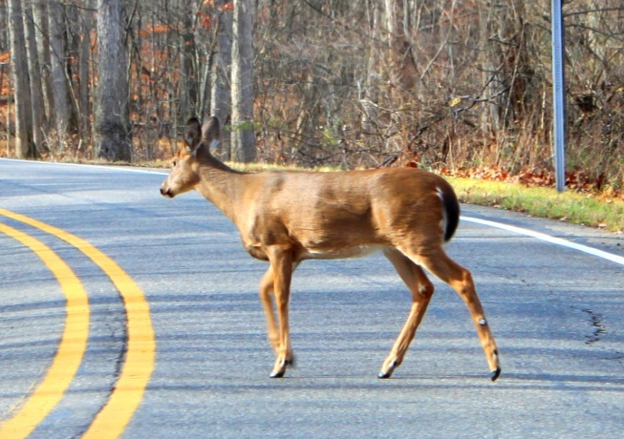
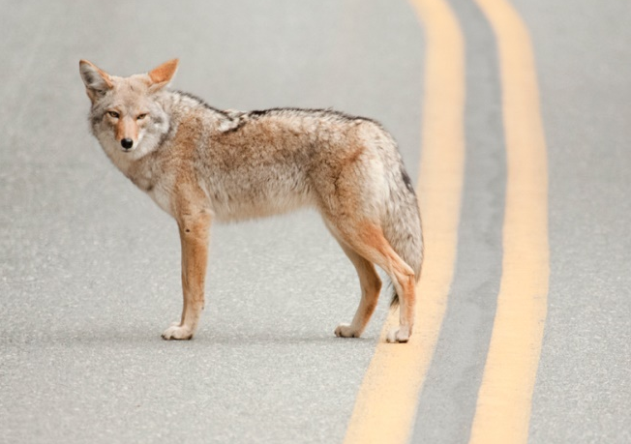
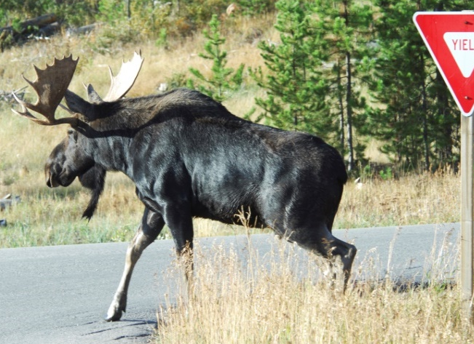
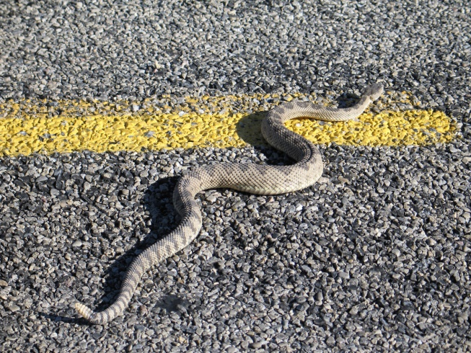
Do you know what to do?
Slow down, steer towards animal
Slow down, steer towards animal
Honk?
Swerve?
Brake hard?
Slow down, steer towards animal?
Hit animal?
Flash lights?
Deer
Deer
Fox
Fox
*Depends
on
Situation*
Slow down, steer towards animal
Moose
Snake
Moose
Snake

Slide 3
More collisions are caused by drivers swerving to avoid wildlife and instead losing control of the vehicle and/or hitting other road users or hazards!

Slide 4
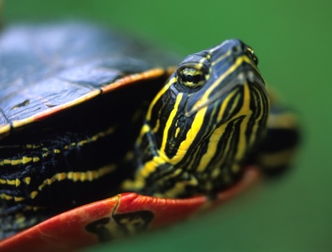
Overview
Background to survey.
Methodology.
Survey results.
Canadian context.
Driver knowledge.
Driver behaviour.
Moving forward.

Slide 5

Background to survey
Ongoing project on wildlife-vehicle collisions (WVCs).
Two goals:
Improve data.
Educate public.
Very little known about driver knowledge and behaviour in response to wildlife.

Slide 6
Methodology
TIRF’s Road Safety Monitor (RSM)
1,031 respondents across Canada.
Random, representative, stratified by region.
Males: 51.2%, females: 48.8%.
Age: 16-88.
Urban: 88.4%, rural: 11.6%.
95% CI, ±3.1%.
“Hit” or “Almost Hit” wildlife details.

Slide 7
Canadian context: Animal type
Percent of different types of animals hit or almost hit.

Slide 8
Canadian context: Light conditions
Percent of drivers who hit or almost hit wildlife
under different light conditions.

Slide 9
Canadian context: Season
Percent of drivers who hit or almost hit wildlife
during different seasons.

Slide 10
Driver knowledge
How drivers think they should respond to wildlife on the road.
✓
Difference
not significant
X

Slide 11
Driver behaviour
Self-reported driver responses to hitting or almost hitting wildlife on the road.
Difference
not significant
Difference is significant

Slide 12
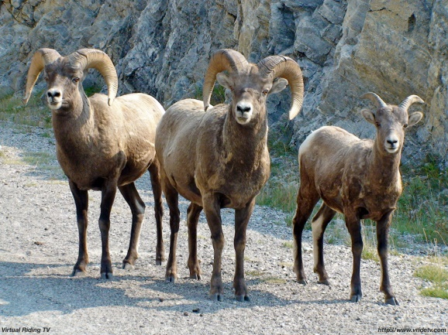
Characteristics of drivers
Drivers who hit or almost hit wildlife.
 | Odds of hitting wildlife | Odds of almost hitting wildlife
Lives in rural area | ⬆ 200.9% | ⬆ 123.4%
Every 500 km more driven | ⬆ 6.0%
Every 10 yr increase in age | ⬇ 19.7% | ⬇ 12.2%

Slide 13
Characteristics of drivers
Driver behavioural response.
 | Increased by
Odds of swerving | ⬆ 126.0% if male
Odds of swerving | ⬆ 296.9% if lived in urban area
Odds of braking hard | ⬆ 200.9% if lived in rural area
Driver knowledge …
Education should target everyone!

Slide 14

Moving forward
Summary:
Some differences to Canadian context.
Driver WVC knowledge low.
Driver behaviour is to swerve.
Education should target everyone.
Recommendations:
More research needed.
Wildlife Roadsharing Resource Centre (WRRC).
www.wildliferoadsharing.tirf.org

Slide 15



Stay informed! Connect with us!
http://www.tirf.ca
tirf@tirf.ca
https://www.facebook.com/tirfcanada
@tirfcanada
http://www.linkedin.com/company/
traffic-injury-research-foundation-tirf

