Slide 1
Training Novice Learners on Driving Simulators – Process and Outcomes
Pierro Hirsch
François Bellavance
26th Canadian Road Safety Professional Conference
June 8, 2016

Slide 2
Dr Pierro Hirsch
Research and Program Development
for
Virage Simulation

Slide 3
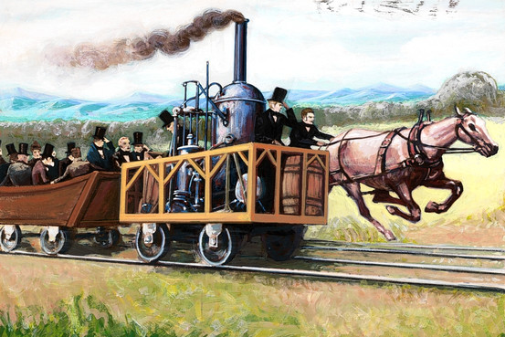
19th Century Technology
Horse-Drawn Cart
vs.
Steam Engine
The horse won
when the engine broke down.

Slide 4
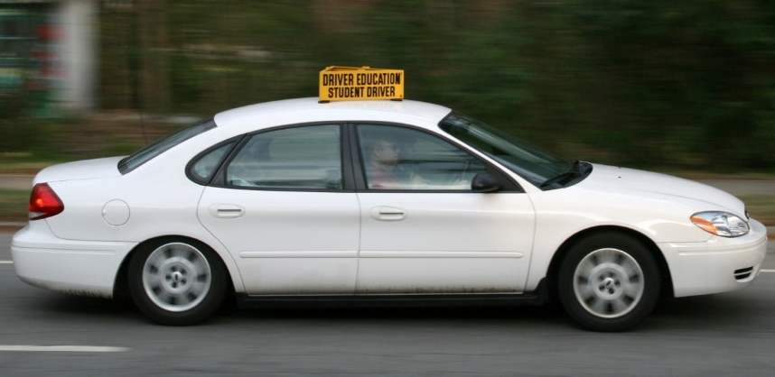
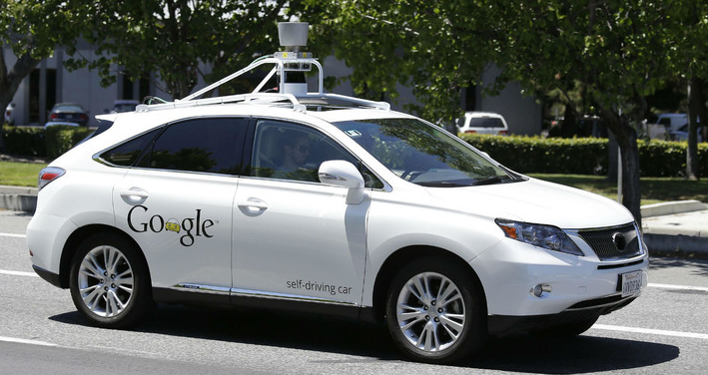
Driver Training VS. Drivers Unnecessary
21st Century Technology

Slide 5
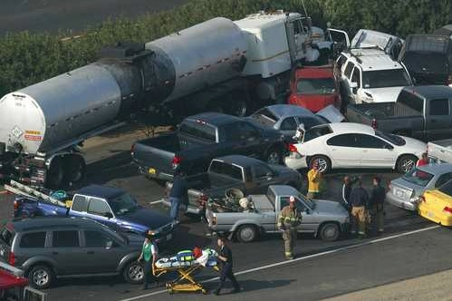
While we are waiting…
how do we improve driver training?
Apologies to Sam Beckett
Notes:
1. Do you believe that current training of novice drivers is adequate?

Slide 6
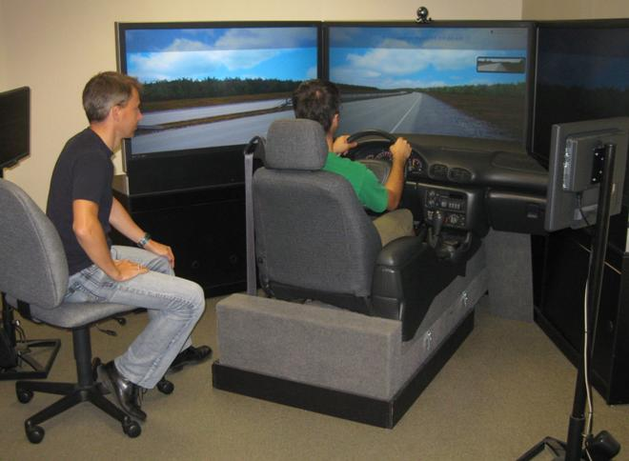
Simulator-based training is fully accepted by:
Driving Simulators?
Patrick and Philippe on Sim.jpg
Military
Law enforcement
Aviation
Medicine
Business
Notes:
2. At this moment, do you think that 50% of on-road lessons can be substituted with an equal number of hours of driving simulator lessons? Yes or No?
Your answer falls into one of three categories – for, against, of neutral. At the end of this presentation, I will ask you if you have changed your viewpoint.
Currently, the United States Department of Transportation Federal Motor Carrier Safety Administration is proposing national standards for mandatory hours of entry-level truck driver training and is not in favor of substituting driving simulation hours for some portion on-road hours.

Slide 7
Rationale for Driving Simulators
Practice any maneuver, any time, any place in a realistic and safe environment
Experience the virtual consequences of actions
Learn faster due to lower stress, better feedback and less wasted time
Control the pace of learning
Progress from easy to difficult - simple to complex

Slide 8
Rationale for Driving Simulators
View instant replays with different POVs
Deliberately practice to achieve correct automaticity
Receive reliable, objective performance scores
Improve hazard anticipation, perception and response skills

Slide 9
Evidence-Based Policy Change
Pilot Project to Validate the Transfer of Training (ToT)
of Driving Skills Learned on a High-Fidelity Driving Simulator to On-Road Driving
Permission to substitute one driving-simulator hour for one on-road hour for up to six of the 15-hours of the Québec mandatory curriculum effect January 2010

Slide 10
Acknowledgments
The SAAQ for financial support and invaluable assistance extracting data on exam performance and driving infractions and collisions.
The instructors and staff of the participating driving schools who embraced a new teaching technology and collected data for this study.

Slide 11
ToT Project – Three Questions

Slide 12
ToT Study PROCESS

Slide 13
Simulator Scenario Development
DESIGN - Scenarios to meet training goals
SEGMENT TASKS – Simple to complex, easy to difficult
FEEDBACK – Develop performance measurements
SUPPORT TRAINERS – With training and tools

Slide 14
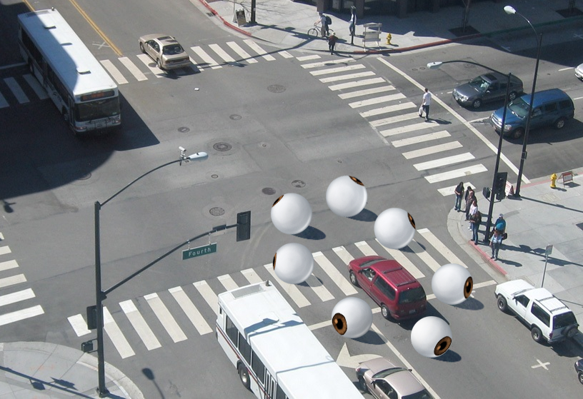
Training goal is learning:
Where
&
when to look
What to look for
How to interpret the information

Slide 15
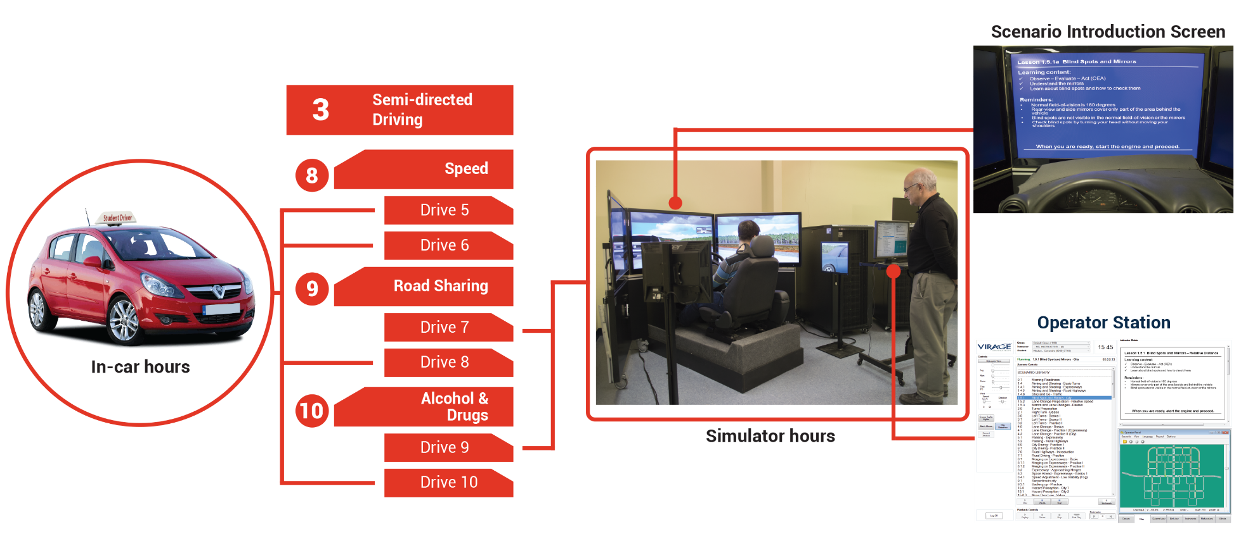
Integration in 15-hour Driving Course
One simulator hour = one in-car hour (maximum 6 hours of substitution)
Scenarios average 10 minutes each
Example

Slide 16
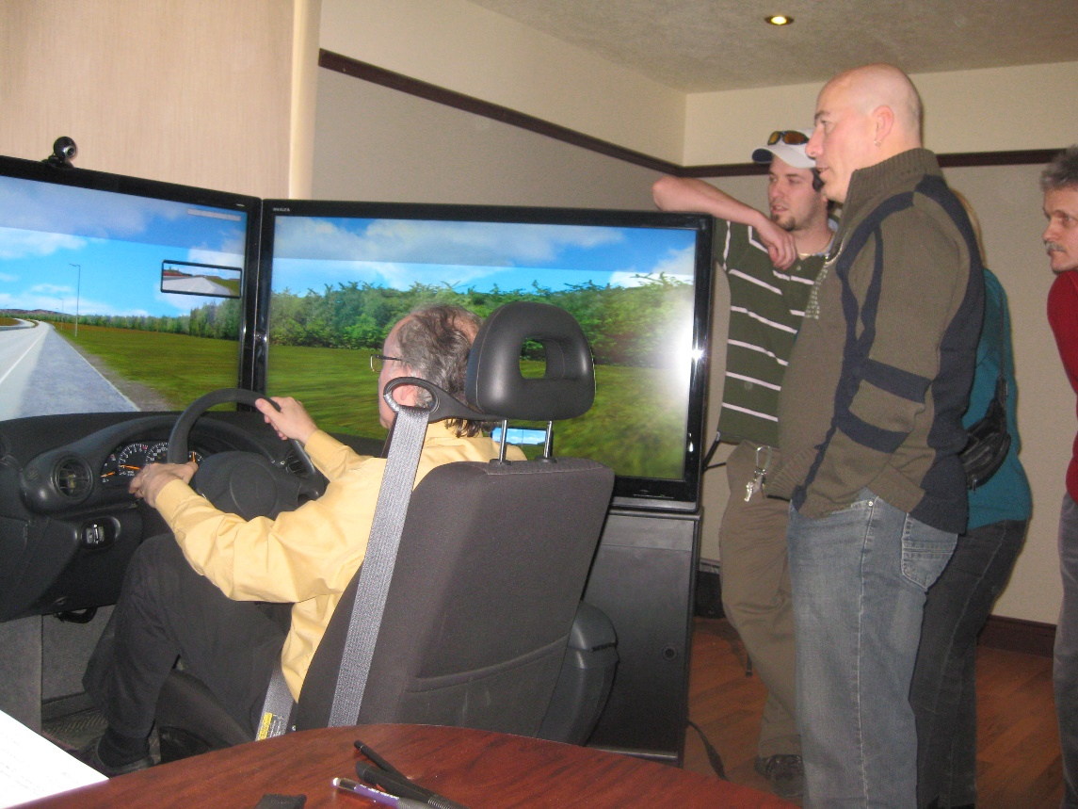
Train-the-Trainer
Teaching techniques applied to
driving simulator lessons:
Explanations
Demonstration
Questions (Socratic Method)
Commentary Driving
Illustrations
Segmentation
Plus Annual Workshops

Slide 17
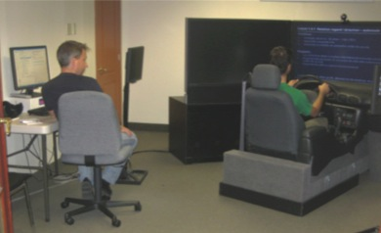
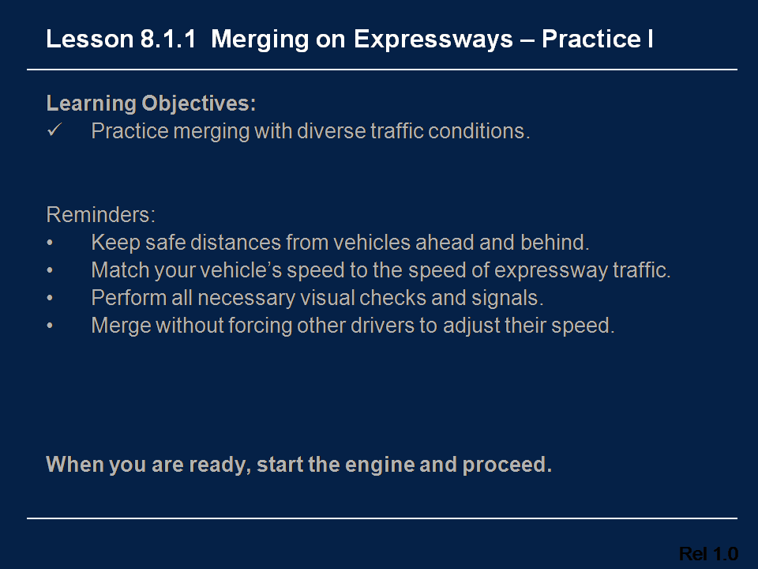
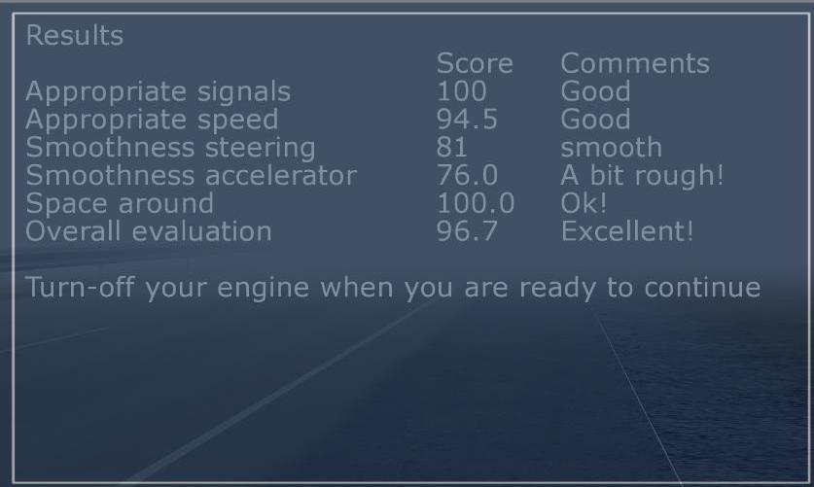
Support Learners
Lesson goals
Objective feedback

Slide 18
ToT STUDY

Slide 19
Study Sample & Comparison Group
Four driving schools around Quebec
Convenience sample of 2,187 learner drivers, average age 17.6 years, 53.8% female
In total, 95% of the study sample substituted between one and four on-road hours with driving simulator hours.
The age- and sex-matched comparison group was drawn from all new Quebec drivers

Slide 20
Learner Perceptions After 15 Lessons
Driving lessons were easy (n=618)

Slide 21
Learner Perceptions After 15 Lessons
Driving lessons were relaxing (n=618)

Slide 22
Learner Perceptions After 15 Lessons
Driving lessons were enjoyable (n=618)

Slide 23
Learner Perceptions After 15 Lessons
Driving lessons were stimulating (n=618)

Slide 24
Compared to 1 h On-Road, 1 h on Simulator was:

Slide 25
Road Test Pass Rates on 1st Attempt
Female: χ²(1)= 44.4, p < .0001; Male: χ²(1)= 37.7, p < .0001

Slide 26
Lower Infraction Rates - Females - Simulator Group
p-values for each solo driving period < 0.06 to < 0.0001

Slide 27
Lower Infraction Rates - Males - Simulator Group
p-values for each driving period after 1st six months between < 0.01 to < 0.0003

Slide 28
Higher Car Ownership - Males - Simulator Group
p-values for each solo driving period after 1st six months between < 0.01 to < 0.009

Slide 29
Male Crash Rates: Simulator vs. Comparison Group
Logistic regression for probability of at least one crash controlling for vehicle ownership
Notes:
Logistic regression for the probability of having at least one crash in each specified time period controlling for vehicle ownership

Slide 30
ToT Project – Outcomes

Slide 31
Follow-up question
Merci - Thank you
Full report available at:
https://www.cirrelt.ca/?Page=DocumentsRecherche2016
or
pierro.hirsch@viragesimulation.com
Notes:
As promised, I will ask you a follow-up question:
Have you changed your viewpoint about whether 50% of on-road lessons can be substituted with an equal number of hours of driving simulator lessons?
Currently, the US Department of Transportation Federal Motor Carrier Safety Administration (FMCSA) is proposing national standards for mandatory minimum hours of entry-level truck driver training that does not allow substituting driving simulation hours for some portion on-road hours. If you had any influence over such a decision regarding mandatory hours of driver training or retraining, would you accept the substitution?

Slide 32
Postscript on Technology & Science
Only in 1878 did photographs show us for certain that when a horse gallops, all four hoofs are off the ground at the same time.
Technology allows us to learn new things about familiar experiences.
Driving simulators will teach us more about driving than we could learn by human observation alone.
In 1830, no camera existed to photograph this event. Even the word “photograph” had not yet been coined.

