Slide 1

Learning to drive:
Does structured education make for safer drivers?
Road Safety Research Office
Ministry of Transportation of Ontario
CARSP Conference 2016

Slide 2

The Driving lifecycle
Collision
Risk
Younger
Older
In Between
Age

Slide 3
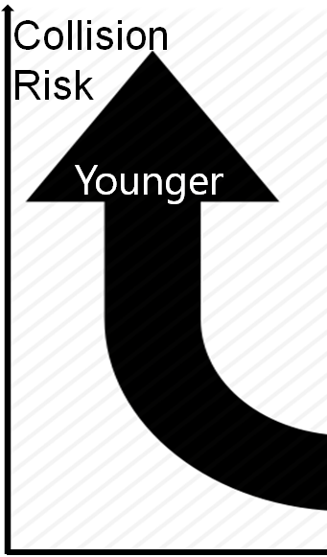

Slide 4
Increased risk explained by:
Driving inexperience & insufficient driving skills
Risk perception & propensity
Decision making & impulse control

Slide 5
Increased risk explained by:
Driving inexperience & insufficient driving skills
Risk perception & propensity
Decision making & impulse control

Slide 6
Graduated Licencing Systems
Increased risk explained by:
Driving inexperience & insufficient driving skills
Modifiable!

Slide 7
Increased risk explained by:
Driving inexperience & insufficient driving skills
Modifiable!
GLS allows gradual accumulation of on-road experience and driving skills under low-risk conditions.

Slide 8
Increased risk explained by:
Driving inexperience & insufficient driving skills
Modifiable!
Learner
Intermediate
Full Licensure
GLS allows gradual accumulation of on-road experience and driving skills under low-risk conditions.

Slide 9
GLS in Ontario
G1
G2
G
12m
12m
Modifiable!

Slide 10
G1
G2
G
12m
12m
G1
reduced by up to 4m if completed BDE
Modifiable!

Slide 11
G1
G2
G
12m
12m
G1
reduced by up to 4m if completed BDE
Modifiable!
BDE allows structured learning, intending for safer accumulation of skills and experience and safer “future” driving.

Slide 12
G1
G2
G
12m
12m
G1
reduced by up to 4m if completed BDE
Modifiable!
BDE allows structured learning, intending for safer accumulation of skills and experience and safer “future” driving.
Beginner Driver Education:
minimum 20h classroom hours
minimum 20h on-road driving training
flexible allocation of 10 instructional hours

Slide 13

Does BDE training lead to lower collisions?
We don’t know.
Mixed results in existing evidence base.
Comparing studies is difficult due to different programs, methods, and outcome definitions.
Modifiable!

Slide 14
There are other factors that independently relate to BDE status and collision risk.
Demographic and SES characteristics
Attitudes and behaviours
Driving exposure
Modifiable!

Slide 15
Driving exposure
Modifiable!

Slide 16
Ontario’s Evaluation
To determine if BDE status is related to collision and suspension risk, after accounting for driving exposure.
Driving exposure = opportunity to be in a crash
Common estimates rely on aggregate measures, i.e., licenced drivers, vehicles registered
Challenge: disaggregate measures for specific sub-groups
Modifiable!

Slide 17
N = 1,058,703
NO BDE
Modifiable!
BDE-TD
BDE-NTD
Obtained G1 between 2004 and 2013

Slide 18
N = 1,058,703
During G2:
Fatal and injury collision rates
Suspension rates
Adjusted by
vehicle kilometres travelled
NO BDE
Modifiable!
BDE-TD
BDE-NTD
Obtained G1 between 2004 and 2013

Slide 19
Estimates of VKT were derived from self-reported survey responses (Vanlaar et al., 2014).
kilometers driven a month
  less than 100km/month
  between 100-500 km/month
  between 501-1000 km/month
  more than 1000 km/month
exact number of kilometers driven a month
Modifiable!

Slide 20
G2 DRIVERS | DISTANCE DRIVEN, PER MONTH
category | BDE-TD | BDE-NTD | NO-BDE
< 100km | 39.4% | 46.0% | 38.8%
101-500km | 38.0% | 37.2% | 39.3%
501-1000km | 17.6% | 12.3% | 14.4%
>1000km | 5.0% | 4.6% | 7.5%
TOTAL | 100.0% | 100.0% | 100.0%
avg. dist. [km]
50 | 19.72 | 23.01 | 19.41
250 | 94.95 | 92.95 | 98.30
750 | 131.70 | 91.88 | 107.78
1500 | 75.48 | 68.30 | 112.25
TOTAL [km] | 321.85 | 276.13 | 337.73
RELATIVE RATIO | 1.17 | 1.00 | 1.22
Modifiable!

Slide 21
Collision RATE
Fatal and injury collisions during G2?
Modifiable!

Slide 22
Fatal and injury collisions during G2?
Adjusted by VKT.
Modifiable!

Slide 23
After adjusting for VKT, the collision rates of all groups become more similar to each other in all years of G2.
Let’s look at the risk of causing a collision for each group.
Modifiable!

Slide 24
Collision RISK
Risk of causing a collision during G2?
Relative Collision Involvement Risk
= at-fault crashes to not-at-fault crashes
Modifiable!
G2 | BDE_TD | BDE_NTD | NO_BDE
At Fault | 5,927 | 3,458 | 2,502
Not at Fault | 2,540 | 1,452 | 1,071
RATIO | 2.33 | 2.38 | 2.34
RR | 0.98 | 1.00 | 0.98

Slide 25
SUSPENSION RATE
Suspensions during G2?
Modifiable!

Slide 26
Suspensions during G2?
Adjusted for VKT.
Modifiable!

Slide 27
LIMITATIONS
Only accounted for driving exposure
Exposure estimates from self-report and from another study cohort
Need to make assumptions for at-fault status
No inferential analysis
Modifiable!

Slide 28
CONCLUSIONS
G1 is a protective stage where all drivers have decreased collision risk.
The transition between G1 and G2 is the riskiest time period for all young novice drivers.
BDE groups differ in their suspension rates.
Modifiable!

Slide 29
BDE groups also differ in their collision rates, but to a lesser extent, after adjustment.
BDE groups do not differ in their risk of causing a collision.
Modifiable!

Slide 30
Tracey Ma
Team Lead, Special Projects
Road Safety Research Office
Ministry of Transportation
tracey.ma@ontario.ca

