Slide 1


A new approach to evaluating roundabout safety Using conflicting volumes and Delay
Taha Saleem
Ryerson University, Department of Civil Engineering
Robert J. Henderson
Transportation Engineering, Region of Waterloo
Bhagwant Persaud
Ryerson University, Department of Civil Engineering
26th CARSP Conference, Halifax, June 5-8, 2016

Slide 2
Overview
Introduction
Data
Methodology
Crash Prediction Models
Conclusions.

Slide 3
Introduction - Background
1.2 million people die every year on the roads.
Over 50 million people suffer injuries due to road traffic crashes.
(World Health Organization, 2013)
In 2012, there were 2,700 deaths and over 10,000 serious injuries on Canadian roads.
(Transport Canada, 2013)
Can we reduce deaths and injuries with better engineering?

Slide 4
Introduction – Background
It is often assumed that roads built to standards were safe and that drivers, not roads, were the reason there are accidents.
However, meeting a standard does not suggest the relative safety that may be achieved by exceeding it.
Transportation agencies should seek methods to reduce crashes by:
  Minimizing potential for human error, and
  Providing a forgiving road environment.
  Transition from Standards to Guidelines

Slide 5
Introduction - Background
Roundabouts are constructed because of their safety and capacity benefits;
  Reduction in speeds through geometry,
  Yield to circulating flow upon entry, and
  Encourage slow and consistent speeds for all traffic.
Roundabouts are shown to reduce injury collisions by approximately 75% as compared to stop control or traffic signals.
(Synthesis of North American Roundabout Practice, TAC 2008)

Slide 6
Introduction - Objectives
To investigate the viability of roundabout crash prediction models based on;
  Estimated Total Peak Hour Conflicting Volumes, and
  Overall Roundabout Delay.
To evaluate the effectiveness of these models against the conventional models based on actual flow.

Slide 7
Data
Data for this study were provided by;
  Region of Waterloo’s Transportation Engineering Department,
  City of Ottawa’s Transportation Engineering Department, and
  Washington State Department of Transportation.
The overall data consisted of 19 multi-lane and 22 single-lane roundabouts.

Slide 8
Methodology
Total peak hour conflicting volumes were estimated by adding the conflicting volumes for each approach.
  Mutli Lane:
  Single Lane:
The overall roundabout delay was calculated using the Highway Capacity Manual methodology.
  Average delay/vehicle was multiplied by volume to get overall roundabout delay.
Circulating and Entry/Exit flows were also calculated using the Highway Capacity Manual methodologies.

Slide 9
Methodology - SPF
A safety performance function (SPF) produces a prediction of the number of expected crashes for a road unit.
  By crash type / severity
  For different combinations of roadway characteristics
The parameters are determined by GLM using a specification for a negative binomial error structure.

Slide 10
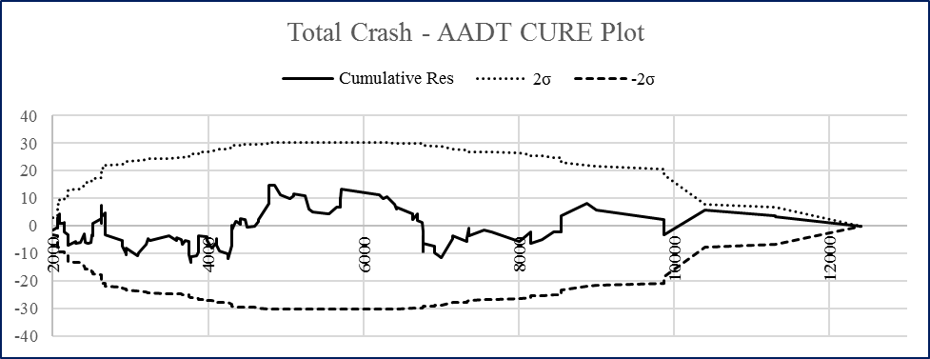
Methodology – Goodness of Fit
Over-Dispersion Parameter (k)
  Part of negative binomial error structure. The higher the better.
  Overdispersion of 0 means the model has converged to a Poisson distribution, where Mean=Variance.
Mean Absolute Deviation (MAD)
  Absolute value of sum of observed minus predicted crash frequencies.
Mean Prediction Error (MPE)
  Square root of the sum of squared differences between observed and predicted crash frequencies.
Cumulative Residual Plots (CURE Plots)
  A plot of cumulative difference between the observed and predicted crashes and any covariate in the model.
  A satisfactory CURE plot would do a “random walk” around the horizontal axis and stay within the 95% confidence boundaries.

Slide 11

Single-Lane Roundabout Models

Slide 12
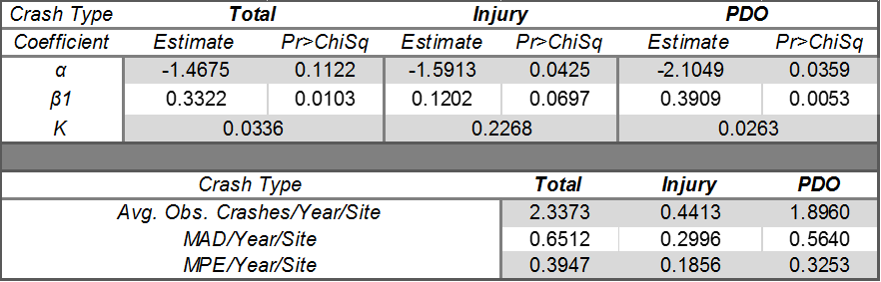
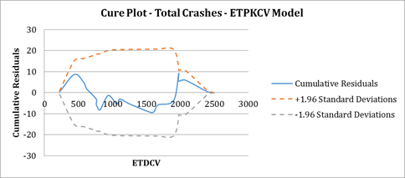
Crash – ETPKCV Models

Slide 13
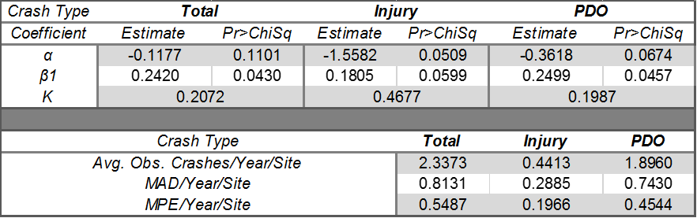
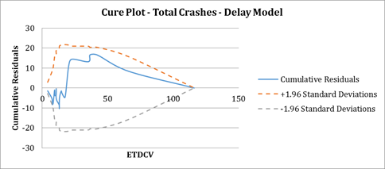
Crash – Delay Models

Slide 14
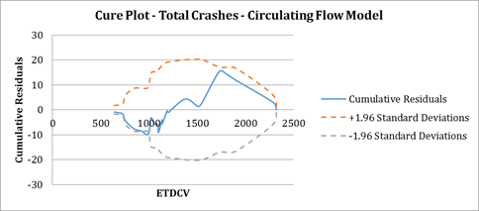
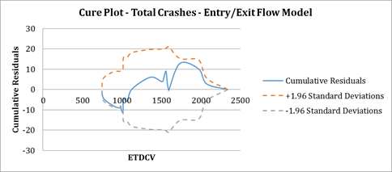
Crash – Flow Models

Slide 15
Multi-Lane Roundabout Models

Slide 16
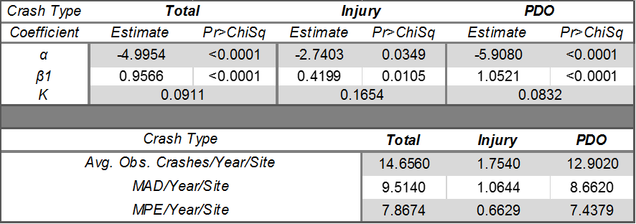
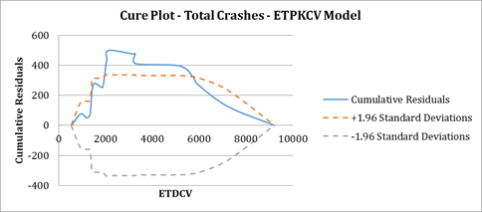
Crash – ETPKCV Models

Slide 17
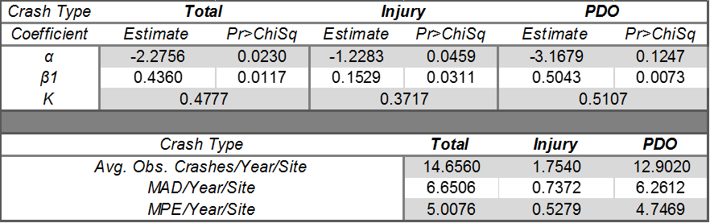
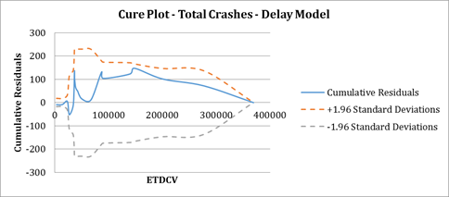
Crash – Delay Models

Slide 18
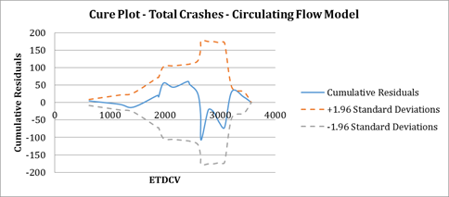
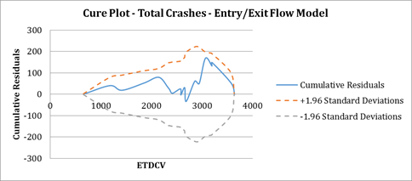
Crash – Flow Models

Slide 19
Comparative Evaluation

Slide 20
Comparative Evaluation
All models (both for single- and multi-lane roundabouts) predicts crashes very well.
  Coefficient estimates are highly significant in all cases as can be seen by p-values of <5%.
  MAD and MPE values are low when compared to the average observed crashes.
  The CURE plots show little or no bias in almost cases.
The coefficient estimates for both ETPKCV and delay are slightly smaller than those for circulating/entry exit flows.
  Models capture the effect of flows better than ETPKCV and delay.
The CURE plot for ETPKCV model (multi-lane) showed slight over prediction in certain ranges on conflicting volumes.
  Other measures (MAD, MPE, and k) do suggest of good fit.

Slide 21
Conclusions
All models show that ETPKCV and delay can predict the safety effects as well (if not better) than the traditional flow models.
A higher number of sites and data from only one jurisdiction might have yielded even better results.
To conclude it can be said;
  ETPKCV and delay based crash models provide a good alternative to the flow based models, and
  They can be used effectively to evaluate the safety of single- and multi-lane roundabouts comparably to the flow-based models.

