Slide 1
Occupational Road Safety:
The road from then to now and BC’s experience
Mark Ordeman
Manager Transportation and Road Safety
WorkSafeBC

Slide 2
Agenda
Brief historical review of road safety & occupational health & safety
Look at occupational road safety programs in UK, Europe, Australia & United States
See what’s happening in Canada
Discuss what we are doing in BC
Future activities & initiatives

Slide 3
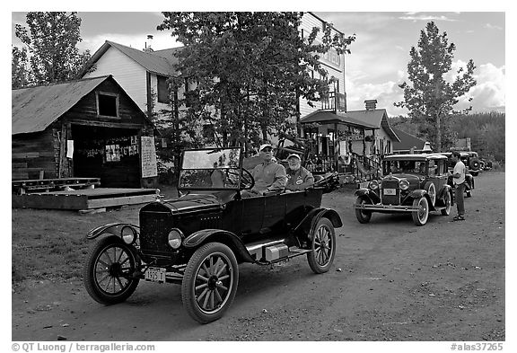
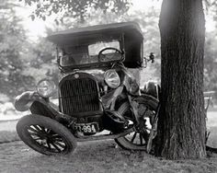
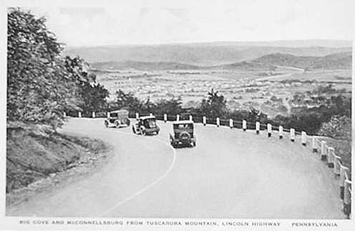

Brief history of road safety: 1900 – 1950’s
Rapid motorization
More crashes & safety issues
Safety is the driver’s responsibility – or is it? Accident proneness
Highway standards – as safe as
“should” be

Slide 4


Brief history of road safety: 1960’s to today
Vehicle safety
Dr. William Haddon – passed several vehicle safety regulations
Increased public awareness of automobile
industries knowing disregard for vehicle safety
(air bags, high-mounted rear brake lights) &
supported efforts of NHTSA.

Slide 5

Brief history of road safety: 1960’s to today
Road Safety Standards
Variables considered when developing standards changed to accommodate vehicle design & performance changes
Took into consideration limitations of drivers
Systems approach
Multi-disciplinary approach considering the driver,
vehicle & road elements
Removes blame from the equation

Slide 6
Road safety today
Widely accepted that crashes are preventable
Many countries have developed national road safety plans & include targets to reduce crash fatalities
Under these plans responsibility falls to:
Governments to provide safe road systems
Motor vehicle industry to provide safe vehicles
Drivers to behave in a safe manner

Slide 7
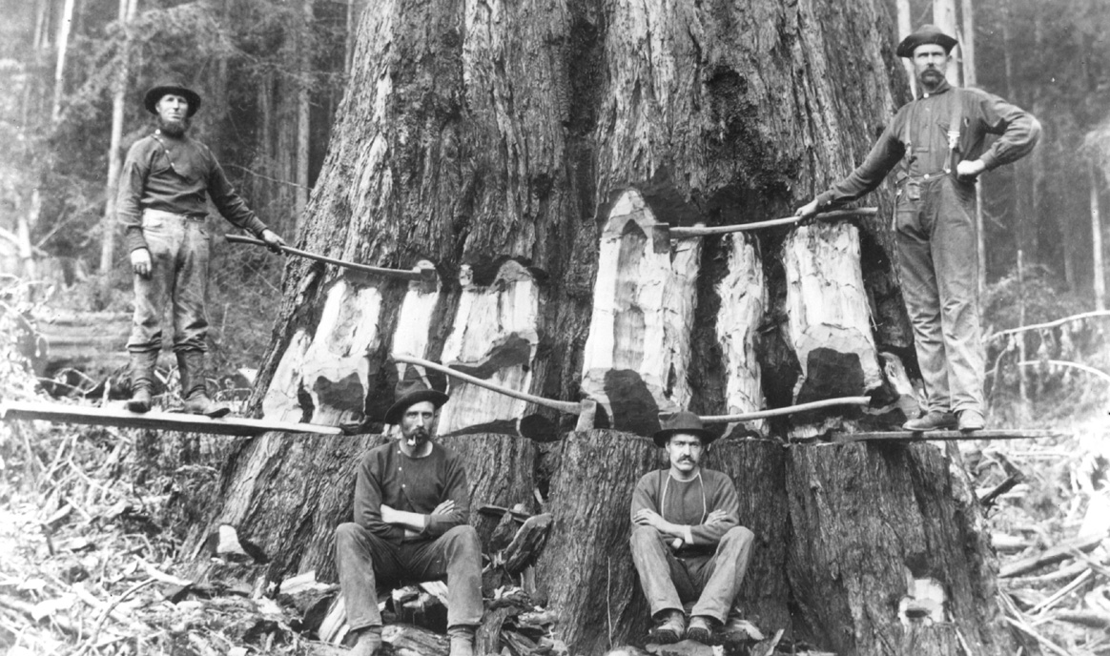
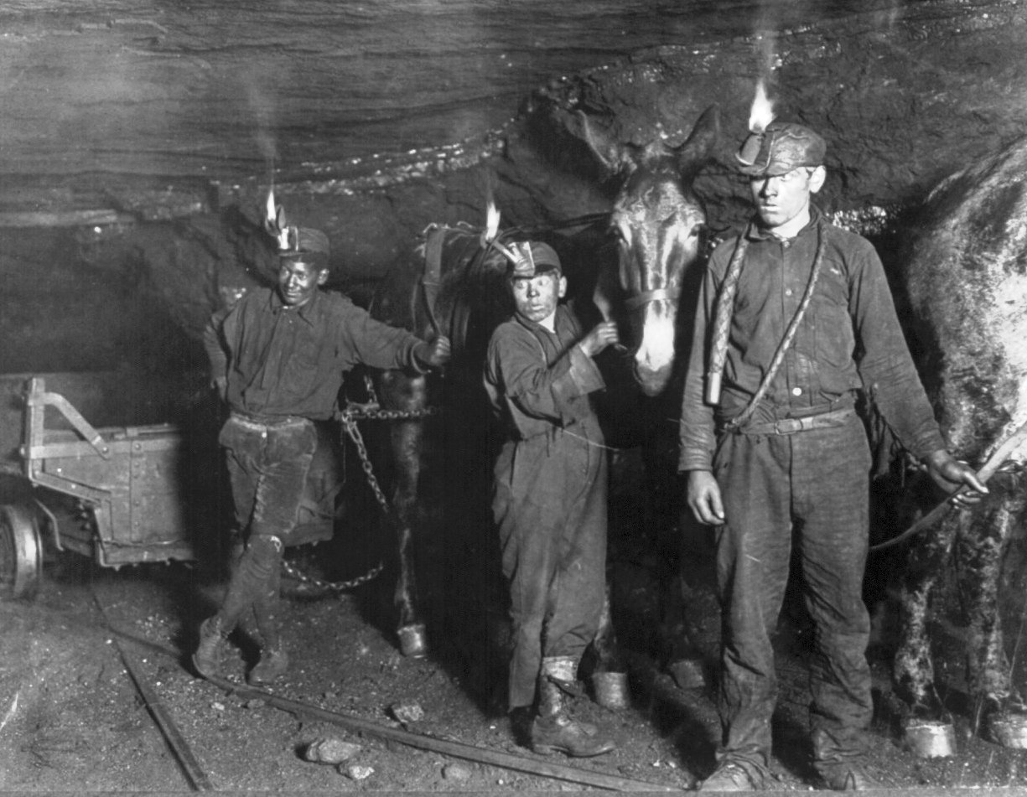
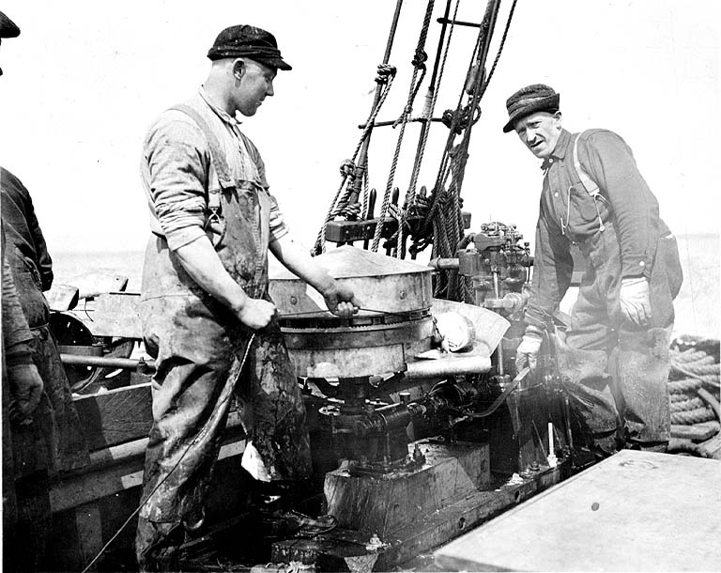
Occupational health & safety: the beginning
Forestry
Dangerous working conditions
No social net for injured workers
& widows often left destitute
Workers could sue employers but
not without consequences
Mining
Fishing

Slide 8
Occupational health & safety: late 1800’s – early 1900s
Starting in 1884 with Germany, industrialized countries introduced laws to support compulsory state-run compensation systems paid by employers & sometimes workers.
Benefits:
Workers guaranteed medical care & wage replacement benefits for work-related injuries
Employers protected from lawsuits by employees
Safety responsibilities defined for employers & workers

Slide 9
Occupational health & safety: the early years
Similar to the early days of road safety, occupational safety professionals thought:
Workplace incidents inevitable, referred to as accidents
Workplace safety primarily the responsibility of the worker –
to be safe, all workers had to do was work safe.
By the 1960s / 1970s occupational safety professionals shifted from a “worker centered” to a systems approach -
workplace safety dependent on interactions between the worker, environment & equipment.

Slide 10

Occupational health & safety: driving for work
It wasn’t until the late 1980s / 1990s that occupational safety professionals started to recognize driving for work as a significant occupational hazard.
Why so late
Occupational safety regulations do not specifically address road safety
Vehicles were not recognized a workplace
Other regulatory bodies address vehicle safety & driver performance
Work-related crashes are the leading cause of traumatic workplace death in industrialized countries.

Slide 11




Occupational road safety: United Kingdom
Primary agency dealing with occupational road safety
Creates & enforces OHS regulation
In 2000, a review concluded OHS regulation should apply to vehicles used for work purposes
Alliance of over 150 organizations
Website provides information on road safety laws & regulations, OHS resources, injury crash data, case studies

Slide 12
Occupational road safety: United Kingdom
Key Occupational Road Safety Activities
1996/7: ROSPA published Management of occupational road risk (MORR), & in 1999 introduced MORR course for fleet managers
2000: Work-related Road Safety Task Group, key recommendations include OHS regulations apply to “on the road” work activities; police accident report to include purpose of journey
2003: HSE produced first resource on occupational road safety - Driving for Work: Managing work-related road safety
HSE does not collect work-related crash data, however available data indicates that on average each year 88 workers are killed in work-related MVIs. (Source: Department of Transport 2015)

Slide 13



Occupational road safety: European Union
Sets minimum standards for OHS that EU
members implement through national legislation
Provides OHS tools & resources for employers /
workers
Mandate to find & promote ways to reduce deaths
and injuries caused by crashes

Slide 14


Occupational road safety: European Union
Key Occupational Road Safety Activities
PRAISE began in 2009 as a 3-year initiative to advance occupational road safety standards in EU member states & advocate for occupational road safety at the EU level
Provides resources for employers to implement or improve their occupational road safety program

Slide 15




Occupational road safety: Australia
Independent administer of national laws for heavy vehicles over 4.5 tons
Health & safety agency that works with all states
& territories to develop national OHS policy &
strategies
Network of Australian organizations that provides
resources & networking opportunities for
businesses to improve their occupational road
safety program

Slide 16
Occupational road safety: Australia
Key Occupational Road Safety Activities
2012: Australian Work Health & Safety Strategy 2012 – 2022 identified freight transport as a top national priority
2013: Heavy Vehicle National Law – first law to hold shippers & receivers responsible for driver safety
2014: National Road Safety Partnership Program – resources based on the safe systems approach to road safety

Slide 17




Occupational road safety: United States
Creates & enforces large truck & bus regulations
Sets & enforces OHS regulations
Provides training, education & compliance assistance
Funds & conducts research on OHS
Works closely with OSHA on creating OHS standards
to protect workers from occupational hazards

Slide 18
Occupational road safety: United States
Key Occupational Road Safety Activities
2006: OSHA developed employer guidelines on driver safety
2006: NIOSH initiated the Global Road Safety for Workers Project
2009: NIOSH hosted the international conference Road Safety at Work
2010: NIOSH established the Centre for Motor Vehicle Safety to provide research based guidance to prevent work-related crashes
MVIs are the leading cause of workplace death in the US, accounting for 35%
of all work-related fatalities. In 2014, over 1700 workers were killed in MVIs.
(Source: Bureau of Labour Statistics)

Slide 19


Occupational road safety: Canada
Commercial Trucking
Provides oversight of the National Safety Code & publishes traffic collision stats
Members are elected from provincial, territorial & federal governments
16 standards that define minimum safety requirements that provinces / territories adopt & enforce through provincial & territorial laws
Applies to vehicles weighing more than 5,000 kg & buses & taxis
National Safety Code

Slide 20
Occupational road safety: Canada
Occupational Health & Safety
Canada Labour Code Part II
OHS regulation for federally regulated workplaces
Provincial OHS
Regulation
Each province / territory sets its own regulation
Different workplace coverage – jurisdiction & benefits
On average each year, 140 Canadian workers are killed & another 7600 injured & missed time from work as a result of work-related MVIs. (Source: AWCBC 2016)

Slide 21
Occupational road safety: Canada
Occupational Road Safety Activities
Alberta:
2011 published Driving for Work: Developing Safe Practices for Employers & Workers to provide guidance on occupational road safety
Manitoba:
RPM Trucking Safety Program – provides OHS resources for the transportation industry
Ontario:
Infrastructure Health & Safety Association – provides OHS resources for the transportation industry
Fleet Safety Council – association of driver trainers & safety professionals who provide resources for employers & workers

Slide 22
Occupational road safety: British Columbia
In BC, MVIs are the leading cause of traumatic workplace deaths, accounting for 37% of all traumatic work-related fatalities.
On average each year:
24 workers are killed
1240 time loss claims
Average cost $51,000
Average duration 19 weeks
In 2014 WorkSafeBC paid more
than $61 million in claims costs
for work-related MVIs.

Slide 23



Occupational road safety: British Columbia
Fleet Safety
Website: OHS tools, resources & online courses for employers, supervisor & workers
Advisory services & workshops for employers, supervisors & workers
Annual Road Safety at Work Week campaign

Slide 24

Occupational road safety: British Columbia
Winter Driving Safety
Winter Driving Safety Alliance
Annual Shift into Winter campaign
Resources for employers, supervisors & drivers
In BC, the average number of crashes in which someone is killed or injured nearly doubles from 114 in October to 222 in December. (Source: ICBC Police Reported Data)

Slide 25

Occupational road safety: British Columbia
Care Around Roadside Workers
Work Zone Safety Alliance
Annual Cone Zone campaign
Resources for employers, supervisors & workers
Since 2006, 14 roadside workers killed & another 226 injured and missed time from work by motor vehicles. (Source: WorkSafeBC)

Slide 26


Occupational road safety:: British Columbia
Trucking Safety Council of BC
Website: OHS tools & resources for employers, supervisors & drivers in trucking, transportation, warehousing, shipping & logistics
Workshops & advisory services for
employers

Slide 27
Occupational road safety: What’s next?
Promote revisions of occupational health & safety legislation to address occupational driving
Increase employer awareness of their legal responsibility for worker safety when driving for work
Improve understanding of root causes of work-related crashes
And in BC, continue support of occupational road safety programs

Slide 28
Occupational road safety:
Questions?

