Slide 1

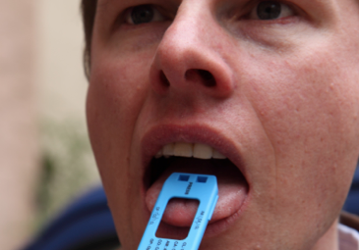
Point of Contact
Oral Fluid Screening Devices
Doug Beirness
D’Arcy Smith
CSFS Drugs and Driving Committee
Powerpoint Templates

Slide 2
Oral Fluid Project
Drugs and Driving Committee
Drugs and Driving Committee is structured under the Canadian Society of Forensic Science to provide advice to the Department of Justice on matters relating to drug impaired driving
Asked to investigate feasibility of point of contact oral fluid testing
Project scope defined while waiting for funding
Ministry of Transportation Ontario and RCMP stepped up to the plate
Project started the beginning of 2014 with instrument purchase and contract with an independent laboratory for analysis of field collected oral fluid samples

Slide 3
Purpose
Test a small number of most promising oral fluid drug screening devices to determine their adequacy for potential use in the enforcement of drug-impaired driving in Canada
Develop standards for devices that manufacturers must meet to be able to sell their device in Canada
NOT a test of specific devices
7

Slide 4
DEVICES SELECTED
Alere DDS 2
Dräger DrugTest 5000
Securetec DrugWipe 6S
4
Notes:
4

Slide 5
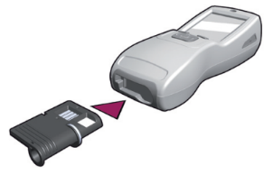
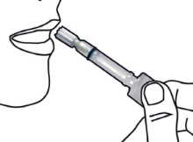
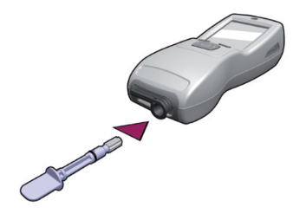
DRUG SCREENING DEVICES
Alere DDS 2
A: Insert test cartridge
  into analyser
B: Collect oral fluid sample
C: Insert collection device into
  test cartridge
5
Notes:
5

Slide 6
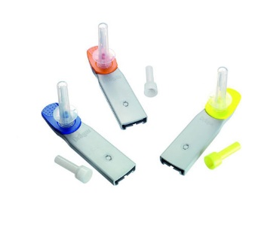
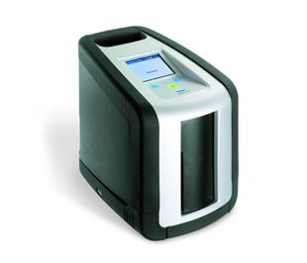
DRUG SCREENING DEVICES
Dräger DrugTest 5000
A: Test Kit: a ready-to-use test cassette with a built-in sample collector and volume adequacy indicator.
B: Analyzer: a rechargeable, fully automated analyzer providing controlled accurate analysis on site
6
Notes:
6

Slide 7
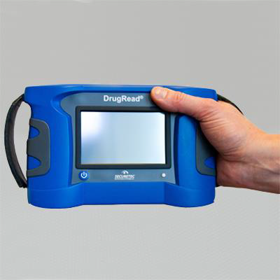
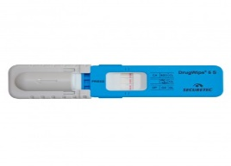
DRUG SCREENING DEVICES
Securetec DrugWipe 6S
A: Separate two parts of tester
B: Swipe down the tongue
C: Re-connect two parts
D: Insert into reader
7
Notes:
7

Slide 8
Field Oral Fluid Collection
Required samples from a group of people who had been using drugs
Attended DRE certification sessions in Phoenix and Jacksonville to collect samples from volunteers
646 samples collected
Samples tested on site with one of the three devices
A second sample was collected and sent to lab for confirmatory analysis

Slide 9
Field Oral Fluid Collection
Drugs tested for:
  Cannabis (THC)
  Cocaine (benzoylecgonine)
  Amphetamine
  Methamphetamine
  Opioids
  Benzodiazepines

Slide 10
Test Results and Performance Measures
 | OF Laboratory Result
OF Screen | Negative | Positive | Total
Negative | True Negatives (TN) | False Negatives (FN) | TN + FN
Positive | False Positives (FP) | True Positives (TP) | FP + TP
Total | TN + FP | FN +TP | TOTAL

Slide 11
Performance Measures
Sensitivity: The ability of the screening device to detect a drug if it
is present
Specificity: The ability of the screening device will find no drugs if
indeed there are no drugs present
Miss Rate: The extent to which the screening device will fail to
detect a drug that is present
False Alarm Rate: the extent to which the screening device will
indicate a drug when no drug is present
Positive Detection Rate: The proportion of times the screening
device correctly identifies drug presence
Accuracy: The proportion of times the screening device correctly
identifies the presence or absence of the drug

Slide 12
Performance Measures
Sensitivity: The ability of the screening device to detect a drug if it
is present
Specificity: The ability of the screening device will find no drugs if
indeed there are no drugs present
Miss Rate: The extent to which the screening device will fail to
detect a drug that is present
False Alarm Rate: the extent to which the screening device will
indicate a drug when no drug is present
Positive Detection Rate: The proportion of times the screening
device correctly identifies drug presence
Accuracy: The proportion of times the screening device correctly
identifies the presence or absence of the drug

Slide 13
Performance Measures
 | Sensitivity | Specificity | Miss Rate | False Alarm Rate
All Drugs & Devices | .874 | .932 | .126 | .068
THC | .869 | .955 | .131 | .045
Cocaine | .846 | .993 | .154 | .007
Amphetamine | .771 | .964 | .229 | .036
Meth | .840 | .965 | .160 | .035
Opioids | .899 | .931 | .101 | .069
Benzo | .592 | .976 | .408 | .024

Slide 14
STANDARDS
Provide clear direction as to what will be required of devices
Standards are in development
Process will be resource intensive:
  Time
  Money
Devices must meet standards before use

Slide 15
Points to Remember
Only screen for a small number of drugs
‘Miss rate’ & ‘False Alarm rate’ need to be examined carefully
Not evidential -- another sample submitted to a Forensic Laboratory
Not impairment detectors
Do not remove the need for the Drug Recognition Experts
Oral fluid testing is a tool, not the solution

Slide 16
Future Steps
Phase II
OF screening devices put into the hands of selected police agencies to gain their feedback on ease of use, durability, acceptance

