Slide 1

Detecting Drug Impaired Drivers
Constable Mark Skinner
RCMP Traffic Services
Provincial DECP Coordinator H Division

Slide 2
Detecting Drug Impaired Drivers
Standardized Field Sobriety Tests
Horizontal Gaze Nystagmus
Walk and Turn
One Leg Stand
Next Step if required: DRE trained police officer for a drug influence evaluation

Slide 4
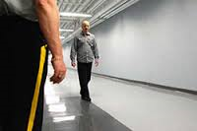
DRE Overview
The DRE Program was developed by the LAPD in the early 1970’s
Used SFST’s in conjunction with accepted medical knowledge to devise a systematic and standardized procedure to determine what category of drug the person was using or if it was a medical condition

Slide 5
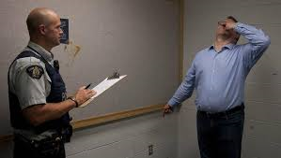
DRE Overview
Bill C-2 was adopted into the Criminal Code of Canada July 2, 2008, allows police officers to conduct SFST and DRE tests
Administered by IACP
Notes:
Check to make sure everyone has the current demand card please!

Slide 6
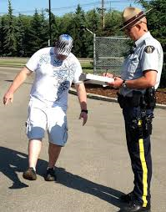
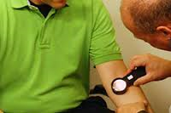
DRE Overview
DRE Program is being used throughout Canada and US, over 7300 active DRE’s with approx 600 in Canada
Nova Scotia has about 65 police officers with DRE training

Slide 7
Why do we need DREs?
Currently no established per-se limits for drugs
Currently no instrument capable of detecting combination drug effects
Legislation requires a DRE
Availability of access to drugs
Shift in youth attitudes and perception to drug use and impaired driving
Shift in Canadian values/perception of drug use

Slide 8
DRE 12 Steps
Breath test
Interview of arresting officer
Preliminary examination and first pulse
Eye examination
Divided attention tests
Vital signs

Slide 9
DRE 12 Steps
Dark room examination
Muscle tone
Injection sites
Interview, statements, observations
Opinion of DRE
Toxicological Sample

Slide 11
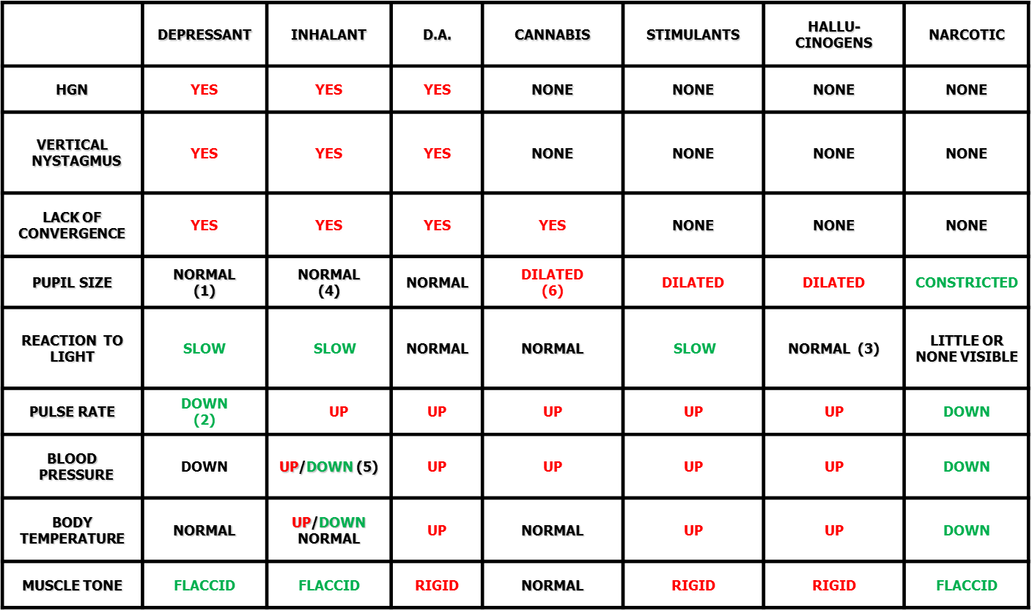
DRE Matrix

Slide 12
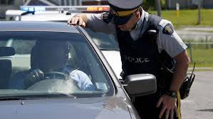
DRE Usage in Nova Scotia
32 Evaluations in 2016 (YTD)
22 Charges Laid (YTD)
185 Evaluations in 2015
101 Charges Laid
173 Evaluations in 2014
110 Charges Laid
84 Evaluations in 2013
64 Charges Laid

Slide 13

DRE Usage in Nova Scotia
R. vs. MacDonald – Port Hawkesbury 2011
Cannabis impaired driving
R. vs. Fogarty – Antigonish 2013
Double fatality in Tracadie
First drug double fatality in Canada, impaired by drugs causing death

Slide 14
Drugs Categories - NS Drug Impaired Drivers
2012 - 2015

Slide 15
Gender of NS Drug Impaired Drivers
2013 - 2015

Slide 16
Ages of NS Drug Impaired Drivers

Slide 17
Questions?
Constable Mark Skinner
mark.skinner@rcmp-grc.gc.ca
902-720-5578

