Slide 1

Human Factors
& Applied Statistics Lab
Technology & Distracted Driving
Birsen Donmez
Associate Professor, University of Toronto
Canada Research Chair in Human Factors and Transportation
^{June, 2016}

Slide 2
Prevalence
  Distraction affected (subset of inattention):
  10% of fatalities (3,154) and 18% of injuries (424,000) in 2013 (NHTSA 2015)
  1.4% of fatalities associated with cell phones
Observable distraction 51% of baselines (Dingus et al 2016)
  Tech-distractions in ~10% of baselines
  %15 interaction with adult/teen passenger
Notes:
3500 drivers over 3-year data collection period
Age 16-98 with 25 and younger and 65 and over overrepresented
To date 1500 crashes have been identified but stats here from 905 injury +property damage crashes that have been analyzed
41% of drivers self-report to talking on cell phones (Tison, Chaudhary, Cosgrove 2011)
14% to texting, 8% to using a navigation system (Schroeder et al. 2013).

Slide 3
Visual-manual most detrimental – use voice interface
Observable distraction* | OR (p<.05) | Baseline prevalence %
In-vehicle device total | 2.5 | 3.53
Radio | 1.9 | 2.21
Climate control | 2.3 | 0.56
Other | 4.6 | 0.83
Cell total (handheld) | 3.6 | 6.40
Browse | 2.7 | 0.73
Dial | 12.2 | 0.14
Reach | 4.8 | 0.58
Text | 6.1 | 1.91
Talk | 2.2 | 3.24
Reading/writing (includes tablet) | 9.9 | 0.09
*From 6-second pre-crash and baseline sample video segments; Dingus et al 2016
Notes:
Case – cohort approach with potentially repeated measures from a single driver
Passengers is at 1.9 with overlapping confidence bands.
Browse: e.g., reading email or checking stocks
Other (e.g., touchscreen menus)
Off-road eye glances > 2 s double a driver’s near-crash / crash risk (Klauer et al 2006)

Slide 4
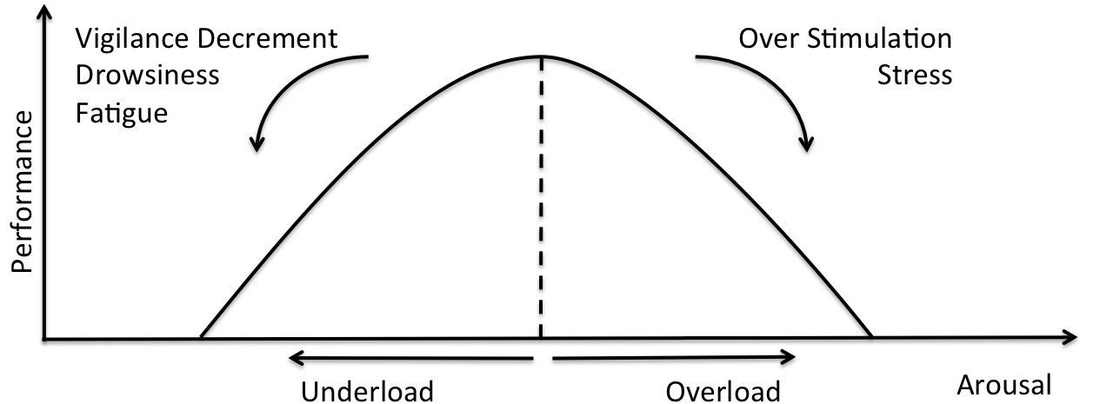
How common is model driving?
“The risks associated with all contributing factors were then evaluated through a comparison with alert, attentive, and sober driving episodes (operationally defined herein as “model” driving).”
Notes:
They pulled the controls (or baselines) from 19732 epochs. 88% of the crash epochs had at least one error, impairment or distraction. But we do not know what this value is for the baseline data.
Short glance with a rapidly changing environment is an issue
41% of drivers self-report to talking on cell phones (Tison, Chaudhary, Cosgrove 2011)
14% to texting, 8% to using a navigation system (Schroeder et al. 2013).

Slide 5
Why distraction happens
Automaticity (lane keeping, car following, vision to action; not pedestrian detection)
  Allows for parallel processing
Under arousal
  Drivers seek out stimulation when driving demands are low (Shinar 2008)
Continual visual attention and intermittent manual input
  Single channel processing
  Instrument panel check
  Expectancy, uncertainty
Notes:
Automaticity for lane keeping and car following as well as perception to direct action events (e.g., optical looming and brake response)
Hazard detection (e.g., pedestrians) is not automatic as there is enough variability in how these events materialize
Driving is an automaticity
Short glance with a rapidly changing environment is an issue
41% of drivers self-report to talking on cell phones (Tison, Chaudhary, Cosgrove 2011)
14% to texting, 8% to using a navigation system (Schroeder et al. 2013).

Slide 6
Last glance; tech can mitigate
People adjust their distraction engagement based on driving demands
  Closure rate rather than distance
Last off-road glance at event onset best predictor (Victor et al 2014, Liang et al 2012, Victor and Dozza 2011)
Inopportune short glances are a common crash, near crash problem (Victor et al 2014)
  >1s at the wrong time are significantly risky
Notes:
Short glance with a rapidly changing environment is an issue
41% of drivers self-report to talking on cell phones (Tison, Chaudhary, Cosgrove 2011)
14% to texting, 8% to using a navigation system (Schroeder et al. 2013).

Slide 7
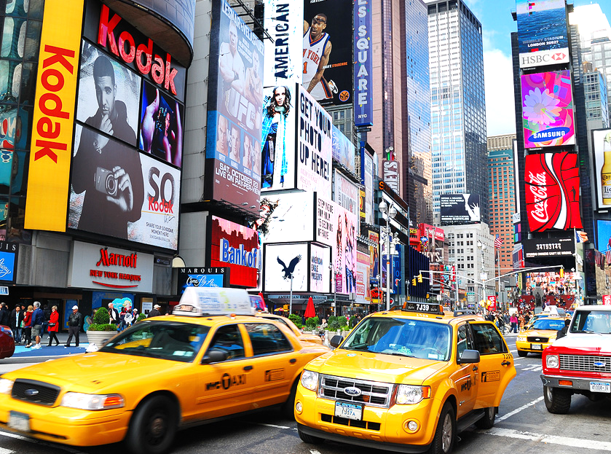
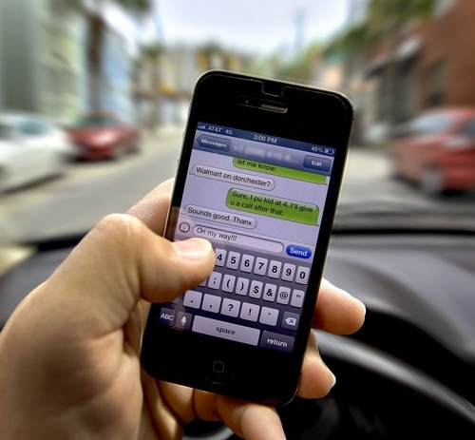
A continuum of intentionality (Lee et al 2008)
Involuntary
Voluntary
Increasing display functionality for infotainment
We found that glance frequency correlated with self-reported everyday attentional failures (CFQ; Broadbent et al 1982)
70% of distraction associated with crashes were voluntary (Beanland et al 2013)
Not enough focus on self-paced paradigm (Caird et al 2008)
Notes:
You don't need an Android Auto-compatible car to use Android Auto anymore
Limited research, mostly on roadside advertisements (e.g., Bendak & Al-Saleh, 2010; Chattington et al., 2009)
For a deeper look at driver distraction, we can see how engagement in driver distraction exists on a continuum of intentionality. On one end we have involuntary distraction, where drivers, without meaning to engage in distraction, are distracted by irrelevant stimuli anyway. On the other end, we have drivers who willingly engage in secondary tasks, such as texting.
This diversion of attention can be voluntary, involuntary, or habitual
Voluntary distraction refers to intentional engagement in secondary tasks while driving
Involuntary distraction occurs as a result of a drivers inability to suppress distracting stimuli due to an innate mechanism
Habitual distraction occurs as an inability to suppress a learned response to a stimulus
These types of distractions have been previously recognized in the literature:
For example, Lee et al. include intentionality, meaning voluntary and involuntary, as a main factor when describing driver distraction within their taxonomy of driver inattention
Using this taxonomy, Beanland et al., found that that of the distraction-based crashes analyzed in their study, 70% were cause by voluntary distractions, and the remaining 30% were involuntary distractions
Finally, cell phone habits have been recently found to be a contributing factor of texting and driving behaviors after accounting for other social/psychological factors

Slide 8
Implications for Distraction Mitigation
Target behavioural modification for voluntary distraction
Function lockouts may be more effective for involuntary distraction
  Cell-phone blocker technology frequently bypassed – Michigan DOT volunteers (Funkhouser and Sayer, 2013)
  Worse rejection for teens; dramatic dropout (Benden et al. 2012)
  Connectivity is important
Smart-driver monitoring/assistance for both
Notes:
Benden et al. could not complete the study because initial participation was low and there was dramatic dropout by the teens (complete blocking of wireless comm)

Slide 9
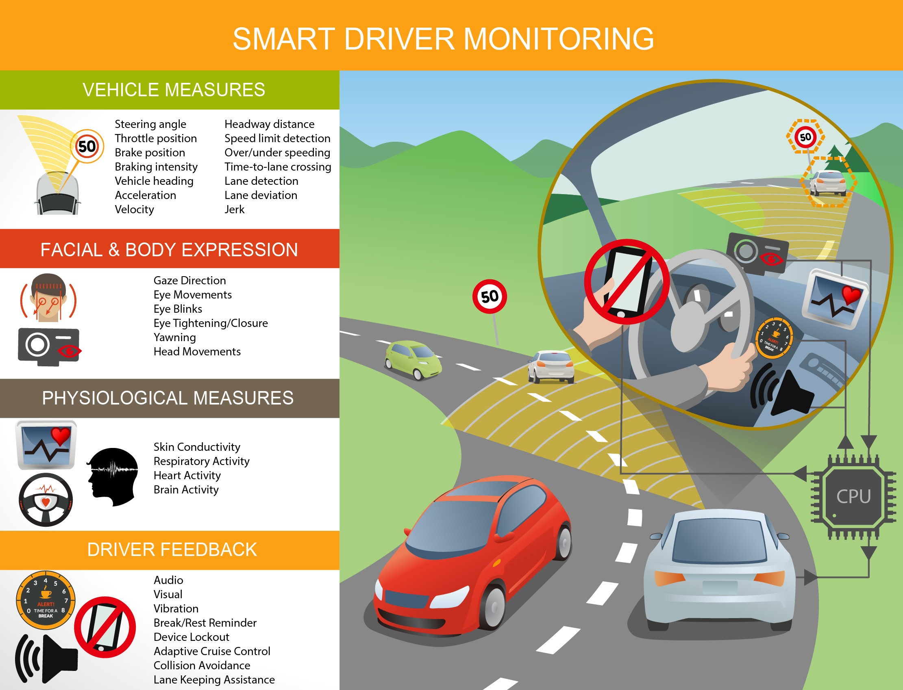
Machine
Learning
Notes:
Benden et al. could not complete the study because initial participation was low and there was dramatic dropout by the teens (complete blocking of wireless comm)

Slide 10
Distraction mitigation
limited attentional resources
memory on driving, real-time feedback and secondary tasks
real-time feedback
secondary
tasks
driving
Post-drive feedback
mental model of safe driving
personality
social norms
during driving
post driving
Feng, Donmez (2013) Proc. of Driver Assessment Conference
Notes:
2016 Chevy Malibu – report card for teen drivers

Slide 11

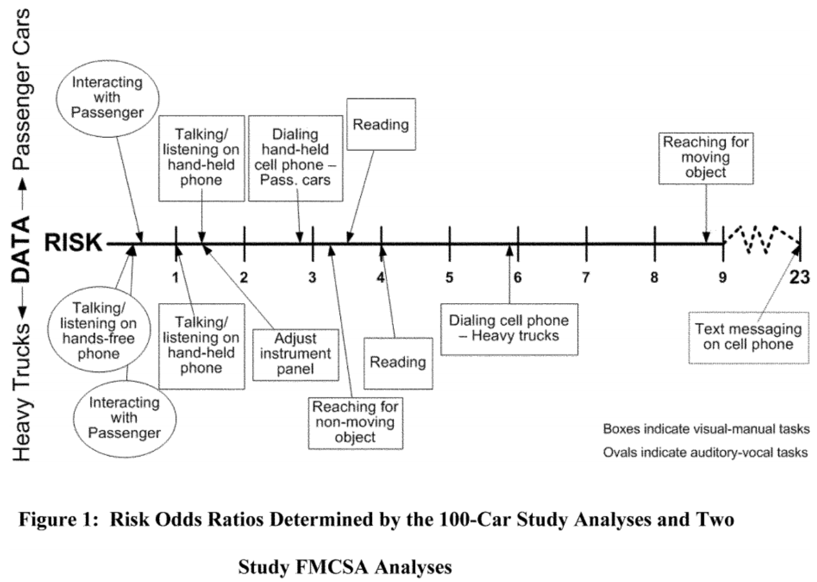
Original equipment (OE) in-vehicle electronic devices used by the driver to perform secondary tasks through visual-manual means.
Lockout display and manual text entry for certain tasks (anything else there are testing procedures)
Android Auto will be available on your phone
Notes:
Alliance of Auto Manufacturers Guidelines (2006)
Alternative A. A visual or visual-manual task intended for use by a driver while the vehicle is in motion should be designed to the following criteria: A1. single glance durations generally should not exceed 2 seconds; and A2. task completion should require no more than 20 seconds of total glance time to task display(s) and controls. Alternative B. Alternatively, the impact of a device-related visual or a visual-manual task on driving safety can be assessed directly by measuring concurrent driving performance under dynamic conditions and relating it to driving performance under specified reference conditions. The influence of such a secondary task on driving performance shall not be greater than that of a scientifically-accepted reference task in terms of: B1. Lateral position control: Number of lane exceedences observed during secondary task execution should not be higher than the number of lane exceedences observed while performing one or more reference tasks (e.g., manual radio tuning) under standard test conditions (e.g., same drivers, driving scenario) replicating routine driving tasks; and B2. Following headway: Car following headway variability observed during secondary task execution should not be worse than car following headway observed while performing one or more reference tasks under standard test conditions (e.g., same drivers, same driving scenario) replicating routine driving tasks. This measure is influenced by speed changes of preceding traffic or lane changes of other vehicles.
NHTSA guidelines are stricter
original equipment (OE) invehicle electronic devices used by the driver to perform secondary tasks (communications, entertainment, information gathering, navigation tasks, etc. are considered secondary tasks) through visual-manual means (i.e., the driver looks at a device, manipulates a device-related control with his or her hand, and/or watches for visual feedback).
Perse lockout (anything else there is testing procedures)
Displaying video not related to driving; • displaying certain graphical or photographic images; • displaying automatically scrolling text; • manual text entry for the purpose of text-based messaging, other communication, or internet browsing; and • displaying text for reading from books, periodical publications, Web page content, social media content, textbased advertising and marketing, or text-based messages.
The first recommended test method measures the amount of time that the driver’s eyes are drawn away from the roadway during the performance of the task. The NHTSA Guidelines recommend that devices be designed so that tasks can be completed by the driver while driving with glances away from the roadway of 2 seconds or less and a cumulative time spent glancing away from the roadway of 12 seconds or less. The second test method uses a visual occlusion technique to ensure that a driver can complete a task in a series of 1.5-second glances with a cumulative time of not more than 12 seconds.

Slide 12
Distraction mitigation
limited attentional resource
memory on driving, real-time feedback and secondary tasks
real-time feedback
secondary
tasks
driving
Post-drive feedback
mental model of safe driving
personality
social norms
during driving
post driving
Feng, Donmez (2013) Proc. of Driver Assessment Conference
Notes:
2016 Chevy Malibu – report card for teen drivers

Slide 13
Voluntary distraction
Attitude
Perceived Control
Intention
Behavior
Perceived Social Norms
Theory of Planned Behavior (Ajzen, 1991)
Self-reported voluntary distraction engagement frequency function of attitudes, perceived control, social norms
Chen, Hoekstra-Atwood, Donmez (2016) Transportation Research Part F
13
Notes:
Attitudes correlate with distraction engagement (across wide variety of distractions) (Li et al., 2014)
Willingness to engage in distraction related to personality traits: sensation seeking (Horrey and Lesch, 2008), extroversion (Lansdown, 2012)
Attitudes & pressure from significant others (injunctive norms) predict cell phone use (talking/texting) (Wash et al., 2008)
Similar accelerator release delays
But faster brake transition times with voluntary distraction
Lack of perceived urgency, slower processing?
Drivers who reported engaging in distractions more often
held a more positive attitude toward distractions (r = .55)
perceived a higher level of control (r = .51)
perceived a higher level of approval toward distracted driving from peers and family (r = .27) as well as from other drivers (r = .30).
Driver distraction is defined as any activity that diverts attention from the primary task of driving
This diversion of attention can be voluntary, involuntary, or habitual
Voluntary distraction refers to intentional engagement in secondary tasks while driving
Involuntary distraction occurs as a result of a drivers inability to suppress distracting stimuli due to an innate mechanism
Habitual distraction occurs as an inability to suppress a learned response to a stimulus
These types of distractions have been previously recognized in the literature:
For example, Lee et al. include intentionality, meaning voluntary and involuntary, as a main factor when describing driver distraction within their taxonomy of driver inattention
Using this taxonomy, Beanland et al., found that that of the distraction-based crashes analyzed in their study, 70% were cause by voluntary distractions, and the remaining 30% were involuntary distractions
Finally, cell phone habits have been recently found to be a contributing factor of texting and driving behaviors after accounting for other social/psychological factors

Slide 14
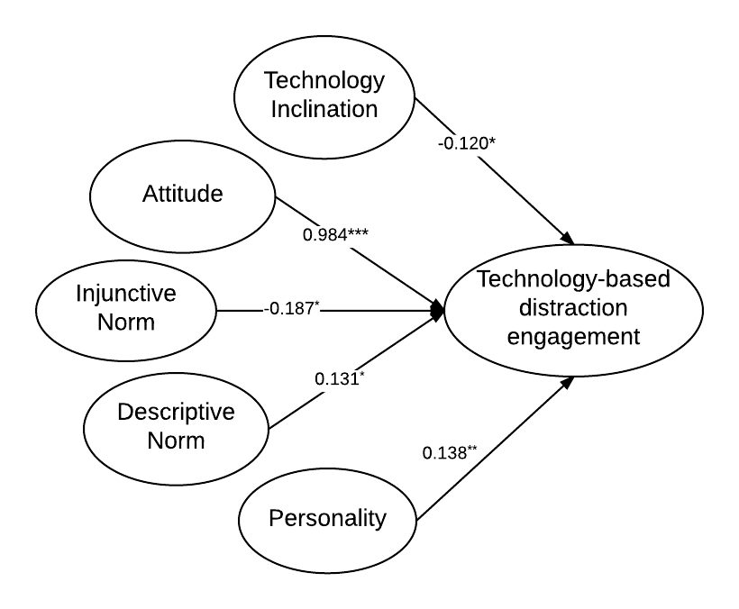
SEM of technology-based distractions
Attitude most important among tested
  Emphasize/calibrate risk perception
Older drivers - sensation/risk seeking personality seems more relevant than norms
  Also likely more susceptible to involuntary distraction
Younger drivers more susceptible to social norms, especially injunctive norm
  Leverage social norms for feedback
Chen, Donmez (2016).
Accident Analysis and Prevention
Notes:
Attitudes correlate with distraction engagement (across wide variety of distractions) (Li et al., 2014)
Willingness to engage in distraction related to personality traits: sensation seeking (Horrey and Lesch, 2008), extroversion (Lansdown, 2012)
Attitudes & pressure from significant others (injunctive norms) predict cell phone use (talking/texting) (Wash et al., 2008)
Attitudes
I think it is alright to drive and…
You think you can drive well and…
Holding phone conversations; manual interactions with cell phones; manual interactions with in-vehicle technology
TPB predictors: attitudes, injunctive norm, descriptive norm
Personality: tendency of sensation seeking and venturesomeness
Technology inclination: experience with and attitude towards technology
Structural model: relationships between latent variables
Measurement model: assesses each factor at the observation level
(a questionnaire item = a measurement variable)
Problem: sample size too small for this many parameters to estimate
Removed 2 LVs, Injunctive Norms and Perceived Control, as assessed using factor loadings and model fits

Slide 15
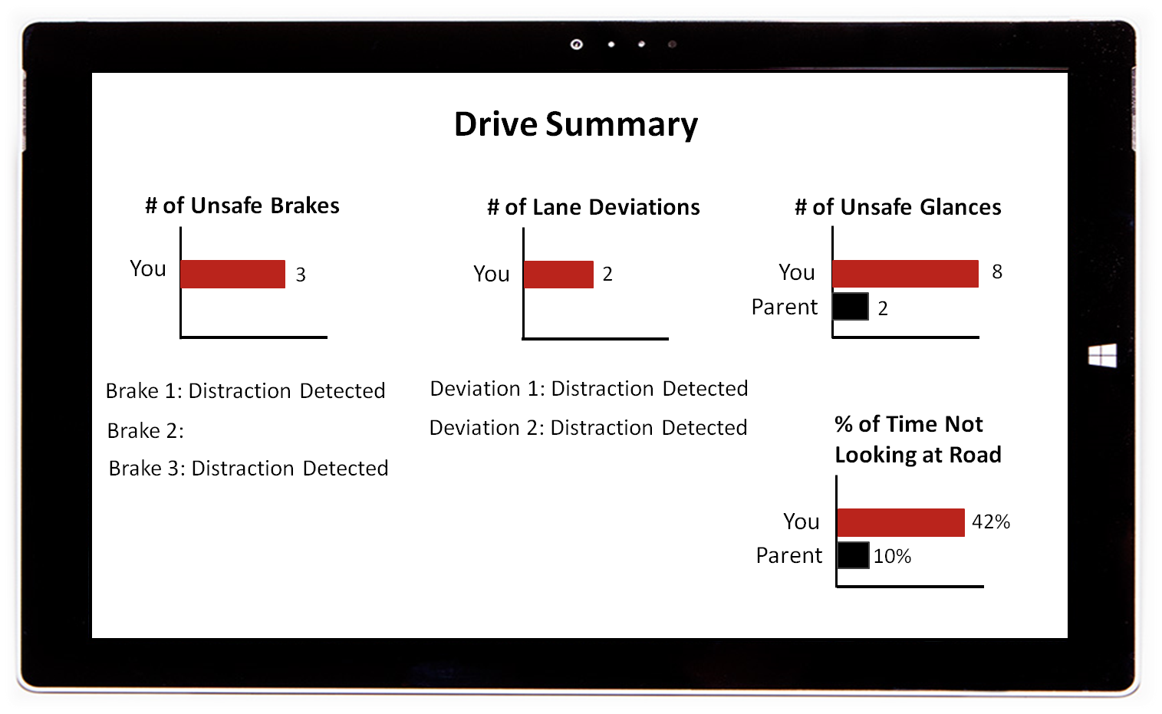
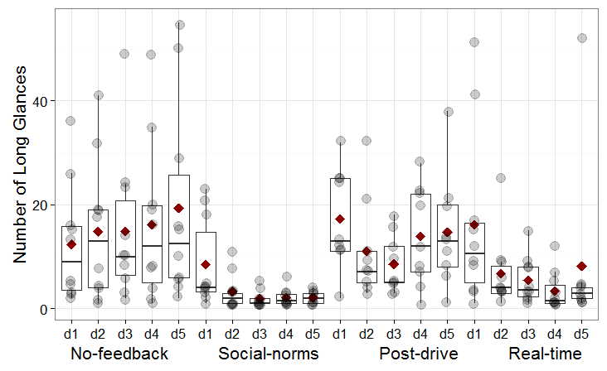
Parental norm feedback
Number of glances >2 sec
15
Notes:
Survey findings:
Parents behavior predictive of teenagers’ distracted driving (Carter et al 2014)
Teens may overestimate their parents’ distraction engagement and approval of distraction
Parents may underestimate their teens’ distraction engagement
In no-feedback condition, participants had large number of long glances (>2s) in each drive: drive 1 ( M= 12.7, SD= 11.7), drive 2 (M= 15.5, SD= 13.9), drive 3 (M= 13.4, SD= 14.6), drive 4( M=17, SD= 17.3), drive 5 (M= 22.44, SD= 22.4). The number of long glances was significantly decreased in social norms feedback condition: drive 1 (M= 5.3, SD= 8.5), drive 2 (M= 3.7, SD= 7.2), drive 3 (M= 1.4, SD= 2.3), drive 4 (M= 1.6, SD= 2.1), and drive 5 (M= 1, SD= 1.3).
Real-time feedback also decreased the number of glances over 2 seconds compared to no-feedback condition. This positive effect was particularly evident during the last two drives where participants had already been exposed to real-time feedback several times: drive 1 (M= 13.3, SD= 15), drive 2 (M= 4.6, SD= 2.9), drive 3 (M= 3.5, SD= 3.9), drive 4 (M= 1.5, SD= 2.1), and drive 5 (M= 2, SD= 1.6).

Slide 16
Automation and Distraction
  Cars can now act in partial, high, or full automation, assuming some or all aspects of vehicle control
Meta-analysis (de Winter et al 2014)
  drivers of a highly automated car and to a lesser extent ACC drivers are likely to engage in non-driving tasks.
  when they are not engaged in non-driving tasks, they are more likely to get fatigue compared to manual driving.
  Driver state detection for transfer of control

Slide 17
Thank you
donmez@mie.utoronto.ca
University of Toronto
Human Factors

