Slide 1
Driven to Distraction
“Driving” forces in our workplaces

Slide 2
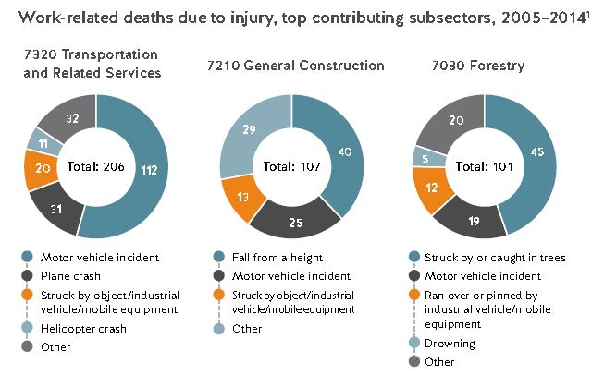

Slide 3
NS Stats
WCB claims as result of MVA increase almost 35% from 2013-2015
25% increase in time loss claims over last 5 yrs

Slide 4
NS OHS Act
Workplace: means any place where an employee is, or is likely to be, engaged in any occupation and includes any vehicle or mobile equipment used, or likely to be used, by an employee in an occupation

Slide 5
Strategies
Policy
Education
Technology

Slide 6
Policy
No policy means minimum standard of legislation
No cellular usage in motion
  Must be set to go to voicemail
  Operator must be safely parked to use
Journey Management Program
  Includes hour of service
  Check-ins
  GPS tracking
  Weather assessment
  Pre-programmed routing
  Secured laptops/devices

Slide 7
Education
Posters/materials
Defensive Driving
Awareness talks
Demonstrations

Slide 8
Technology
Disabling technologies
  Tech industry
  Auto industry

Slide 9
Distractions
More than just wireless devices
  GPS Navigation
  Complex vehicle systems
  Computers
  Loose object
  Eating/drinking
  Pets
  Children/passengers

Slide 10


