Slide 1

CARSP ACPSER Conference 2017
Non-Intrusive Monitoring of Drowsiness Using Eye Movement and Blinking
Ali Zandi, Ph.D.
aszandi@acs-corp.com

Slide 2

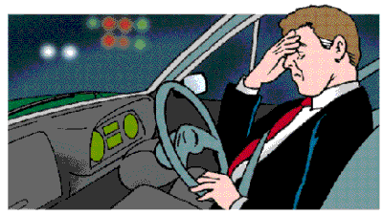
Background
Increasingly sleep-deprived society
Fatigue, drowsiness, cognitive deficits
Negative impacts on health, safety and performance
Annual average of 83,000 sleep-related crashes on U.S. roadways (2005-2009); Drowsiness involvement in nearly 3% of US crash fatalities in 2014 (NHTSA).
Increase of fatigue-related motor vehicle fatalities from 4.6% in 2000 to 6.4% in 2013 in Canada (Traffic Injury Research Foundation).
https://inscopeca.wordpress.com/fatigue-information-2/employer-and-hse-fatigue-information/
http://www.drivingschoolireland.com/what_not.html

Slide 3
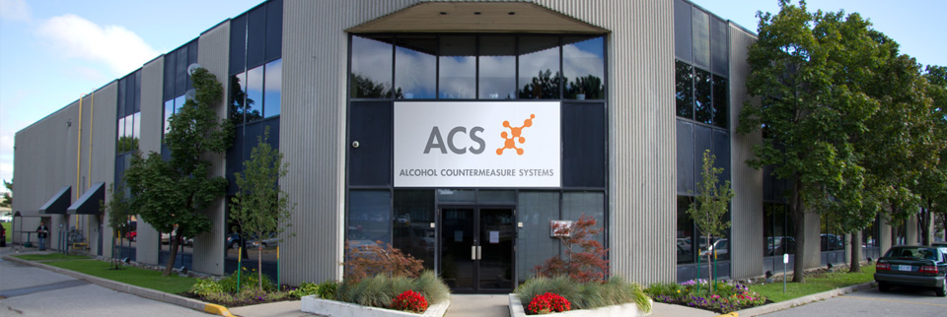
Alcohol Countermeasure System Corp. (ACS)
Research collaborations with academic sector
In-house R & D
An international group of companies (beginning in 1970) with a Canadian headquarter
Pioneer in alcohol detection technology and road safety
Scientific research, product development, and manufacturing

Slide 4
Objective
To develop non-intrusive real-time techniques to reliably assess the state of vigilance, which is critical for managing fatigue in people and reducing motor vehicle collisions and human fatalities.

Slide 5
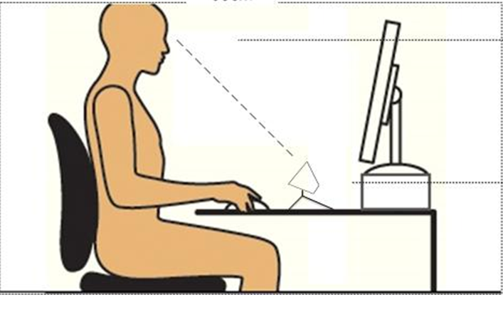
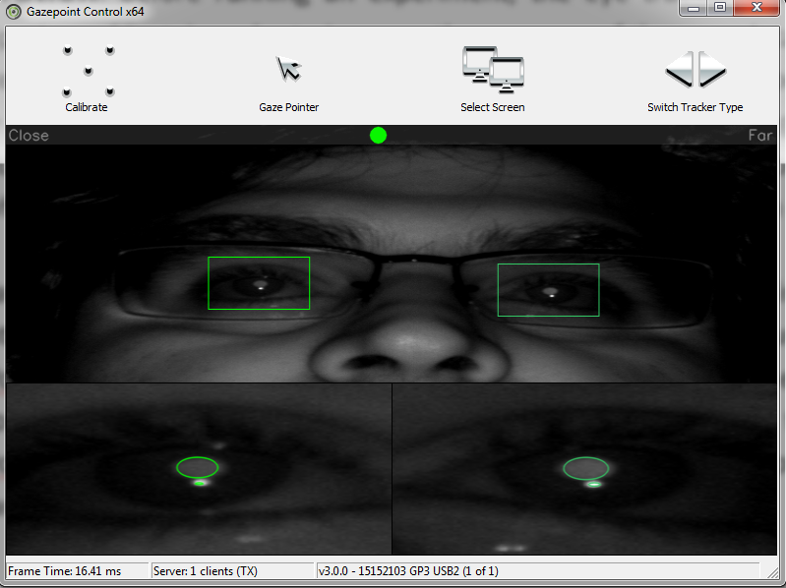
Methods
Sustained Vigilance Task (SVT)
Six consecutive psychomotor vigilance task (PVT)
A highly controlled laboratory setting
100 stimulus-response trials per PVT episode
Two separate sessions (different sleep conditions):
normal sleep (NS)
sleep restriction (SR)
15 subjects (age 22.9±3.3 years; 11 females)
Brain & Mind Sleep Research Lab. Western University, Canada
Multi-modal data (eye tracking, EEG, and reaction time)
Reaction times to visual stimuli as the baseline
GazePoint GP3 Eye Tracker

Slide 6
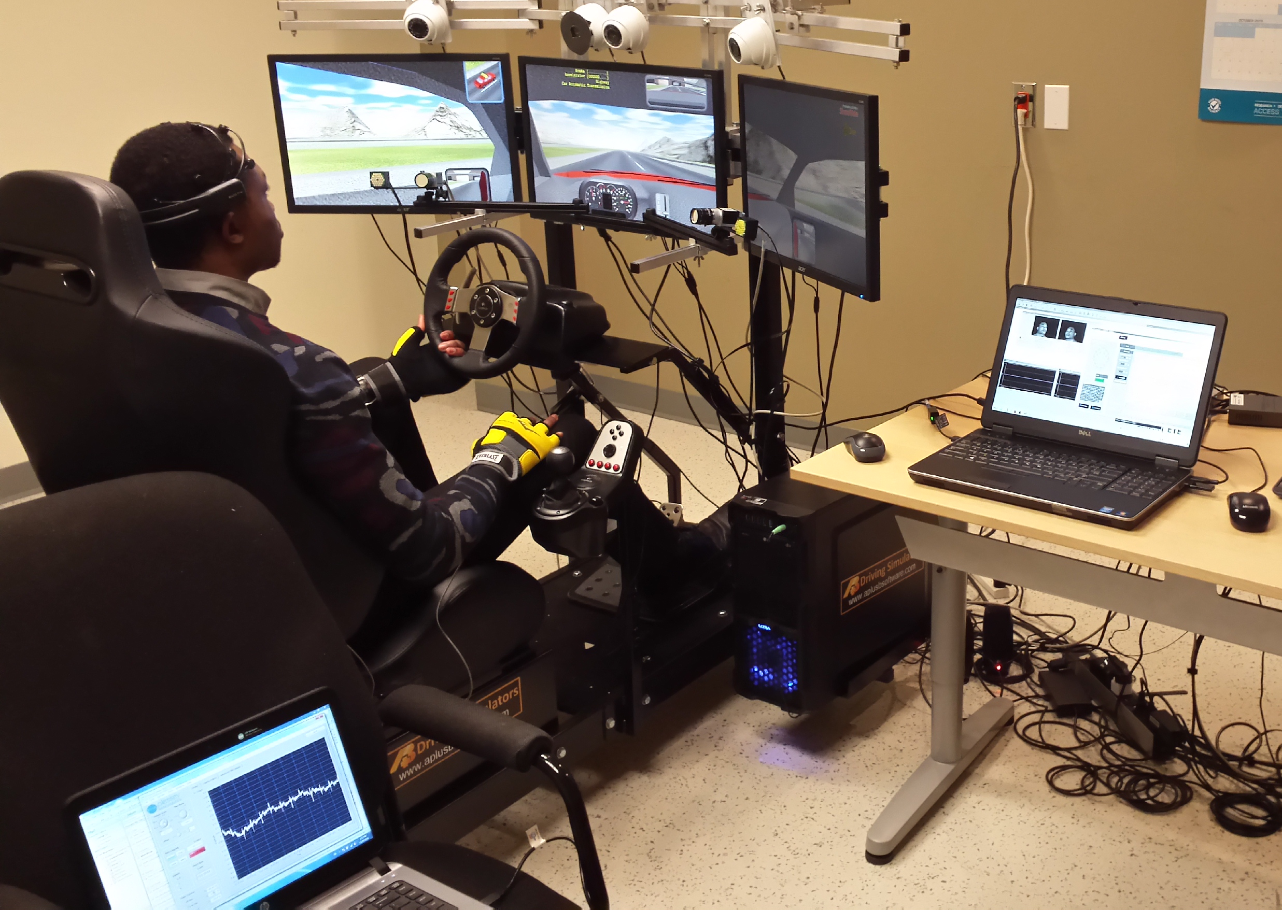
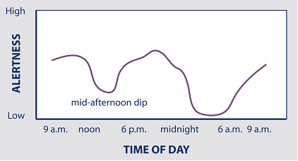
Methods
Simulated Driving Task (SDT)
More real-world situation using a driving simulator
Two separate sessions (different conditions & time of the day):
10-min control driving (CD)
30-min monotonous driving (MD)
7 subjects (age 36.6±8.1 years; 5 males)
Alcohol Countermeasure System Corp., Toronto, Canada
Multi-modal data (eye tracking, EEG, and ECG)
Characteristic changes in EEG power spectrum as the baseline
SmartEye Pro Eye Tracker
http://www.salemhealth.org/services/sleep/what-is-normal-sleep-

Slide 7
Methods
Feature Extraction (25 features)
General Gaze | STD, median, scanpath, velocity
Fixation | Duration, frequency, percentage, scanpath, velocity
Saccade
Blinking | Duration, frequency, percentage
Dimensionality reduction
Fisher’s discriminant analysis (FDA)
Classification
Non-linear support vector machine (SVM) with Gaussian kernel

Slide 8
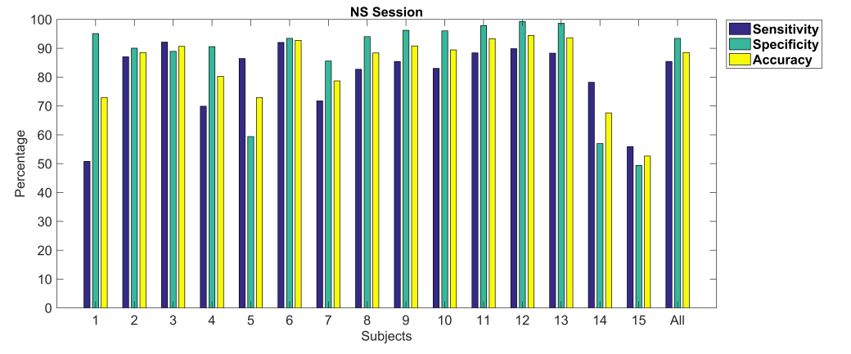
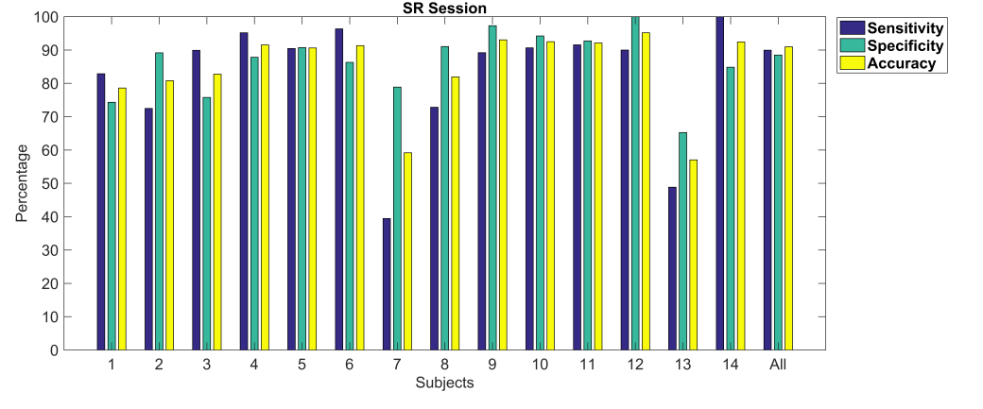
Results
86%
94%
89%
SVT (per subject):
NS session,
SR session
(a)
90%
89%
91%
(b)

Slide 9
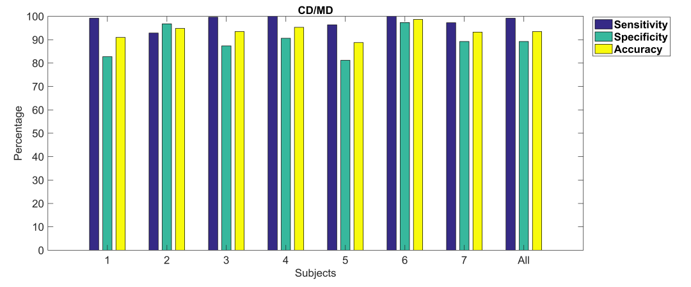
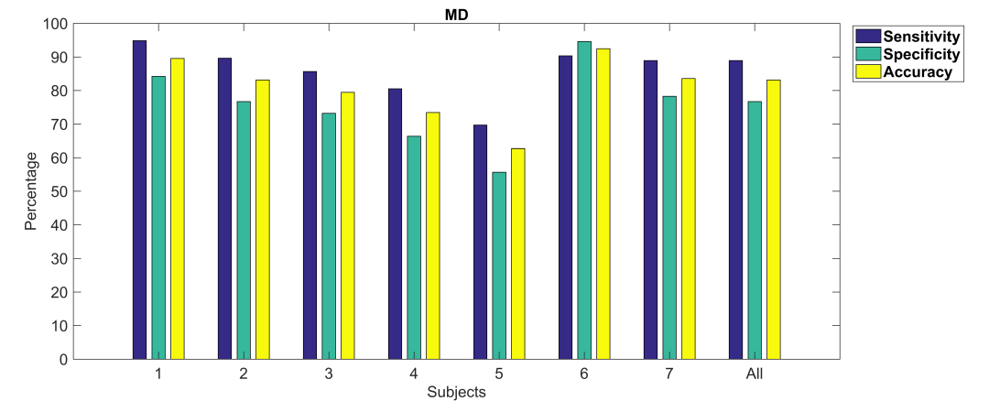
Results
99%
89% 94%
SDT (per subject):
CD/MD,
MD
(a)
89%
77%
83%
(b)

Slide 10
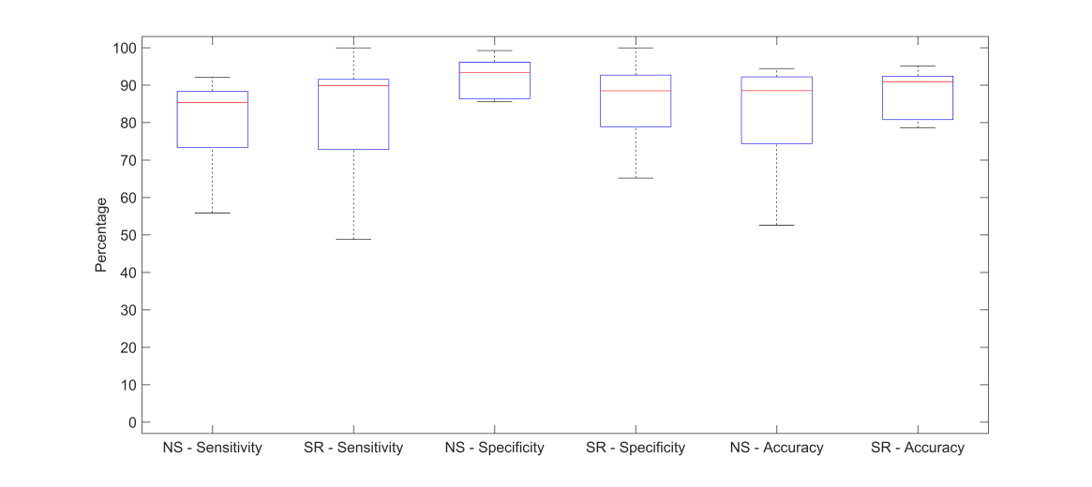
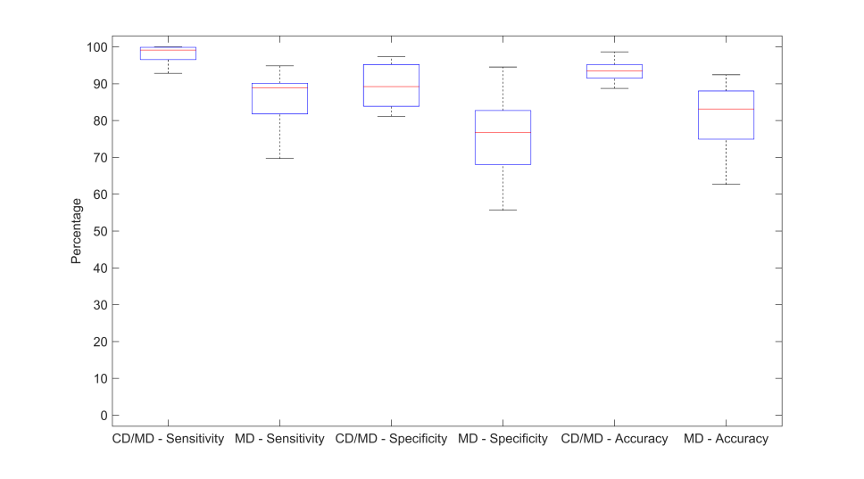
Results
Summary (all subjects):
SVT,
SDT
(a)
p>0.05
p>0.05
Two-Way ANOVA: p>0.1
p>0.1
(b)
p<0.05
p<0.05
Two-Way ANOVA: p>0.5

Slide 11
Conclusion & Discussion
A machine learning method for non-intrusive assessment of drowsiness using eye tracking data
Sustained vigilance task (SVT) & simulated driving task (SDT)
RTs to visual stimuli / EEG as baseline
Preliminary study verifies the potential of the proposed methodology
High correspondence between the selected eye tracking features and both the behavioural (PVT) and physiological (EEG) measures of vigilance
Further investigations required:
Various levels of fatigue/sleep deprivation and time of day
Exploring more eye tracking features
Real driving scenarios

Slide 12
Thank you!
Q & A
Ali Zandi, Ph.D.
aszandi@acs-corp.com

