Slide 1
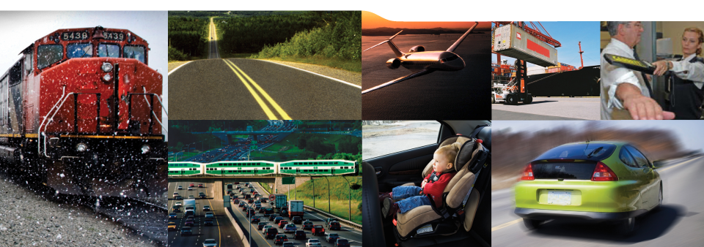
An In-depth Examination of Driver Fatalities
Involving Drugs
CARSP Conference
Toronto, 2017
Notes:
1

Slide 2
Project Partners
Paul Boase, Chief Road Users, Transport Canada
Doug Beirness, Beirness and Associates
Erin Beasley, Beirness and Associates
BC Coroner’s Office
Saskatchewan Coroner’s Office
Nova Scotia Coroner’s Office

Slide 3
Background
Driving after drug use is a common behaviour
CAS self-reports 4.8% of Canadians drove within 2 hours of using cannabis in the last year
16 to 18 year olds was 20.6% drugs, 19.6 alcohol
Roadside surveys show
  BC, (2010) 7.2% positive for drugs, 9.% for alcohol
  BC, (2013) 10.1 positive for drugs, 6.5 for alcohol
  Ontario (2014) 10.2% positive for drugs, 4% for alcohol

Slide 4
Background…
Regional trauma unit found 41.3% tested positive for drugs
Selected jurisdictions: 30% of fatally injured drivers were positive for drugs
Review of fatally injured drivers in Canada, 33.5% were positive for drugs and 37.9 for alcohol
  18.5 were positive for drugs only
  21.9 were positive for alcohol only
  14.2 were positive for at least one drug and alcohol

Slide 5
Purpose
Understanding of the involvement of drugs in fatally injured motor vehicle drivers
Assess if review of coroner’s records was possible
Assess if drug involved characteristics differ from alcohol involved characteristics or drivers with neither

Slide 6
Method
Confidentiality agreements with BC, Sask and NS
Cases were selected to meet the following criteria:
  Fatality was the driver/operator of a motor vehicle;
  The person was tested for both alcohol and drug;
  Fatality occurred within the previous four years; and
  Complete records were available with few instances of missing or incomplete data
Examined autopsy, toxicology & MVC reports

Slide 7
Cases
200 case files were requested from each
Attempt to obtain approximately equal numbers of cases in each of four categories:
  Negative for both alcohol and drugs;
  Positive for alcohol, negative for drugs;
  Negative for alcohol, positive for drugs; and
  Positive for alcohol and drugs.
Quality assessment of records (97 removed)
Cases not random or representative

Slide 8
Results
Cases were divided into 4 groups:
  Negative – No alcohol and drugs or drugs present (n=123, 24.6%);
  Alcohol Only -- Positive for alcohol, negative for drugs (n=124, 21.6%);
  Drugs Only -- Negative for alcohol, positive for drugs (n=108, 21.6%); and
  Drugs and Alcohol -- Positive for alcohol and drugs (n=145, 29.0%).

Slide 9
Characteristics
 | Negative | Drugs Only | Alcohol Only | Drugs and Alcohol | Total
Male | 92 (74.2%) | 69 (63.3%) | 96 (77.4%) | 124 (84.9%) | 381 (75.7%)
Female | 32 (25.8%) | 40 (36.7%) | 28 (22.6%) | 22 (15.1%) | 122 (24.3%)
Total | 124 (24.7%) | 109 (21.7%) | 124 (24.7%) | 146 (29.0%) | 503

Slide 10
Age Groups

Slide 11
Time of Day

Slide 12
Weekend/Weekday

Slide 13
Involved Vehicles
 | Negative | Drugs Only | Alcohol Only | Drugs and Alcohol | Total
Car | 63 (51.2%) | 60 (56.6%) | 54 (44.3%) | 68 (46.6%) | 245 (49.3%)
Passenger Van | 10 (8.1%) | 8 (7.5%) | 11 (9.0%) | 11 (7.5%) | 40 (8.0%)
SUV | 8 (6.5%) | 11 (10.4%) | 5 (4.1%) | 16 (11.0%) | 40 (8.0%)
Pick-up truck | 11 (8.9%) | 16 (15.1%) | 36 (29.5%) | 37 (25.3%) | 100 (20.1%)
Motorcycle | 16 (13.0%) | 2 (1.9%) | 11 (9.0%) | 10 (6.8%) | 39 (7.8%)
Other | 15 (12.2%) | 9 (8.5%) | 5 (4.1%) | 4 (2.7%) | 33 (6.6%)
Total | 123 (24.7) | 106 (21.3) | 122 (24.5) | 146 (29.3) | 497

Slide 14
Safety Equipment
 | Negative | Drugs Only | Alcohol Only | Drugs and Alcohol | Total
Safety Equipment Used | 85 (80.95%) | 57 (63.3%) | 49 (47.1%) | 50 (38.8%) | 241 (50.3%)
Not used | 20 (19.0%) | 33 (36.7%) | 55 (52.9%) | 79 (61.2%) | 187 (43.7%)
Total | 105 | 90 | 104 | 129 | 428
Single vs Multi-Vehicle
 | Negative | Drugs Only | Alcohol Only | Drugs and Alcohol | Total
Single Vehicle | 37 (29.8%) | 45 (42.1%) | 98 (79.0%) | 109 (74.7%) | 289 (57.7%)
Multiple Vehicles | 87 (70.2%) | 62 (57.9%) | 26 (21.0%) | 37 (25.3%) | 212 (42.3%)
Total | 124 | 107 | 124 | 146 | 501

Slide 15
Speed
 | Negative | Drugs Only | Alcohol Only | Drugs and Alcohol | Total
Not Speeding | 96 (77.4%) | 67 (63.2%) | 45 (36.3%) | 69 (47.9%) | 277 (55.6%)
Speeding | 28 (22.6%) | 39 (36.8%) | 79 (63.7%) | 75 (52.1%) | 221 (44.4%)
Total | 124 | 106 | 124 | 144 | 498
Weather
 | Negative | Drugs Only | Alcohol Only | Drugs and Alcohol | Total
Clear/Dry | 84 (74.3%) | 80 (78.4%) | 99 (89.2%) | 109 (82.0%) | 372 (81.0%)
Rain/Wet | 8 (7.1%) | 14 (13.7%) | 6 (5.4%) | 16 (12.0%) | 44 (9.6%)
Snow/Ice | 13 (11.5%) | 5 (4.9%) | 1 (0.9%) | 2 (1.5%) | 21 (4.6%)
Limited Visibility | 8 (7.1%) | 3 (2.9%) | 5 (4.5%) | 6 (4.5%) | 22 (4.8%)
Total | 113 | 102 | 111 | 133 | 459

Slide 16
Assessed Role
 | Negative | Drugs Only | Alcohol Only | Drugs and Alcohol | Total
No Alcohol/Drug Present | 123 (100%) | -- | -- | -- | 123 (100%)
Alcohol/Drug Present – No Role | -- | 31 (28.7%) | 5 (4.0%) | 3 (2.1%) | 39 (7.8%)
Minimal Role | -- | 24 (22.2%) | 2 (1.6%) | 1 (0.7%) | 27 (5.4%)
Moderate Role | -- | 25 (23.1%) | 19 (15.3%) | 16 (11.0%) | 60 (12.8%)
Strong Role | -- | 28 (25.9%) | 98 (79.0%) | 125 (86.2%) | 251 (50.2%)
Total | 123 | 108 | 124 | 145 | 500

Slide 17
BAC Levels
 | Alcohol Only | Drugs and Alcohol | Total
BAC=1-49 | 6 (4.8%) | 13 (9.0%) | 19 (7.1%)
BAC=50-80 | 3 (2.4%) | 6 (4.1%) | 9 (3.3%)
BAC=81-159 | 22 (44.9%) | 27 (18.6%) | 49 (18.2%)
BAC=160+ | 93 (48.8%) | 99 (68.3%) | 192 (71.4%)
Total | 124 | 145 | 269

Slide 18
Analysis
 | Drug | Alcohol | No Drug/Alcohol Involvement
Sex (Female) | 35.8% | 22.4% | 26.4 | n.s
Safety Equipment Used | 60.9% | 44.9% | 80.5% | p<.001
Speed | 49.1% | 66.7% | 23.1% | p<.001
Single Vehicle | 49.1% | 82.9% | 30.2% | p<.001
Crash Time 12am-6am | 13.7% | 32.4% | 7.1% | p<.001
6am-12pm | 25.5% | 4.5% | 31.8%
12pm-6pm | 37.3% | 18.9% | 39.6%
6pm-12am | 23.5% | 44.1% | 21.4%
Age <19 | 5.7% | 9.4% | 11.9% | p<.001
20-24 | 15.1% | 18.8% | 11.3%
25-34 | 22.6% | 20.5% | 9.4%
35-44 | 15.1% | 12.8% | 11.9%
45-54 | 30.2% | 19.7% | 14.5%
55-64 | 7.5% | 13.7% | 17.0%
65+ | 3.8% | 5.1% | 23.9%

Slide 19
Discussion
Understanding of drugs in collisions
  Drug use does not follow the same pattern as alcohol and may require specific responses
Assess if coroner’s records possible
  It was possible to get detailed information from coroners records, didn’t review antecedent factors
  Difficulty in linking MVC and coroner records
Assess drug involved characteristics
  A number of differences among drug, alcohol and drug, drug only and negative were found

Slide 20
Limitations
High testing jurisdictions were used, but many cases not tested
Protocols for testing drugs and cut-offs differ by jurisdiction
The link between victim based records in coroners records and crash based records is not straight forward

Slide 21
Questions
Thank you for your attention

