Slide 1


Visual Attention Failures during Turns at Intersections: An On-road Study
Nazli E. Kaya
Suzan Ayas
Canmanie T. Ponnambalam
Birsen Donmez
Human Factors & Applied Statistics Lab

Slide 2
Safety at Intersections
Maneuvering intersections is high demand for drivers
~ half of crashes are on intersections or intersection-related
47% of US crashes in 2015 (NHTSA, 2017)
42% of Ontario crashes in 2014 (MTO, 2014)
Intersections are particularly risky for vulnerable users, e.g., pedestrians and cyclists
69% of vulnerable user crashes recorded in Toronto, 2008-2012, were at intersections (Toronto Public Health, 2015)
Complex intersections with high traffic volume require particular attention
In Toronto, ~70% of vulnerable user major-injury/fatalities are on major arterials (>20,000 vehicles/day) (Toronto Public Health, 2015)

Slide 3
Driver or Vulnerable User Error?
Driver error appears to play a larger role
Canadian pedestrian fatality/injury, 1999-2008: 40% occurred when pedestrians had right of way, as opposed to 20% when they did not (CCMTA, 2013)
Pedestrian-car crashes in Toronto, 2008-2012: 67% had the right of way when they were struck as opposed to 19% who did not (Toronto Public Health, 2015)
Cyclist-car crashes in Finland, 1990-1994: Only 11% of drivers noticed the cyclist, whereas 68% of cyclists noticed the driver and assumed that the driver would give right of way (Rasanen & Summala, 1998)

Slide 4
Misallocation of Driver Attention
Driver misallocation of attention is a major error type
Canadian pedestrian-car crashes, 1999-2008: “failing to yield the right of way” and “distraction and inattention” are two most common driver errors (CCMTA, 2013)
Cyclist-car crashes in Finland, 1990-1994: Misallocation of attention such that others are not detected is a common mechanism (Rasanen & Summala, 1998)
Videos from outside (Summala et al. 1995) and inside (Wu & Xu, 2017) vehicle indicate drivers allocate attention based on expectations
However, the extent drivers fail to properly scan for vulnerable users at intersections is unknown

Slide 5
Research Objectives
Examine attention failures toward vulnerable users during right turns at intersections
Data collected as part of a larger instrumented vehicle study focusing on demands associated with urban driving (Ponnambalam & Donmez, HFES 2018)
Eye-tracker and video allowed for accurate gaze position data
Validate intersection-related error items of the Driver Behaviour Questionnaire (DBQ)
DBQ is widely used to assess aberrant driving behaviours (Reason et al. 1990; Parker et al. 1995; Lawton et al. 1997)
Three subscales: Errors, lapses, violations
Validated via
Self-reported crash data (De Winter & Dodou, 2012; Donmez et al. 2017)
On-road highway study (Zhao et al. 2012)
On-road urban study excluding vulnerable user items (Amado et al. 2014)

Slide 6
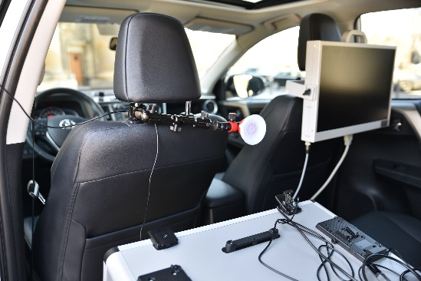
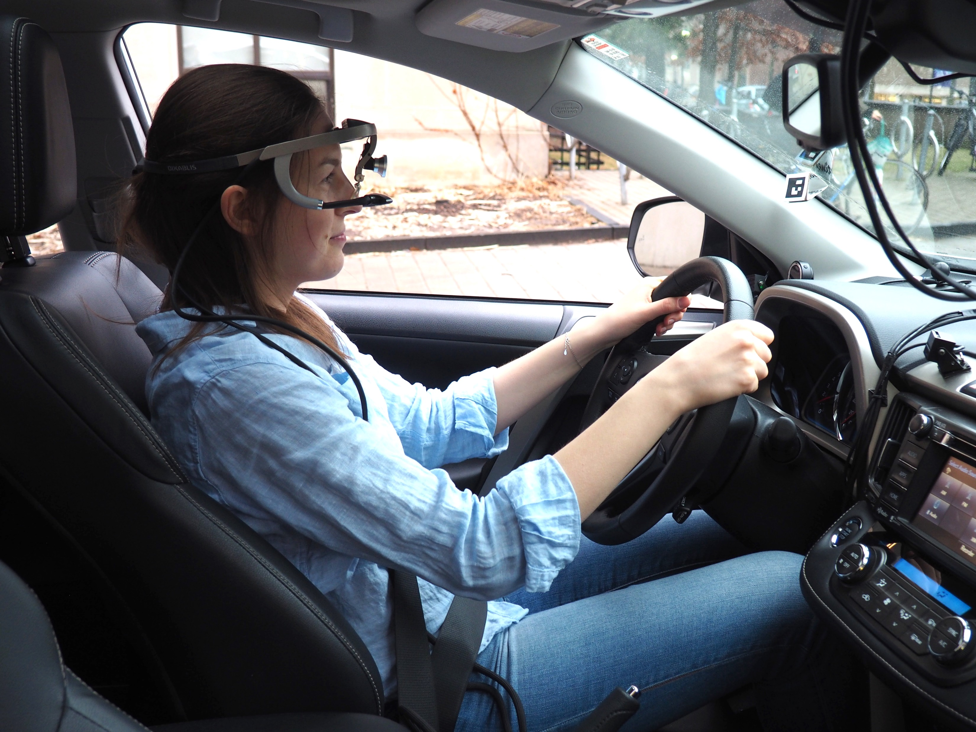
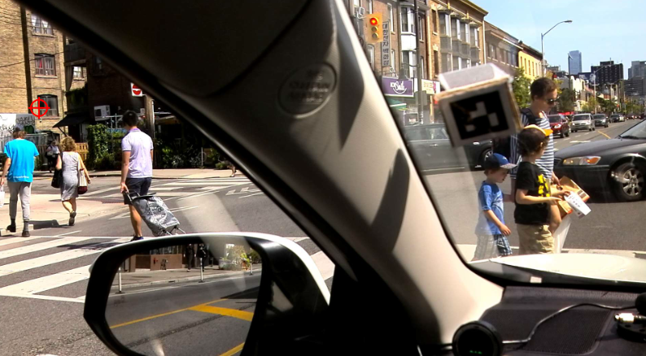
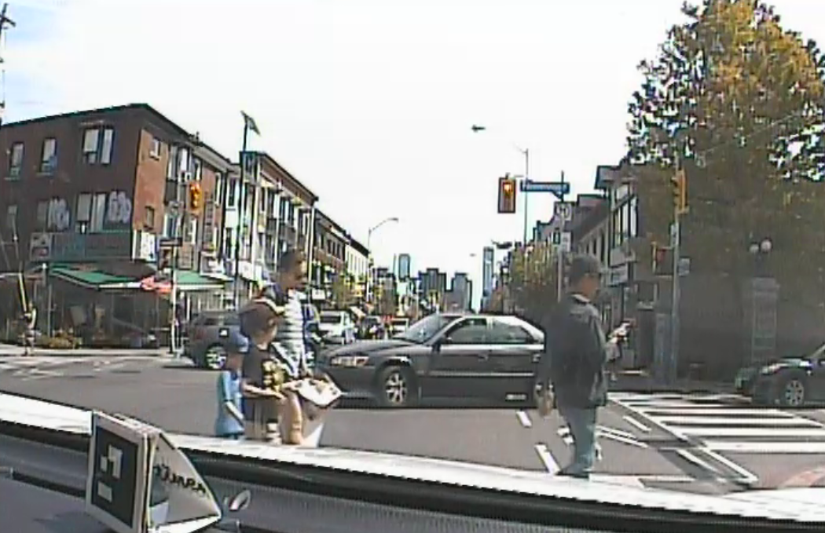
On-road Data Collection
Instrumented vehicle study conducted in downtown Toronto (Ponnambalam & Donmez, HFES 2018)
July to October 2017
Good weather conditions
On weekends, starting at 10:30 am or 1:30 pm
Turn-by-turn directions provided by experimenter
~35 min total driving time after practice drive
Relevant Apparatus:
Head-mounted Dikablis eye tracking glasses, 50 Hz
Gaze position automatically overlaid on video from front-facing eye-tracking camera
Vehicle mounted camera looking forward

Slide 7
19 Participants
Low crash risk group:
Age: 35-54 (Mean=42, SD = 5.9)
Driving Experience: +3 years
Self-reported frequency of downtown Toronto driving:
Few times a week or more (n=9)
Few times a month or less (n=10)
Intersection-related error DBQ items (Reimer et al. 2005):
How often do you do each of the following? “Never” (coded 0) “Hardly ever” (1) “Occasionally” (2) “Quite often” (3) “Frequently” (4) “Nearly all the time” (5)
Average | SD
0.89 0.74 | 0.57 0.65
0.74 | 0.65
(1) fail to notice pedestrians crossing when turning onto a side street (2) when making a right turn, you almost hit a cyclist or pedestrian who has come up on your right side. (3) when preparing to turn from a side road onto a main road, you pay too much attention to the traffic on the main road so that you nearly hit the car in front of you.

Slide 8
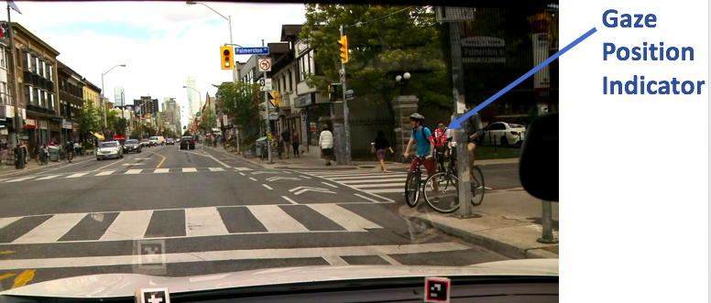
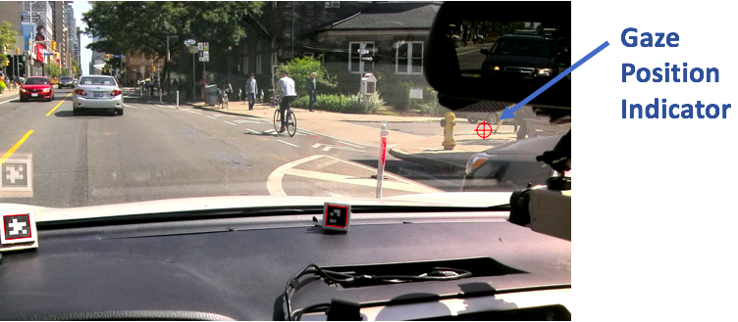
Attentional Failure Coding
Attentional failure to vulnerable users: participant fails to gaze at a certain area of importance (e.g., bike lane on the right) with enough frequency
Three independent coders; fixed marginal kappa=0.67 (Chen et al. 2005)
Consensus through discussion
2 intersections on Bloor St (major arterial):
Signalized 4-way cross intersection
To collector road
Uncontrolled T-intersection
To local road

Slide 9
No Failure Case; Cross intersection

Slide 10
Failure Case; T-intersection

Slide 11
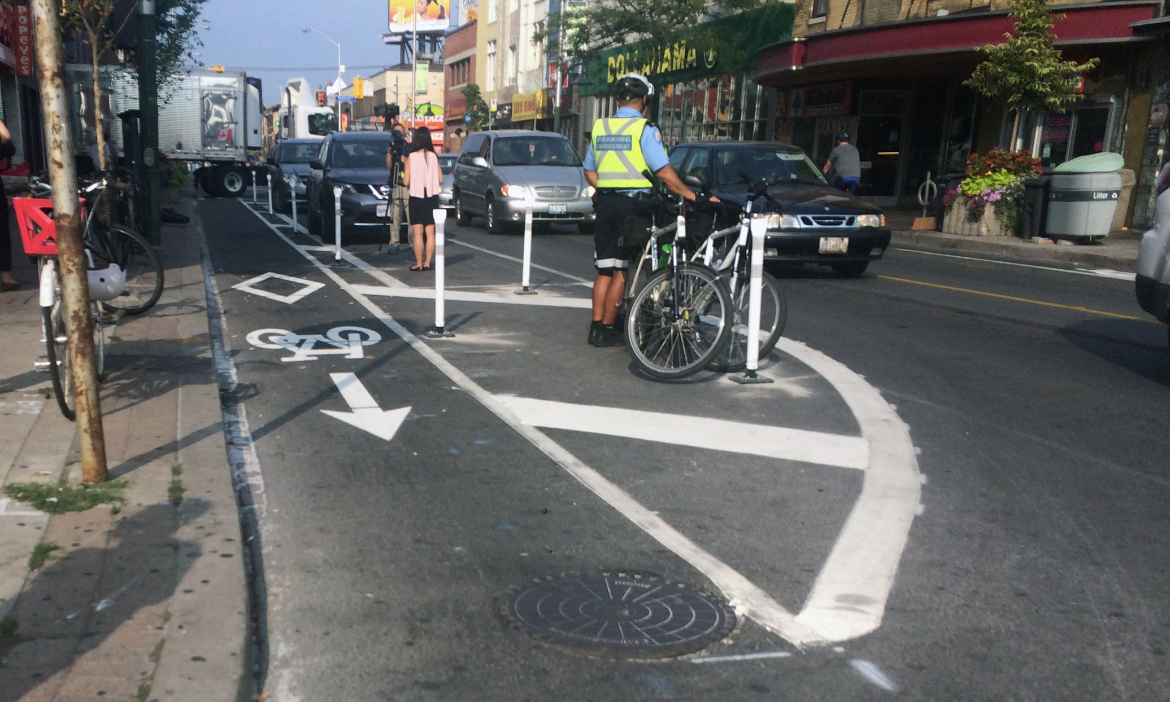
Prevalence of failures
11 of the 19 participants had a failure in at least one intersection
Prevalence concerning given our participants represent low crash-risk age group
All failures related to cyclists
Over-the-shoulder checks require effort (head movements)
Pedestrians stay more within the drivers’ field of view
More failures on T- than cross intersection (10 vs. 6 participants)
Parked vehicles blocked drivers’ view of the cyclists necessitating over-the-shoulder checks
Summer Reid, Gleaner News
Parked Vehicles

Slide 12
Likelihood of failures
Ordered logit model in SAS GENMOD
Dependent variable: No failure (n=8), Failed at 1 turn (n=6), Failed at both turns (n=5)
Predictor variables:
3 DBQ items’ average (higher vs. lower)
Self-reported frequency of downtown Toronto driving (frequent vs. non-frequent)
No multicollinearity, 𝜒²(1) = 1.35, p = .37
Both marginally significant at p = .07, Odds Ratio: 6.04
Likelihood of more failures for drivers who self-reported
making more intersection-related errors in DBQ
driving more frequently in downtown Toronto

Slide 13
Contributions
First on-road study to analyze drivers’ eye tracking data at intersections towards vulnerable users
Preliminary results on the extent drivers fail to properly scan for vulnerable users at intersections, especially for cyclists
Validation of the intersection-related error items of DBQ

Slide 14
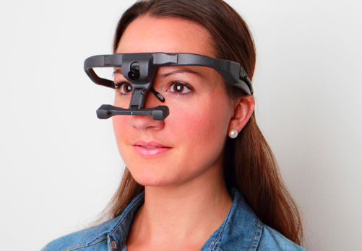
Limitations & Next Steps
Limitations:
Sample size
Variations in signal status and traffic flow
Directing gaze toward a location is a pre-requisite for perception but it does not guarantee perception
Uncomfortable eye tracker
Next Steps:
Different age and experience groups (e.g. novice drivers)
Various types of intersections (e.g. signal-controlled, stop-controlled, uncontrolled junctions)
Ergoneers

Slide 15
Acknowledgement
NSERC
Elzat Imam and Ryan Cheng
Questions?
Nazli E. Kaya
nkaya@mie.utoronto.ca

