Slide 1

CARSP ACPSER Conference 2018
Driver Verification Using Eye Movements and Blinking
Azhar Quddus, Ph.D.
Ali Zandi, Ph.D.
Laura Prest
Felix Comeau

Slide 2

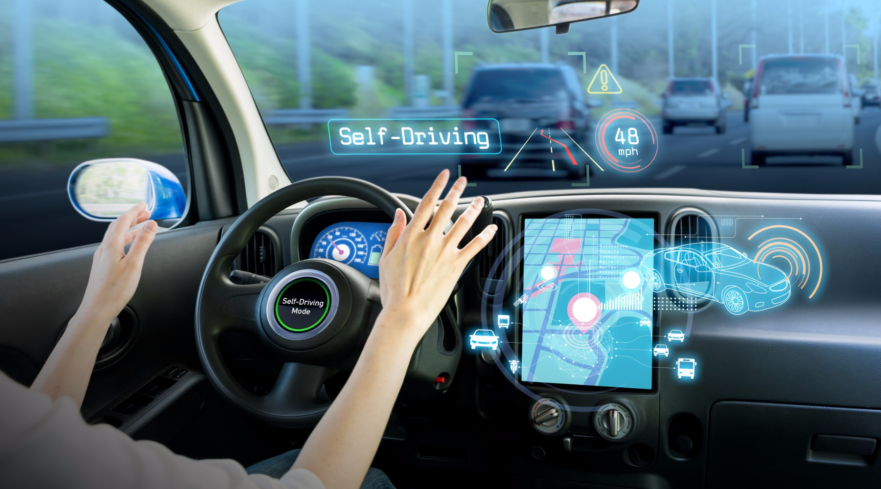
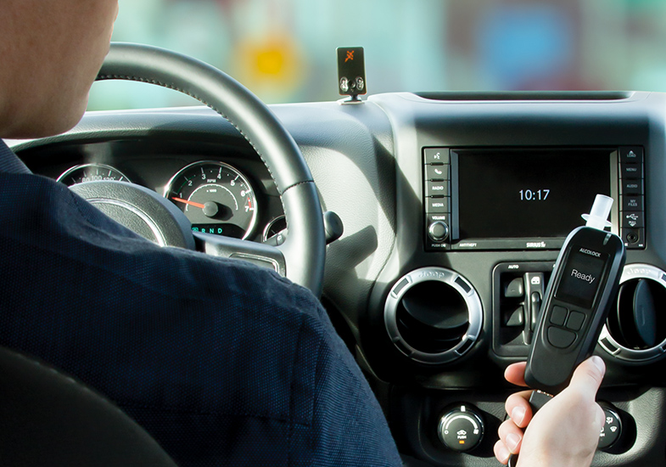
Background
Need to authenticate driver identity from safety point of view:
Verification of people operating in-vehicle safety devices, e.g. alcohol interlocks
Identification of drivers in connected vehicles
Self-driving mode
Various technologies available for identification/verification of people
Many are not robust against circumvention/spoofing and/or or interfere with the driver activity
https://internationalbanker.com/banking/putting-right-finger-forward-consumer-technologies-encouraging-biometric-banking/
http://transportationtech.com/qualcomm-unveils-next-gen-connected-vehicle-chipset/
acs-corp.com

Slide 3
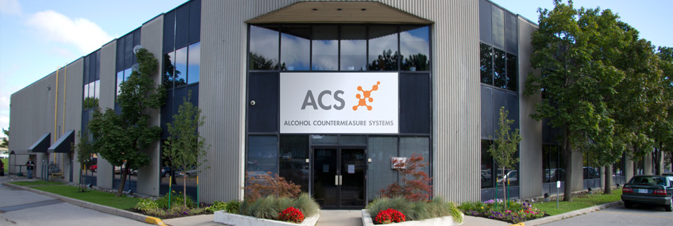
Alcohol Countermeasure System Corp. (ACS)
Research collaborations with academic sector
In-house R & D
An international group of companies (beginning in 1970) with a Canadian headquarter
Pioneer in alcohol detection technology and road safety
Scientific research, product development, and manufacturing

Slide 4
Objective
To develop non-intrusive real-time techniques for reliable and practical identification/verification of the driver, using eye movements and blinking.

Slide 5
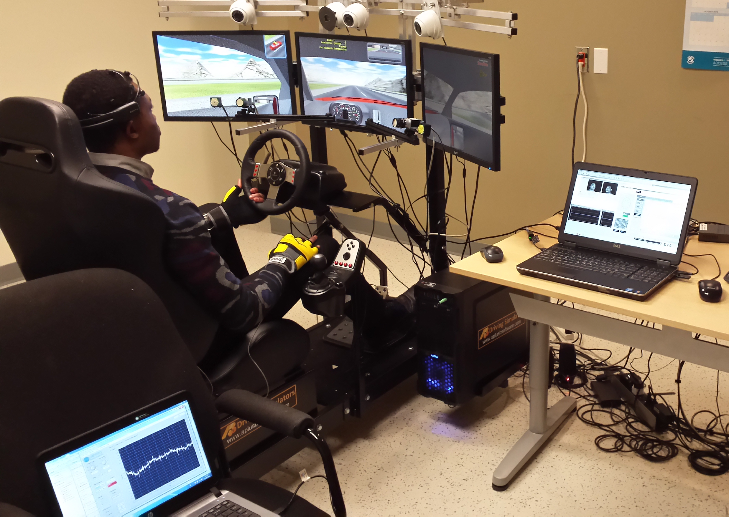
Methods
Simulated Driving Task (SDT)
More real-world situation using a driving simulator
Two separate sessions (different conditions & time of the day):
10-min control driving (CD)
30-min monotonous driving (MD)
30 subjects (age 40.13±9.69 years; 8 females)
Alcohol Countermeasure System Corp., Toronto, Canada
Smart Eye Pro system (60 Hz; two IR-based cameras)
SmartEye Pro Eye Tracker

Slide 6
Methods
Feature Extraction (28 features):
10-sec window with 50% overlap
General Gaze | Average, median, standard deviation, duration, frequency, percentage, scanpath, velocity, similarity index
Fixation
Saccade
Blinking
Classification:
Non-linear support vector machine (SVM) with RBF kernel
Gradient boosted tree (GBT) with maximum depth of 5
Evaluation:
CD alone
MD alone
Mixed CD and MD

Slide 7
Methods
Eye tracking data
Training
Testing
Models
SVM classifier
SVM classifier
Feature vectors
(training set)
Fusion
GBT classifier
GBT classifier
Time
timing window (10 sec)
Feature vectors
(testing)
Fused score
Feature vectors
Feature extraction (Left), Training (Middle), Verification (Right)

Slide 8
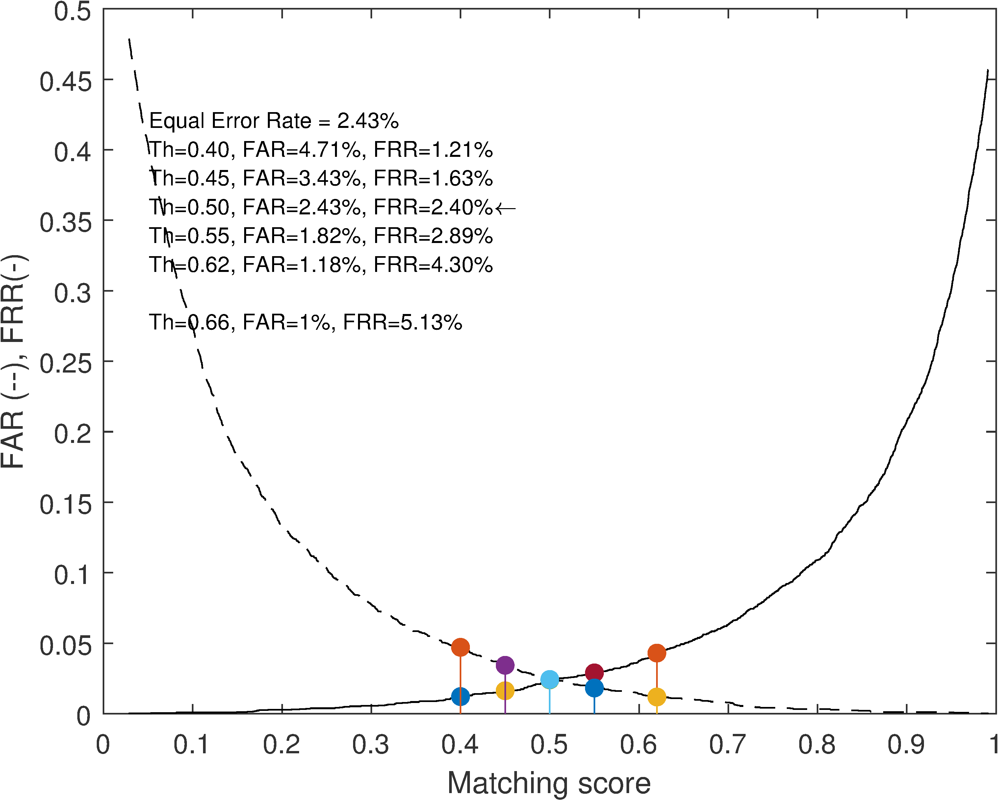
Results
CD Session:

Slide 9
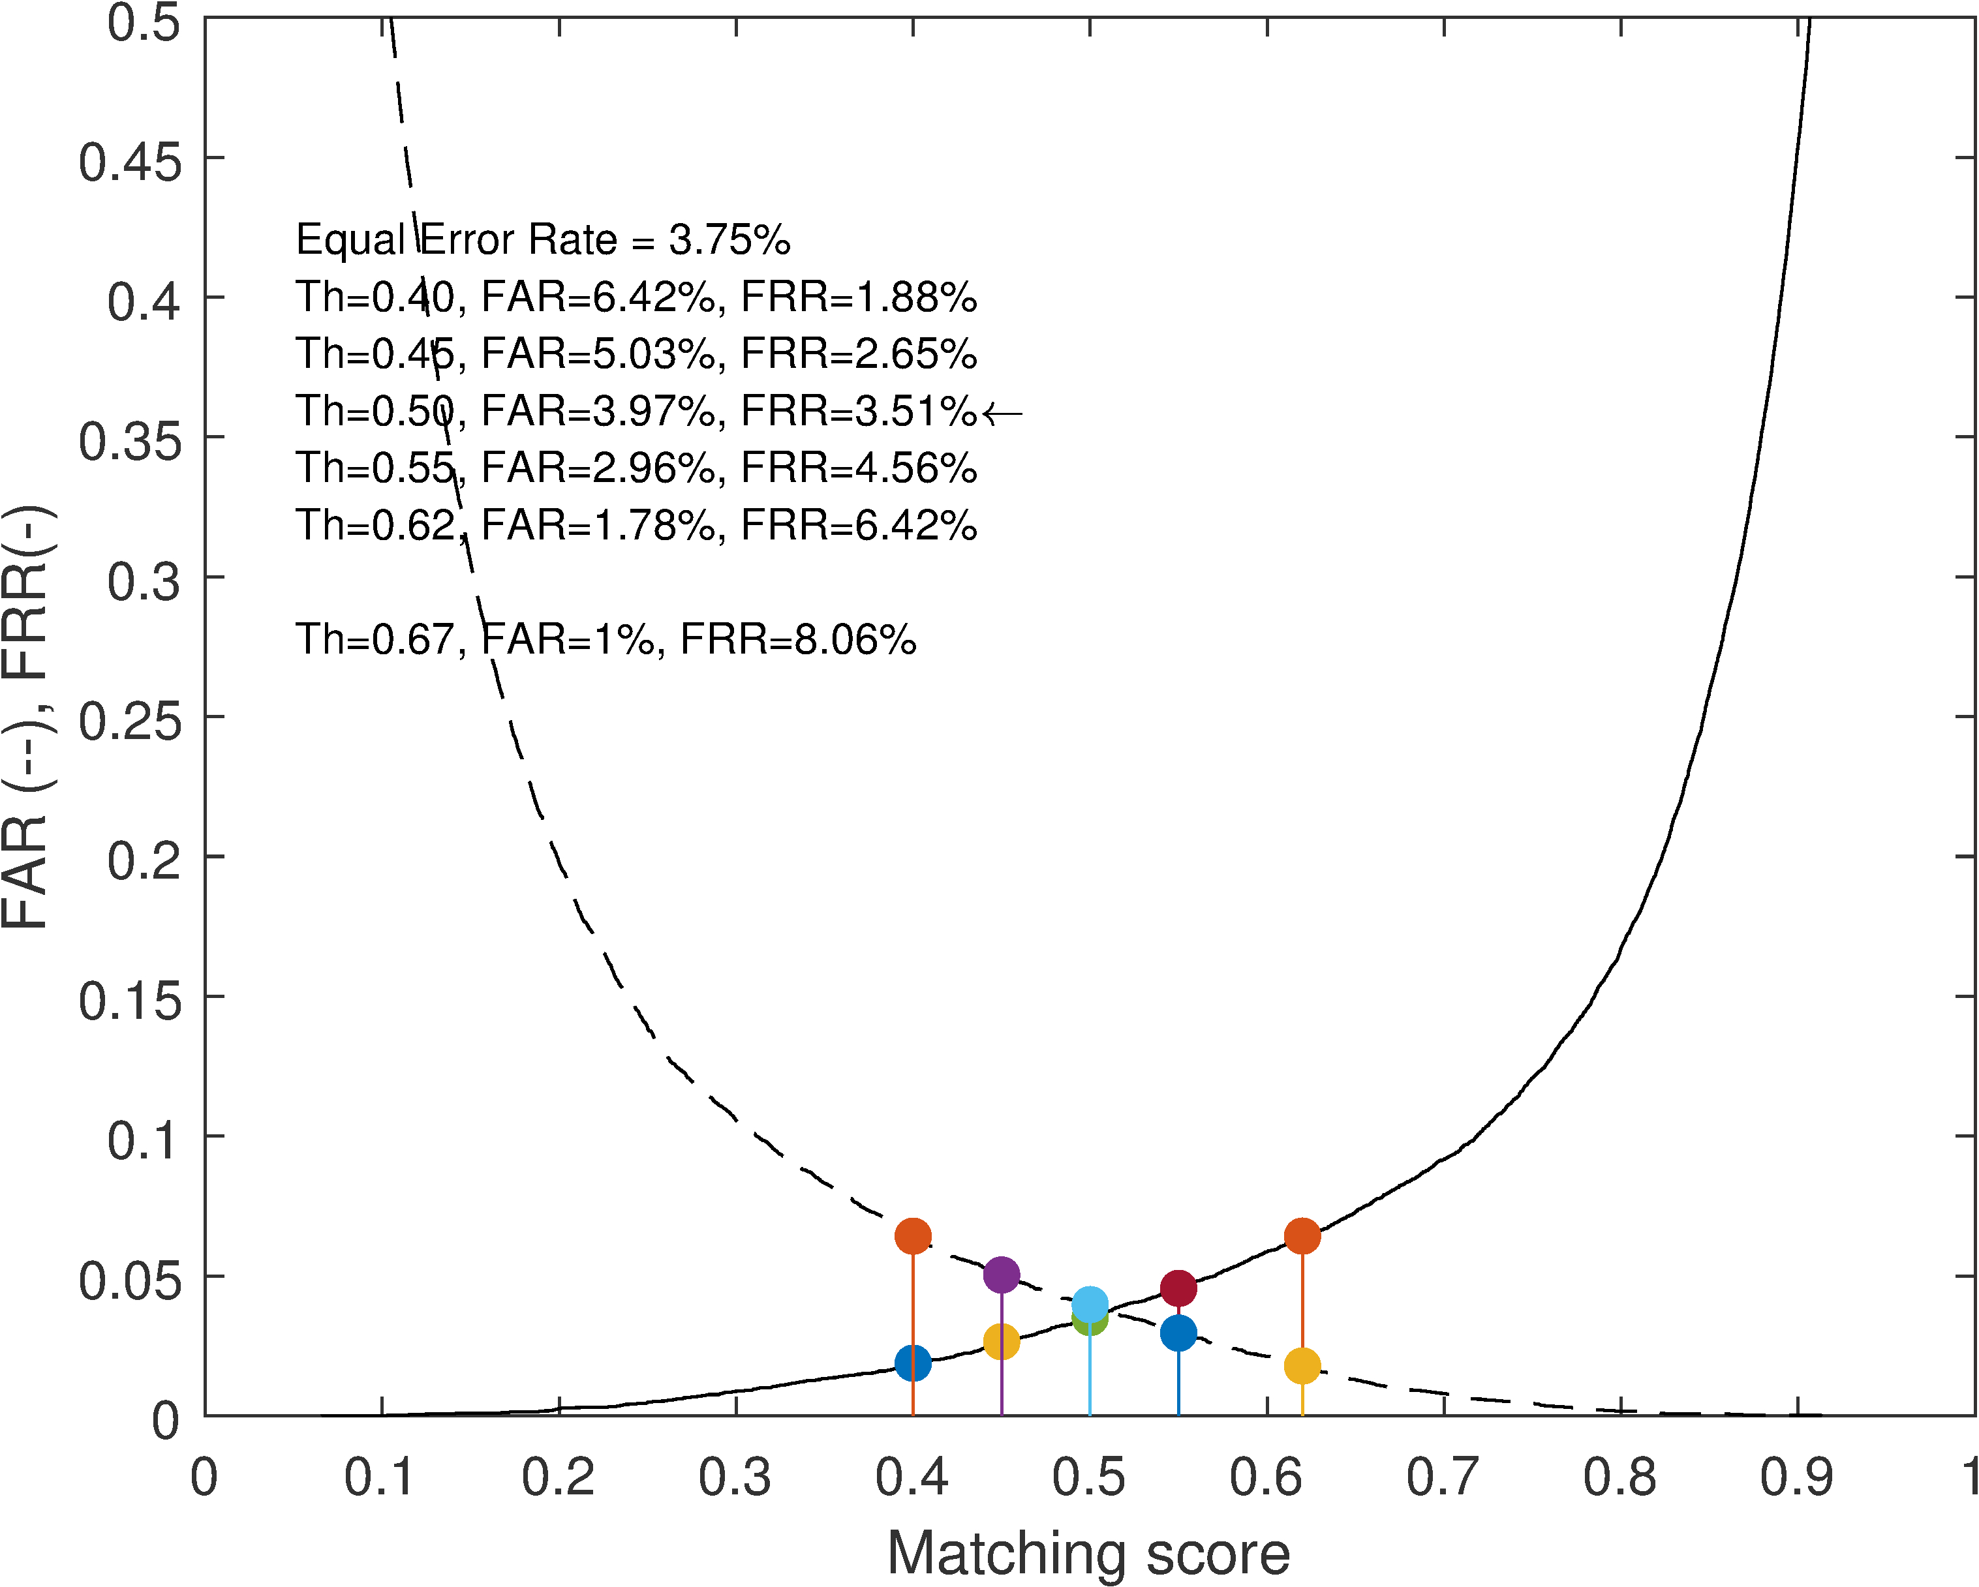
Results
MD Session:

Slide 10
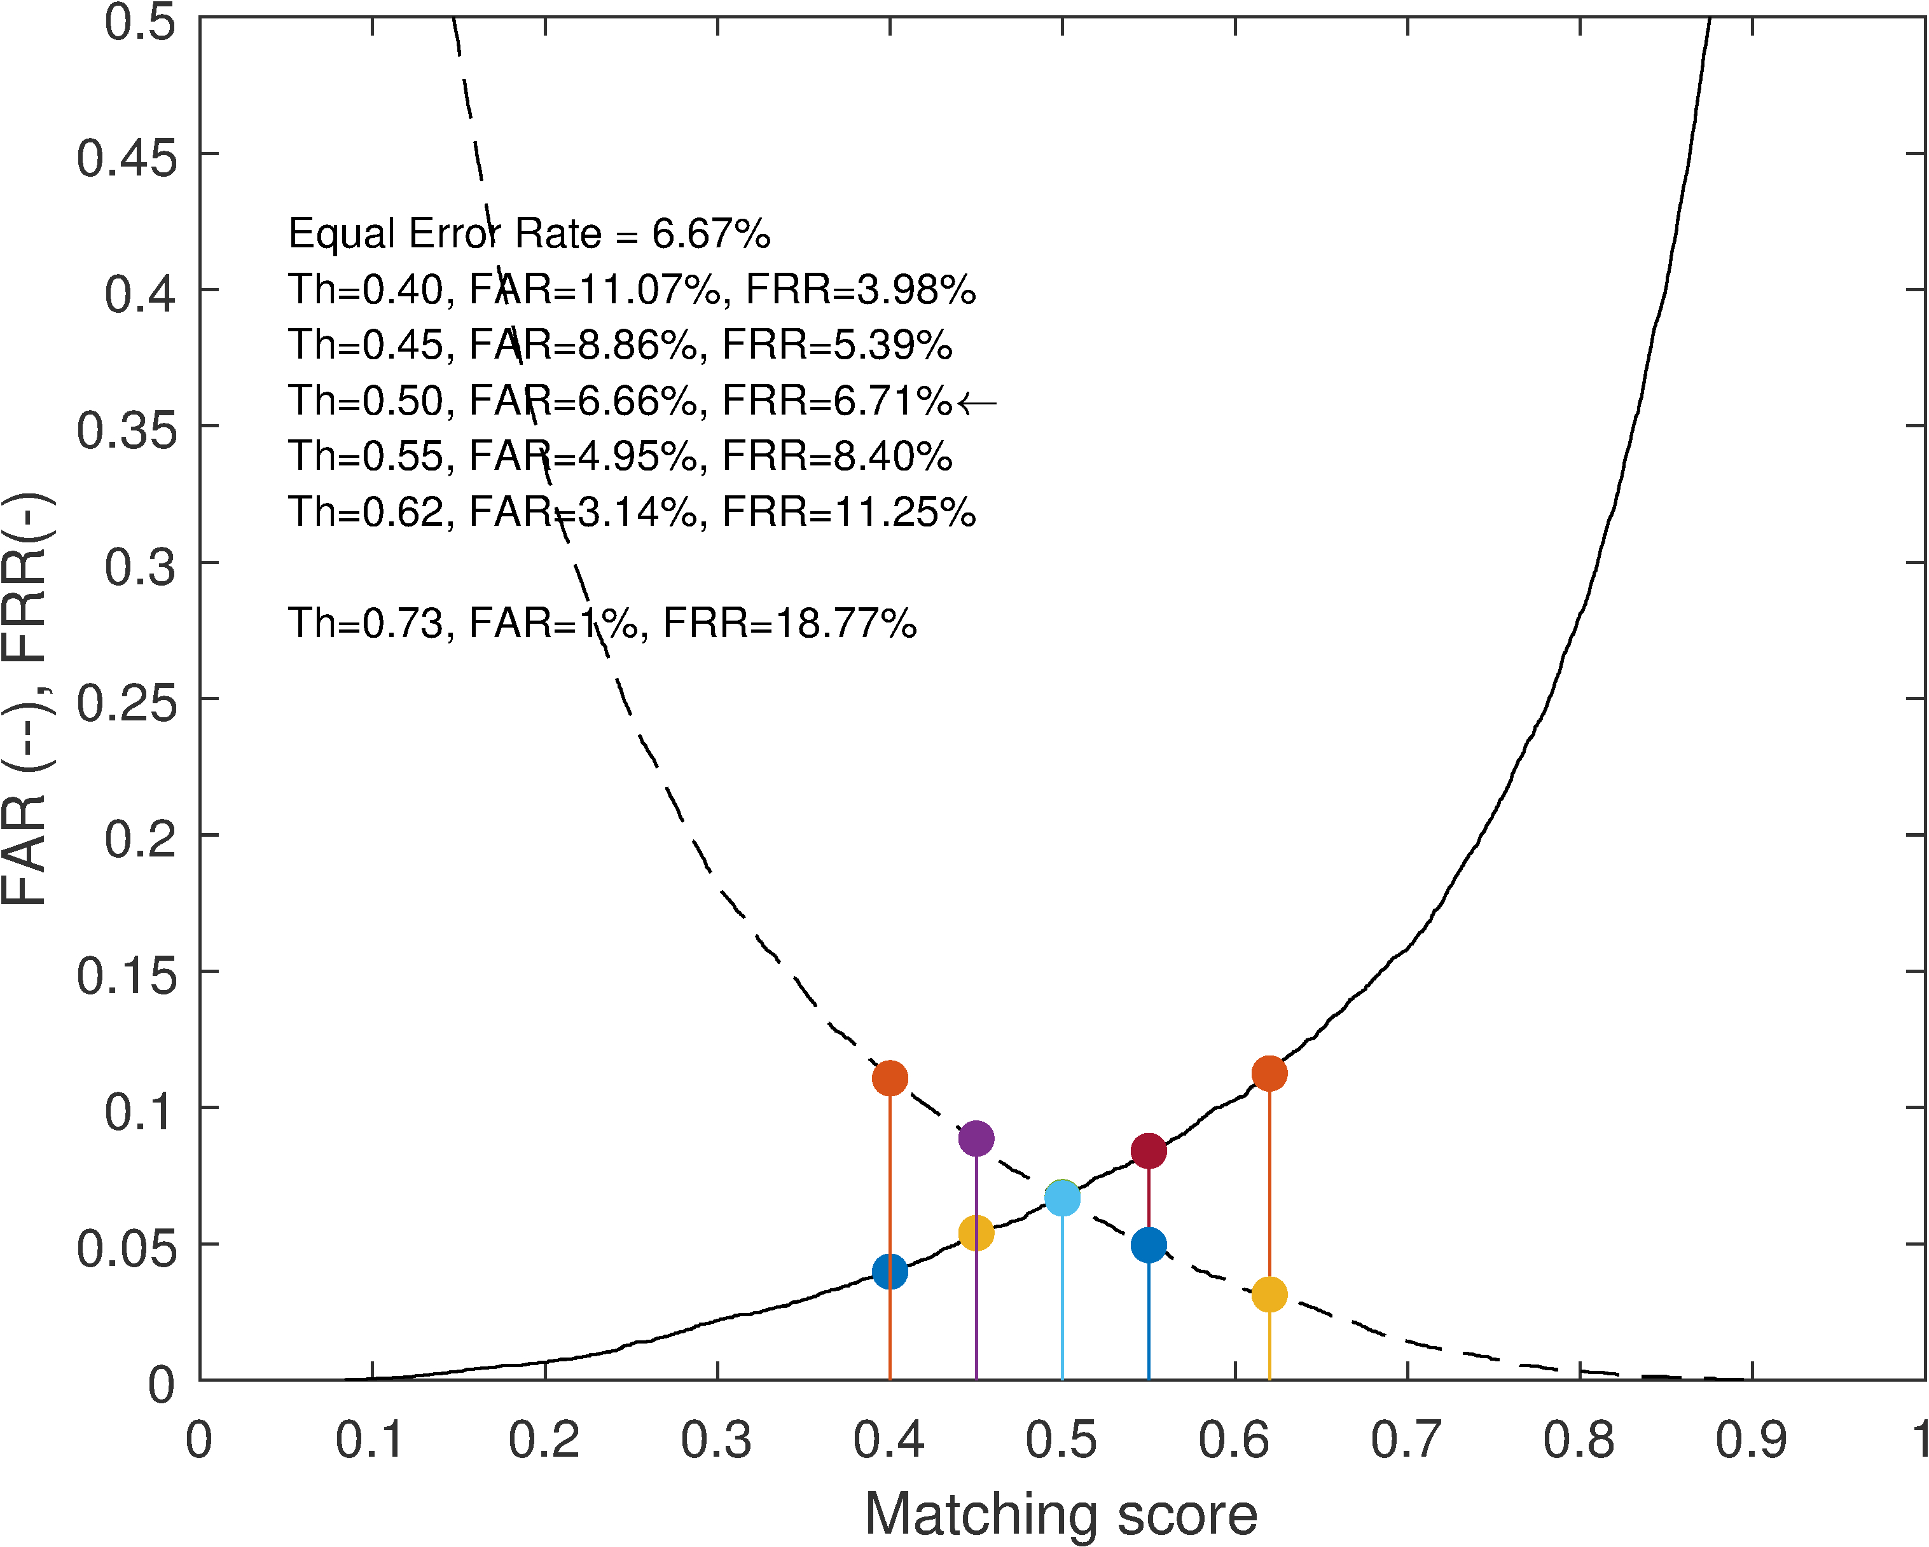
Results
Mixed Sessions:

Slide 11
Conclusion & Discussion
A machine learning based approach for driver verification using eye tracking data.
A simulated driving task (SDT).
The proposed methodology is suitable for practical implementation using simple features extracted in real-time.
The verification scheme can be easily implemented on embedded platforms.
Next steps:
Real driving conditions
Larger number of subjects
Other AI technologies including deep learning techniques
Extension to identification

Slide 12
Thank you!
Ali Zandi, Ph.D.
aszandi@acs-corp.com
Azhar Quddus, Ph.D.
aquddus@acs-corp.com
Q & A

