Slide 1


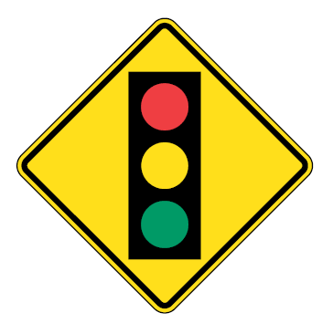

MUTCDC Sixth Edition:
Revisions to Enhance Safety
Raheem Dilgir, P.Eng., RSP
Alex Tahmazian, CET
CARSP Annual Conference
Calgary, AB
May 27, 2019
Notes:
The status is that it has been drafted and internally reviewed, but now addressing comments and receiving comments on today’s presentation about the proposed changes, then the team will revise and issue the first draft for the PSC.
The first draft can be provided in December.

Slide 2


Acknowledgements

Slide 3
Overview
Background
New Introductory Sections
New Structure for Guidance
New Guidance for Warning Signs
New Guidance on Sign Placement

Slide 4

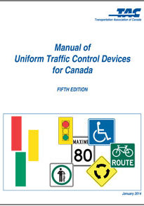
What is the MUTCDC?
Published by Transportation Association of Canada (TAC)
Led by the Traffic Operations and Management Standing Committee (TOMSC) and the sub-committee on Revisions and Additions
Owned by most TAC Members
Contains catalog of traffic control devices
  Signs
  Traffic Signals
  Pavement Markings
  Temporary Traffic Control Devices…

Slide 5
What’s in the MUTCDC?

Slide 6
Part A:
Signs

Slide 7
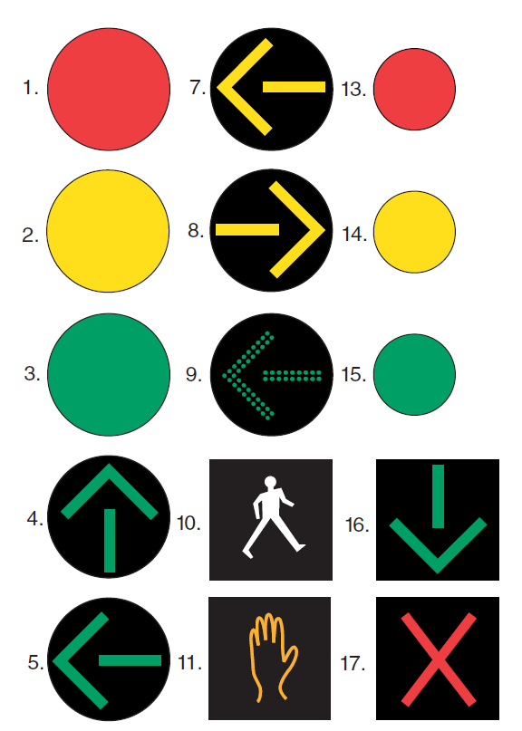
Part B:
Signals

Slide 8
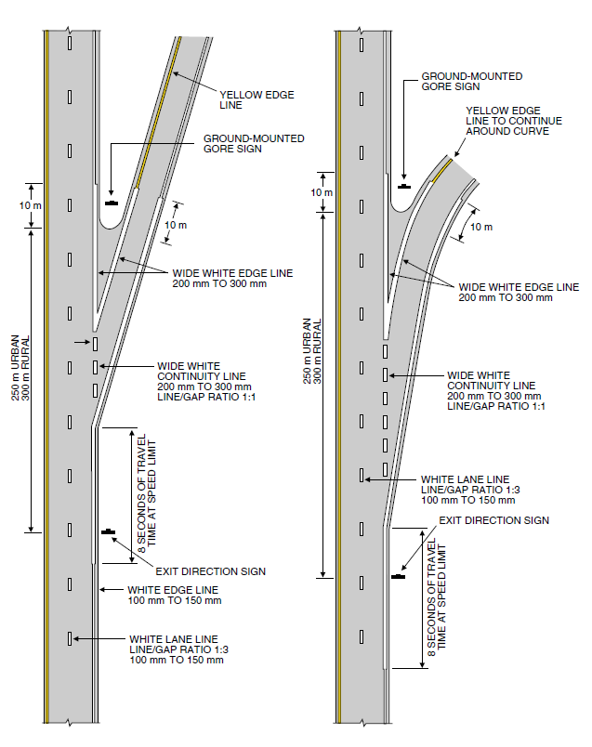
Part C:
Markings

Slide 9
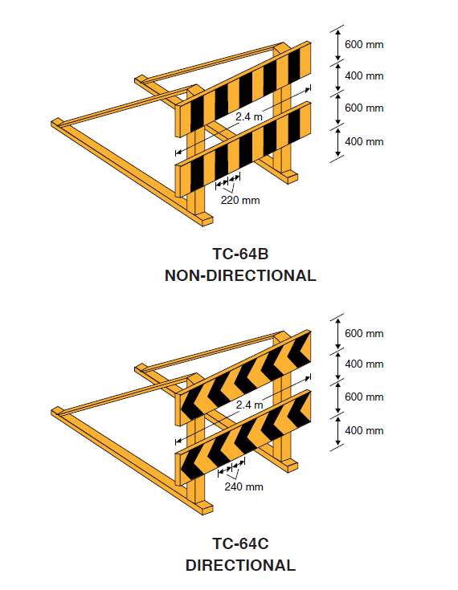
Part D:
Temporary Traffic Control

Slide 10

MUTCDC Development Chronology
1998
4th Edition Release
2014
5th Edition
Scoping 6th Edition
2016
Start of 6th Edition
2020
6th Edition Release
Last Major Update

Slide 11
New Introductory Sections

Slide 12

Safety Effects of Traffic Control Devices
National Policy Context: Road Safety Vision 2025
Impacts of Traffic Control Devices (TCD) on Road Safety
How safety is measured
Introduction to Safety Performance Functions and Collision Modification Factors
Road Safety Management Process (how safety is considered in making decisions)
Relationship between TCD compliance, warrants and safety performance

Slide 13

Road Users
Road user limitations
Traffic control device needs of:
  Aging road users
  Pedestrian
  Cyclists

Slide 14
New Structure for Each Device

Slide 15
New Structure and Language
Standard
Device “must” be provided
Guidance
Device “should” be provided
Option
Device “may” be provided

Slide 16
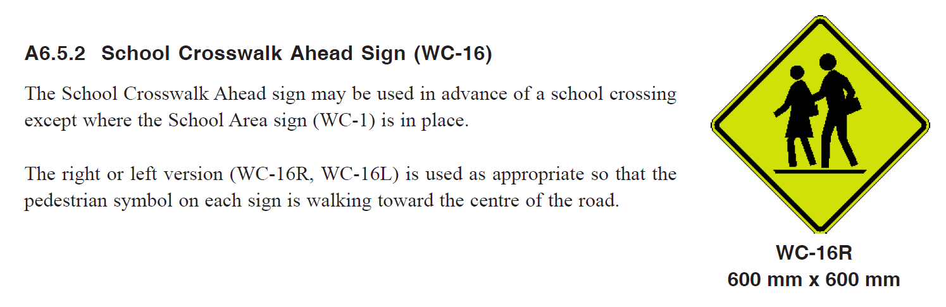
Example #1:
School Crosswalk Ahead (WC-16)
Existing Structure

Slide 17
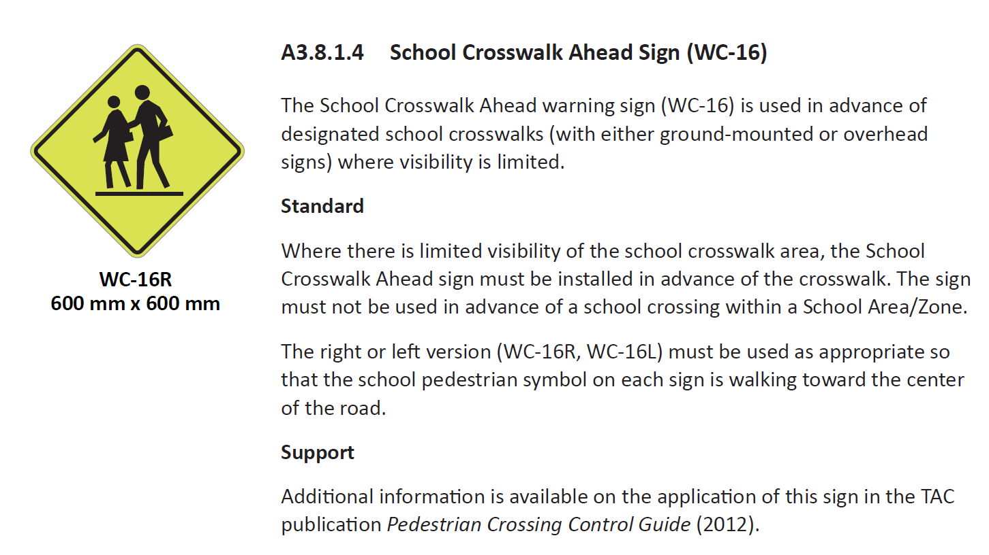
Example #1: School Crosswalk Ahead (WC-16)
New Structure

Slide 18
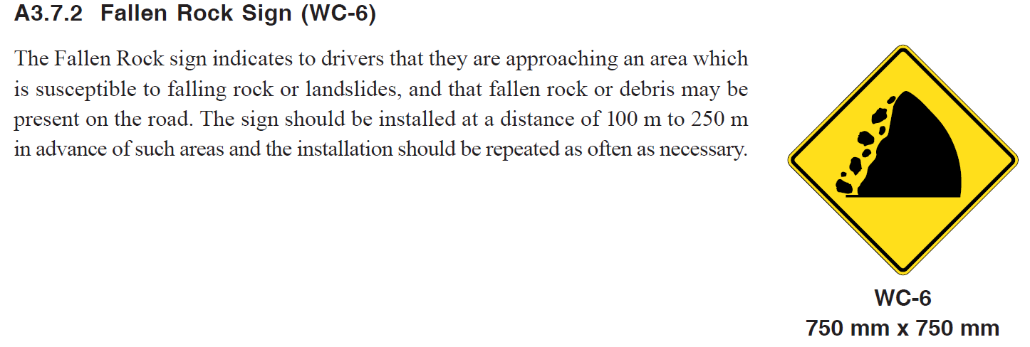
Example #2:
Fallen Rock (WC-6)
Existing Structure

Slide 19
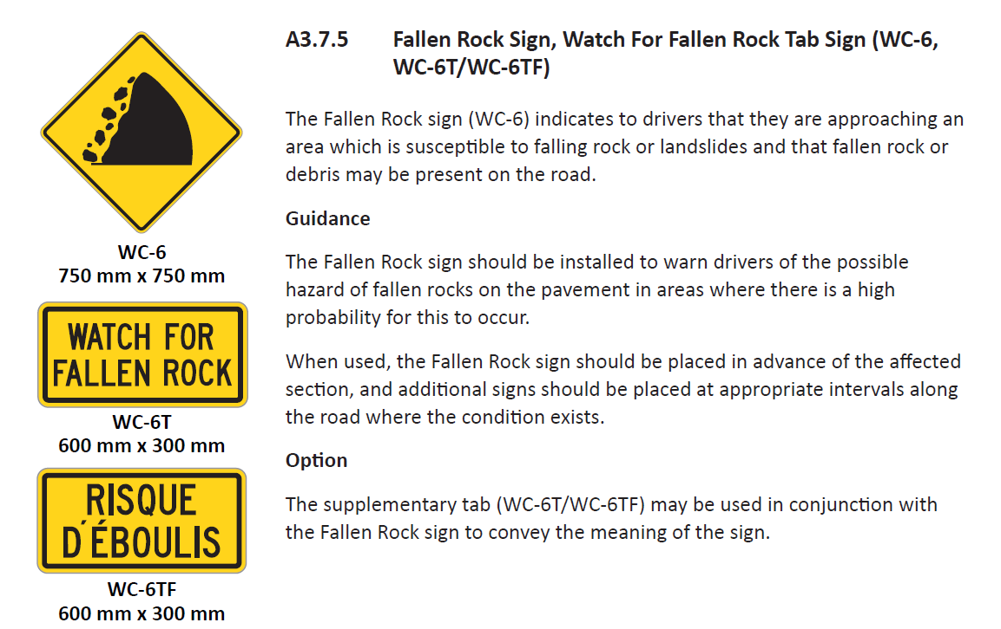
Example #2: Fallen Rock (WC-6)
New Structure

Slide 20
Signs with “Must” Requirements
Checkerboard (WA-8) – wherever a roadway ends in a T
Merge (WA-16) – wherever a merge manoeuvre is required
Railway Crossing Ahead (WA-18, WA-19) – before every railway crossing
Road Narrows (WA-23) – before every significant narrowing
Narrow Structure (WA-24) – wherever two-way roadway narrows to 6 m
Lane Ends (WA-33) – wherever a lane terminates
Low Clearance (WA-26, WA-27) - wherever the clearance < 4.3 m
Object Marker (WA-36) – to mark any road obstruction
Neighbourhood Speed Hump (WA-50) – before every hump
Divided Highway Ahead (WA-34) – before every two-stage crossing
Two-way Traffic Ahead (WB-3) – where road changes to two-way undivided
Notes:
Note, in most cases the “must” requirements are for conditions that are present (e.g. object marker), but in a few cases, it is on the basis of the degree of the condition (e.g. limited SSD for traffic control devices)

Slide 21
Signs with “Must” Requirements (cont’d)
Stop Ahead (WB-1) – where SSD is inadequate
Yield Ahead (WB-2) – where SSD is inadequate
Signals Ahead (WB-4) – where SSD is inadequate
Roundabout Ahead (WA-39) – where SSD is inadequate
Reserved Lane Ahead (WB-7) – where a lane change is required
Pedestrian/Bicycle Crossing Ahead (WC-46) – before every MUT crossing
Opening Bridge (WC-11) – for any bridge that opens
Pedestrian Crosswalk Ahead (WC-2) – where SSD is inadequate
School Crosswalk Ahead (WC-16) – where SSD is inadequate

Slide 22
New Detailed Guidance for Warning Signs

Slide 23
Approach to Providing Additional Guidance
FOR EACH SIGN, START HERE:
1. Is adequate guidance provided in MUTCDC?
Yes
Leave as is, minor edits
No
Develop “basic” warrant
2. Is sign “safety-critical”?
No
Provide summary, link to publication in MUTCDC
3. Is adequate guidance provided in other TAC publications?
Yes
Yes
Develop “detailed” warrant
No
Notes:
Notes to Hart:
This process was not followed rigorously, but as a guideline. There were several exceptions, e.g. some signs were safety-critical but did not need “detailed” guidance (in some cases they just needed more safety-oriented guidance); and other signs were not considered safety-critical, but did require more extensive guidance. Safety was just used as a guideline to help prioritize.
We prioritized the list of signs that required “detailed” guidance for the sake of managing our effort, not knowing if we would get through all of them…but we did!
In April we proposed to prepare “detailed” guidance for up to 10 signs, but we ended up doing 19 signs!
Some of the “detailed” guidance was for implementation, not only application.

Slide 24
Signs for which Detailed Guidance/Revisions were Prepared (Application or Implementation Guidance)
Single Turn and Curve (WA-1, WA-2, WA-3, WA-4, WA-5)
Advisory Speed Tab (WA-7S)
Checkerboard (WA-8)
Concealed Road Signs (WA-11, WA-12, WA-13, WA-14, WA-15)
Road Narrow/Narrow Structure (WA-23, WA-24)
Stop, Yield, Roundabout and Signal Ahead Signs (WB-1, WB-2, WA-39, WB-4)
Prepare to Stop (WB-5)

Slide 25


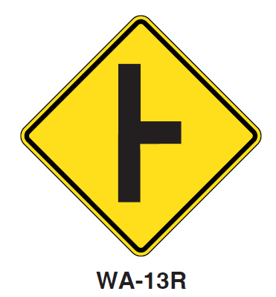
Example of Detailed Warrant Guidance
Concealed Road Signs (WA-11, WA-12, WA-13)

Slide 26
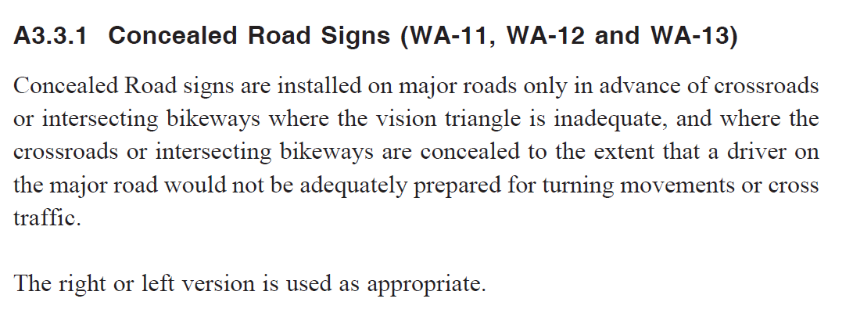
Concealed Road Signs (WA-11, WA-12, WA-13)
Existing Guidance

Slide 27
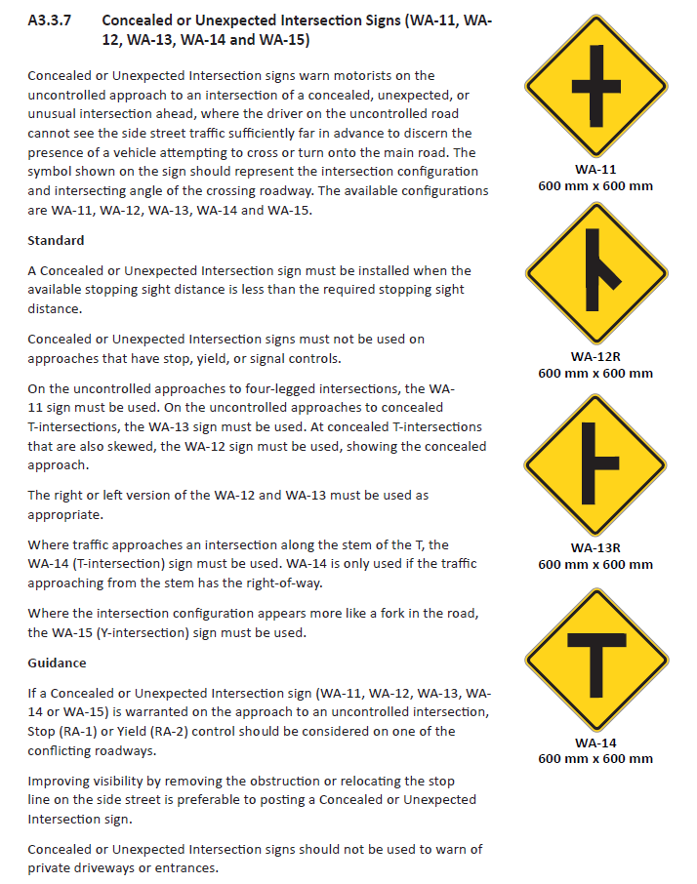
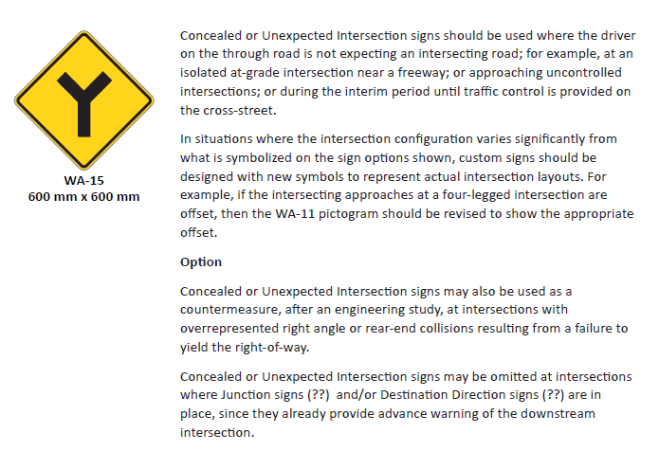
New Detailed Warrant Guidance
Notes:
Note, the new guidelines provide a lot more guidance:
-consolidation of all configurations and systematic discussion
-option to use for “unexpected” situation, not only concealed (i.e. redefinition)
-guidance regarding sight distance: requirements and measurement method
-suggestions for customization based on configuration

Slide 28
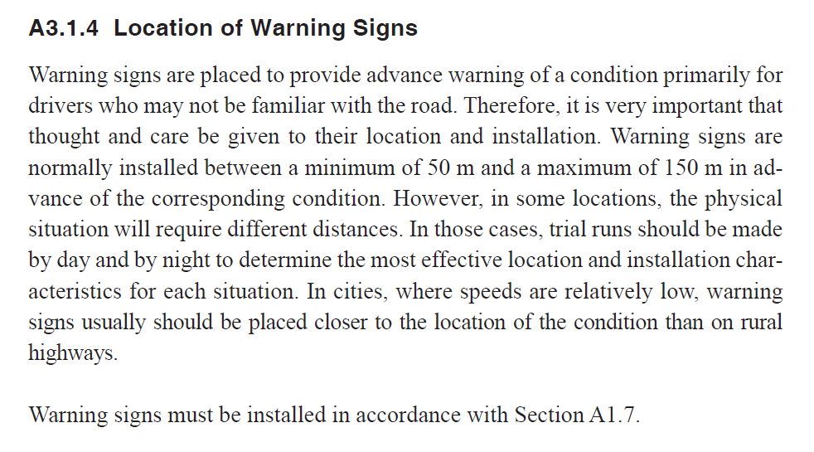
Sign Placement – Existing Guidance

Slide 29
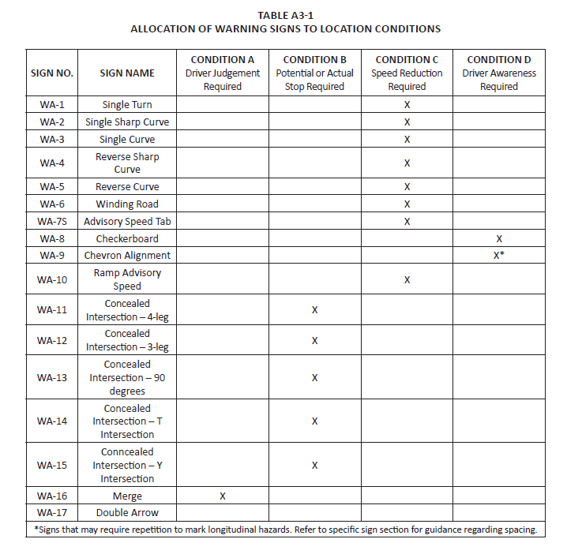
Sign Placement – New Guidance

Slide 30
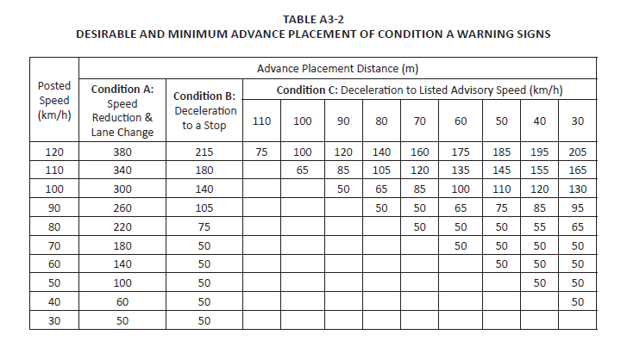
Sign Placement – New Guidance (cont’d)

Slide 31

Questions / Discussion
Raheem Dilgir
TranSafe Consulting Ltd.
(604) 563-9988
raheem@transafe.ca
www.transafe.ca

