Slide 1
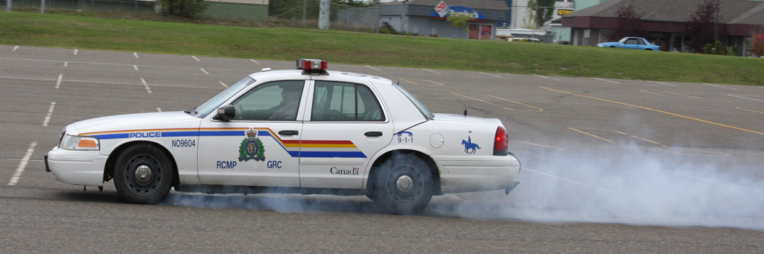
Synectics
DRAG SLED MECHANICS;
WHAT IT MEASURES
Francis P.D. Navin, P.Eng, Ph.D., D.Sc.(Hon)
Professor Emeritus, Civil Engineering, UBC.
President, Synectics RSR Corp., Vancouver, BC
.

Slide 2
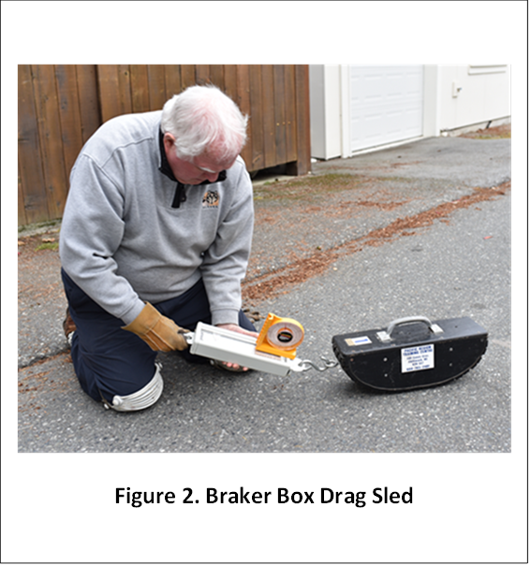
WHAT IS A DRAG SLED?
A Drag Sled is shown to the right.
A DRAG SLED measures the interaction of a rubber tire and dry pavement.
It has been used for about 75 years to estimate a “vehicle’s stopping ability”.
There have been questions about how well it can measure what ever it measures!
This presentation defines the necessary conditions for a drag sled to measure the “tire pavement coefficient of kinetic friction”.

Slide 3
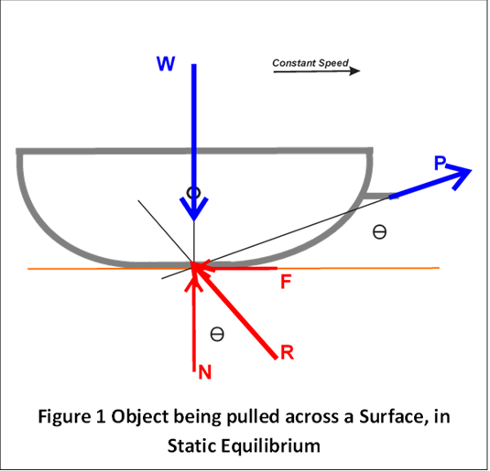
FREE BODY OF A DRAG SLED IN STATIC EQUILIBRIUM
1. This diagram shows a drag sled in static equilibrium. The conditions are; the three forces are coplanar and concurrent (they converge to a single point on the pavement surface) and uniform motion.
    An object at rest stays at rest and an object in motion remains in motion with the same speed and in the same direction unless acted upon by an unbalanced force.
2. Given these conditions then; by definition the ratio of the friction force F divided by the normal force N is the coefficient of the drag sled’s rubber pavement coefficient of kinetic friction.

Slide 4
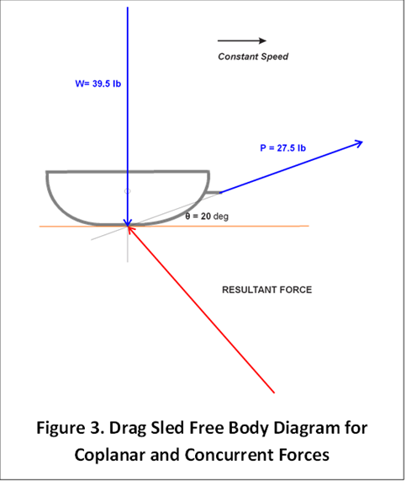
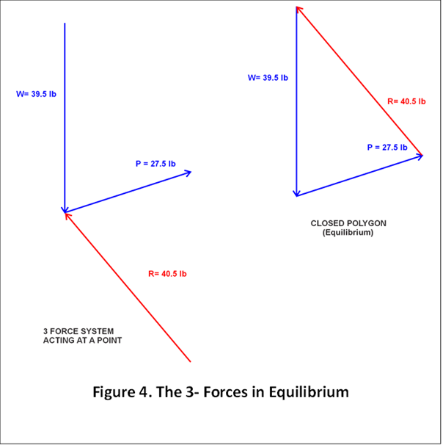
EXAMPLE OF A
DRAG SLED
FREE BODY DIAGRAM
CLASSIC THREE FORCE SYSTEM
The three force system is in equilibrium if it is a closed polygon of forces.
The Resultant may be further analyzed.
.

Slide 5
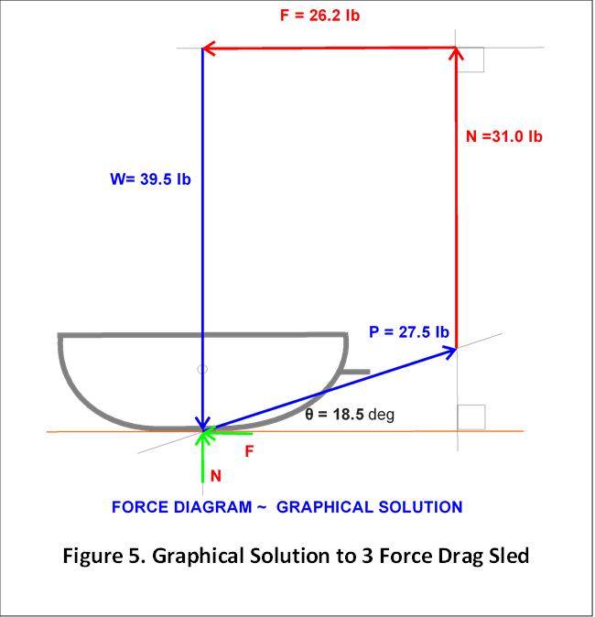
GRAPHICAL SOLUTION FOR THREE FORCES
IN STATIC EQUILIBRIUM
SOLUTION PROCESS
  1. Draw the Drag Sled to Scale.
  2. Select the force scale.
  3. Draw W acting vertical through the centre of mass and intersecting the drag sled pavement interface.
  4. Draw the Pull Force P starting at the concurrent point and going through the pulling pin.
  5. Draw the Normal force N vertical at the end of the Pulling Force P.
  6. Finally, draw the Friction Force, F parallel to the interface such that it starts at N and ends at the start of W.
  7. BY DEFINITION the coefficient of kinetic friction is; µ = F/N = 26.2/31.0 = 0.85
A DRAG SLED, PROPERLY USED, MEASURES THE COEFFICIENT OF KINETIC FRICTION.
.

Slide 6
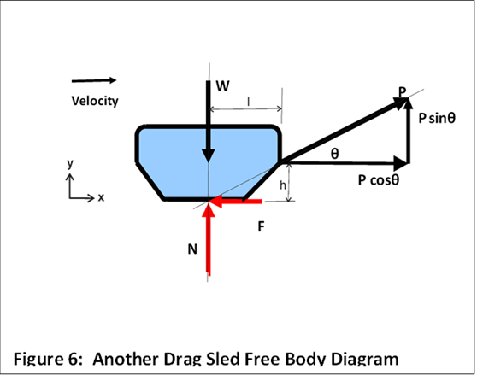
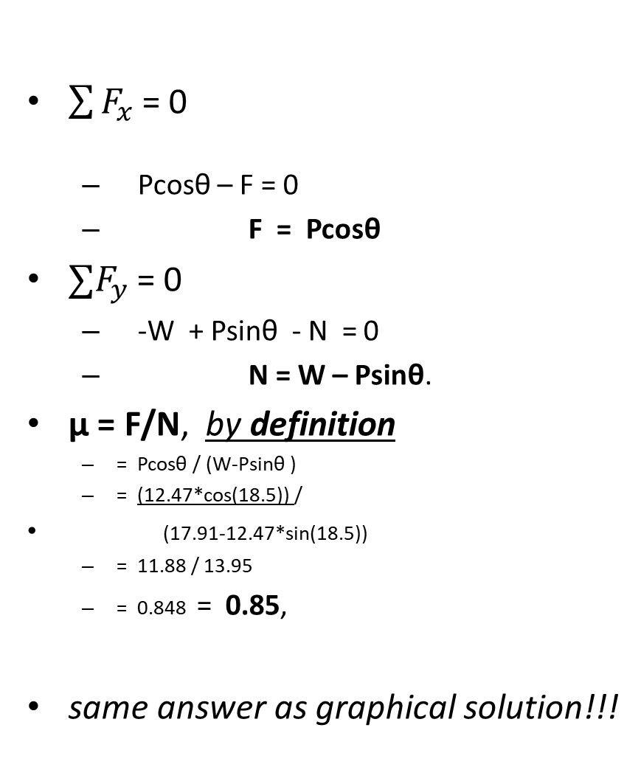
ANALYTICAL SOLUTION FOR THREE FORCES
IN STATIC EQUILIBRIUM
$\sum{F_{x}}$= 0
  Pcosθ – F = 0
  F = Pcosθ
$∑F_{y}$ = 0
  -W + Psinθ - N = 0
  N = W – Psinθ.
µ = F/N, by definition
  = Pcosθ / (W-Psinθ )
  = (12.47*cos⁡(18.5)) /
(17.91-12.47*sin⁡(18.5))
  = 11.88 / 13.95
  = 0.848 = 0.85,
same answer as graphical solution!!!
Note that the three forces are concurrent and coplanar.

Slide 7
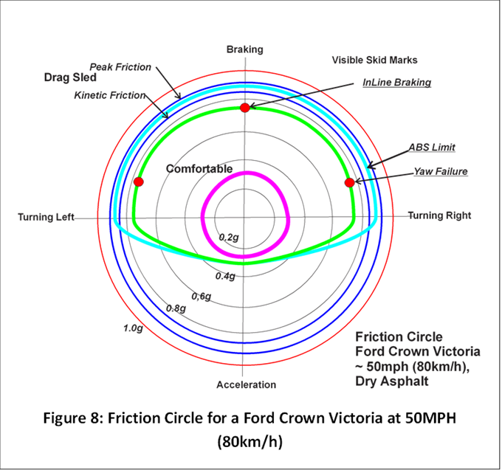
USING A DRAG SLED’S COEFFICIENT OF FRICTION TO ESTIMATE A VEHICLE’S SPEED WITH LOCKED WHEEL BRAKING
USE THE FOLLOWING EQUATION
  V=(254 N f(x ) d)^0.5
  V = Vehicle speed estimate, km/h
  d = Visible skid marks, m
  f(x) = Tire pavement coefficient of kinetic friction,
  N = Vehicle’s estimated braking efficiency relative to the tire pavement coefficient of kinetic friction.
  254 = a factor to convert speed estimate to km/h.
  N is estimated as;
    N = InLine Braking/Drag Sled Kinetic Friction
    = 0.75/ 0.848 = 0.88 then
    V = (254 * 0.88 * f(x) * d)^0.5
  Assume a new measure of f(x) is 0.70, then the new speed estimate is;
    V= (254 *0.88 *0.70 *d)^0.5
    = (254 * 0.66 *d)^0.5
FRICTION CIRCLE.

Slide 8
STANDARDIZING THE ESTIMATE OF A
VEHICLE’S SPEED AT THE START OF SKID MARKS.
Given a vehicle’s visible skid marks of length d on a dry pavement.
Make measurements using the three force static equilibrium model, for the drag sled’s coefficient of kinetic friction, f(x) on the dry pavement.
Given the friction circle for the vehicle at a similar speed; estimate the vehicle’s braking efficiency N relative to the drag sled’s coefficient of kinetic friction.
Then use this braking efficiency, N to estimate the vehicle’s speed at the start of visible skid marks, d;
    V=(254 N f(x ) d)^0.5

Slide 9
conclusions
A drag sled, having Three Forces in Static Equilibrium, measures a rubber tire on pavement coefficient of kinetic friction, f(x).
Given a measured length of a stopping vehicle’s visible skid marks, d.
Given the known or estimated vehicle’s braking efficiency, N.
Then the vehicle’s speed, V at the start of visible skid marks is;
V = (254 N f(x ) d)^0.5
This is a scientifically correct estimate of the vehicle’s start of braking speed!

Slide 10

THANK YOU
CONTACT INFORMATION
Prof. Frank Navin, P.Eng., Ph.D., D.Sc.(Hon).
4548 West 7th Avenue.
Vancouver, BC.
V6R 1X3, Canada
604-683 4714 (cell)
fnavin@synectics.ca, or
navin@civil.ubc.ca

