Slide 1

Real World Side Impacts Involving
Rear Pediatric Occupants
Dr. Michael Shkrum
Kevin McClafferty
Allison Pellar
Dennis Carter
Western University
Motor Vehicle Safety (MOVES) Research Team
Dr. Douglas Fraser
Tanya Charyk-Stewart
London Health Sciences Centre
Jean-Louis Comeau
Transport Canada

Slide 2
MOVES Research Team
Conducts field investigations and research for Transport Canada
  Collision investigations
  Motor vehicle safety research
  Investigations of public complaints of safety-related motor vehicle defects
Pediatric Study
  Transport Canada + LHSC + MOVES

Slide 3
Aims
Mechanisms of pediatric injury in severe side impacts
Crash performance of restraint systems
Mitigate and prevent injury
Notes:
Increased knowledge of pediatric injury causation is needed for public education and to assess/improve government regulations

Slide 4
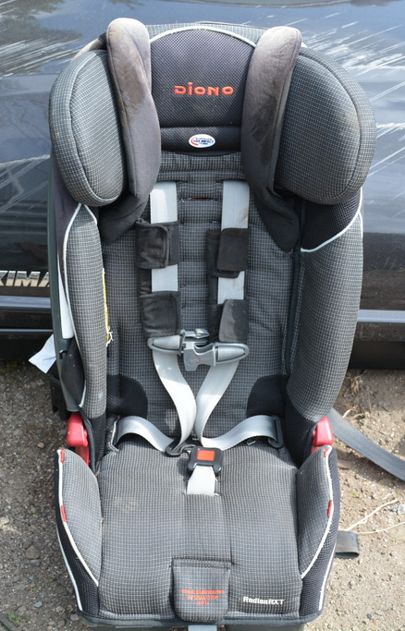
Methodology
Case notifications
  Daily level 1 Pediatric Trauma Center reports
Collision investigation
Delta-V (velocity change)
  Collision severity
Injury data

Slide 5
Methodology
Side impacts involving children under 12 years of age in a rear seating position
Collisions investigated by the Western MOVES Team
  Weighted towards severe pediatric injury
Comparison of injury severity

Slide 6
Abbreviated Injury Scale (AIS)
Injuries are ranked on a scale of 1 to 6 according to the associated threat to life
MAIS = Maximum Abbreviated Injury Score
AIS SCORE | INJURY
1 | MINOR
2 | MODERATE
3 | SERIOUS
4 | SEVERE
5 | CRITICAL
6 | MAXIMUM

Slide 7
Literature Review
Risk and rate of injury varies by seat position
4x as likely sustain injuries from intrusion than in frontal impacts
Head injuries most common
Greater risk of injury for near side occupants
Benefit of adjacent occupants

Slide 8
Case Study
2009 Dodge Journey 4-Dr SUV
Struck on front left side by front end of pickup
Driver: 35-yr-F, Lap / torso / front+torso+curtain airbag, Major injuries
Left rear passenger: 3-month-M, Infant carrier, Fatal injuries
Rear passenger: 33-yr-M, Unrestrained, Fatal injuries

Slide 9
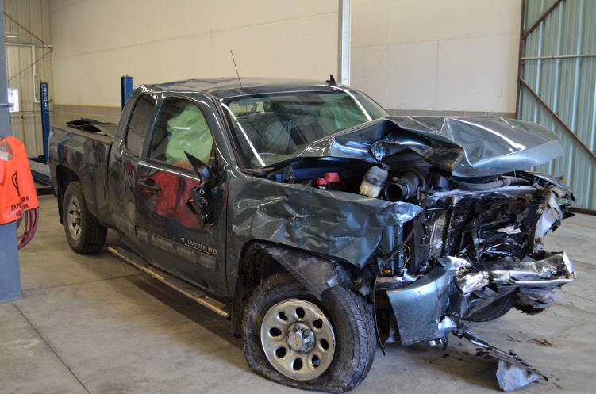

Slide 10
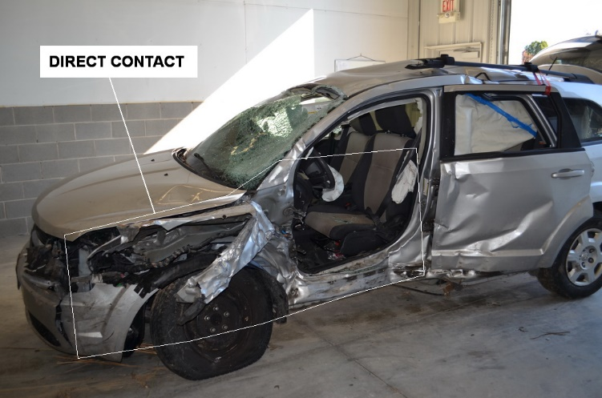

Slide 11
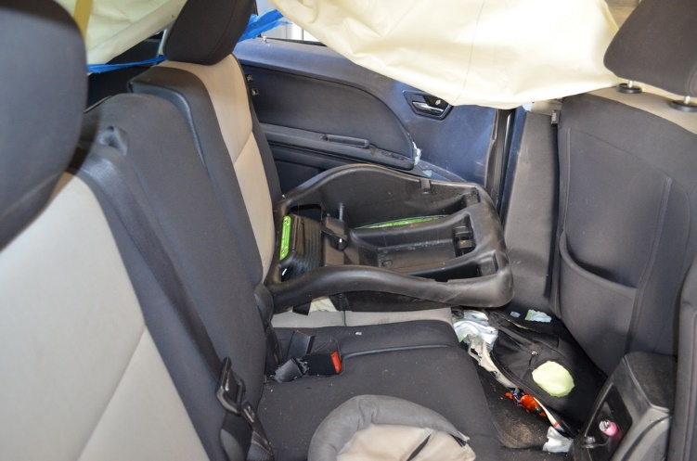

Slide 12
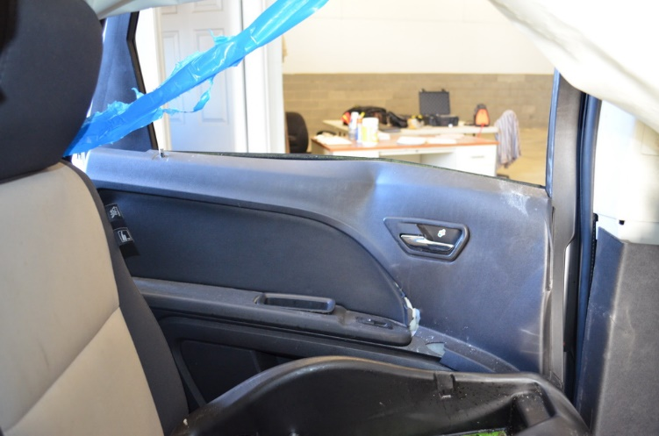

Slide 13
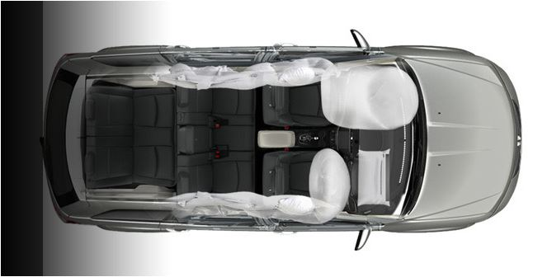
IMPACT FORCE
DELTA-V

Slide 14
Injury Summary
Head injuries
  Facial contusions/abrasions
  Multiple skull fractures
  Brain hemorrhage
Contusions lower mid-chest
Pulmonary contusion
Right humerus fracture

Slide 15
Injury Mechanisms
Unrestrained adult likely loaded the child seat and infant
  Damage to interior of left door and B-pillar
  Compression of child seat
  Patterned injury on left face due to CRS handle
High delta-V and very severe central impact with minimal intrusion

Slide 16
Results
Collisions (N = 27) involved 52 children
  23 F / 29 M
  3 months-12 years
Posted speed limit 80 km/h or above (N=24)
  Average speed striking vehicle 72 km/h
  Average speed case vehicle 52 km/h

Slide 17
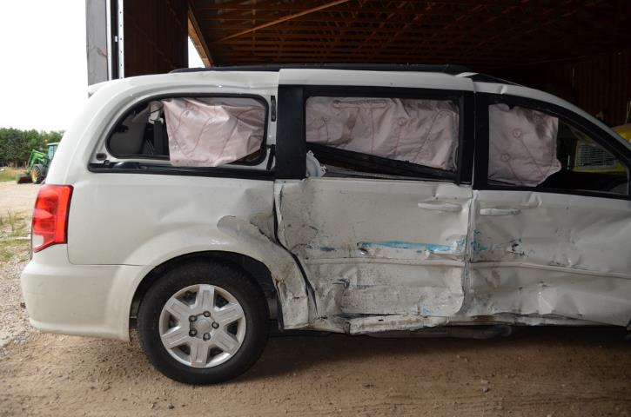
Results
Delta-V ranged from 23 km/h to 65 km/h (average= 39 km/h)
Intersection related (N=19)
  Travelling straight (N=16)
  Turning left (N=3)

Slide 18
Injuries
7 fatalities
28 children with MAIS-2+ injuries
Head injuries
  35% (N=18) MAIS-2+
  5 of 7 fatalities
  8 outside intrusion zone
Notes:
MAIS 2+ abdominal injuries in 2 fatal cases
MAIS 2+ head injuries in 3 cases (including both fatalities)
MAIS 2+ spine injuries in 3 cases

Slide 19
Injuries
Chest injuries
  17% (N=9) MAIS-2+ (2/7 fatalities)
  6 near-side
Abdominal injuries
  15% (N=8) MAIS-2+ (2/7 fatalities)
  5 near-side
Notes:
MAIS 2+ abdominal injuries in 2 fatal cases
MAIS 2+ head injuries in 3 cases (including both fatalities)
MAIS 2+ spine injuries in 3 cases

Slide 20
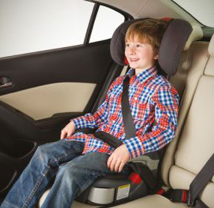
Restraint Use
87% restrained (N=45)
  47% (N=21) MAIS-2+
13% unrestrained (N=8)
  86% (N=6) MAIS-2+
  1 fatal
Restraint misuse (N=7)
Notes:
MAIS 2+ abdominal injuries in 2 fatal cases
MAIS 2+ head injuries in 3 cases (including both fatalities)
MAIS 2+ spine injuries in 3 cases

Slide 21
Seating Position
19 seated on left side
  63% (N=12) MAIS-2 + injuries
  4 fatal
23 seated on right side
  56% (N=13) MAIS-2 + injuries
  3 fatal
Notes:
MAIS 2+ abdominal injuries in 2 fatal cases
MAIS 2+ head injuries in 3 cases (including both fatalities)
MAIS 2+ spine injuries in 3 cases

Slide 22
Seating Position
12 left side impacts (24 children)
15 right side impacts (28 children)
Right side impacts 71% of the MAIS-2 + injuries
Notes:
MAIS 2+ abdominal injuries in 2 fatal cases
MAIS 2+ head injuries in 3 cases (including both fatalities)
MAIS 2+ spine injuries in 3 cases

Slide 23
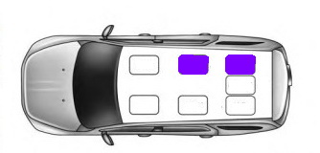
Near-Side Occupants
21 near-side
  76% (N=16) MAIS-2+
  5 out of 7 fatal
Intrusion <10 cm
  5 out 7 had no or minor injuries
Intrusion >10 cm
  14 out 14 had MAIS-2 or higher
Notes:
MAIS 2+ abdominal injuries in 2 fatal cases
MAIS 2+ head injuries in 3 cases (including both fatalities)
MAIS 2+ spine injuries in 3 cases

Slide 24
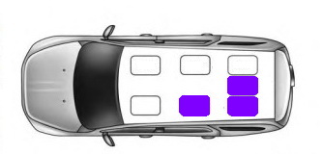
Far-Side and Centre Occupants
29 occupants outside intrusion zone
  34% (N=10) MAIS-2 +
  2 fatal
60 % (3/5) unrestrained MAIS-2+
28 % (7/25) restrained MAIS-2+
1 out 8 centre occupants MAIS-2+
Notes:
MAIS 2+ abdominal injuries in 2 fatal cases
MAIS 2+ head injuries in 3 cases (including both fatalities)
MAIS 2+ spine injuries in 3 cases

Slide 25
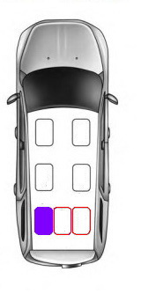
Adjacent Occupants
76% (N=22) outside intrusion had 1+ adjacent occupant
  18 % (N=4) MAIS-2+
86% (6 out of 7) without MAIS-2+
Notes:
MAIS 2+ abdominal injuries in 2 fatal cases
MAIS 2+ head injuries in 3 cases (including both fatalities)
MAIS 2+ spine injuries in 3 cases

Slide 26
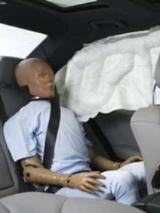
Side Curtain Airbags
18 vehicles side curtain deployed
13 near-side with
  31% (N=4) MAIS-2 + head injury
8 near-side without
  75% (N=6) MAIS-2 + head injury
Notes:
Front seats manage occupant energy with multi-stage airbags and seatbelt pretensioners for lap and torso
Rear seats manage only through lap/torso belts without pretensioners
Optimal seatbelt anchorage locations for small children are very different from those for adults
TC crash tests show that even with booster seats, the torso belt can roll off shoulder or lap belt ride up into abdomen

Slide 27
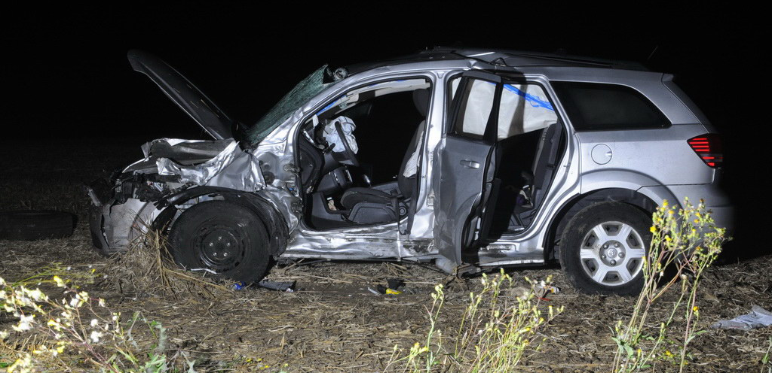
Discussion
High-severity rural events
Average delta-V: 39 km/h
Average delta-V frontal: 53 km/h
Notes:
Front seats manage occupant energy with multi-stage airbags and seatbelt pretensioners for lap and torso
Rear seats manage only through lap/torso belts without pretensioners
Optimal seatbelt anchorage locations for small children are very different from those for adults
TC crash tests show that even with booster seats, the torso belt can roll off shoulder or lap belt ride up into abdomen

Slide 28
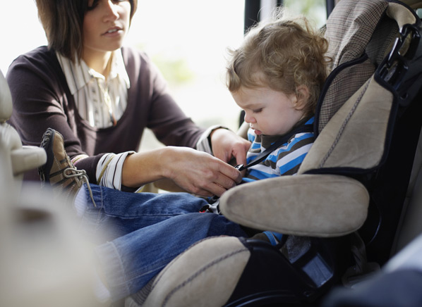
Discussion
52 children: 52% (N=27) MAIS-2+
Head injuries most common
  35% MAIS-2+
  5 out of 7 fatal
Injury risk
  Unrestrained
  Intrusion

Slide 29
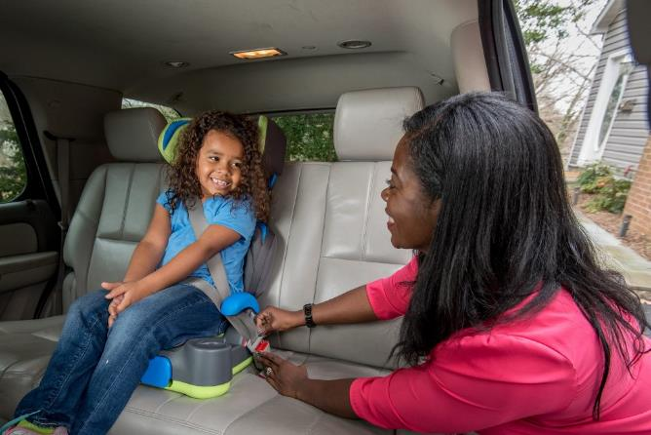
Discussion
Restrained far-side occupants
  72 % (18/25) sustained no or minor injuries
  94 % (17/18) had an adjacent occupant
Centre position
  1/8 MAIS-2+
  8/8 had a nearside
  occupant

Slide 30
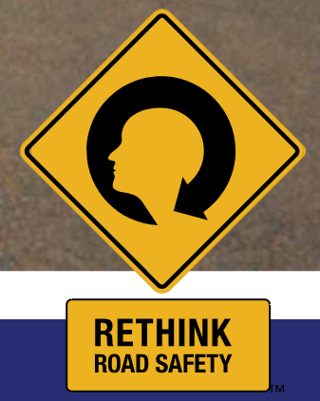
Conclusions
Proper restraint use critical
Intrusion good predictor of injury
Side curtain airbags beneficial
Further field investigations for rear torso airbags
Notes:
Booster seats improve occupant protection in frontal impacts when worn properly
Continue to use booster seat until they have outgrown height and/or weight limits
Misuse can cause devastating consequences in severe frontal impacts
Need for better education of caregivers and children regarding proper restraint use
Improvements are needed in restraint technology for rear occupants

Slide 31




Acknowledgments
SPECIAL THANK YOU TO
ONTARIO PROVINCIAL POLICE
LONDON POLICE SERVICE

