Slide 1
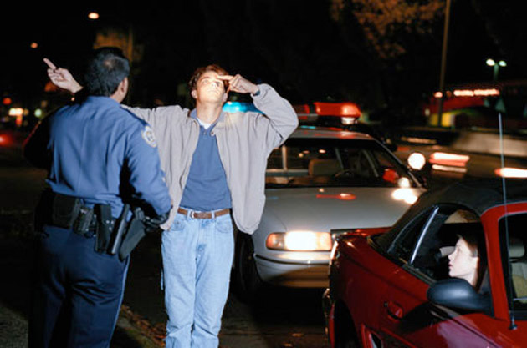

Enhancing the Standardized Field Sobriety Test to Detect Cannabis Impairment
Doug Beirness
Amy Porath
D’Arcy Smith
Erin Beasley
CanDART

Slide 2
Overview
Standardized Field Sobriety Test (SFST)
Development and Validation of SFST
SFST for Drug Impairment
New tests/indicators
Enhancements
CanDART

Slide 3
Standardized Field Sobriety Test
  Horizontal Gaze Nystagmus (HGN)
    Eyes follow a slowly moving object as it is moved from side to side
  One Leg Stand (OLS)
    Stand with one foot about 15 cm off the ground while counting aloud for 30 seconds
  Walk and Turn (WAT)
    Walk nine steps, heel-to-toe, along a straight line, followed by a turn on one foot, and then return in the same manner in the opposite direction
CanDART

Slide 4
SFST Background
Search for a quick, simple test battery police could use at roadside to identify drivers who were impaired by alcohol
Began with series of potential tests from other studies
Administered different doses of alcohol
Selected 3 best tests suitable for roadside use
Standard scoring scheme
Series of field studies to validate SFST

Slide 5
Validation Studies
Sensitivity = proportion of all positive cases correctly identified by the SFST
Specificity = proportion of all negative cases correctly identified by the SFST
Accuracy = proportion of all cases correctly classified by the SFST
 | Criterion
SFST (Officer Decision) | BAC < .08 | BAC ≥ .08
Not Impaired (Release) | True Negatives | False Negatives
Impaired (Arrest) | False Positives | True Positives

Slide 6
Stuster & Burns (1998)
Overall Accuracy
All 3 Tests = 91%
HGN = 88%
OLS = 83%
WAT = 79%
 | Criterion
SFST (Officer Decision) | BAC < .08 | BAC ≥ .08
Not Impaired (Release) | True Negatives n=59 | False Negatives n=4
Impaired (Arrest) | False Positives n=24 | True Positives n=210

Slide 7
Stuster & Burns (1998)
Sensitivity
% correctly identified
as impaired (BAC>.08)
All 3 Tests = 98%
HGN = 98%
OLS = 92%
WAT = 92%
Specificity
% correctly identified
as not impaired (BAC ≤ .08)
All 3 Tests = 71%
HGN = 63%
OLS = 59%
WAT = 47%

Slide 8
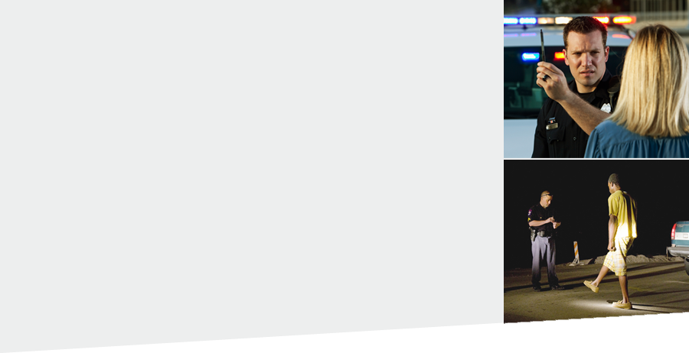
What problem are we trying to solve?
Is the SFST a valid
test to identify driver impairment
due to drugs?

Slide 9
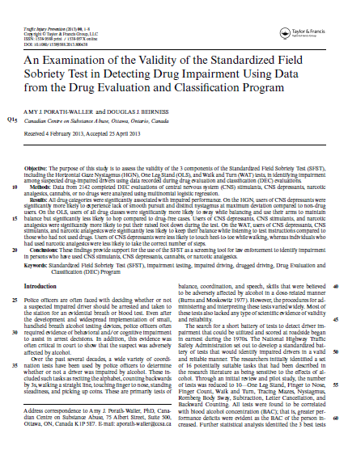
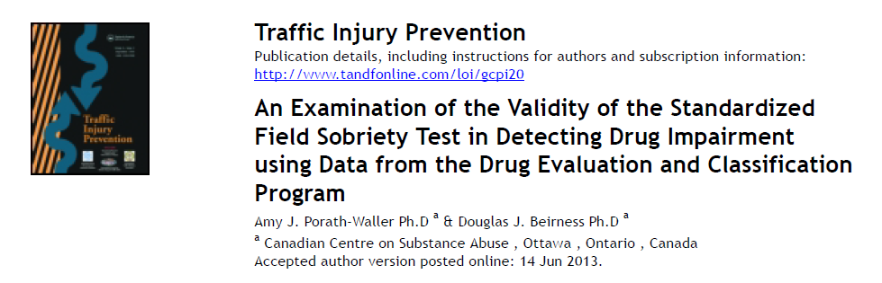
Initial Studies
Data from DRE evaluations provide a wealth of information that can be used to help determine validity of the SFST to detect drug impairment
Examine SFST clues by drug category

Slide 10
HGN (4+ Clues) by Drug Category
Percent

Slide 11
WAT (2+ Clues) by Drug Category
Percent

Slide 12
OLS (4+ Clues) by Drug Category
Percent

Slide 13
Validity Indicators of SFST for Drugs
 | Sensitivity | Specificity | Accuracy
All Drugs | 0.607 | 0.867 | 0.634
Depressants | 0.961 | 0.867 | 0.913
Stimulants | 0.629 | 0.867 | 0.724
Narcotic Analgesics | 0.698 | 0.867 | 0.793
Cannabis | 0.414 | 0.867 | 0.513

Slide 14
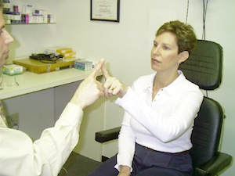
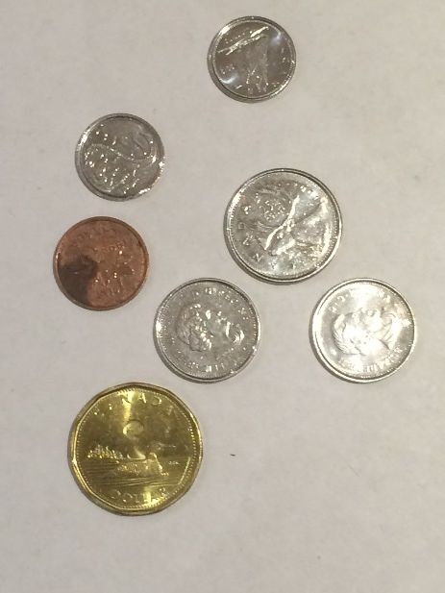
Additional Tests
Romberg Balance
Finger to Nose
Finger to Finger
Finger Count
Hand Pat
Coin pick-up
Head Movement/Jerks
Lack of Convergence
Eyelid Tremors
Backwards Alphabet

Slide 15

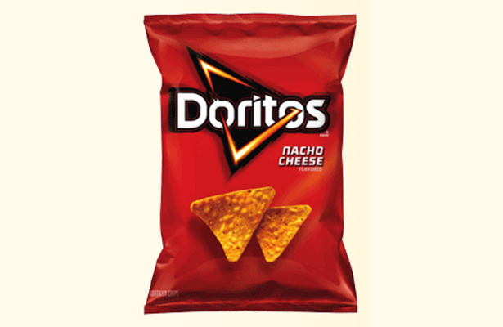
Additional Tests

Slide 16
Other Indicators of THC
Test/Indicator | Sensitivity | Specificity | Accuracy
LOC | 0.63 | 0.61 | 0.62
Romberg 2+ | 0.52 | 0.79 | 0.58
Eyelid Tremors | 0.78 | 0.69 | 0.77
FTN 3+ | 0.83 | 0.52 | 0.76
Droopy Eyelids | 0.41 | 0.86 | 0.51

Slide 17
SFST + FTN + Eyelid Tremors
Drug Category | Sensitivity | Specificity | Accuracy
All Drugs | 0.949 | 0.681 | 0.915
Depressants | 0.992 | 0.681 | 0.842
Stimulants | 0.943 | 0.681 | 0.783
Narcotic Analgesics | 0.949 | 0.681 | 0.782
Cannabis (THC) | 0.937 | 0.681 | 0.879

Slide 18
Conclusions
    SFST not a sensitive test of cannabis impairment
    Additional tests/indicators could prove beneficial
    FTN and Eyelid Tremors
    Work is ongoing…
CanDART

