Slide 1


Is psychological distress related to driving under the influence of cannabis?
TIRNOVANU, Andreea ¹ ,BERTHIAUME-GRONDIN, Jade¹ , FOUG-SUNG, Meileen ¹,
PAQUETTE, Martin¹, BERGERON, Jacques¹

Slide 2


A little bit about me…
Bachelor’s student in psychology
Research assistant
Counselor at IVAC

Slide 3
CONTEXT
Cannabis legalization in Canada
and
its potential effects

Slide 4
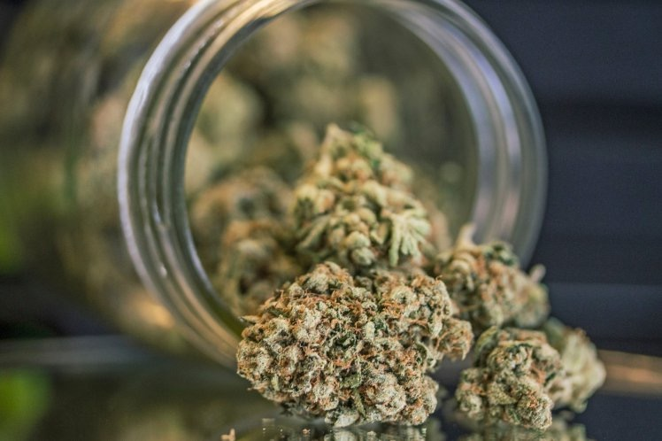
Context
Canada’s cannabis legalization: October 17, 2018
41% of Canadians smoked cannabis at least once in their lifetime
One of the substances mostly found in the blood…
Notes:
Among people that had a car accident

Slide 5
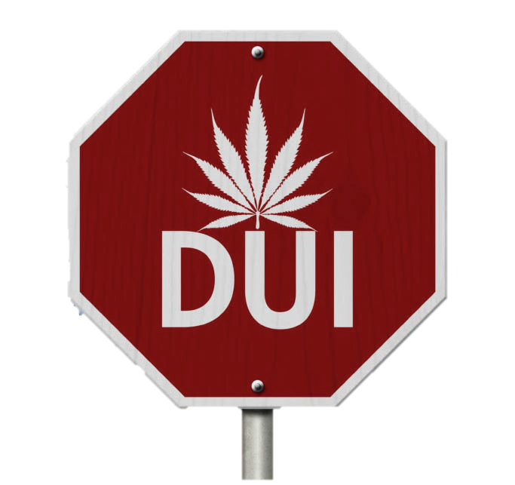
Context
Is the number of drivers under the influence of cannabis going to increase?
What are the consequences
on the ability to drive?
Notes:
The questions asked for the development of the study

Slide 6
Context
What is risky driving behavior?
Definition
Driving under the influence of a variety of substances
  (One of the risky driving behaviors people have)
Important contributing factors
Sensation seeking
Psychological distress
Consequences
Effects on cognitive abilities
  Decreased concentration
  Increased reaction time
Accidents
Notes:
Canada’s security code

Slide 7

Context
What is psychological distress?
Emotional distress is affecting the normal functioning of an individual which implies a variety of symptoms:
Depressive symptoms
Anxiety symptoms
A result of primary stressors
Notes:
https://www.google.com/search?biw=1146&bih=710&tbm=isch&sa=1&ei=_MWzXOP5G8rN_AaY86m4CA&q=depression+and+anxiety&oq=depression+and+anxiety&gs_l=img.3..0j0i30l9.14602.17494..17660...0.0..0.96.1733.23......1....1..gws-wiz-img.....0..0i67.NdW2bcfiXaI#imgrc=Vl-jvMpgiv-0fM:

Slide 8
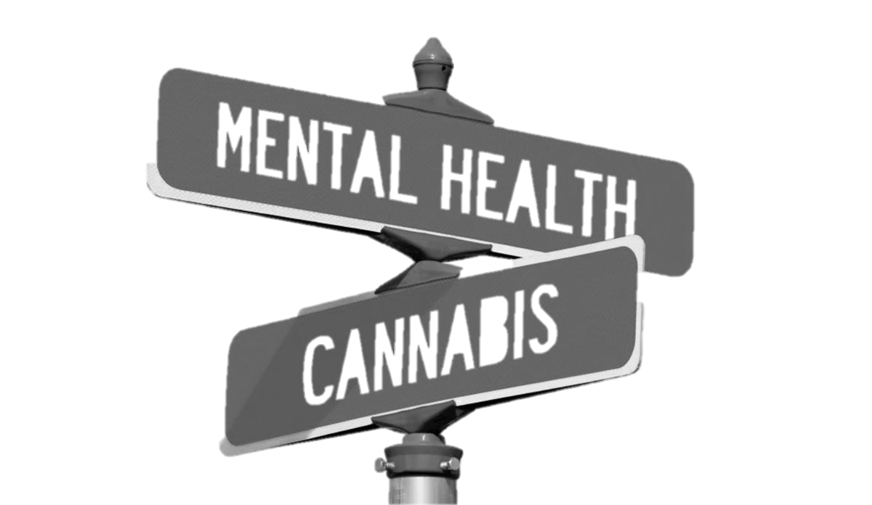
Psychological distress and cannabis use
Context
Emotion regulation
Reduction of
anxiety symptoms
Increased self-esteem
Reduction of depressive symptoms
Notes:
Une des principals motivations (il y a en a d’autres) – dire a l’oral

Slide 9

Objective of the study
Determine if the psychological distress is different between cannabis users that drive after cannabis intake and those who do not
Notes:
The objective of the study is to determine

Slide 10
Hypothesis
Psychological distress level
Notes:
Tell the hypothesis verbally
Dependent variable: psychological distress level
Independent variable: driving decision

Slide 11
METHODOLOGY
Characteristics
of
cannabis consumers

Slide 12
Methodology
General health questionnaire -12
My perceptions
Consumption habits
Notes:
Le GHQ-12 mesure divers aspects de la sante Y COMPRIS la détresse Y

Slide 13


Methodology
496 drivers
157 men
181 women
Cannabis consumers
Total: 338
Age: 18-62
Mean average: 28.34
SD = 11.05
- Regular or probationary licensing
- Driving at least once a week
- Cannabis consumption: at least once a week
Notes:
Driving : at least once a week + Regular or probationary licensing
Cannabis consumption: at least once in their lifetime

Slide 14
RESULTS
Behavior pattern

Slide 15
Results
✓Driving after cannabis intake
(DUIC)
110 participants
✗Not driving after cannabis intake
(No DUIC)
228 participants
47 Women
63 Men
134 Women
94 Men

Slide 16
ANOVA
The mean psychological distress on the GHQ-12 scale among cannabis consumers, driving or not, under the influence of cannabis
★
(F= 3.815, p=0.055)
Mean GHQ-12 score

Slide 17
ANOVA
The mean psychological distress on the GHQ-12 scale among cannabis and alcohol consumers, driving or not, after being intoxicated
★
(F=6,176, p<0,05)
Mean GHQ-12 score
Notes:
Cannabis + alcohol (au moins 1 fois par semaine)

Slide 18
DISCUSSION
What can be understood
of the
shown behavior pattern

Slide 19
Discussion
Scott-Parker, B., Watson, B., King, M. J., and Hyde, M. K. (2011)
- The psychological distress level predicts risky driving behavior.
Beirness, D. J., et Beasley, E. E. (2009)
Men are more likely than women to :
Drive under the influence of cannabis
Have a reckless driving style
Notes:
British Columbia’s study on drugs and alcohol among drivers
Scott-Parker, B., Watson, B., King, M. J., et Hyde, M. K. (2011) : Australia study on students aged 17-25 years
Decreased psychological distress level
Beirness, D. J., et Beasley, E. E. (2009).

Slide 20
Scale choice
General Health Questionnaire-12
V.S
Kessler’s psychological distress scale

Slide 21
CONCLUSION
OUR ROAD MAP AHEAD

Slide 22
Continue to study the relationship between the psychological distress level and the risky driving behavior mainly among men of 26 years and older.
Notes:
De futures études dans le domaine seront pertinentes, surtout chez les hommes de 26 ans et plus. Cela permettra de cerner les populations à risque de conduite avec les facultés affaiblies par le cannabis, et de sensibiliser ces populations ainsi que les professionnels œuvrant auprès de celles-ci.
Continuer a etudier la detresse Y car en connaissant mieux les conducteurs qui prennent le volant, on connaitra leur etat mental et mieux intervenir car on connait leur profil

Slide 23
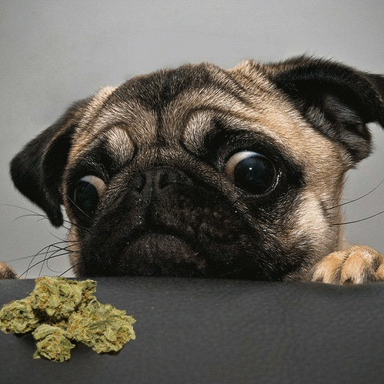
Thank you!

Slide 24
REFERENCES
¹ Begg, D. J., Langley, J. D., et Stephenson, S. (2003). Identifying factors that predict persistent driving after drinking, unsafe driving after drinking, and driving after using cannabis among young adults. Accident Analysis & Prevention, 35(5), 669-675. ²Bergeron, J. et Paquette, M. (2014). Relationships between frequency of driving under the influence of cannabis, self-reported reckless driving and risk-taking behavior observed in a driving simulator. Journal of Safety Research, 49. 19-24. ³Blows, S., Ivers, R. Q., Connor, J., Ameratunga, S., Woodward, M., et Norton, R. (2005). Marijuana use and car crash injury. Addiction, 100(5), 605-611. ⁴Richer, I et Bergeron, J. (2009). Driving under the influence of cannabis: Links with dangerous driving, psychological predictors, and accident involvement. Accident Analysis & Prevention, 41(2), 299-307. Danielsson, A-K., Lundin, A., Allebeck, P. et Agardh, E. (2016). Cannabis use and psychological distress: An 8-year prospective population-based study among Swedish men and women. Addictive behaviors, 59, 18-23. ⁵Drapeau, A., Marchand, A et Beaulieu-Prévost, D. (2012). Epidemiology of psychological distress. Dans L. L’Abate (dir.), Mental Illnesses- Understanding, Prediction and Control (p.105-134) InTech. ⁶Dula, C. S. et Ballard, M. E. (2003). Development and evaluation of a measure of dangerous, agressive, negative emotional, and risky driving. Journal of Applied Social Psychology, 33(2), 263-282. ⁷Gao, W., Stark, D., Bennett, M., Siegert, R. J., Murray, S. et Higginson, I. J. (2012) Using the 12-item General Health Questionnaire to screen psychological distress from survivorship to end-of-life care: dimensionality and item quality. Psycho-Oncology, 21(9), 954-961. ⁸Romppel, M., Braehler, E., Roth, M. et Glaesmer, H. (2013). What is the General Health Questionnaire-12 assessing? Dimensionality and psychometric properties of the General Health Questionnaire-12 in a large scale German population sample. Comprehensive psychiatry, 54(4), 406-413. ⁹Scott-Parker, B., Watson, B., King, M. J., et Hyde, M. K. (2011). The psychological distress of the young driver: a brief report. Injury prevention, 17, 275-277.

