Slide 1
Safety Evaluation of Speed Limit Increase on Rural Highways in BC
Joy Sengupta, P.Eng.
Mohamed Elesawey, Ph. D, P.Eng.
CARSP Conference
May 26-29, 2019
Calgary

Slide 2
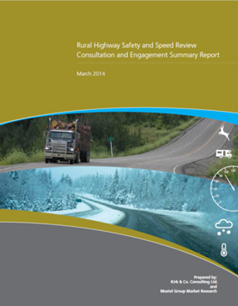
Background
9,100 kilometres of highway reviewed
  300 speed surveys
  85th percentile operating speeds
  Serious collisions trend
Conducted public consultation
Notes:
In 2013, the ministry initiated a review of over 9,100 kilometres of highway across the province, which included:
The ministry conducted public consultation, with over 2,300 participants.

Slide 3
2014 Rural Highway Safety and Speed Review
  Speed limits increased on 33 highway segments covering 1,300 Km
  120 km/h rural divided highways
  100 km/h rural undivided highways
Notes:
Speed plays an important role in road safety, and traffic operations is enhanced when appropriate speed limits are set. In 2014, as a result of the review, the following actions were taken:

Slide 4
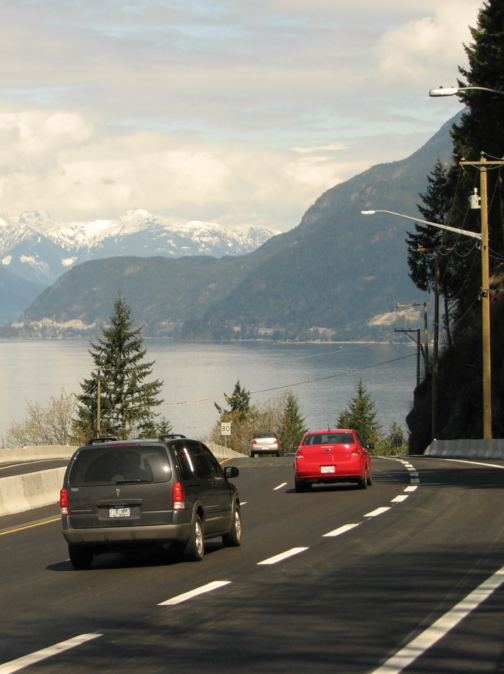
Study Overview
Estimate safety effect of increased speed limits
Methodology
Conclusion
Notes:
The main objective of this analysis was to estimate the safety effects of the changed speed limits on rural highways after three years of implementation.

Slide 5
Before-After Safety Evaluation
Methodology
Time-series analysis
Empirical Bayes approach
SPF development
Notes:
The study design used to estimate the safety effects of the changed speed limits is a time-series analysis, which is often referred to as a before-after (BA) analysis. This approach measures the change in safety over time due to the implementation of a safety initiative.
An EB approach with SPFs was employed for this evaluation for two main reasons. First, the available data enabled the development of reliable SPFs that could be used in an EB safety evaluation. Second, the EB technique is currently a standard safety evaluation technique in the Highway Safety Manual (HSM, 2010) while the FB method is not yet considered an industry-standard safety evaluation method.

Slide 6
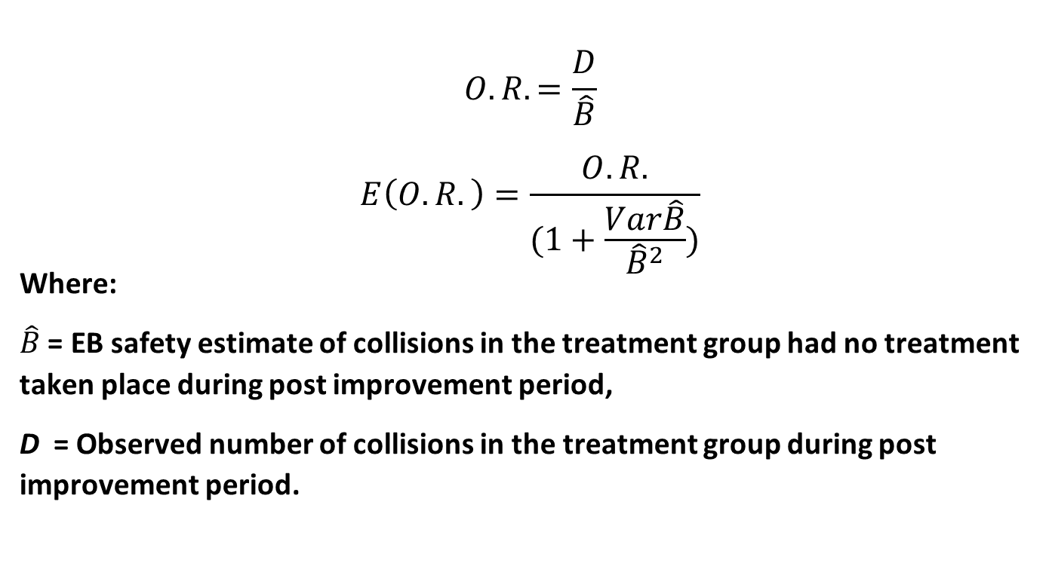
Before-After Safety Evaluation
Empirical Bayes Method

Slide 7
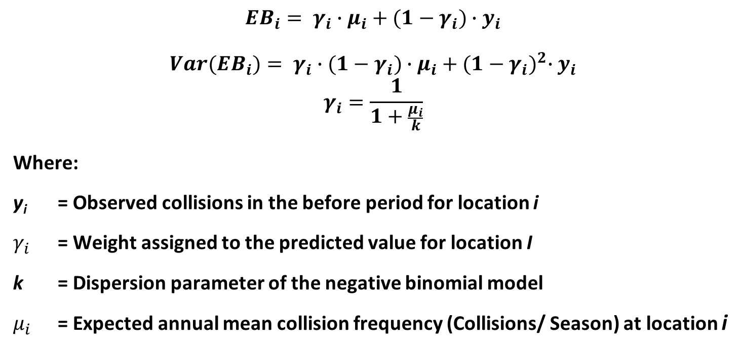
Before-After Safety Evaluation
Empirical Bayes Method

Slide 8
Before-After Safety Evaluation
Empirical Bayes Method

Slide 9
Before-After Safety Evaluation
Safety Performance Function (SPFs) Development

Slide 10
Before-After Safety
Evaluation Data
Serous collision
Treatment sites
Reference sites
Reference sites for SPFs development
3 yrs of collision data available for after period
Notes:
Serous collision (fatal and injury)
Treatment sites (where speed limits were increased)
Reference sites (other similar characteristics sites)
Reference sites used for SPFs development
7 yrs of collision data used for SPF development
3 yrs of collision data available for after period

Slide 11
Overall Safety Evaluation Results
All highway segments where speed limits were increased
Highway segments where Variable Speed Limit System (VSLS) was installed in 2016
Highway segments where speed limits were reverted back
Highway segments where neither VSLS was installed nor speed was reverted back.

Slide 12
Change from the before to the after period Serious collisions
Evaluation Group | Odds Ratio | Change* | Change LL | Change UL | T-Stat | Statistically Significant
All Speed Limit Increase Segments | 1.098 ± 0.035 | +9.8% | +6.3% | +13.2% | 2.83 | Yes
VSLS Segments | 0.933 ± 0.083 | -6.7% | -15.1% | +1.6% | 0.81 | No
Reverted Speed Segments | 1.385 ± 0.262 | +38.5% | +12.4% | +64.7% | 1.47 | No
Segments with Only Speed Limit Change | 1.112 ± 0.038 | +11.2% | +7.4% | +15.0% | 2.96 | Yes

Slide 13
Change from the before to the after period Serious collisions - Winter months
Evaluation Group | Odds Ratio | Change* | Change LL | Change UL | T-Stat | Statistically Significant
All Speed Limit Increase Segments | 1.025 ± 0.046 | 2.5% | -2.1% | 7.1% | 0.54 | No
VSLS Segments | 0.921 ± 0.111 | -7.9% | -19.0% | 3.1% | 0.72 | No
Reverted Speed Segments | 1.035 ± 0.285 | 3.5% | -25.0% | 32.0% | 0.12 | No
Segments with Only Speed Limit Change | 1.039 ± 0.052 | 3.9% | -1.2% | 9.1% | 0.76 | No

Slide 14
Change from the before to the after period Serious collisions - Non-winter months
Evaluation Group | Odds Ratio | Change* | Change LL | Change UL | T-Stat | Statistically Significant
All Speed Limit Increase Segments | 1.170 ± 0.049 | 17.0% | 12.0% | 21.9% | 3.44 | Yes
VSLS Segments | 0.945 ± 0.121 | -5.5% | -17.6% | 6.6% | 0.45 | No
Reverted Speed Segments | 1.727 ± 0.446 | 72.7% | 28.2% | 117.3% | 1.63 | No
Segments with Only Speed Limit Change | 1.182 ± 0.054 | 18.2% | 12.8% | 23.6% | 3.39 | Yes

Slide 15
Summary and Conclusion
9.8 % increase - All locations
11.2% increase – No VSLS and speed reverted locations
6.7% decrease – VSLS locations
Winter season collisions minor & insignificant

Slide 16
Safety Evaluation Findings By Segment
Location | Speed above posted (km/h) | Change in speed related collisions (per year) | Statistical Result (%)
Hwy 97A - Grindrod to Sicamous | 5 | 0.6 | +3.6
Hwy 3 - Sunday Summit to Princeton | 16 | 0.8 | +8.0
Hwy 99 - Squamish to Whistler | 7 | 2.4 | +8.4
Hwy 1 - Tobiano to Savona | 5 | 0.5 | +14.9
Hwy 99 - Horseshoe Bay to Squamish | 16 | 6.3 | +18.9
Hwy 1 - Cowichan Bay to Nanaimo | 8 | 6.1 | +24.2
Hwy 1 - Hope to Boston Bar | 21 | 3.3 | +29.3
Hwy 97C - Merritt to Aspen Grove | 15 | 1.6 | +33.4
Hwy 97C - Aspen Grove to Peachland | 10 | 12.2 | +34.6
Hwy 19 - Parksville to Campbell River | 9 | 16.9 | +34.8
Hwy 1 - Whatcom Road to Hope | 1 | 29.1 | +38.2
Hwy 99 - Whistler to Pemberton | 0 | 3.3 | +51.8
Hwy 5A - Princeton to TN Boundary | 13 | 2.4 | +55.3
Hwy 7 - Agassiz to Hope | 9 | 0.8 | +56.7
Hwy 1 - Chase to Sorrento | 5 | 7.2 | +65.9
Hwy 19 - Bloedel to Sayward | 4 | 5.3 | +87.5
Hwy 1 - Boston Bar to Jackass Mountain | 11 | 2.5 | +108.2

Slide 17
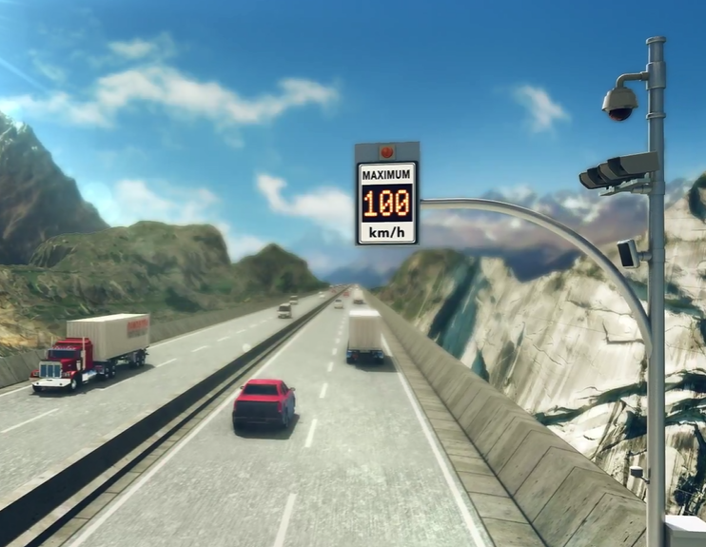
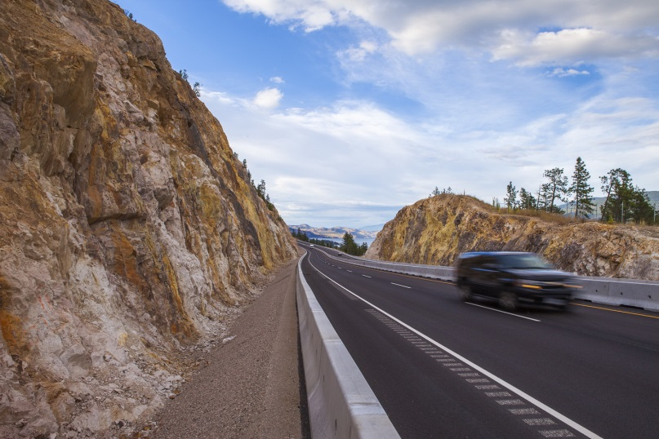
Update
Roll back speed limits on segments with increased crashes
Strategic Enforcement
Road Weather Information Systems with Dynamic Message Signs on 2 segments
Notes:
Rolled back speed limits on all segments with increased crashes
15 segments in addition to the 2 rolled back in 2016
Strategic Enforcement
Road Weather Information Systems with Dynamic Message Signs on 2 segments

Slide 18
Thank You

