Slide 1


BC’s Enhanced Road Assessment Program: Implementation & First Year Results

Slide 2
Agenda
Overview
Challenges with the Previous Program
Options Considered
ERA Project and Vision
Key ERA Components
Key Success Factors
Results to Date
Summary

Slide 3
Overview
One of RoadSafetyBC’s mandates is to monitor the medical fitness of B.C.’s 3.4 million drivers
RoadSafetyBC refers roughly 5,000 drivers annually to an on-road assessment to determine if drivers with medical conditions can drive safely
While on-road assessments are vital to inform licensing decisions, for over a decade the contracted DriveABLE assessments were a contentious area for RoadSafetyBC

Slide 4
Overview
RoadSafetyBC’s Driver Medical Fitness Program implemented a new Enhanced Road Assessment (ERA) on March 5, 2018
ERA was 18+ months in development and is delivered in partnership with the Insurance Corporation of BC (ICBC)
ERA is a superior assessment, available in more locations province wide (80 up from 27), and has operational costs 50% less than the DriveABLE program

Slide 5
The Drivers for Change

Slide 6
Challenges with Previous Model (DriveABLE):
Drivers’ and Media Perspective:
  Complaints about computer-based assessment
  Unfamiliar vehicle
  Unfamiliar area
  Number of locations across BC (27)
Program Perspective:
  Lack of independent supporting research
  Detail/content in assessment results not providing RoadSafetyBC with reliable information for decision making

Slide 7
How to Move Forward?

Slide 8
Key Options Considered:
1. Go to market – likely result in status quo
2. Develop in-house assessment and bring to market
3. Develop in-house assessment with ICBC as service provider (option chosen)

Slide 9
Why Partner with the Insurance Corporation of BC (ICBC)?
  Respected in the provision of road tests
  Have existing infrastructure and staffing – 80 offices across BC
  Potential for in house model:
  Flexibility to adapt assessment
  Existing relationship with RoadSafetyBC
  Detailed and transparent communication to RoadSafetyBC and the driver

Slide 10
The ERA Project Begins

Slide 11
ERA Vision – RoadSafetyBC’s vision for an innovative assessment
Actionable for the program
Evidence based &
produces reliable outcomes
Increases fairness for citizens
Safe to administer
Geographically accessible

Slide 12
Key Project Components
Assessment Design
Stakeholder Relations
RoadSafetyBC & ICBC staff change management and training
Legislative analysis and policy creation
Business process design across ICBC and RoadSafetyBC and KPI’s
IM/IT changes
MOA and program governance

Slide 13
ERA Assessment Development
Jurisdictional review of approaches and best practice
Consultations included:
  ICBC
  RoadSafetyBC’s Driver Fitness Advisory Group and BC’s medical practitioners
  Seniors’ advocacy groups and University of Victoria Institute on Aging & Lifelong Health
Seconded SME – to design ERA based on ICBC retest, RoadSafetyBC's needs and best practices

Slide 14
How the ERA is Different?
Designed to assess whether a driver is medically fit and functionally able to safely operate a motor vehicle
We want the healthy driver to succeed – provide as much information
to the driver as possible
Driver’s own vehicle - 90 minute assessment on a single day
(35-45 minutes in car)
Improved citizen and Indigenous peoples access - 80 ICBC locations province wide with far more locations in BC’s North
No in-office, computer-based screening

Slide 15
ERA Components
Task | Evidence for Inclusion – Best Practice
Adjust Safety Controls | Ontario pilot study BC Functional Driving Evaluations
Multiple Step Directions | Ontario pilot study California Supplemental Driving Performance Evaluation (SDPE) BC Functional Driving Evaluations
Reverse Route | Ontario pilot study California SPDE
Feedback Session | Saskatchewan Quebec Ontario pilot study BC Functional Driving Evaluations
Notes:
The ERA assessment itself was informed by best practices from several Canadian provinces and contains tasks similar to the demands of real-world driving.
A driver of any age with a medical condition that may make them unsafe to drive can be referred to an ERA
The ERA takes a citizen centric approach to be more accommodating to the driver, especially seniors and those with barriers
driver uses their own vehicle
ERAs are available at 80 locations throughout BC and the reports provide comprehensive information to RoadSafetyBC decision makers, rather than a road test that is either passed or failed, making it more administratively fair to drivers.

Slide 16
ERA Report
Form

Slide 17
ERA Narrative Template
Pre-trip: driver’s awareness of name/address, road signs, safety check, gas/brake exercise
Dangerous Action/Other: driver or other road user’s actions and awareness
Traffic Violations: provide details, i.e. if speeding, include km/h over and driver awareness
Cognitive Tasks: how driver maintained skills during task
Ability to compensate: driving behaviour compensating for bad habits
Communication Barriers: describe if any
Level of Concern: low/medium/high rating and reason

Slide 18
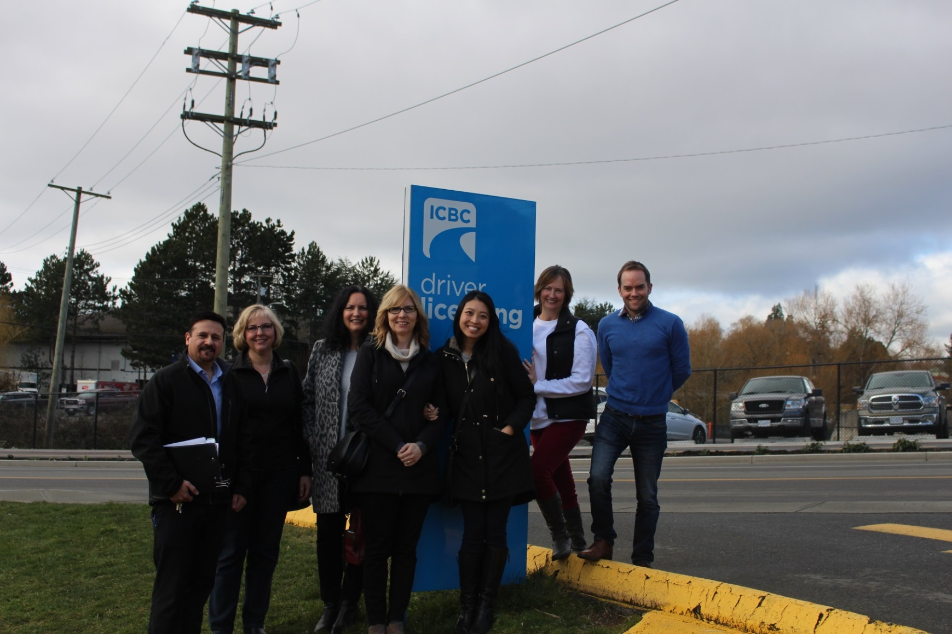
Key Success Factors
Change management – early and ongoing staff engagement/support (staff completed mock ERAs prior to go live)

Slide 19
Key Success Factors
ERA Vision – Clear from beginning
Comprehensive transition planning
Relationships and early buy-in from partners and stakeholders:
ICBC
Other Canadian jurisdictions
Medical Practitioners - Doctors of BC, Health Authorities, etc
Council of Seniors Citizens Organizations, Office of the Senior’s Advocate, Uvic Institute for Aging

Slide 20
Results to Date
Over 5000 drivers assessed
Report information supports administratively fair and timely decisions (average 8 days from receipt to decision)
Easier to inform driver why they were/not successful –
less re-referrals
Very well received by citizens, other jurisdictions across Canada, and by B.C.’s medical community
Media response is mostly positive – notable for this contentious topic

Slide 21
Results to Date
77% of drivers either successful outright or referred for another ERA attempt
Survey results - very good, averaging 4.2/5 - comments note high professionalism of ICBC staff and care provided
Data and metrics indicate that the ERA is a valid assessment tool
Operational costs roughly 50% lower than the 5 previous years - substantial ongoing savings
Increased control over quality, service provision and the assessment itself

Slide 22
Stakeholder Responses to Date
“The changes being implemented by RoadSafetyBC represent a major improvement and will make the processes much less stressful for those seniors required to undertake a road test.”
Isobel Mackenzie, B.C.’s Seniors Advocate
“RoadSafetyBC’s new enhanced road assessment for individuals with medical conditions that may affect driving is a huge step in the right direction.”
Holly Tuokko, Institute on Aging and Lifelong Health, University of Victoria
“The Counsel of Senior Citizens Organizations of B.C. (COSCO) is encouraged that our collaboration with RoadSafetyBC assisted with the new direction - no one wants unsafe drivers on the road, regardless of age.”
Gudrun Langolf, acting president, COSCO

Slide 23
Evaluation Findings

Slide 24
Evaluation – Key Questions
Q1
Is there a relationship between the cause for referral and the outcome of the assessment?
Q2
Are the Pass/Fail rates consistent across all regions in BC?
Q3
Do ERA participants have more satisfaction than the previous process?
Q4
Does the length of time to a decision compare with previous assessment program (DriveAble)?

Slide 25
Evaluation challenges
Consistent examination across all regions – ERA results have a subjective component
Difficult to have consistent routes across all offices which could affect ERA result
Subjective elements of ERA evaluation (narrative, feedback, level of concern, etc.) create challenges for evaluation and analysis
Small sample sizes with some inconsistent or missing data

Slide 26
Key findings
No statistically significant correlation between case origin (i.e. age-based medical, police reports, etc.) and/or medical condition and ERA results
There are statistically significant differences in ERA success rates across different regions in BC
ERA test takers are overall more satisfied with the program than DriveAble
Unable to compare length to decision with DriveAble due to insufficient data

Slide 27
Highest number of referrals due to potential cognitive impairment
Findings:

Slide 28
Findings:
ERA result – according to medical condition

Slide 29
Findings:
There is a statistically significant difference in pass rates between the various regions in BC
Northern Interior has highest pass rate and Fraser Valley has lowest pass rate
Provincial ERA average pass rate – 51.5%

Slide 30
Evaluation: Areas of Further Inquiry
Pre/Post ERA crash data of drivers across BC
Demographic information of ERA test takers across different regions and the affects on ERA results
Determination of components of ERA having the greatest impact on final results (aside from dangerous actions, traffic violations) - current sample size is too small

Slide 31
Survey Findings:
What ERA drivers say
“My last examiner explained to me very thoroughly before and after the road test. I am thankful for him”
“The whole process from beginning to end was very smooth and professional. I don't think any improvements are required”
“I am very pleased with the plan for us seniors. It's a must for us all. After 80 we need to be checked. This has helped. I did not like my driving. I know I was uptight and was raining hard. Thank you all for the care of our BC roads”

Slide 32
What’s Next?
Continue driver survey
Monitor trends and modify
Premiers Award Application (underway)
Continued data analysis and evaluation (currently underway)
Presentations to other Canadian jurisdictions

Slide 33

Summary
The ERA is superior to the previous service model, available in more locations, less costly and more administratively fair - highly valuable in BC’s Driver Fitness program.
The ERA involved leveraging significant partnerships and stakeholder relationships and greatly assists RoadSafetyBC’s mandate of keeping BC’s drivers safe.

