Slide 1
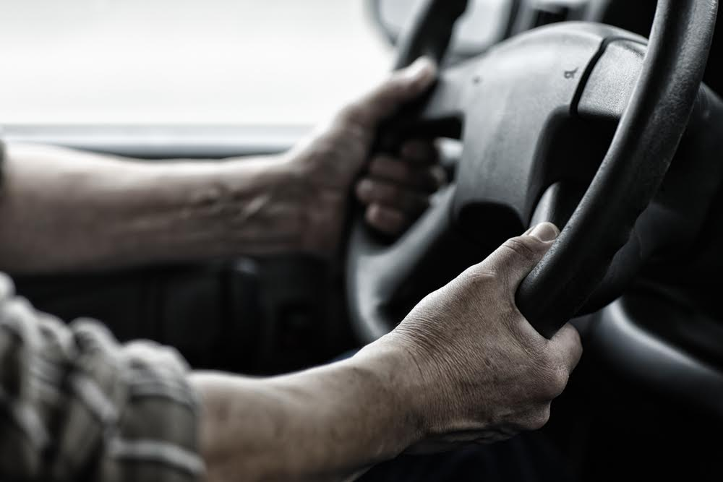
Prevalence and Risk Factors for Depression Among Long-Haul Truck Drivers
Maeve McLean, MPH Candidate, Jennifer Malkin, MPH Graduate, Maryam Madani, PhD Alexander Crizzle, PhD

Slide 2
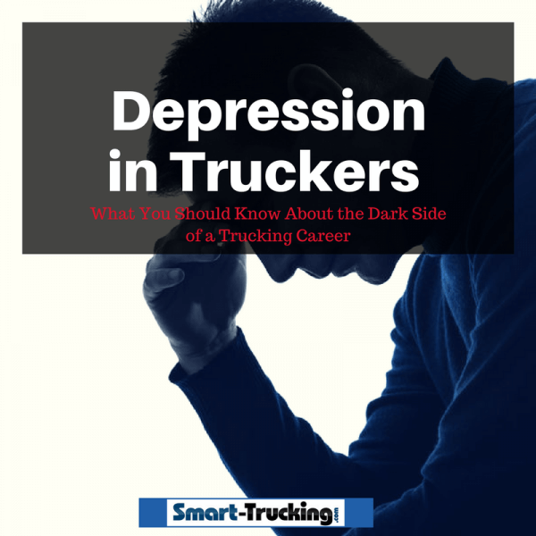
Outline
What is depression?
Are truck driver’s at risk?
What do we know so far?
Methods
Results
Discussion
Recommendations
Conclusion

Slide 3

Background What is depression?
Second leading cause of disability worldwide
Observed changes in
Neuroanatomy
Neurochemistry
Immune function
Adrenal system
Characterized by a constellation of symptoms
Extreme sadness
Inability to feel pleasure
Concentration difficulties
Sleep problems
Loss of appetite
Feelings of guilt

Slide 4

Background Are Truck Drivers at Risk?
High work demands (Melchior et al., 2007)
Lack of control over work demands (Gray-Stanley et al., 2013)
Low job satisfaction (Thomas & Ganster, 1995)
Night shift work (Selvi et al., 2010)
Social isolation (Mathews et al., 2016)
Unhealthy diet (Jacka et al., 2010)
High BMI (Wit et al., 2009)
Low levels of physical exercise (Strohle, 2009)
Poor health outcomes (Lazo et al., 2008; Joynt et al., 2003)

Slide 5

Background What do we know so far?
Limited research in Canada
Prevalence 13.6% - 26.9%
Some drivers may be at greater risk
Young drivers (Fransisco et al., 2009)
Low levels of education (Franisco et al., 2009)
Wage earning drivers (Frandisco et al., 2009)
Drivers who take longer and more frequency road trips
Drivers who use substances (Fransisco et al., 2009)
Drivers who are depressed are at a greater risk for
Substance use (Mona et al., 2012)
Impaired driving (Garbino et al., 2018)
Risk taking behaviour (Shatell et al., 2010)
Fatigue/insomnia (Garbarino et al., 2018)
Depression is largely left untreated in truck drivers (Mona et al., 2012)

Slide 6

Methods
Truck drivers from… (n=170)
Lloydminster
Edmonton (2 sites)
Red deer
Saskatoon (2 sites)
Calgary
Inclusion Criteria
Canadian
Class 1 driver’s license
Long-haul truck driver
Survey
Adapted from an American study
Assessed work demands, health status, substance use, sleep quality, fatigue, work-related stress and self reported depression
Analyzed using SPSS

Slide 7

Results Sample Characteristics
n = 107
Gender
Male | 95.6%
Female | 4.4%
Age Range | 24 to 89
Ethnicity
Caucasian | 81.3%
Other (Asian, Native American Indian, African American, East Indian, Latino/Hispanic) | 18.7%
Employment Type
Company Employee | 68.9%
Owner/Operator | 29.3%
Depression | 39.0%

Slide 8
Variable | Depression (Yes) n= 47 | Depression (No) n=60 | Sig.
Sex Male Female | 45% 1% | 51% 3% | .621
Level of education Not completed high school High school diploma Some college Completed post-secondary | 17.3% 11.5% 9.6% 5.8% | 24.0% 14.4% 9.6% 7.7% | .949
Cigarette Smoking Every day Some days Not at all | 22% 5% 20% | 23% 4% 26% | .774
Marijuana Use Yes No | 7% 1% | 36% 56% | .020*
Healthy diet while driving Yes No | 24.4% 19.3% | 39.7% 16.6% | .236
Lower back pain Yes No | 23.3% 21.4% | 12.6% 42.7% | .004*
R
E
S
U
L
T
S

Slide 9
Results
Variable | Depression (yes), n = 47 | Depression (no), n = 60 | Sig.
Sleep apnea Yes No | 10.1% 30.3% | 4.5% 55.1% | .032*
Sleep quality Broken Continuous | 32.4% 8.8% | 20.6% 38.2% | .000*
CPAP machine use Yes No | 7.0% 37.0% | 1.0% 55.0% | .020*
Severe job related stress Yes No | 22.0% 21.2% | 13.5% 43.3% | .007*

Slide 10
Results
Variable | Depression (Yes) n=47 | Depression (No) n=60 | Sig.
Age | M = 49.3 | M=51.8 | .323
Annual Income | M = $102,448 | M = $174,639 | .150
Km/year | M = 172,374km | M = 175,017km | .871
Nighttime driving (%) | M = 25.4% | 27.0% | .723
Weeks worked/year | M = 51.0 weeks | M = 47.5 weeks | .151
Marijuana use/day | M = 0.2x/day | M = .1x/day | .511
Alcohol use (days/month) | M=14.0 days/month | M = 6.9 days/month | .410
Alcohol consumption (drinks/day) | M = 1.3 drinks/day | M = 1.4 drinks/day | .329
Self-reported health rating (0-10) | M = 3.3 | M=2.8 | .016*
Days of physical activity/week | M = 3.0 days | M = 2.9 days | .808
Hours of sleep/night | M = 6.8 hours | M = 7.6 hours | .026*
Fatigue severity (0-10) | M = 2.7 | M = 1.6 | .011*
Days slept at home/month | M = 6.1 days | M = 6.9 days | .445

Slide 11
Results
Predictor | Sig. | OR | 95%CI
Broken Sleep | < .05 | 4.09 | 1.23, 13.60
Severe work-related stress | < .05 | 3.25 | 1.05, 10.09
C-PAP machine use | < .05 | 13.38 | 1.12, 156.32
N=68, -2Log Likelihood Ratio = 73.71, Nagelkerke R-square = .297

Slide 12

Discussion
Depression is common among long haul truck drivers in central Canada
Stress, marijuana use, back pain, fatigue, broken sleep, sleep duration, sleep apnea and non-use of a CPAP machine are risk factors for depression among truck drivers
Undiagnosed or untreated sleep apnea may be a contributing to depression among truck drivers
Higher rates of depression among truck drivers in Central Canada may be an intervention area for road safety

Slide 13

Future Directions
Research
Examine rates of undiagnosed/untreated sleep apnea among Canadian truck drivers
Examine severity of sleep apnea among Canadian truck drivers
Practice
Ergonomic seats
Reduce work-related stress
Routine screening/treatment of sleep problems
Challenges
Cost (testing/equipment)
Truck driver reluctance

Slide 14
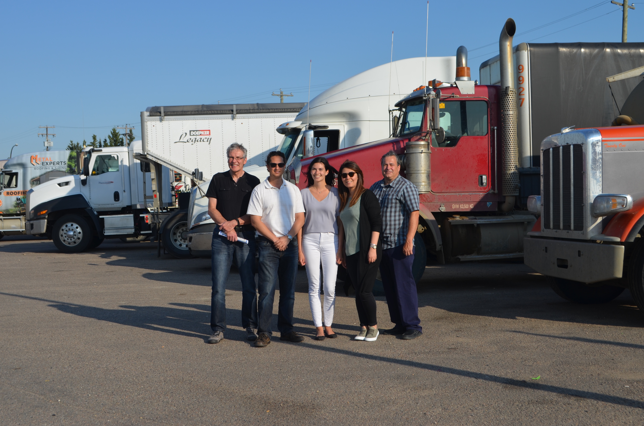



Acknowledgements
Alexander Crizzle
Gordon Zello
Philip Bigelow
Mamdouh Shubair
Pierre Thiffault
Maryam Larijani
Jennifer Malkin
Funding: OHS Futures Research Grant

Slide 15

Questions?

