Slide 1

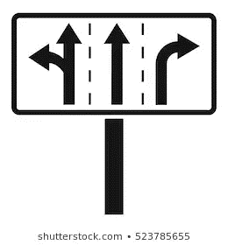












Modeling Associations between Pedestrian Injury Severity and Road Infrastructure
Jeff Pascua M.Sc. Candidate, E.I.T.
Presentation prepared for:
Built Environment’s Relationship to Roadway Session of the 2019 CARSP Conference, Calgary, AB
Michel Bédard, Ph.D., FGSA;
Juan C. Pernia, Ph.D., P.Eng;
Sacha Dubois, MPH

Slide 2

/
Overview
Results & Discussion
Introduction
Methodology
Conclusions
Background
Injury Data
Model Results
Limitations & Future Work
Research Objective
Statistical Analyses
Non-Roadway Factors
Roadway Factors
Notes:
Here is a brief outline of what I’ll be discussing this afternoon:
First, I’ll provide some very brief details about pedestrians in the U.S. and introduce the scope of the study.
Next, I’ll go over some of the common practices found in pedestrian safety and road safety targets.
I’ll discuss the methodology used in creating our fatality forecasts.
Due to time constraints, I’ll show a few forecasts that we’ve developed.
…and lastly, I’ll tie everything together with some conclusions, recommendations, and some final thoughts.

Slide 3


Fatal pedestrian injury counts in the U.S. have been increasing since 2009.
!
Figure 1: Annual pedestrian fatality trend within the United States, 1975-2017 (1).
A recent report from the GHSA indicated a projected fatality count of 6,227 pedestrians in 2018, representing:
a 4% increase from 2017, and
the highest pedestrian death count since 1990.²
3/22

Slide 4
Introduction
Research Objective
To evaluate associations between various road user and roadway characteristics and pedestrian injury severity.

Slide 5

Methodology
Pedestrian Injury Data
NHTSA NASS GES
National Automotive Sampling System – General Estimates System
2011 - 2015
Nationally-representative datasets of traffic crashes that:
Were on publicly-available roadways
Resulted in property damage or injury
Are recorded in a Police Accident Report (PAR)
Inclusion criterion: Crashes with a single pedestrian AND a single vehicle (n = 10481)
Notes:
Multiple vehicles: confounding variables
Issue, difficult to interpret findings

Slide 6






Methodology
Pedestrian Injury Data
Pedestrian-related factors: age, sex, impairment, unsafe actions/behaviours
Driver-related factors: age, sex, impairment
Temporal characteristics: crash hour, crash day
Vehicle-related factors: vehicle type, travel speed, turning
movements
Environmental factors:
lighting and surface conditions
Roadway factors: posted speed limits, traffic control devices, roadway features/geometry

Slide 7
Methodology
Pedestrian Injury Data
Fatal Injury | Incapacitating Injury | Non-Incapacitating Injury | Possible Injury | Property Damage Only
5.1% | 27.8% | 60.0% | 5.9% | 0.5%
Severe Injury | Non-Severe Injury | No/Possible Injury
32.9% | 60.0% | 6.4%
0.7% of cases – injured, severity unknown

Slide 8
Methodology
Statistical Analyses
Multinomial (Polytomous) Logistic (MNL) Regression
outcome variable: injury severity
forced variable entry
univariable and multivariable analyses were undertaken
reference attributes were assumed to represent the most safest condition
(e.g., not impaired, dry surface conditions, presence of signals)
quadratic interaction terms were considered for continuous variables
(i.e., pedestrian & driver age)

Slide 9
Predictor Variable
Pedestrian Age (Center: 10, Increment: 5)
Pedestrian Age
Pedestrian Age - Squared
Pedestrian Sex
Male
Female (Reference)
Pedestrian Action
Unsafe Pedestrian Action (UPA)
No UPAs reported (Reference)
Full MNL Model Adjusted Odds Ratios (95% Confidence Interval)
Non-Severe Injuries | Severe Injuries
0.92 (0.90 – 0.93) | 1.00 (0.99 – 1.02)
1.01 (1.01 – 1.01) | 1.01 (1.01 – 1.01)
0.69 (0.66 – 0.72) | 0.77 (0.74 – 0.81)
1.00 (1.00 – 1.00) | 1.00 (1.00 – 1.00)
1.72 (1.64 – 1.80) | 2.19 (2.08 – 2.30)
1.00 (1.00 – 1.00) | 1.00 (1.00 – 1.00)
Notes:
Pedestrian Action:
Pedestrian actions such as jaywalking, failing to yield right-of-way, and darting/dashing out were associated with higher odds of severe pedestrian injuries.

Slide 10
Predictor Variable
Driver Age (Center: 16, Increment: 5)
Driver Age
Driver Age (Squared)
Driver Sex
Male
Female (Reference)
Full MNL Model Adjusted Odds Ratios (95% Confidence Interval)
Non-Severe Injuries | Severe Injuries
0.85 (0.84 – 0.87) | 0.82 (0.80 – 0.83)
1.01 (1.01 – 1.01) | 1.01 (1.01 – 1.01)
0.77 (0.74 – 0.80) | 1.08 (1.03 – 1.13)
1.00 (1.00 – 1.00) | 1.00 (1.00 – 1.00)
Notes:
Driver Sex:
Female drivers were found to have higher odds of non-severe pedestrian injury involvement
Male drivers were found to be more likely to be involved with severe pedestrian injuries

Slide 11
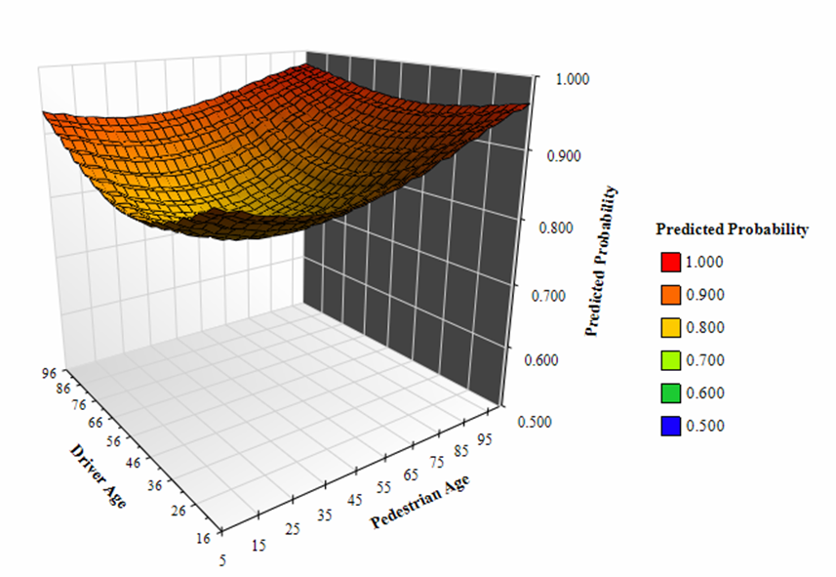
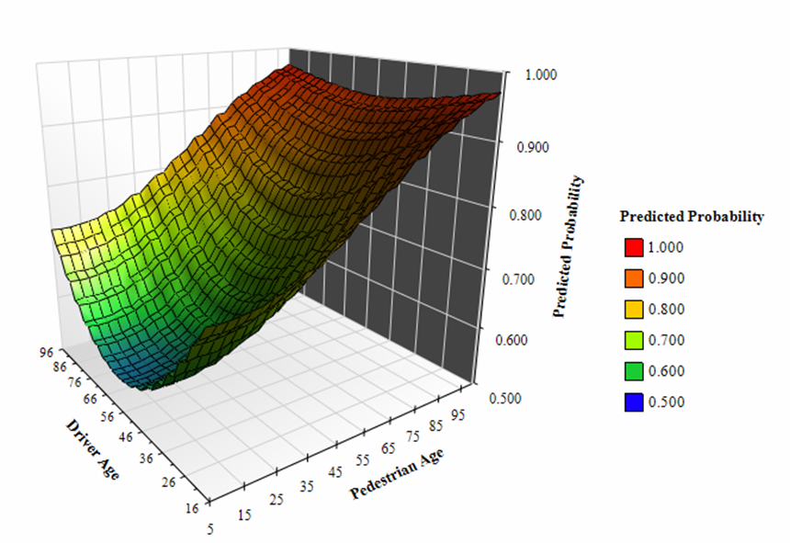
Non-Severe Injuries
Severe Injuries

Slide 12
Predictor Variable
Crash Day
Weekends (20:00 Fridays – 20:00 Sundays)
Weekdays (else)
Light Condition
Dark & Unlit
Dark & Artificially Lit
Daylight (Reference)
Surface Condition
Adverse
Dry (Reference)
Vehicle Type
Trucks
Utility Vehicles
Automobiles (Reference)
Full MNL Model Adjusted Odds Ratios (95% Confidence Interval)
Non-Severe Injuries | Severe Injuries
1.39 (1.32 – 1.45) | 1.40 (1.33 – 1.47)
1.00 (1.00 – 1.00) | 1.00 (1.00 – 1.00)
0.94 (0.88 – 1.01) | 1.99 (1.86 – 2.14)
0.77 (0.74 – 0.81) | 1.48 (1.41 – 1.55)
1.00 (1.00 – 1.00) | 1.00 (1.00 – 1.00)
0.71 (0.67 – 0.75) | 0.53 (0.50 – 0.56)
1.00 (1.00 – 1.00) | 1.00 (1.00 – 1.00)
0.98 (0.94 – 1.02) | 1.34 (1.28 – 1.40)
2.91 (2.73 – 3.10) | 3.38 (3.16 – 3.62)
1.00 (1.00 – 1.00) | 1.00 (1.00 – 1.00)
Notes:
Light Condition:
As the degree of surrounding light decreases, the odds of a severe pedestrian injury increase
Low light conditions will have negative effects on road user visibility
Surface Condition:
Pedestrians exposure is likely reduced during adverse weather
Motorists may drive more cautiously during inclement weather conditions, but should be investigated with further research

Slide 13
Predictor Variable
Posted Speed Limit (PSL) (Center: 30 mph, Increment: 5 mph)
PSL
Vehicle Movement
Turning Left
Turning Right
Straight / Through (Reference)
Crash Location
Midblock
3-/4-leg Intersection (Reference)
Full MNL Model Adjusted Odds Ratios (95% Confidence Interval)
Non-Severe Injuries | Severe Injuries
0.95 (0.94 – 0.96) | 1.04 (1.02 – 1.05)
0.96 (0.90 – 1.02) | 0.45 (0.42 – 0.48)
0.73 (0.68 – 0.79) | 0.37 (0.33 – 0.40)
1.00 (1.00 – 1.00) | 1.00 (1.00 – 1.00)
0.98 (0.93 – 1.04) | 0.79 (0.74 – 0.84)
1.00 (1.00 – 1.00) | 1.00 (1.00 – 1.00)

Slide 14
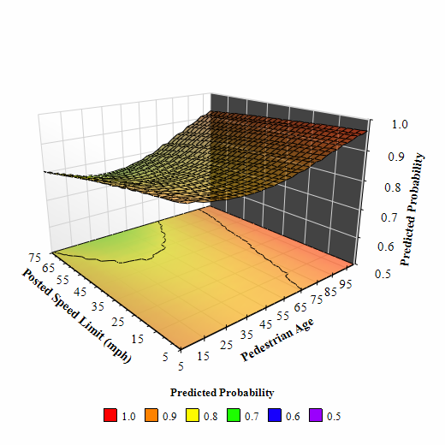
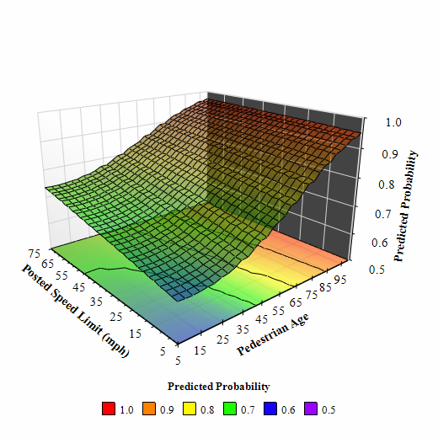
Non-Severe Injuries
Severe Injuries
Notes:
Forcing posted speed limit to be linear
Remember that no/possible injury severity surface plot is not shown

Slide 15
Predictor Variable
Traffic Control
No Control
Regulatory Sign
Signal (Reference)
Roadway Profile
Vertical Curvature
Level Roadway (Reference)
Median Type
No Median/Undivided Road
Painted Median
Raised/Physical Median (Reference)
Full MNL Model Adjusted Odds Ratios (95% Confidence Interval)
Non-Severe Injuries | Severe Injuries
1.02 (0.96 – 1.08) | 1.36 (1.27 – 1.45)
1.05 (0.98 – 1.13) | 1.57 (1.44 – 1.71)
1.00 (1.00 – 1.00) | 1.00 (1.00 – 1.00)
1.42 (1.32 – 1.53) | 2.55 (2.36 – 2.74)
1.00 (1.00 – 1.00) | 1.00 (1.00 – 1.00)
0.31 (0.29 – 0.34) | 0.25 (0.23 – 0.27)
0.45 (0.41 – 0.49) | 0.37 (0.35 – 0.40)
1.00 (1.00 – 1.00) | 1.00 (1.00 – 1.00)
Notes:
Traffic Control:
The full model results suggest that crashes at locations with signs as the primary method of traffic control had higher odds of severe pedestrian injuries.
In addition, uncontrolled locations also had higher odds of severe pedestrian injuries.
Roadway Profile:
Crashes on roadways with non-zero gradients had higher odds of severe pedestrian injuries.
Median Type:
Crashes on roads with physical medians had higher odds of resulting in a severe pedestrian injury.

Slide 16
Discussion
Non-Roadway Factors
older pedestrians
female pedestrians
unsafe pedestrian actions
(darting/dashing out, jaywalking, failing to yield right-of-way)
older & younger drivers
male drivers
weekend hours
(20:00 Fridays – 20:00 Sundays)
dark conditions
(unlit or artificially lit)
dry surface conditions
large vehicles
(trucks or utility vehicles)

Slide 17

Discussion
Roadway Variables
for those variables that were significant, odds ratios were accentuated with the jump from non-severe to severe injuries.
no significant differences could be obtained regarding traffic control types and non-severe injuries.

Slide 18
Discussion
Roadway Variables
crashes at intersections were found to have higher odds of severe injuries.
physical road medians were assumed to represent the safest condition for pedestrians, but were found to have a harmful effect.
medians may provide different uses for pedestrians, depending on other factors ^{5,6} (e.g., posted speed limits).
the presence of medians may influence the choice to jaywalk.

Slide 19
Conclusions
Limitations
Although GES contains information on various severity levels, a number of limitations were present.
macroscopic location data (city/county/state) were not available
inability to disaggregate geographically
collision impact speeds were not available
several variable attributes were collapsed or disregarded entirely, due to small sample sizes
pedestrian impairment, horizontal curvature, intersection configuration

Slide 20
Conclusions
Future Work
Future research could include:
adding the influence of transit (access to transit may affect rates of jaywalking³, vehicle operating speeds⁴, etc.)
considerations for complex intersections (5+ legs, roundabouts, interchanges)
detailed roadway geometric data (lane/shoulder/sidewalk configurations)
the effects of various land use types (residential, commercial, industrial, mixed-use)

Slide 21
References
¹ NHTSA. (2018). FARS Encyclopedia. Retrieved May 5, 2018, from NCSA Data Resource Website website: https://www-fars.nhtsa.dot.gov/Main/index.aspx
² Retting, R. (2019). Pedestrian Traffic Fatalities by State: 2018 Prelminary Data. Retrieved from Governors Highway Safety Association website: https://www.ghsa.org/sites/default/files/2019-02/FINAL_Pedestrians19.pdf
³ Zheng, Y., Chase, T., Elefteriadou, L., Schroeder, B., & Sisiopiku, V. P. (2015). Modeling vehicle–pedestrian interactions outside of crosswalks. Simulation Modelling Practice and Theory, 59, 89–101. https://doi.org/10.1016/j.simpat.2015.08.005
⁴ Clifton, K. J., Burnier, C. V., & Akar, G. (2009). Severity of injury resulting from pedestrian–vehicle crashes: What can we learn from examining the built environment? Transportation Research Part D: Transport and Environment, 14(6), 425–436. https://doi.org/10.1016/j.trd.2009.01.001
⁵ Chen, H., Cao, L., & Logan, D. B. (2012). Analysis of risk factors affecting the severity of intersection crashes by logistic regression. Traffic Injury Prevention, 13(3), 300–307. https://doi.org/10.1080/15389588.2011.653841
⁶ Hanson, C. S., Noland, R. B., & Brown, C. (2013). The severity of pedestrian crashes: an analysis using Google Street View imagery. Journal of Transport Geography, 33, 42–53. https://doi.org/10.1016/j.jtrangeo.2013.09.002

Slide 22



Questions?
Jeff Pascua
M.Sc. Candidate, E.I.T.
Department of Civil Engineering
Lakehead University
jpascua@lakeheadu.ca
Sacha Dubois, MPH
Juan Pernia, Ph.D., P. Eng
Michel Bédard, Ph.D., FGSA
Thank you! Merci!

Slide 23
Predictor Variable
Pedestrian Age (Center: 10, Increment: 5)
Pedestrian Age
Pedestrian Age (Squared)
Pedestrian Sex
Male
Female
Pedestrian Action
Unsafe Pedestrian Action (UPA)
No UPAs reported
Driver Age (Center: 16, Increment: 5)
Driver Age
Driver Age (Squared)
Driver Sex
Male
Female
Univariable Analyses Unadjusted Odds Ratios
Non-Severe Injuries | Severe Injuries
0.86 (0.86 – 0.87) | 0.96 (0.95 – 0.96)
1.01 (1.01 – 1.01) | 1.00 (1.00 – 1.01)
1.22 (1.20 – 1.24) | 1.61 (1.58 – 1.64)
1.77 (1.74 – 1.80) | 3.35 (3.28 – 3.41)
0.85 (0.84 – 0.86) | 0.80 (0.79 – 0.81)
1.01 (1.01 – 1.01) | 1.01 (1.01 – 1.01)
0.76 (0.75 – 0.78) | 0.91 (0.89 – 0.93)
Full MNL Model Adjusted Odds Ratios
Non-Severe Injuries | Severe Injuries
0.82 (0.90 – 0.93) | 1.00 (0.99 – 1.02)
1.01 (1.01 – 1.01) | 1.01 (1.01 – 1.01)
0.69 (0.66 – 0.72) | 0.77 (0.74 – 0.81)
1.72 (1.64 – 1.80) | 2.19 (2.08 – 2.30)
0.85 (0.84 – 0.87) | 0.82 (0.80 – 0.83)
1.01 (1.01 – 1.01) | 1.01 (1.01 – 1.01)
0.77 (0.74 – 0.80) | 1.08 (1.03 – 1.13)
Values in parentheses represent 95% confidence intervals.

Slide 24
Predictor Variable
Crash Day
Weekend
Weekday
Light Condition
Dark & Unlit
Dark & Artificially Lit
Daylight
Surface Condition
Adverse
Dry
Vehicle Type
Trucks
Utility Vehicles
Automobiles
Univariable Analyses Unadjusted Odds Ratios
Non-Severe Injuries | Severe Injuries
1.54 (1.51 – 1.57) | 1.73 (1.70 – 1.77)
1.60 (1.55 – 1.65) | 4.27 (4.13 – 4.40)
1.06 (1.04 – 1.08) | 1.91 (1.87 – 1.95)
0.72 (0.70 – 0.73) | 0.67 (0.65 – 0.69)
0.77 (0.75 – 0.78) | 0.93 (0.91 – 0.95)
1.06 (1.03 – 1.08) | 1.08 (1.05 – 1.11)
Full MNL Model Adjusted Odds Ratios
Non-Severe Injuries | Severe Injuries
1.39 (1.32 – 1.45) | 1.40 (1.33 – 1.47)
0.94 (0.88 – 1.01) | 1.99 (1.86 – 2.14)
0.77 (0.74 – 0.81) | 1.48 (1.41 – 1.55)
0.71 (0.67 – 0.75) | 0.53 (0.50 – 0.56)
0.98* (0.94 – 1.02) | 1.34 (1.28 – 1.40)
2.91 (2.73 – 3.10) | 3.38 (3.16 – 3.62)
Values in parentheses represent 95% confidence intervals.

Slide 25
Predictor Variable
Posted Speed Limit (PSL) (Center: 30 mph, Increment: 5 mph)
PSL
Vehicle Movement
Turning Left
Turning Right
Straight / Through
Crash Location
Midblock
3-/4-leg Intersection
Traffic Control
No Control
Regulatory Sign
Signalized
Univariable Analyses Unadjusted Odds Ratios
Non-Severe Injuries | Severe Injuries
1.08 (1.08 – 1.09) | 1.38 (1.37 – 1.39)
0.57 (0.56 – 0.58) | 0.25 (0.24 – 0.26)
0.65 (0.64 – 0.67) | 0.27 (0.26 – 0.28)
1.31 (1.29 – 1.33) | 2.02 (1.99 – 2.07)
1.57 (1.55 – 1.60) | 2.55 (2.49 – 2.60)
1.43 (1.38 – 1.47) | 1.46 (1.40 – 1.52)
Full MNL Model Adjusted Odds Ratios
Non-Severe Injuries | Severe Injuries
0.95 (0.94 – 0.96) | 1.04 (1.02 – 1.05)
0.96 (0.90 – 1.02) | 0.45 (0.42 – 0.48)
0.73 (0.68 – 0.79) | 0.37 (0.33 – 0.40)
0.98* (0.93 – 1.04) | 0.79 (0.74 – 0.84)
1.02* (0.96 – 1.08) | 1.36 (1.27 – 1.45)
1.05* (0.98 – 1.13) | 1.57 (1.44 – 1.71)
Values in parentheses represent 95% confidence intervals.

Slide 26
Predictor Variable
Roadway Profile
Vertical Curvature
Level Roadway
Median Type
No Median (Undivided)
Painted Median
Physical Median
Univariable Analyses Unadjusted Odds Ratios
Non-Severe Injuries | Severe Injuries
1.59 (1.54 – 1.64) | 2.37 (2.29 – 2.45)
0.84 (0.81 – 0.87) | 0.45 (0.43 – 0.47)
1.31 (1.25 – 1.37) | 1.03* (0.99 – 1.08)
Full MNL Model Adjusted Odds Ratios
Non-Severe Injuries | Severe Injuries
1.42 (1.32 – 1.53) | 2.55 (2.36 – 2.74)
0.31 (0.29 – 0.34) | 0.25 (0.23 – 0.27)
0.45 (0.41 – 0.49) | 0.37 (0.35 – 0.40)
Values in parentheses represent 95% confidence intervals.

