Slide 1


Predicting Crashes with Safe Systems Surrogates Obtained from Video Analytics – Implications for Evaluation of Vision Zero Safety Treatments
Alireza Jafari
May 2019

Slide 2

Introduction
Using statistical methods for crash data analysis has hugely benefited roadway safety.
Issues in safety analysis that mainly stem from the nature of crash data sources;
Underreporting
Crashes are rare and complex events
Using crash data is a reactive approach

Slide 3
Introduction
Using non-crash traffic events for safety effects inferences can be beneficial.
The term safety surrogate measures (SSM) is used to refer to such non-crash traffic events.
The most widely used SSMs are traffic conflicts.
The indicators of traffic conflicts can be categorized into
    - Time-to-Collision (TTC) family
    - Post-Encroachment Time (PET) family
    - Deceleration family
    - Safe Systems Surrogates

Slide 4
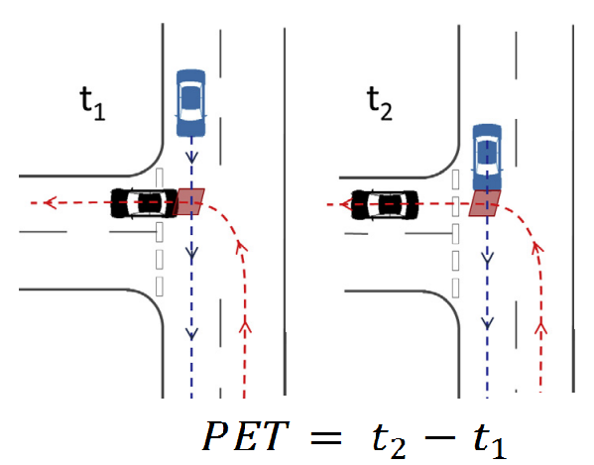
Introduction
The objective of this research was to establish a relationship between left turn opposed crashes and corresponding traffic conflicts at signalized intersections using Safe Systems Surrogates that are based on PET and the speed of conflicting vehicles.

Slide 5
Introduction
Traffic conflicts based on PET, along with corresponding conflicting vehicle speeds, were first measured using video analytics software.
Then, using a novel approach, statistical models were developed to relate these measures of conflict frequency and severity to the crashes.

Slide 6
Data
The data were obtained from MicroTraffic, a company that provided the conflict data from video files provided by the City of Winnipeg, Manitoba, who also supplied the traffic and crash data.
The video recordings ranged from 7.5 hr to 24 hr at 15 urban signalized intersections.
Crash records were for the 6-year period from 2009-2014.

Slide 7
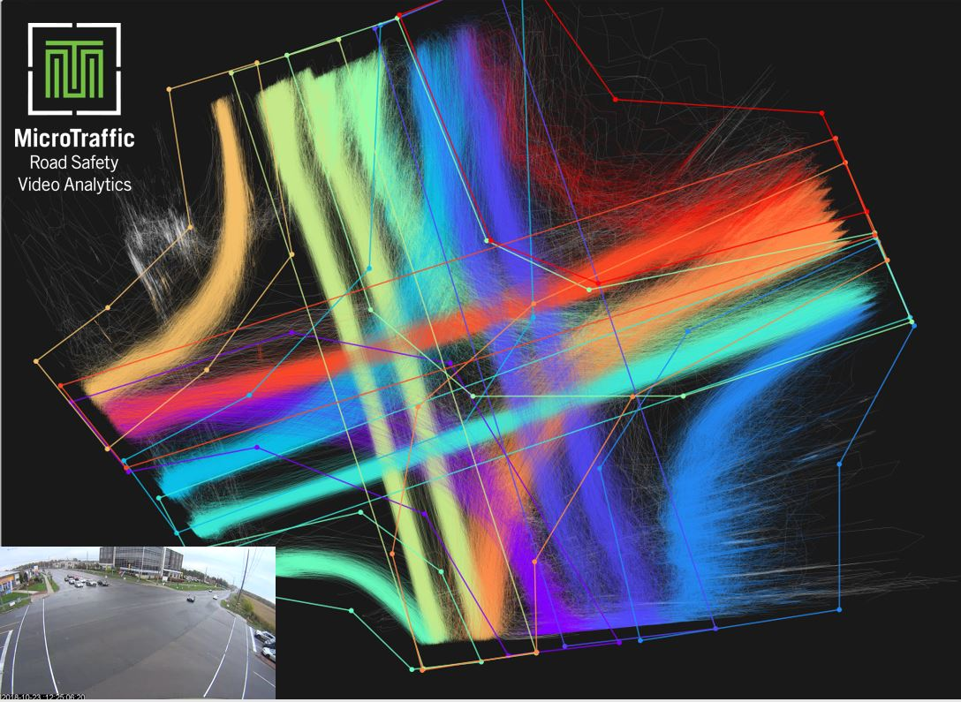
Data
The video recordings were analyzed based on road user trajectories that were automatically extracted using video analytics software.
A sample road user trajectory development can be seen below.
.

Slide 8
Data
For every vehicle-vehicle conflict, the data included:
PET less than 5 sec. (with 0.1 sec accuracy),
and the speed of each conflicting vehicle (with 2 km/h accuracy).

Slide 9

Modeling Procedure
The first step was to find a threshold of PET that provides the best crash prediction.
In the second step, the aim was to define a risk score (RS) measure, based on PET and the speed of the conflicting vehicles.
$$RS= \frac{Thru movement speed+LT movement speed}{PET}$$
Using Generalized Linear Modeling (GLM), a relationship was established between conflicts categorized according to RS and the recorded collisions.

Slide 10
Modeling Procedure
Separate models were developed for total crashes and fatal plus injury (FI) crashes.
Moreover, another aim was to examine the crash-conflict relationship by only focusing on the Thru movement speed.

Slide 11

Results
It was found that focusing on those conflicts having a PET less than 2.5 sec and 3 sec will provide the most accurate predictions.
The total number of crashes per year at an intersection was estimated as follows:
N= $e^{(−23.1+\left[4.27×conflicts RS≥60\right]+\left[0.871×conflicts RS<60\right])}×{Thru}^{0.836}×{LT}^{2.297}$
The estimated $R^{2}$ was obtained to be 0.458 implying that 45.8% of the variability of Thru-LT collisions can be captured by the estimated model.

Slide 12

Results
Using Thru speed only model:
-Total crashes:
N= $e^{(−19.12+\left[3.35×conflicts RS≥60\right]+\left[0.29×conflicts RS<60\right])}×{Thru}^{1.02}×{LT}^{1.75}$
- FI crashes:
N= $e^{(−10.42+\left[1.81×conflicts RS≥60\right]+\left[1.06×conflicts RS<60\right])}×{Thru}^{1.16} ^{ }$

Slide 13
Results
Figure below shows the conflicts categorized based on the two RS approaches for a sample intersection in the city of Winnipeg.

Slide 14
Conclusions
This research highlights the potential of using these measures to quantify the safety of an intersection.
The results emphasize the need for a proper classification of conflicts based on their severities and suggests that using a single time-based threshold, such as PET or TTC, may not be adequate.
To take into account the effects of speed, the results confirm the premise of higher dependency of the severity of conflicts on the speed of Thru movement.

Slide 15
Conclusions
The models can be applied to estimate the change in crashes following a safety treatment by observing, through video analytics, the change in conflicts and speeds and using the crash-conflict-speed model.
The methodological approach is viable for quickly evaluating all safety treatments and, in particular, innovative ones for which knowledge on safety effects is sparse or non-existing.
And this can pave the way to realize VISION ZERO.

Slide 16
Main References
Hydén C. The development of a method for traffic safety evaluation: The Swedish Traffic Conflicts Technique. Bulletin Lund Institute of Technology, Department 70, 1987.
Laureshyn A, de Goede M, Saunier N, & Fyhri A. Cross-comparison of three surrogate safety methods to diagnose cyclist safety problems at intersections in Norway. Accident Analysis & Prevention Vol. 105, pp 105: 11-20, Aug 2017.
Zheng L, Ismail K, Meng X. Traffic conflict techniques for road safety analysis: open questions and some insights. Canadian journal of civil engineering Vol. 41, No. 7, pp 633-641, May 2014.
Tarko, A.P., Surrogate measures of safety, in Safe Mobility: Challenges, Methodology and Solutions, Emerald Publishing Limited. p. 383-405, 2018.

Slide 17
Thank you

